Slide 1

Cilium Network Policy Anti-Patterns I Learned the Hard Way
Shubham Singh, Obmondo
Ashish Jaiswal, Obmondo

Slide 2

About Myself
About Us
Hi 👋
This is Shubham
SRE @Obmondo
Certified Kubernetes Administrator
CNCF Contributor
LFX graduated mentee
GitHub: @1shubham7
Twitter: @1shubham7
Youtube: @pea-shooter17

Slide 3

About Myself
About Us
Hi 👋
This is Ashish
CTO @Obmondo
15+ years building Cloud Native Solutions
Maintainer LinuxAid and KubeAid
GitHub: @ashish1099

Slide 4
Agenda
What Cilium is, in one breath
Why we chose CiliumNetworkPolicy over vanilla NetworkPolicy
8 anti-patterns from real production incidents

Slide 5
01 · FOUNDATIONS
What is Cilium?
What is Cilium?
An eBPF-based networking, observability & security layer for Kubernetes
Replaces kube-proxy; enforces policy in the kernel, not iptables
Identity-based security
Ships Hubble for flow visibility and CiliumNetworkPolicy as a richer superset of the native NetworkPolicy API
Traditional NetworkPolicy vs CNP
• L3/L4 only → L3–L7 (HTTP, gRPC, Kafka, DNS)
• IP/CIDR-centric → Identity/label-centric
• iptables datapath → eBPF datapath
• No visibility → Hubble flow observability

Slide 6
02 · FOUNDATIONS
Why CiliumNetworkPolicy?
Why CiliumNetworkPolicy?
Native netpols can only allow - CNP adds explicit deny
CiliumClusterwideNetworkPolicy for Cluster wide netpols
Native netpols - CIDR only, no hostnames support
DNS/L7-aware rules (toFQDNs, toServices, toEntities)
Native netpols can only reference Pods/ns via selectors, or raw CIDR blocks. CNP gives you predefined identities - world, host, cluster, kube-apiserver, remote-node.

Slide 7
02 · FOUNDATIONS
Why CiliumNetworkPolicy?
apiVersion: cilium.io/v2
kind: CiliumNetworkPolicy
metadata:
name: db-access
namespace: production
spec:
endpointSelector:
matchLabels:
app: database
ingress:
- fromEndpoints:
- matchLabels:
role: backend
ingressDeny:
- fromEndpoints:
- matchLabels:
role: untrusted-clientv
apiVersion: cilium.io/v2
kind: CiliumNetworkPolicy
metadata:
name: db-access
namespace: production
spec:
endpointSelector:
matchLabels:
app: database
ingress:
- fromEndpoints:
- matchLabels:
role: backend
ingressDeny:
- fromEndpoints:
- matchLabels:
role: untrusted-client

Slide 8
PART TWO
The Anti-Patterns
The Anti-Patterns
8 anti patterns I learned about CNP

Slide 9
ANTI-PATTERN 2
ANTI-PATTERN 1
toServices Instead of toEndpoints
toServices Selector
✗ WRONG
✓ CORRECT
egress:
- toServices:
- k8sService:
serviceName: my-database
namespace: my-namespace
toPorts:
- ports:
- port: "5432" # Service port
# Service exposes 5432, Pod (pgbouncer)
# listens on 6432 -- after DNAT the dest
# port is 6432, so this never matches
egress:
- toServices:
- k8sService:
serviceName: my-database
namespace: my-namespace
toPorts:
- ports:
- port: "80" # Pod targetPort
# after DNAT, the packet's destination
# port IS the Pod's targetPort -- write
# that here, not the Service port
toPorts has to match the backend Pod's real targetPort, not the Service's exposed port -- after DNAT, the packet's destination port already is the Pod's port.

Slide 10
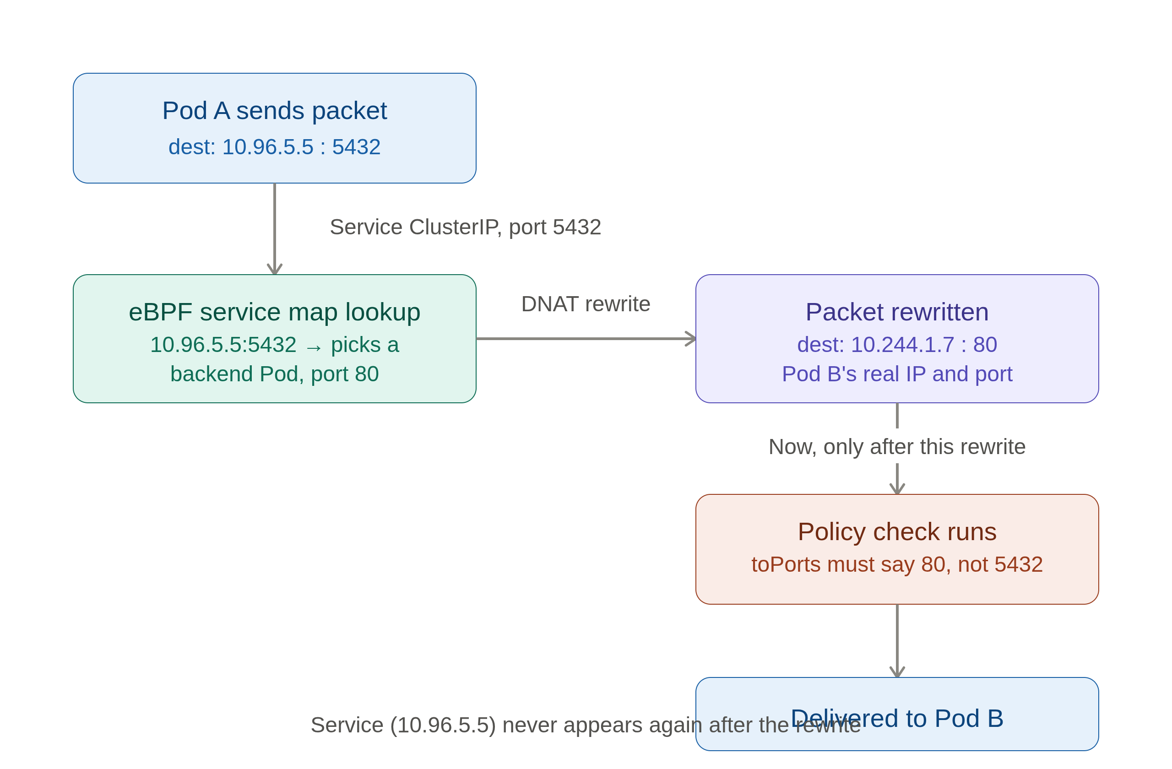
ANTI-PATTERN 2
ANTI-PATTERN 1
toServices Instead of toEndpoints
toServices Selector

Slide 11
ANTI-PATTERN 2
toEndpoints vs ToServices
✗ WRONG
✓ CORRECT
egress:
- toServices:
- k8sService:
ServiceName: {{ .Release.name }}-pg
namespace: my-namespace
toPorts:
- ports:
- port: "5432"
# Service name is templated per Helm
# release -- rename/reinstall, and this
# rule silently stops matching anything
egress:
- toEndpoints:
- matchLabels:
cnpg.io/cluster: oncall-pgsql
k8s:io.kubernetes.pod.namespace: \
my-namespace
toPorts:
- ports:
- port: "5432"
# operator-set label -- stable across
# releases, no Service/DNAT layer at all
toServices ties your policy to whatever the Service happens to be named right now -- Helm-templated names change on release rename or reinstall, silently breaking the rule. Even when the name holds steady, you're still exposed to toServices' toPorts quirks (the previous slide). toEndpoints on a stable, operator-set label sidesteps both: the label doesn't move, and there's no Service/DNAT layer to get confused about.

Slide 12

ANTI-PATTERN 4
ANTI-PATTERN 3
Selecting on Unique-per-Pod Labels
Unique-per-Pod Labels
✗ WRONG
✓ CORRECT
endpointSelector:
matchLabels:
statefulset.kubernetes.io/pod-name: \
oncall-pgsql-1
# Cilium excludes this label from
# identity calculation entirely
# selector matches NOTHING, silently
endpointSelector:
matchLabels:
cnpg.io/cluster: oncall-pgsql
k8s:io.kubernetes.pod.namespace: \
my-namespace
# shared label across all replicas
# -> one stable security identity
Cilium maintains a list of label patterns excluded from identity calculation (to avoid identity churn). Per Pod unique or per deployment revision unique labels are in that exclusion list
10

Slide 13
ANTI-PATTERN 5
ANTI-PATTERN 4
toFQDNs Without a DNS Proxy Rule
toFQDNS
✗ WRONG
✓ CORRECT
egress:
- toFQDNs:
- matchName: example.com
toPorts:
- ports:
- port: "443"
# no rules.dns on THIS pod's policy
# → proxy interception never turns on
egress:
- toEndpoints:
- matchLabels: {k8s-app: kube-dns}
toPorts:
- ports: [{port: "53", protocol: ANY}]
rules:
dns: [{matchPattern: "*"}]
- toFQDNs:
- matchName: example.com
DNS proxy activation is per-endpoint. A default-deny policy's DNS rule doesn't activate it for this pod. Without it, IP↔FQDN mapping never lands in this pod's cache.

Slide 14
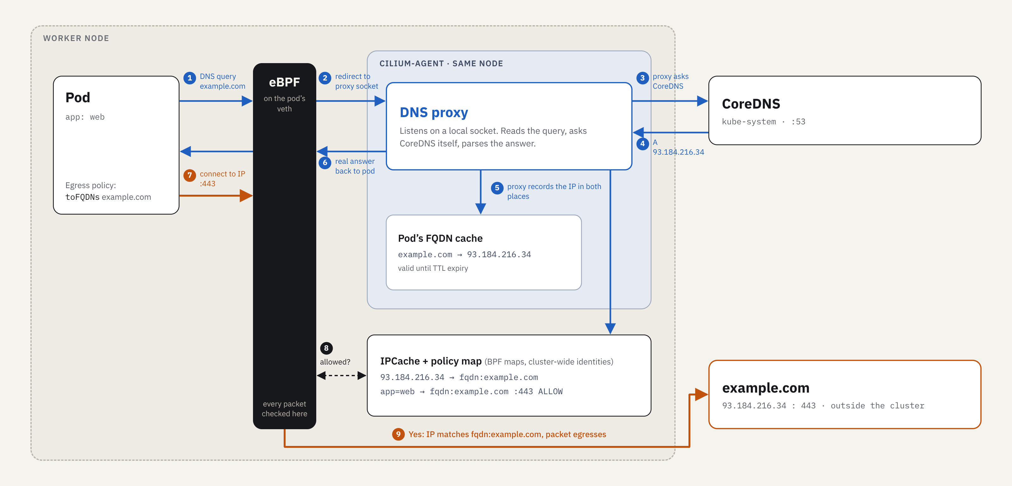
ANTI-PATTERN 5
ANTI-PATTERN 4
toFQDNs Without a DNS Proxy Rule
toFQDNS

Slide 15
ANTI-PATTERN 5
ANTI-PATTERN 4
toFQDNs Without a DNS Proxy Rule
toFQDNS
spec:
endpointSelector:
{{- if $config.excludedPods }}
...
{{- else }}
{}
{{- end }}
enableDefaultDeny:
egress: true
ingress: true
# Allow only DNS egress to kube-dns
egress:
- toEndpoints:
- matchLabels:
io.kubernetes.pod.namespace: kube-system
k8s-app: kube-dns
toPorts:
- ports:
- port: "53"
protocol: ANY
rules:
dns:
- matchPattern: "*"

Slide 16
ANTI-PATTERN 6
ANTI-PATTERN 5
ANTI-PATTERN 5
Default-Deny Surprises
Default-Deny Surprises
✗ WRONG
✓ CORRECT
Applying ANY CiliumNetworkPolicy
flips this endpoint from
"enforcement: never" to "always"
Result: DNS breaks, kubelet health
checks get dropped, pods restart —
none of it was explicitly denied
# Treat default-deny as day-1 design,
not an afterthought:
1. write a default deny
2. allow DNS egress
3. allow kubelet health-check probes
4. allow kube-apiserver where needed
5. allow ingress from operator
6. roll out in audit/monitor mode first and check hubble
7. THEN add app-specific rules
The very first CNP that selects a pod silently switches it from "no enforcement" to "default deny."

Slide 17
ANTI-PATTERN 6
ANTI-PATTERN 6
Assuming LoadBalancer Traffic Is Pre-Authorized
Assuming LoadBalancer Traffic Is Pre-Authorized
✗ WRONG
✓ CORRECT
ingress:
- fromEndpoints:
- matchLabels:
app: frontend
# traffic actually arrives via an
# internet-facing Service/LB -- no
# fromEntities/fromCIDR rule admits
# it, so it's dropped right after
# the Service DNAT step
ingress:
- fromEndpoints:
- matchLabels:
app: frontend
- fromEntities:
- world
# Service DNAT and policy enforcement
# are two separate, sequential steps
# -- passing the LB grants nothing
A packet can pass Service load-balancing successfully and still get dropped immediately after by policy. The policy engine only ever sees world → Pod identity -- it doesn't know or care that traffic arrived via an internet facing Service, so that path needs its own explicit rule.

Slide 18
ANTI-PATTERN 7
ANTI-PATTERN 7
Expecting Instant Enforcement on Label Changes
Expecting Instant Enforcement on Label Changes
✗ WRONG
✓ CORRECT
# relabel a pod mid-incident to cut
# it off from a sensitive backend...
kubectl label pod x \
role=quarantined --overwrite
# ...and assume the already-open
# connection to that backend is now
# blocked. It may not be, yet.
# treat relabeling as eventually-
# consistent, not instant:
# - new identity => endpoint
# regenerates policy
# - enforcement is largely tied to
# connection-setup time
# - to force a cut: kill the pod
# or the connection, don't just
# relabel and assume
Changing a Pod's labels recomputes its identity, but already-established connections aren't necessarily re-evaluated against policy instantly -- enforcement is largely at connection-setup time. Exact behavior is version- and config-dependent, so verify, don't assume.

Slide 19
ANTI-PATTERN 8
Death by a Thousand NetPols
- Real namespaces aren't one-app-per-ns - a shared ns like checkout might run 6, 8, 12+ services owned by different teams
- Every team bolts on their own CiliumNetworkPolicy whenever they need a new path open -- no shared owner, no central review
- Policies only ever compose additively -- nobody's rule technically conflicts with anyone else's, they just keep piling up
- Debugging a drop stops being “read the policy” and becomes “grep every CNP that selects this namespace and hope you find the one that's wrong”
- The fix is centralizing NetPol authoring under one roof -- but naive centralization has its own trap. Next slide.
team-a
team-b-in
legacy’23
team-c-eg
??
ns: checkout
App A
App B
App C
App D
❓ which rule dropped this packet?

Slide 20
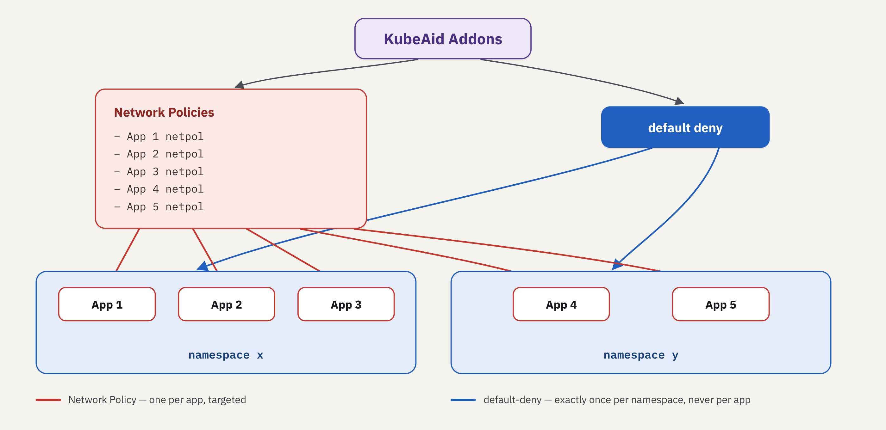
ANTI-PATTERN 8 · THE FIX
Centralize the Chart, Render Conditionally

Slide 21
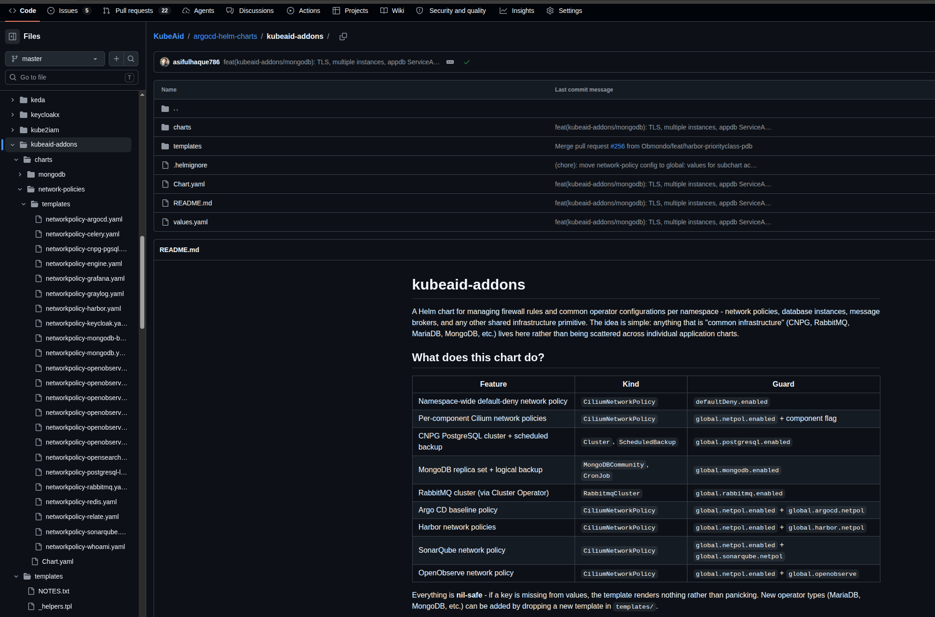
ANTI-PATTERN 8 · THE FIX
Centralize the Chart, Render Conditionally

Slide 22
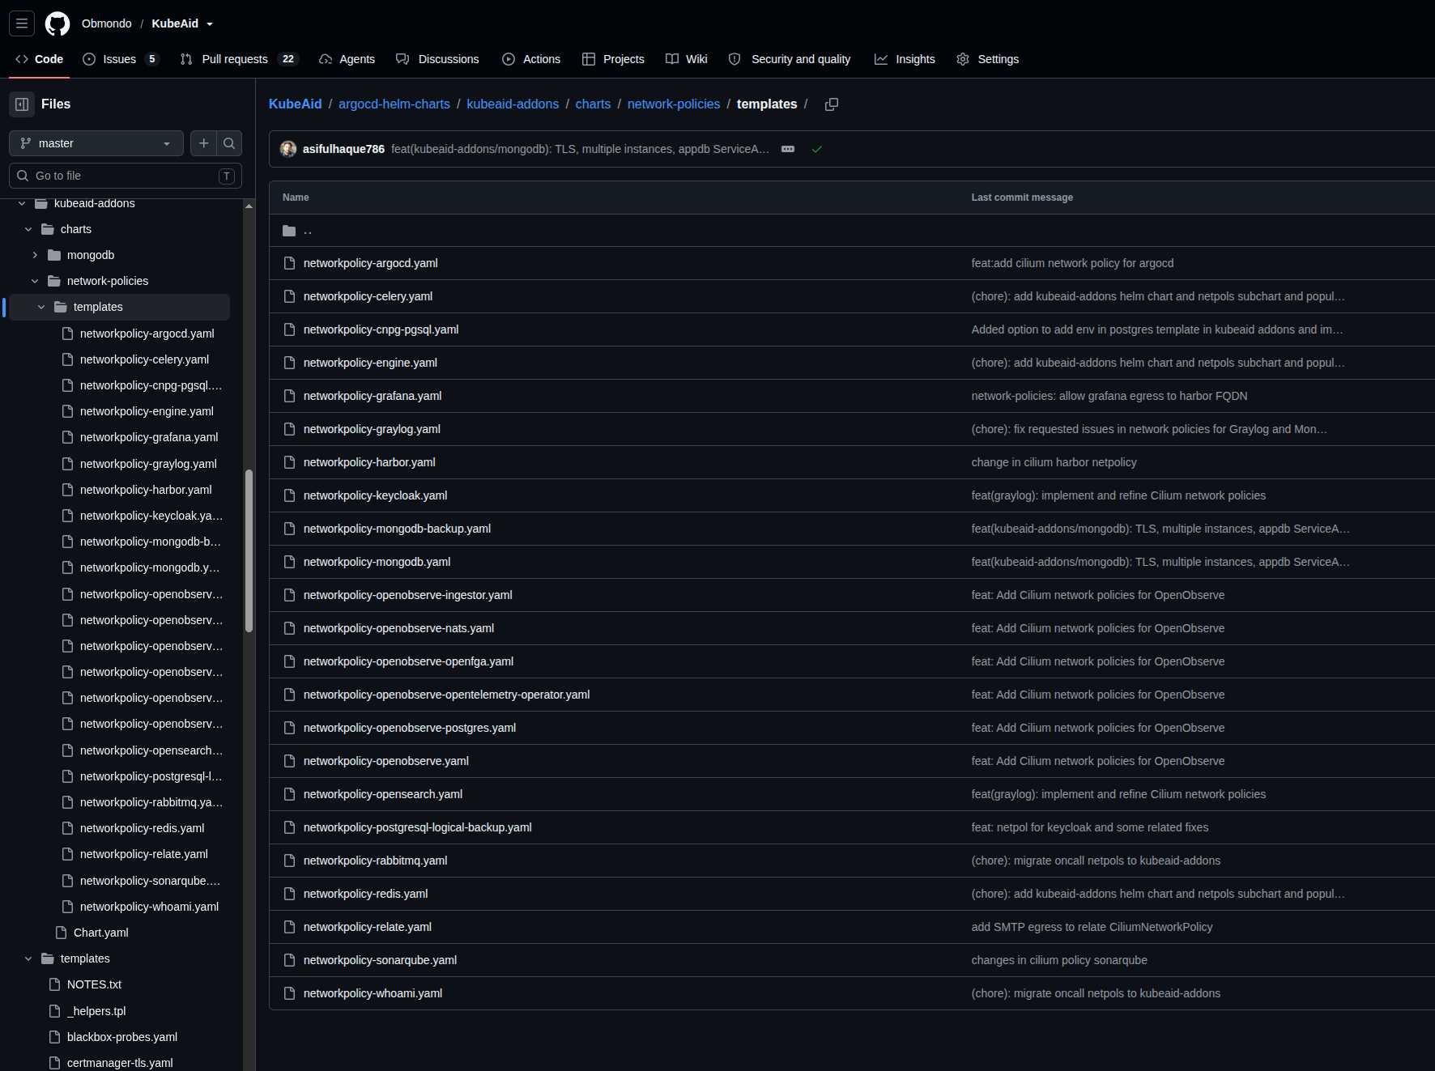
ANTI-PATTERN 8 · THE FIX
Centralize the Chart, Render Conditionally

Slide 23


Thank You
Thank You
Know More:
kubeaid.io
github.com/obmondo/KubeAid/

