Slide 1

Cilium Network Policy Anti-Patterns I Learned the Hard Way
Shubham Singh, Obmondo
Sat, August 22, 2026 · Le Méridien Kochi
Notes:
Open the session. Welcome, house-keeping, and hand over to the first speaker.

Slide 2

About Myself
About Myself
Hi 👋
This is Shubham
SRE @Obmondo
Certified Kubernetes Administrator
CNCF Contributor
LFX graduated mentee
GitHub: @1shubham7
Twitter: @1shubham7
Youtube: @pea-shooter17

Slide 3
AGENDA
What we will cover
01
What Cilium is, in one breath
02
Why we chose CiliumNetworkPolicy over vanilla NetworkPolicy
03
Anti patterns from real production incidents
Notes:
Walk the agenda in under a minute.

Slide 4

What is Cilium?
NetworkPolicy vs CNP
• L3/L4 only → L3–L7 (HTTP, gRPC, Kafka, DNS)
• IP/CIDR-centric → Identity/label-centric
• iptables datapath → eBPF datapath
• No visibility → Hubble flow observability
An eBPF-based networking, observability & security layer for Kubernetes
Replaces kube-proxy; enforces policy in the kernel, not iptables
Identity-based security
Ships Hubble for flow visibility and CiliumNetworkPolicy as a richer superset of the native NetworkPolicy API
Notes:
Section break. Pause before the next part of the talk.

Slide 5
Why CiliumNetworkPolicy?
Native netpols can only allow - CNP adds explicit deny
CiliumClusterwideNetworkPolicy for Cluster wide netpols
Native netpols - CIDR only, no hostnames support
DNS/L7-aware rules (toFQDNs, toServices, toEntities)
Native netpols can only reference Pods/ns via selectors, or raw CIDR blocks. CNP gives you predefined identities - world, host, cluster, kube-apiserver, remote-node.
Notes:
Section break. Pause before the next part of the talk.

Slide 6
Why CiliumNetworkPolicy?
apiVersion: cilium.io/v2
kind: CiliumNetworkPolicy
metadata:
name: db-access
namespace: production
spec:
endpointSelector:
matchLabels:
app: database
ingress:
- fromEndpoints:
- matchLabels:
role: backend
ingressDeny:
- fromEndpoints:
- matchLabels:
role: untrusted-client
Notes:
Section break. Pause before the next part of the talk.

Slide 7
Anti patterns I learned about CNP
Notes:
Three headline figures. Give the audience a beat on each.

Slide 8
About Myself
ANTI-PATTERN 1
toServices Selector
✗ WRONG
✓ CORRECT
egress:
- toServices:
- k8sService:
serviceName: my-database
namaespace: my-namespace
toPorts:
- ports:
- port: "5432" # Service port
# Service exposes 5432, Pod (pgbouncer)
# listens on 80 -- after DNAT the dest
# port is 80, so this never matches
egress:
- toServices:
- k8sService:
serviceName: my-dataabase
namespace: my-namespace
toPorts:
- ports:
- port: "80" # Pod targetPort
# after DNAT, the packet's destination
# port IS the Pod's targetPort -- write
# that here, not the Service port
toPorts has to match the backend Pod's real targetPort, not the Service's exposed port - after DNAT, the packet's destination port already is the Pod's port.

Slide 9
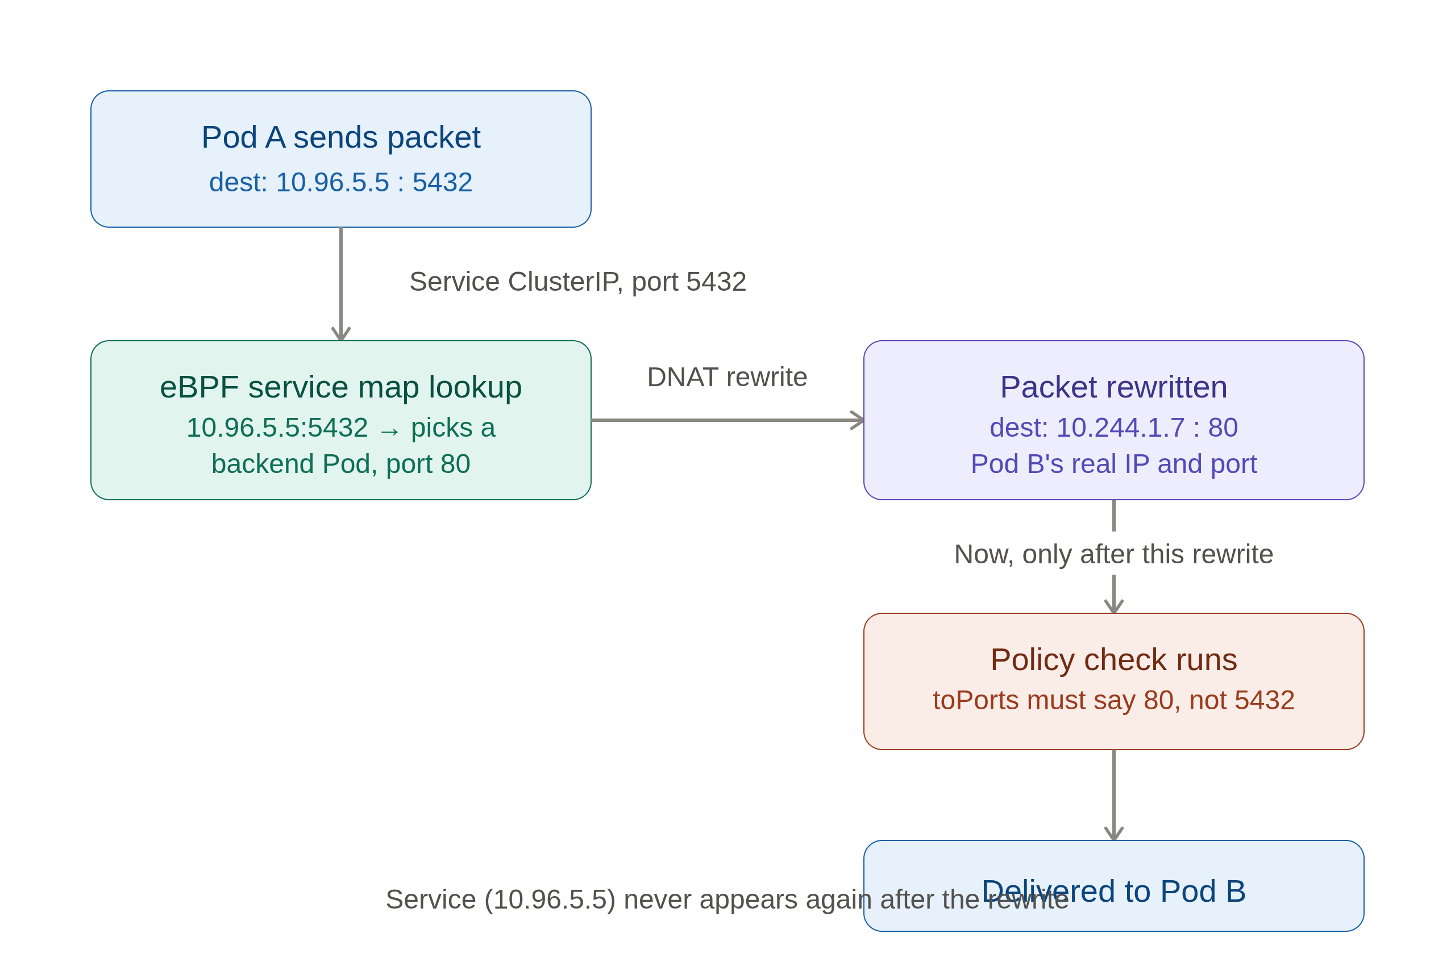
About Myself
ANTI-PATTERN 1
toServices Selector

Slide 10
About Myself
ANTI-PATTERN 2
toEndpoints vs ToServices
✗ WRONG
✓ CORRECT
egress:
- toServices:
- k8sService:
serviceName: oncall-pgsql
namespace: my-namespace
toPorts:
- ports:
- port: "5432"
# Service name is templated per Helm
# release - rename/reinstall, and this
# rule silently stops matching anything
egress:
- toEndpoints:
- matchLabels:
cnpg.io/cluster: oncall-pgsql
k8s:io.kubernetes.pod.namespace: \
my-namespace
toPorts:
- ports:
- port: "5432"
# operator-set label - stable across
# releases, no Service/DNAT layer at all
toServices ties your policy to the service name - Helm templated names change on release rename, which will silently break the rule. Also, you're exposed to toServices' toPorts quirks. toEndpoints on a stable, operator-set label sidesteps both.

Slide 11

About Myself
ANTI-PATTERN 3
Unique-per-Pod Labels
✗ WRONG
✓ CORRECT
endpointSelector:
matchLabels:
statefulset.kubernetes.io/pod-name: \
oncall-pgsql-1
# Cilium excludes this label from
# identity calculation entirely
# selector matches NOTHING, silently
endpointSelector:
matchLabels:
cnpg.io/cluster: oncall-pgsql
k8s:io.kubernetes.pod.namespace: \
my-namespace
# shared label across all replicas
# -> one stable security identity
Cilium maintains a list of label patterns excluded from identity calculation (to avoid identity churn). Per Pod unique or per deployment revision unique labels are in that exclusion list

Slide 12
About Myself
ANTI-PATTERN 4
toFQDNS
✗ WRONG
✓ CORRECT
egress:
- toFQDNs:
- matchName: api.telegram.org
toPorts:
- ports:
- port: "443"
# no rules.dns on THIS pod's policy
# → proxy interception never turns on
egress:
- toEndpoints:
- matchLabels: {k8s-app: kube-dns}
toPorts:
- ports: [{port: "53", protocol: ANY}]
rules:
dns: [{matchPattern: "*"}]
- toFQDNs:
- matchName: api.telegram.org
DNS proxy activation is per-endpoint. A default-deny policy's DNS rule doesn't activate it for this pod. Without it, IP↔FQDN mapping never lands in this pod's cache.

Slide 13
About Myself
ANTI-PATTERN 4
toFQDNS
a
spec:
endpointSelector:
{{- if $config.excludedPods }}
...
{{- else }}
{}
{{- end }}
enableDefaultDeny:
egress: true
ingress: true
# Allow only DNS egress to kube-dns
egress:
- toEndpoints:
- matchLabels: ...
toPorts:
- ports:
- port: "53"
protocol: ANY
rules:
dns:
- matchPattern: "*"

Slide 14
About Myself
ANTI-PATTERN 5
Default-Deny Surprises
✗ WRONG
✓ CORRECT
Applying ANY CiliumNetworkPolicy
flips this endpoint from
"enforcement: never" to "always"
Result: DNS breaks, kubelet health
checks get dropped, pods restart —
none of it was explicitly denied
# Treat default-deny as day-1 design,
not an afterthought:
1. write a default deny
2. allow DNS egress
3. allow kubelet health-check probes
4. allow kube-apiserver where needed
5. allow ingress from operator
6. roll out in audit/monitor mode first and check hubble
7. THEN add app-specific rules
The very first CNP that selects a pod silently switches it from "no enforcement" to "default deny."

Slide 15
About Myself
ANTI-PATTERN 6
Assuming LoadBalancer Traffic Is Pre-Authorized
✗ WRONG
✓ CORRECT
ingress:
- fromEndpoints:
- matchLabels:
app: frontend
# traffic actually arrives via an
# internet-facing Service/LB -- no
# fromEntities/fromCIDR rule admits
# it, so it's dropped right after
# the Service DNAT step
ingress:
- fromEndpoints:
- matchLabels:
app: frontend
- fromEntities:
- world
# Service DNAT and policy enforcement
# are two separate, sequential steps
# -- passing the LB grants nothing
A packet can pass Service load-balancing successfully and still get dropped immediately after by policy. The policy engine only ever sees world → Pod identity - it doesn't know or care that traffic arrived via an internet facing Service.

Slide 16
About Myself
ANTI-PATTERN 7
Expecting Instant Enforcement on Label Changes
✗ WRONG
✓ CORRECT
# relabel a pod mid-incident
# kubectl label pod x \
role=quarantined --overwrite
# ...and assume the already-open
# connection to that backend is now
# blocked.
# treat relabeling as eventually-
# consistent, not instant:
# - new identity => endpoint
# regenerates policy
# - enforcement is largely tied to
# connection-setup time
Changing a Pod's labels recomputes its identity, but already established connections aren't re-evaluated against policy instantly - enforcement is largely at connection setup time. Exact behavior is version and config dependent.

Slide 17
About Myself
ANTI-PATTERN 8
Death by a Thousand NetPols
Namespaces aren't ‘one app per ns’ - a shared ns like checkout might run multiple services.
Every service owner bolts on their own CNP whenever they need a new path open - no shared owner, no central review
Policies only ever compose additively - nobody's rule technically conflicts with anyone else's, they just keep piling up
Debugging a drop becomes “grep every CNP that selects this namespace and hope you find the one that's wrong”
The fix is centralizing NetPol authoring under one roof - but naive centralization has its own trap.
team-a
team-b-in
legacy’23
team-c-eg
??
ns: checkout
App A
App B
App C
App D
❓ which rule dropped this packet?

Slide 18
About Myself
ANTI-PATTERN 8
Death by a Thousand NetPols
KubeAid Addons
Network Policies
– App 1 netpol
– App 2 netpol
– App 3 netpol
– App 4 netpol
– App 5 netpol
default deny
App 1
App 2
App 3
App 4
App 5
namespace x
namespace y
Network Policy - one per app
Default-deny - exactly once per namespace

Slide 19
A Few Tips
2 things that would've
saved me time
Notes:
Three headline figures. Give the audience a beat on each.

Slide 20
About Myself
TIP 1
Additive Policy Composition - No Ordering, No Deny
✗ WRONG
✓ BETTER
# team A's policy (unrelated purpose):
CiliumNetworkPolicy: policy-a
endpointSelector: {matchLabels: {app: payments}}
ingress: [...]
# team B later adds their OWN policy
# selecting the SAME pod, for a
# totally different reason:
CiliumNetworkPolicy: policy-b
endpointSelector: {matchLabels: {app: payments}}
ingress: [...]
# the moment EITHER selects this pod,
# ingress flips to default-deny for
# BOTH -- nobody declared that
# there is no priority / ordering /
# explicit-deny model in Cilium --
# every applicable rule is OR'd
# together into one allow set
# before shipping a policy that
# selects a shared pod, check who
# else already selects it:
kubectl get cnp -n <ns> -o \
jsonpath='{.items[*].metadata.name}'
# you can't deny your way out of
# someone else's allow rule
Multiple CNP selecting the same Pod gets OR'd together, and the moment any policy selects a Pod for a direction, that direction becomes default-deny for everyone touching that Pod. There's no explicit DENY that overrides another policy's ALLOW.

Slide 21
About Myself
TIP 2
Debugging: How We Actually Find the Drop
Identify the failing pod - the app log usually names the peer it couldn't reach
Find the Cilium pod on that node, then query Hubble for DROPPED verdicts scoped to the namespace or pod
Read the verdict: policy-verdict:none = no policy allows it · EGRESS/INGRESS DENIED tells you the direction
Fix the policy, re-apply, re-test
$ hubble observe
kubectl exec -n cilium <cilium-pod> --
hubble observe --namespace <ns> \
--verdict DROPPED --last 50
# per-pod, and live-follow variants
# also available
# example output:
test-oncall/engine:46440 (ID:5057)
test-oncall/oncall-pgsql-1:5432
(ID:56144)
policy-verdict:none EGRESS DENIED
(TCP Flags: SYN)

Slide 22


Thank you
kubeaid.io
github.com/obmondo/KubeAid
Notes:
Close with the ask: slides link, QR, and where to find you during the day.

