Slide 1
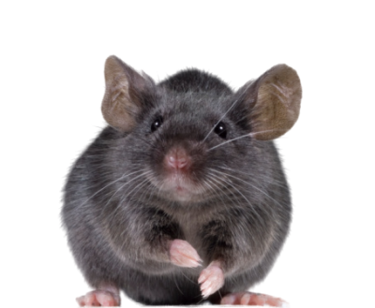
MOUSE-TRACKING
How to track that mouse using OpenSesame <3333

Slide 2
PLAN FOR MOUSE-TRACKING
TODAY
Installation of OpenSesame (hopefully everyone did this already <333)
Try running the experiment found on Github
Follow the exercise sheet to get acquainted with OpenSesame
Make your own experiment by modifying the script!
----------------------------------------
Matrix reading with Cordula
NEXT WEEK
Own experiment should be ready and tested before class (or very close to ready ☺)
Have a fellow student or two run your experiment
Begin analysis
----------------------------------------
Midterm evaluation
THE WEEK AFTER NEXT WEEK
Continue with analysis of data from AWESOME mouse-tracking experiment
Prepare a SHORT presentation of the results!
Create a nice poster including:
A quick description of experiment
Results
Beautiful plots

Slide 3
INSPIRATION

Slide 4
OPENSESAME 101

Slide 5
TIPS AND TRICKS
If the window keeps expanding to one side in OpenSesame, double-click the menu-bar. Then it goes back to your normal screen size.
When it comes to error messages, it can be difficult to figure out what OpenSesame is complaining about ☺☺☺ A tips is to go into ‘Extended template’ and from there choose ‘General Script’. This gives you the python script, which you can search in. This might give you an idea of where the problem is.
Visual stimuli: When introducing different stimuli, you can refer to the file itself in the block loop by writing the path and file name, e.g. ‘stimuli/first_picture.jpeg’. NB! Remember to write the full file name including the end part such as ‘.png’ or ‘.jpeg’. See the GitHub for different examples of how to include pictures (especially, see gaze_cueing_B, if you want to include many different pictures)
Auditory stimuli: OpenSesame is only compatible with .wav and .ogg files. Use an online converter if needed. Add sounds by using the ‘sampler’.

