Slide 1
RAVE
A title proposal for Elective 2, Saturday 2-5 P.M.

Slide 2
Target Audience
Tourists, Local Citizens, Families, Outdoor Enthusiasts, Seniors, and Students

Slide 3
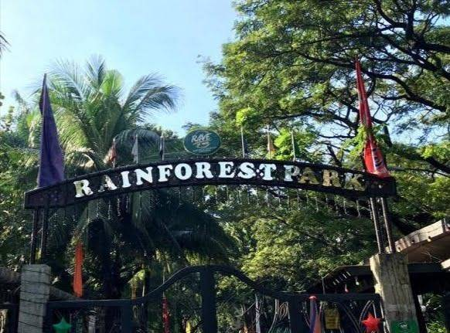
Tourists:
These are visitors who are primarily from out of town or even from other countries. They often visit parks for recreational purposes, sightseeing, and experiencing the local culture and environment. For them, parks serve as attractions, offering opportunities for relaxation, exploration, and enjoyment of natural beauty. Providing clear signage, multilingual information, and unique attractions can enhance their experience.

Slide 4
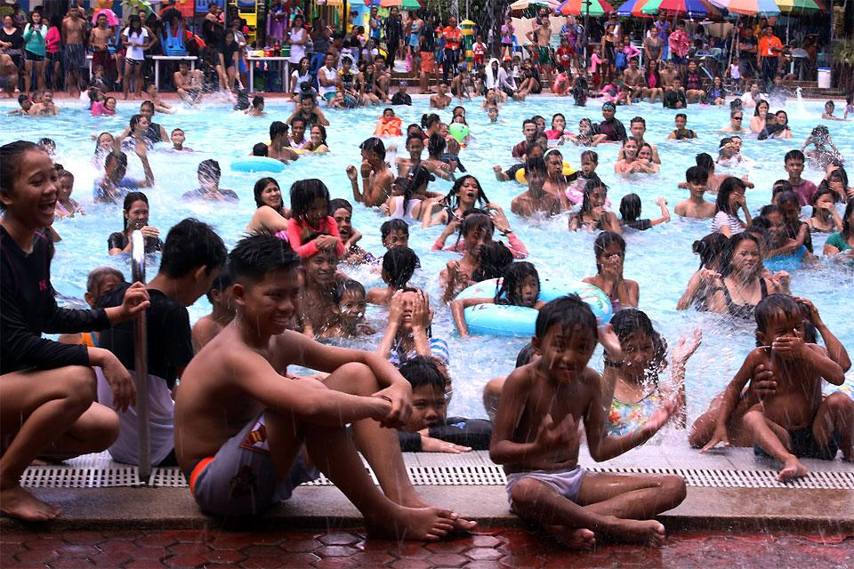
Local Citizens:
These are the residents of the area where the park is located. For them, parks are valuable community assets offering spaces for leisure activities, exercise, socializing, and connecting with nature. They may use the park regularly for activities like jogging, picnics, family outings, or simply enjoying a peaceful environment. Local citizens often appreciate well-maintained facilities, programming tailored to their interests, and opportunities for community engagement such as volunteer programs or events.

Slide 5
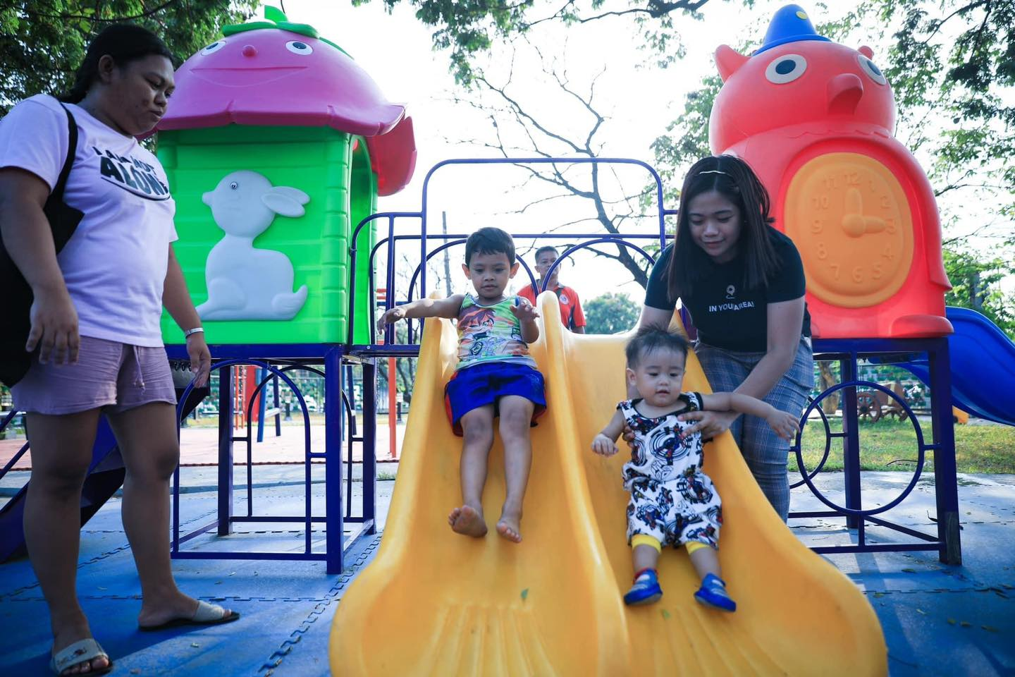
Families
Families with children represent a significant audience for parks. They seek safe and family-friendly environments where kids can play, explore, and learn. Amenities such as playgrounds, splash pads, and family-friendly events cater to their needs. Additionally, providing educational opportunities like nature trails or interactive exhibits can make the park attractive to families.

Slide 6
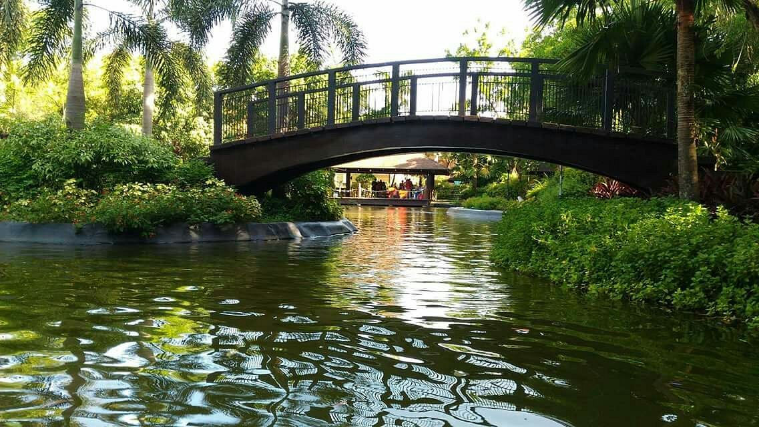
Outdoor Enthusiasts
This group includes individuals who are passionate about outdoor activities such as hiking, cycling, birdwatching, or photography. They visit parks to pursue their hobbies, enjoy nature, and seek adventure. Parks can attract outdoor enthusiasts by offering well-maintained trails, designated areas for specific activities, and opportunities for wildlife observation or photography.

Slide 7
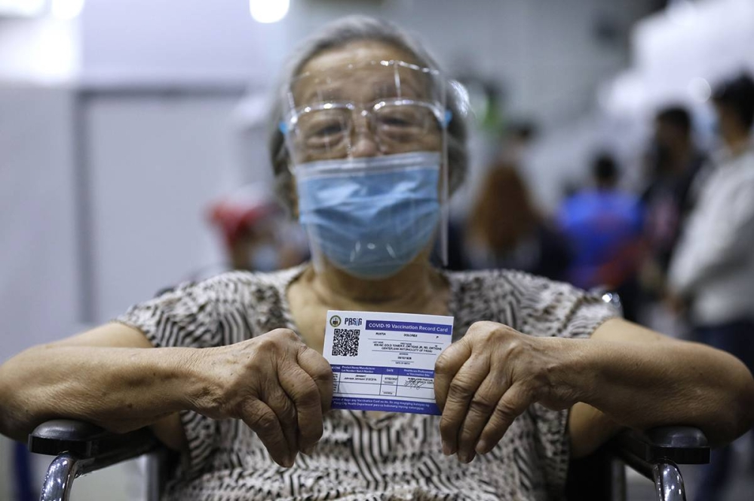
Seniors
Parks can also cater to the needs of older adults who may seek places for gentle exercise, relaxation, and socializing. Providing accessible walking paths, seating areas, and programs tailored to their interests (such as gardening clubs or tai chi classes) can make the park welcoming and inclusive for seniors.

Slide 8
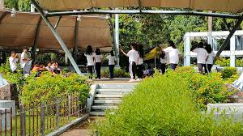
Students and Educational Groups
Schools and educational institutions often visit parks for field trips, nature studies, and outdoor learning experiences. Parks can support these groups by offering educational resources, guided tours, and hands-on activities that align with curriculum objectives. Engaging students in environmental conservation efforts can also foster a sense of stewardship and environmental awareness.

Slide 9
Scope
Rainforest park attractions, schedules, news, events

Slide 10
Scope
The park's website aims to provide visitors with comprehensive information about the park, including its facilities, attractions, events, and guidelines for visitors. The website will feature an interactive map to help users navigate the park's amenities and locate points of interest. Additionally, the website will offer a user-friendly booking system for reserving facilities such as picnic areas, campsites, and event spaces. The website will also serve as a platform for promoting the park through advertisements, showcasing its unique features and inviting visitors to explore and experience its offerings.

Slide 11
Limitation
Informational Focus, Limited Booking Options, Advertisement Restrictions, No Transactional Capabilities, and Information Accuracy

Slide 12
Informational Focus
The website will primarily serve as an informational resource, providing details about the park's features, activities, and guidelines. It will not offer interactive features beyond the map and booking system, such as virtual tours or live webcams.

Slide 13
Limited Booking Options
While the website will facilitate bookings for certain facilities within the park, such as picnic areas and campsites, it will not support reservations for third-party activities or services offered outside the park.

Slide 14
Advertisement Restrictions:
The advertisements displayed on the website will be limited to promoting the park itself and its affiliated events or services.

Slide 15
No Transactional Capabilities:
While the website will facilitate booking reservations, it will not process financial transactions directly. Users will be required to complete payments for bookings through third-party payment gateways or in-person transactions at the park.

Slide 16
Information Accuracy:
While every effort will be made to ensure the accuracy and timeliness of information provided on the website, the park management cannot guarantee that all details, such as event schedules or facility availability, will be up-to-date at all times.

Slide 17
End of Title Proposal

