Slide 1



Heard or Halted?
Analyzing the Emotional Tone of Judicial Interruptions
PPOL-6801 Text As Data
Tian Tong

Slide 2

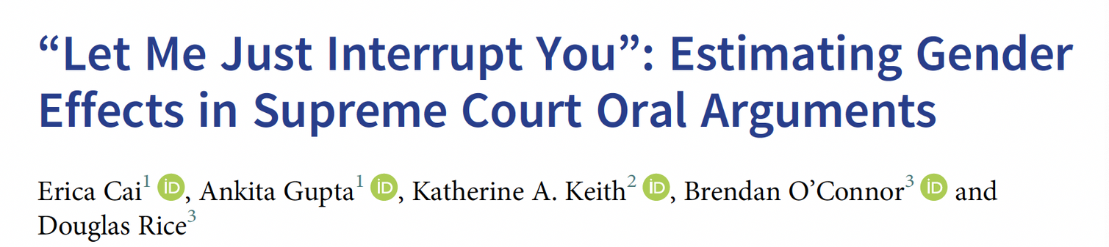
Background &
Research Motivation
Context: Supreme Court Oral Arguments
Justices and advocates engage in high-stakes, spoken exchanges that shape legal outcomes.
Why study Interruptions?
Female justices and advocates are interrupted more often than their male counterparts.
Institutional power asymmetries and gendered dynamics.
Motivation:
Frequency of interruptions to emotional impact
Notes:
Oral argument is the most public and visible part of the U.S. Supreme Court’s decision-making process.
Quantify the gender effect over justice interruption behavior

Slide 3
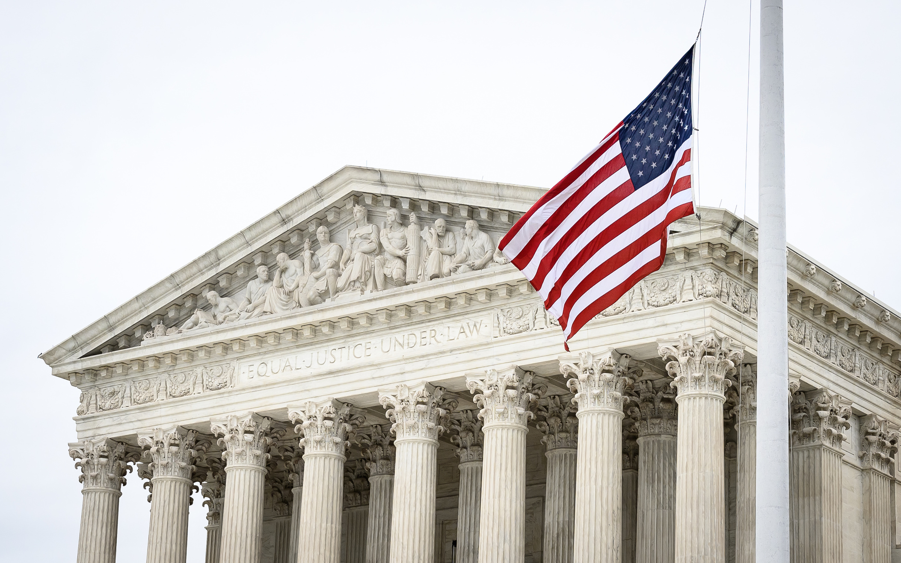
Research Questions
#1 Semantic Shift
Do interruptions shift the semantic meaning of an advocate’s argument during Supreme Court oral arguments?
#2 Gendered Sentiment
Do interruptions directed at female advocates contain more negative sentiment than those directed at male advocates?

Slide 4
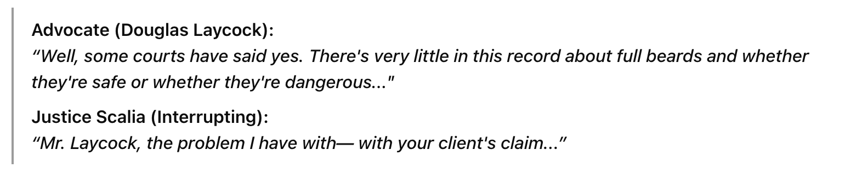
Dataset
Supreme Court Oral Argument transcripts from the ConvoKit Supreme Court Corpus
Time-range: 2010-2019
Final Sample set: 12,663 chunks (continuous segments of speech) of advocate speech
Utterance-level Information: Case id/Advocate’s name/Speaker type/Actual text etc.
Gender information: First-name Lookup from standard U.S. name-based dataset
What does an interruption look like?
When a speaker is cut off, the transcript will typically show: -- (double dash) and ... (Ellipsis）)
Notes:
Uneven gender advocates/removal of female issue
These chunks were created by grouping together advocate utterances that occur between interruptions or pauses in dialogue.
Each chunk captures a coherent portion of an advocate’s argument — typically a few sentences long — and is treated as a single unit of analysis.
This interruption steers the conversation away from Laycock’s argument and toward the justice’s own analogy.
These markers are automatically tagged in the corpus and used to identify interruptions.
It starts with an utterance (utt_id_first) and ends with another (utt_id_last).

Slide 5
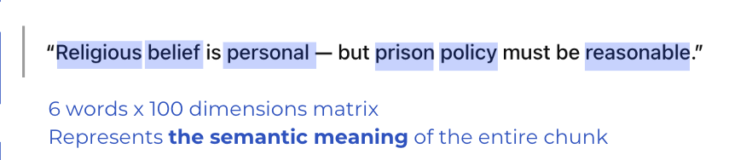
Question#1
Methodology
Pretrained Word Embeddings
GloVe 100d pretrained vectors
Match each token in a chunk to its corresponding vector
Generate Chunk Embeddings
Average all token vectors →
Generate a 100-dimensional vector
Group by Advocate & Interruption Status
Label: Interrupted or Not Interrupted
Cosine
Similarity
Cosine similarity between the two embeddings (per advocate)
Higher similarity(>0.85) → Semantic meaning preserved
Lower similarity → Potential semantic shift
Notes:
Loaded GloVe 100d pretrained vectors (glove.6B.100d.txt)
Matched each token in a chunk to its corresponding vector
Removed tokens not found in the GloVe vocabulary
For each speech chunk:
Averaged all token vectors → generated a 100-dimensional vector
Result: Each chunk has a single semantic embedding

Slide 6
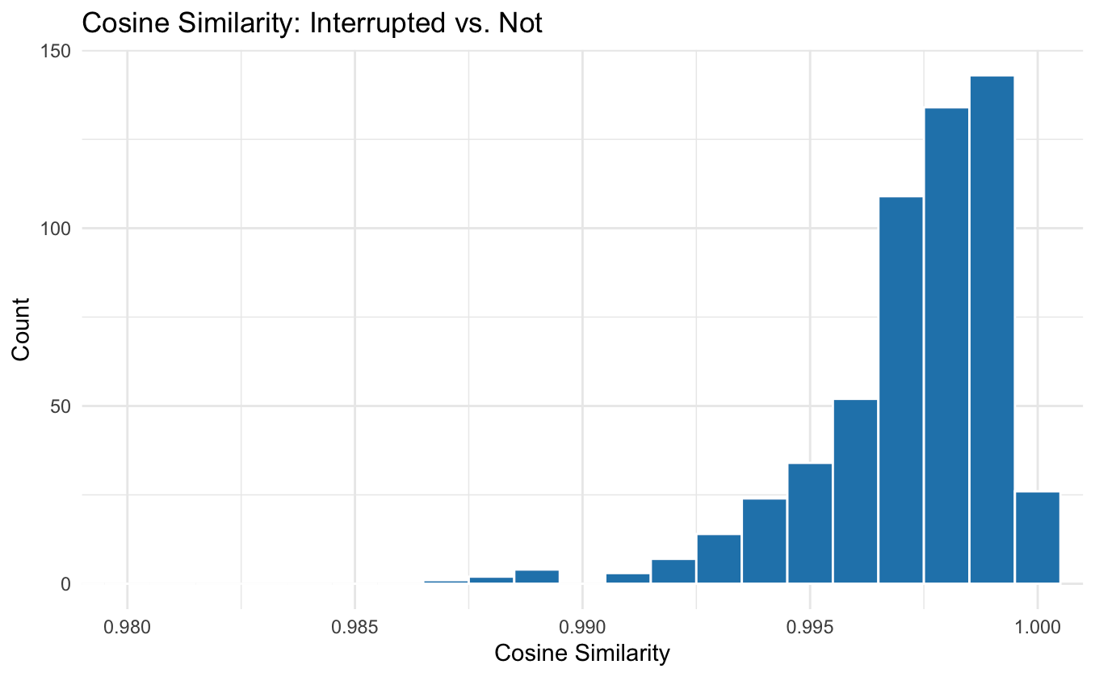
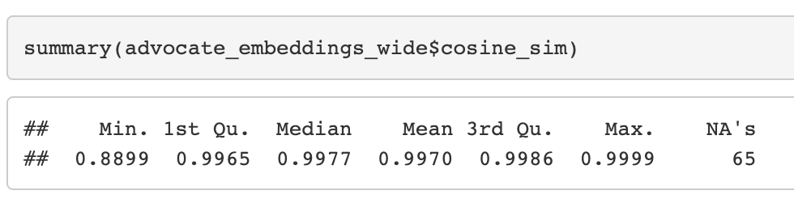
Visualization
Semantic content is largely preserved
Power dynamics or interactional dominance
Notes:
1. Semantic content is largely preserved
The near-perfect cosine similarity implies that interrupted and uninterrupted statements from the same advocate have extremely similar semantic content. That is, being interrupted does not drastically shift the semantic vector (meaning) of an advocate’s chunk — at least as measured by average GloVe embeddings.
2. Interruptions may affect delivery more than content
This supports an interpretation that interruptions likely disrupt flow or perception, but not necessarily the semantic substance. This aligns with research noting that interruptions often reflect power dynamics or interactional dominance, rather than forcing an actual change in argumentative content.

Slide 7
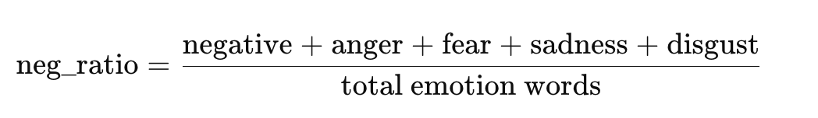
Question#2
Methodology
Filter to inlcude only interrupted advocate chunks
The NRC integration with selected emotions(positive, negative, anger, fear, sadness, and disgust)
Emtion score aggregation with Negative Ratio:
Gender comparison

Slide 8
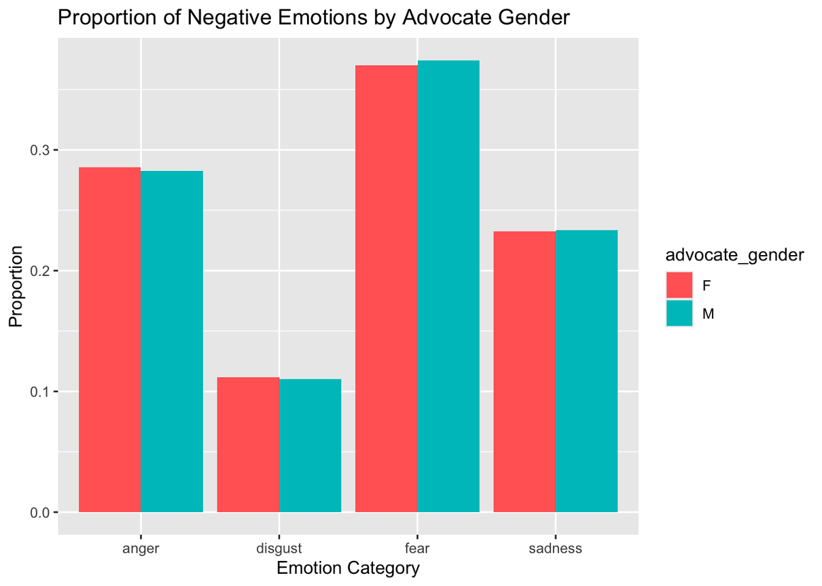
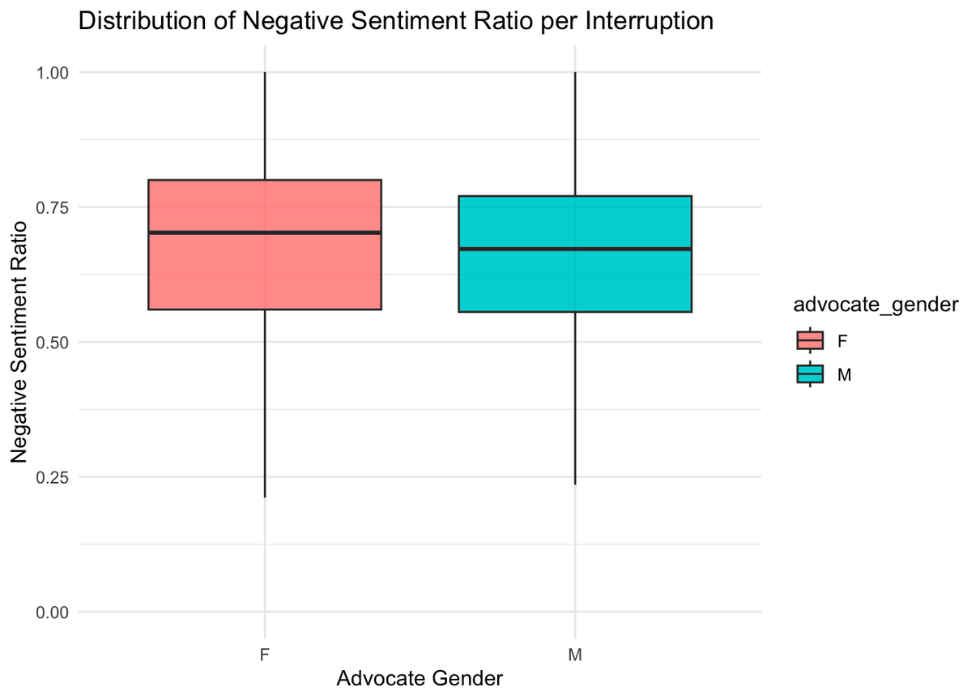
Gender Comparison
Notes:
Both groups have similar overall ranges, but female advocates are more skewed toward higher negativity.
The median (thick line) for female advocates (F) is higher than for male advocates (M).

Slide 9
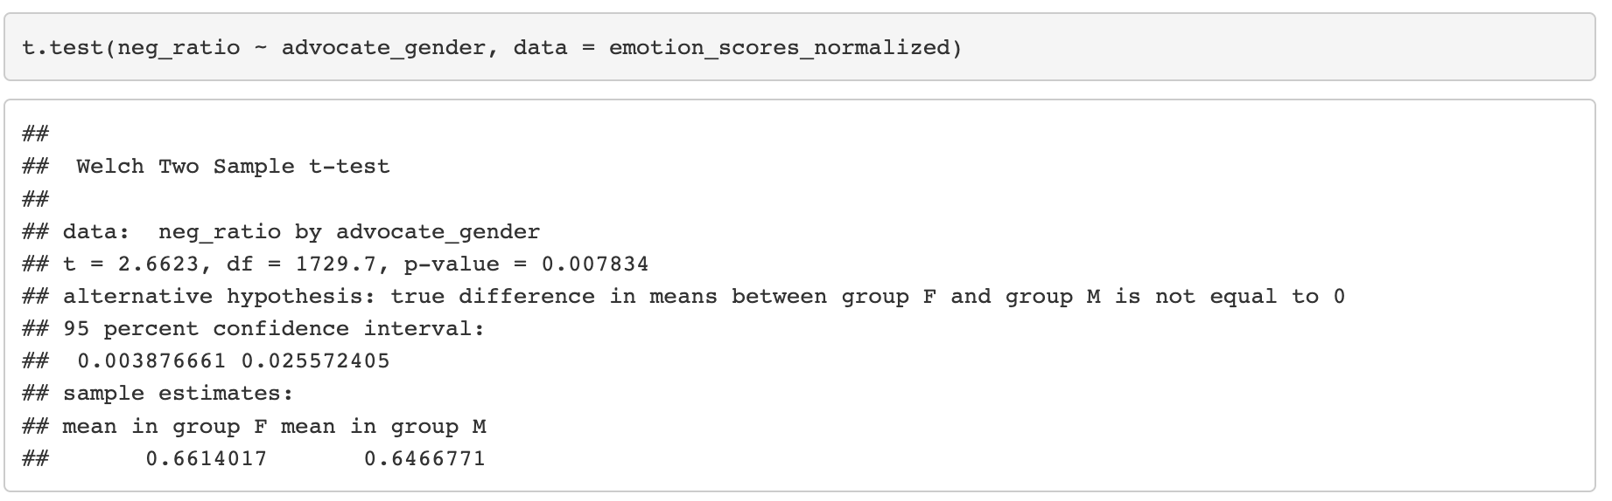
Gender Comparison

Slide 10
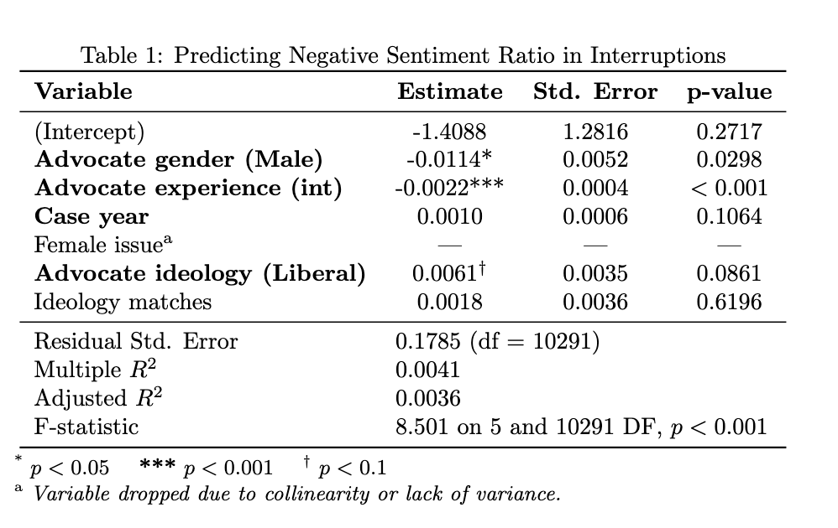
Gender Comparison
Female advocates face more negative interruptions, controlling for case year, experience, and ideological dynamics.
Notes:
Female advocates face more negative interruptions, controlling for case year, experience, and ideological dynamics.
Experience tempers the negativity of interruptions, while ideological alignment with justices does not offer significant protection from negative tone.

Slide 11
LDA for Topic Modeling
Will advocates be interrupted more under certain topics?
Whether interruptions toward women are more negative with particular areas?
Notes:
While sentiment analysis tells you how negative the language is, topic modeling (LDA) helps explain what they are talking about.
Topics may be weakly separated or artificially similar.
LDA picks up on term frequency. Legal arguments naturally reuse a common vocabulary, making it hard for LDA to form meaningful distinctions.
Why it matters: For a study about emotion and interruption dynamics, it’s important that topics reflect different kinds of legal content, not just variations of “court talk.”
Result: LDA fails to capture meaningful variation relevant to gender or sentiment.

Slide 12
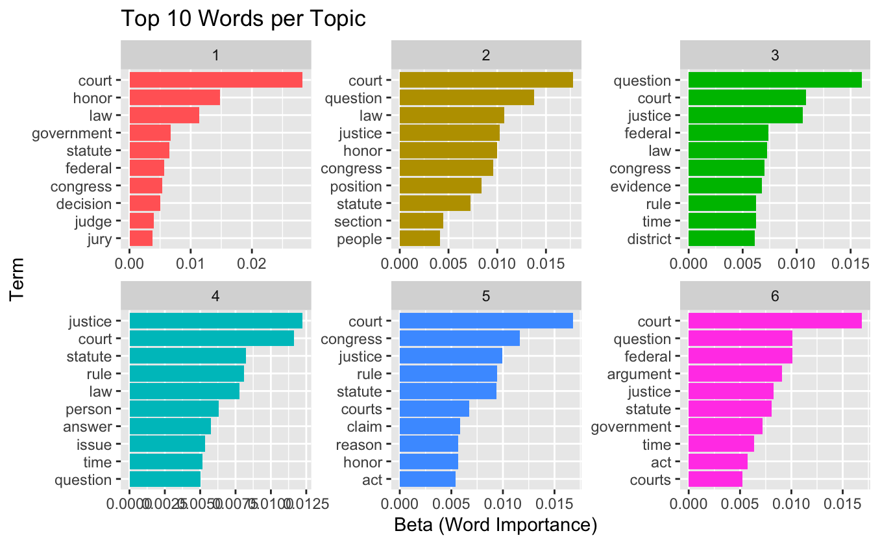
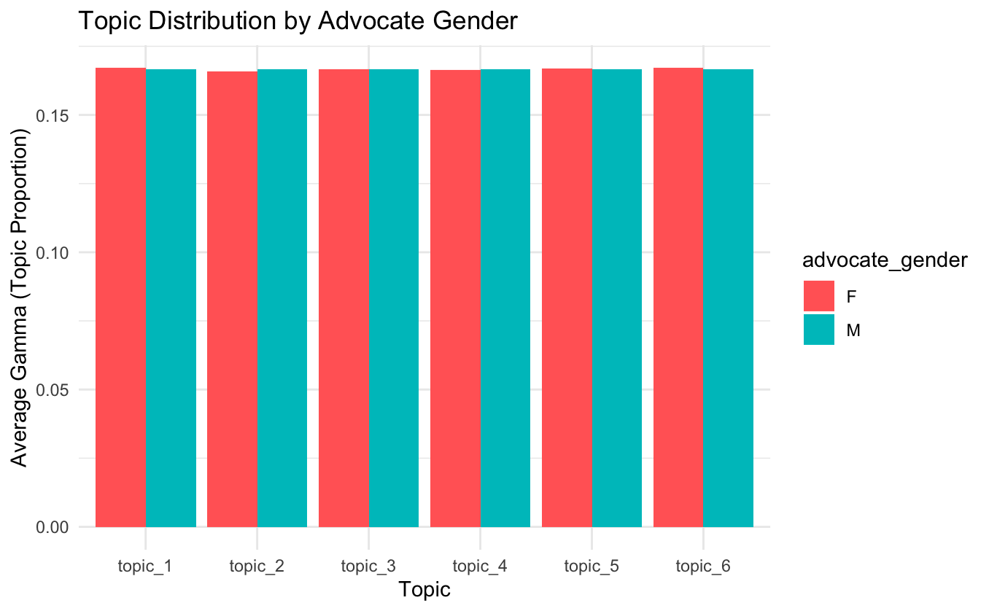
LDA for Topic Modeling
Will advocates be interrupted more under certain topics?
Whether interruptions toward women are more negative with particular areas?
Notes:
While sentiment analysis tells you how negative the language is, topic modeling (LDA) helps explain what they are talking about.
Topics may be weakly separated or artificially similar.
LDA picks up on term frequency. Legal arguments naturally reuse a common vocabulary, making it hard for LDA to form meaningful distinctions.
Why it matters: For a study about emotion and interruption dynamics, it’s important that topics reflect different kinds of legal content, not just variations of “court talk.”
Result: LDA fails to capture meaningful variation relevant to gender or sentiment.

Slide 13
LDA for Topic Modeling
Will advocates be interrupted more under certain topics?
Whether interruptions toward women are more negative with particular areas?
Highly Overlapping Topics
Too similar topics discussed
Supreme Court oral arguments are relatively formal and structured
LDA Assumptions Violated
LDA assumes documents are long enough to exhibit a mixture of multiple topics
Dominated Vocabulary
Topics offer little analytical value or interpretability
Nearly identical top words such as “court” and “justice”
No Clear Thematic Separation
Fail to correspond to clear conceptual or emotional themes
variations of “court talk”
Notes:
While sentiment analysis tells you how negative the language is, topic modeling (LDA) helps explain what they are talking about.
Topics may be weakly separated or artificially similar.
LDA picks up on term frequency. Legal arguments naturally reuse a common vocabulary, making it hard for LDA to form meaningful distinctions.
Why it matters: For a study about emotion and interruption dynamics, it’s important that topics reflect different kinds of legal content, not just variations of “court talk.”
Result: LDA fails to capture meaningful variation relevant to gender or sentiment.

Slide 14

Limitations
Semantic Embedding Limitations
Miss nuance or context shift? Try BERT or Sentence-BERT for richer sentence representation
Domain Specificity
Study focuses on U.S. Supreme Court — elite, formal setting
Topic Modeling Constraints
Uneven Advocate Distribution

Slide 15
Future Direction
Temporal Dynamics of Arguments
Analyze changes across time within a case or speaker — e.g., whether tone escalates after interruptions
Disentangle Interruption Intent
Classify interruptions as supportive vs. opposing using speech acts or dialogue structure
Justice-Level Analysis
Cross-Institution Comparison
Incorporate Audio/Behavior Features
Notes:
Add voice tone, pacing, or volume if audio becomes available for richer emotional cues

Slide 16
Thank You

