Slide 1

Farmvision-2026
Turning Farm Data into Meaningful Insights Using Microsoft Excel
Project Year: 2026
Domain: Data Analytics & Agriculture

Slide 2

WHY I CREATED THIS PROJECT
Agriculture is attracting people from different professional backgrounds.
Many first-time farmers are interested in farming but may not have practical agricultural knowledge.
I personally experienced this gap when I started exploring agriculture.
Coming from a BCA and data analytics background, I wanted to approach this problem through data.
With practical farming knowledge from my family, I decided to build a simple data-driven farming project.

Slide 3

OBJECTIVE
Collect relevant farm information.
Organise the information into a structured Excel dataset.
Clean and prepare the data for analysis.
Analyse cultivation expenses, yield and revenue.
Compare different crops and cultivation activities.
Visualise important patterns using Excel charts.
Generate insights that can support future farming decisions.

Slide 4
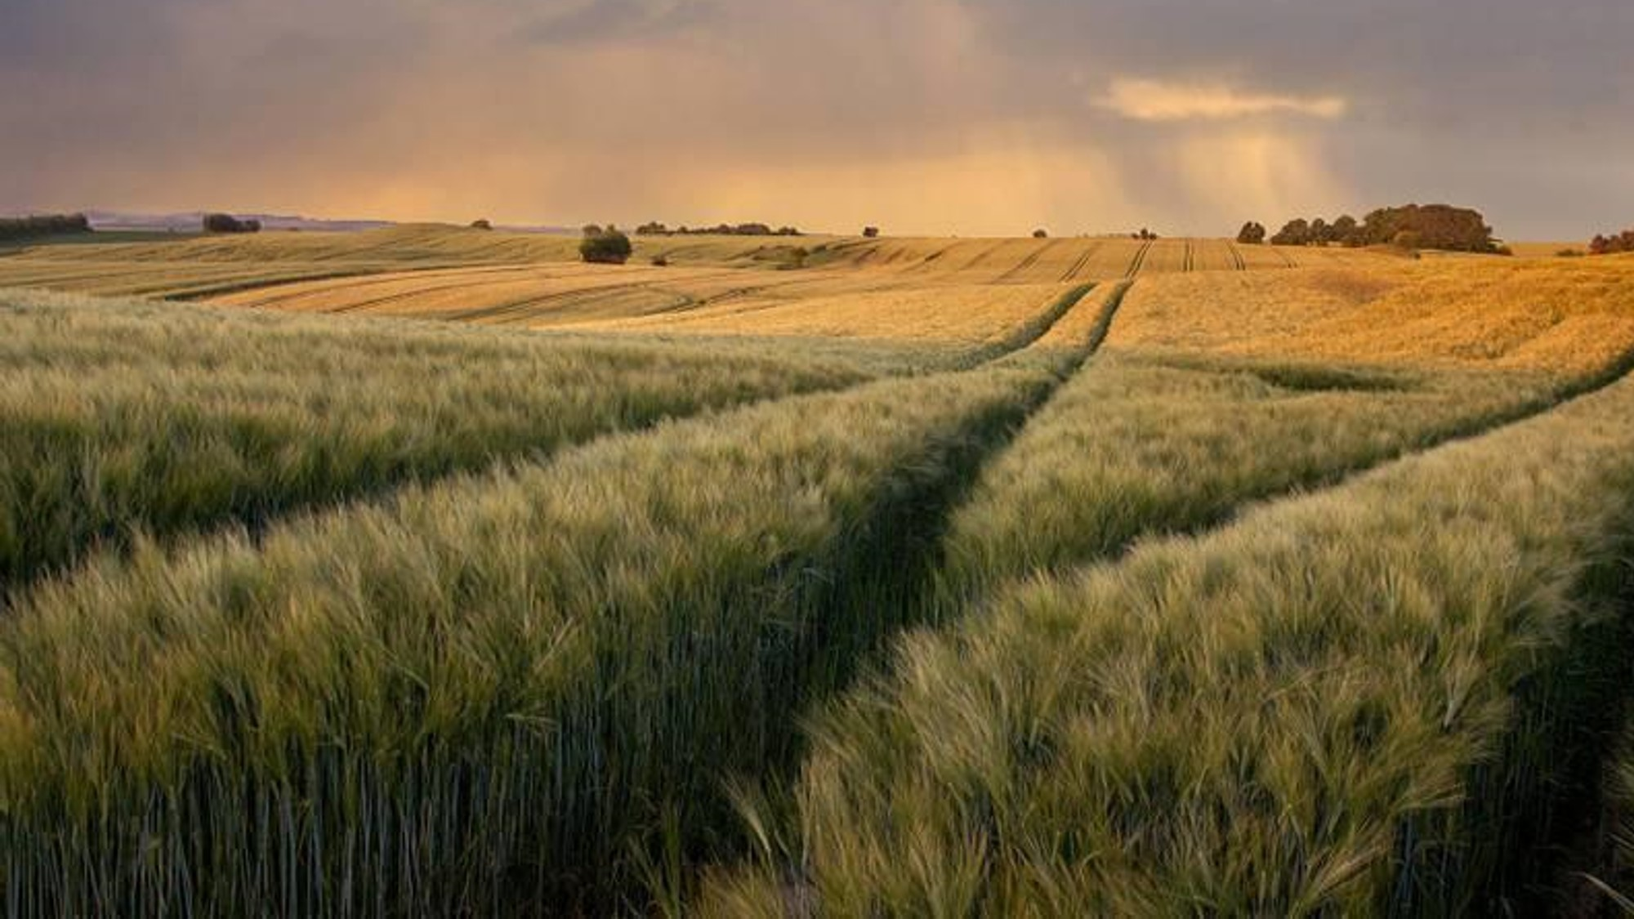
THE PROBLEM - The Challenge for a First-Time Farmer
🌱 Which crop should I cultivate?
💰 How much will cultivation cost?
📊 Where is most of the money being spent?
🌾 How much yield can I expect?
💵 What revenue can the crop generate?
📈 Which crop performs better?
🔄 Can previous farm data help with future decisions?

Slide 5
CROPS & CULTIVATION PLAN
Crops Considered
🌽 Maize
🌱 Cotton
🥬 Lady's Finger
2. Cultivation Information
The dataset captures information such as:
🌱 Cultivation Data
💰 Expense Data
🌾 Production Data
📊 Financial Data

Slide 6
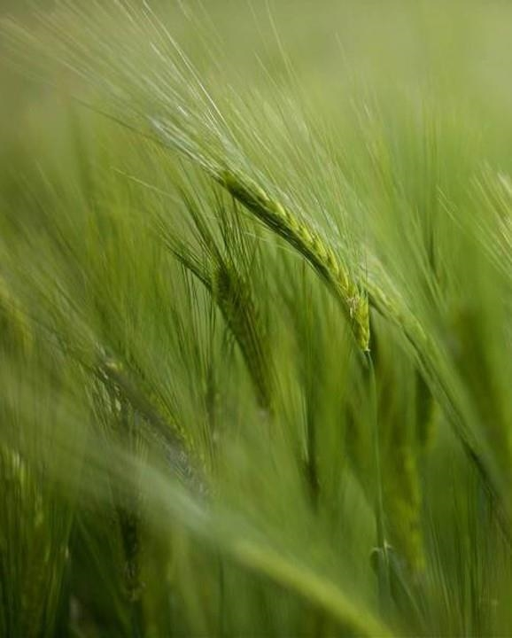
Before analysing the data, I checked for:
Missing values
Duplicate records
Incorrect data types
Inconsistent crop names
Incorrect units
Empty or invalid entries
Inconsistent expense categories
DATA CLEANING & PREPARATION

Slide 7
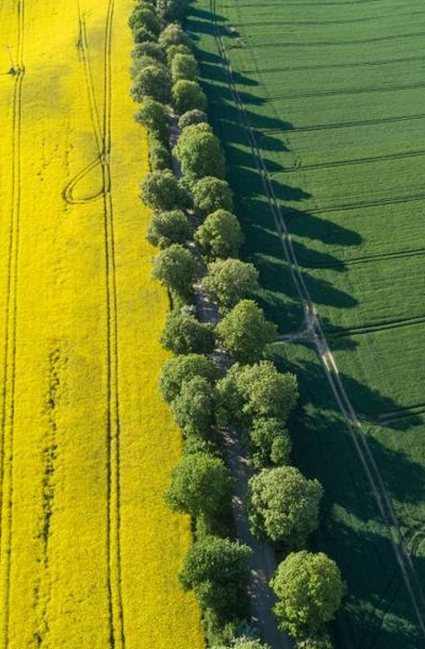
EXCEL ANALYSIS
💰 Financial Metrics
Total cultivation cost
Cost per acre
Revenue
Profit
Profit per acre
ROI
🌱 Crop Metrics
Area cultivated
Cost by crop
Yield by crop
Revenue by crop
Profit by crop

Slide 8
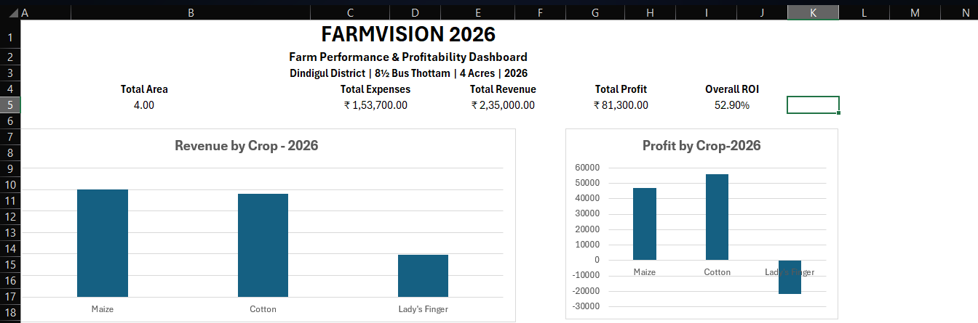
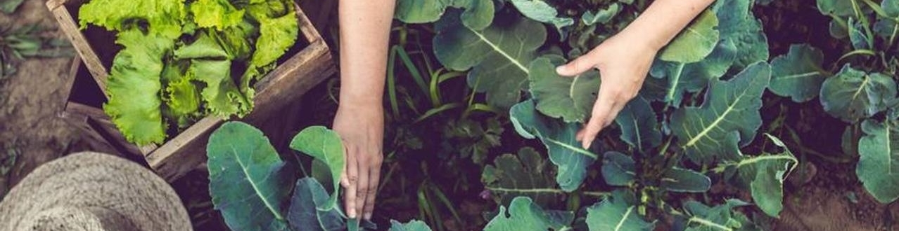
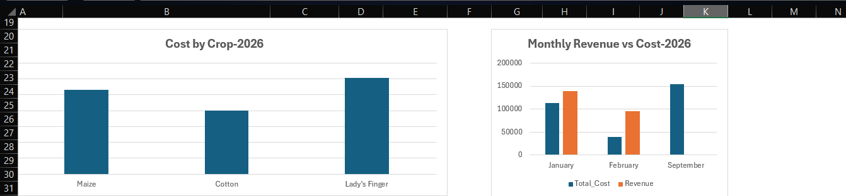

Slide 9
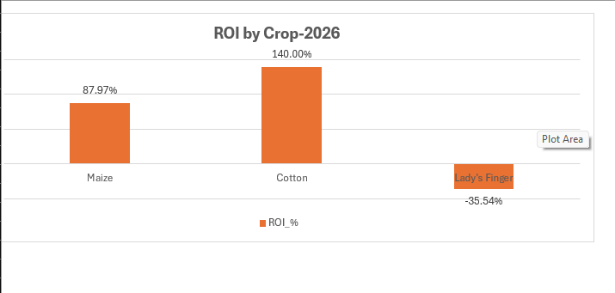
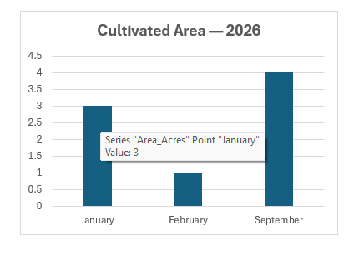

Slide 10
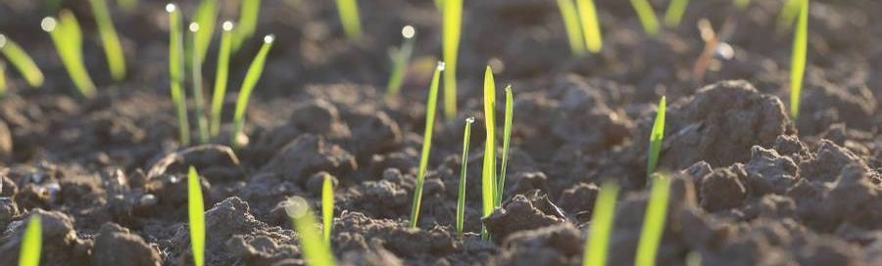
INSIGHTS
🌽 Insight 1: Which crop had the highest cultivation cost?
💰 Insight 2: Which crop generated the highest revenue?
📈 Insight 3: Which crop had the highest profit per acre?
🌱 Insight 4: Which expense category consumed the largest share of the budget?
📊 Insight 5: How did profitability differ between crops?

Slide 11
CONCLUSION
Cotton Generated The Highest Profit Among The Analysed Crops.
Maize Generated The Highest Overall Revenue.
Cotton Achieved The Strongest Roi, Making It The Most Profitable Crop In The Current Analysis.
The February Cultivation Performed Better In Terms Of Profit Relative To The Cultivated Area Compared With The January Cultivation.
Lady's Finger Cultivation Costs And Selling Price Should Be Reviewed Before Expanding Its Cultivated Area.
Based On The Current Analysis, Cotton Shows The Strongest Overall Profitability And Roi Among The Analysed Crops.

Slide 12

Thank you
Dhaksha S
dhakshasubramani@gmail.com
https://www.linkedin.com/in/dhakshasubramani

