Slide 1
Cooperative-Owned Digital Marketplace for Skilled Services
Connect • Verify • Match • Book • Pay • Protect

Slide 2
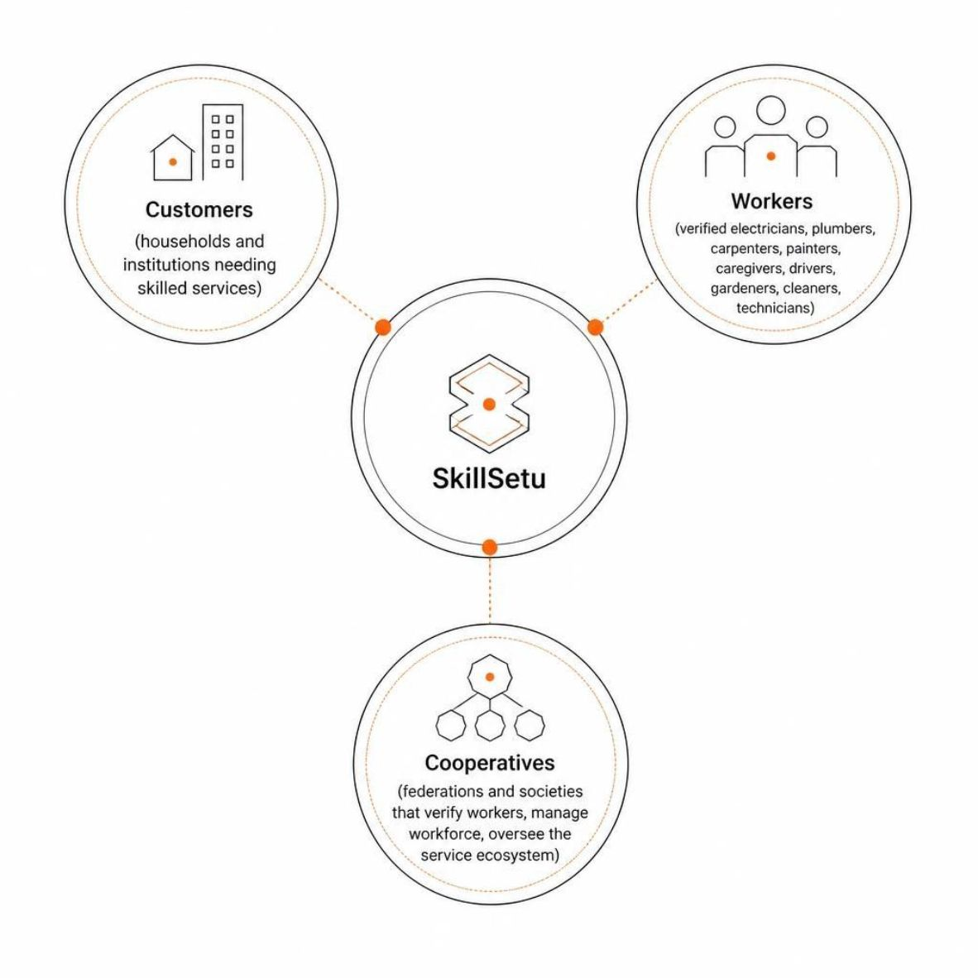


A digital service network built around cooperative workers
SkillSetu connects cooperative-owned skilled workforce with local service demand through a structured digital marketplace.
Customers
Households and institutions needing skilled services
Workers
Verified electricians, plumbers, carpenters, painters, caregivers, drivers, gardeners, cleaners, and technicians
Cooperatives
Federations and societies that verify workers, manage workforce, and oversee the service ecosystem

Slide 3
The current service ecosystem is fragmented
01 — Discovery
02 — Verification
Customers struggle to find the right skilled local worker without a structured channel
Worker identity, skills, and certifications lack a unified marketplace representation
03 — Coordination
04 — Worker Support
Availability and scheduling depend on calls, messaging, and manual coordination
Payments, welfare, insurance, and dispute handling lack a structured mechanism
Current State
With SkillSetu
Worker → phone calls / word of mouth → Customer
Structured platform → Verified match → Service → Payment → Feedback

Slide 4




SkillSetu turns fragmented coordination into one structured workflow
Customer
SkillSetu Intelligence
Request → Select time → Confirm → Pay → Rate
Verify → Geo-match → Forecast demand → Allocate
Worker
Cooperative
Profile → Accept → Complete → Get paid → Build history
Verify → Monitor → Payout → Resolve → Analyze
Verified Workers
Cooperative Ownership
Transparent Transactions
Worker Welfare

Slide 5

The solution is backed by an actual project
GitHub Repository
Project Structure
https://github.com/your-team/skillsetu
mobile/
backend/
Customer & worker apps
APIs & business logic
ai/
database/
⚠ PLACEHOLDER — REPLACE WITH ACTUAL REPOSITORY
Forecasting & matching
Schemas & migrations
Source Code • Implementation • Documentation
admin-dashboard/
Federation management
QR PLACEHOLDER — link to repository

Slide 6
A practical solution also needs to handle failure cases
Potential Problem | Mitigation
Fake / incorrect worker information | Cooperative-backed identity and skill verification
Worker availability changes | Real-time availability updates and booking confirmation
Incorrect matching | Combine skill, service type, location, and availability — not distance alone
Low initial demand | Start with selected service categories and cooperative pilot regions
AI predictions are inaccurate | Treat forecasting as decision support; retain manual cooperative oversight
Payment disputes | Digital transaction records, invoices, and structured dispute handling
Privacy / location concerns | Collect only necessary data; apply role-based access to sensitive information
Emergency booking limitations | Distinguish emergency requests from ordinary bookings; prioritize appropriate available workers

Slide 7



Designed to be feasible as an MVP and scalable as a platform
1. Technical Feasibility
2. Operational Feasibility
Mobile App → Backend APIs → Cloud Database → Geo-Spatial Services → Digital Payments → AI / ML Services
Develop incrementally: start with verification, profiles, booking, and matching before introducing advanced intelligence.
Cooperative → Worker Verification → Service Marketplace → Customer → Transaction → Worker + Cooperative Records
The cooperative remains an administrative layer — not removed from the workflow.
3. Reliability Mechanisms
Verified identities
Structured worker profiles
Digital transaction records
Availability validation
Server-side data storage
Human oversight for AI decisions
Audit-friendly administrative records
MVP strategy: Build the deterministic transaction workflow first, then layer AI on top.

Slide 8

Skilled workers already exist.
SkillSetu connects them to opportunity.
Verification
Certified and verified services
Foundations
Ecosystem
Workers, co-ops, customers, tech
Structured digital service network
Student Innovation Challenge 2026

