Slide 1

DBC Whiteboarding Workshop: Intro to Trees
Nov 19, 2014
Amelia Downs
Notes:
8th algorithms night, my 3rd

Slide 2
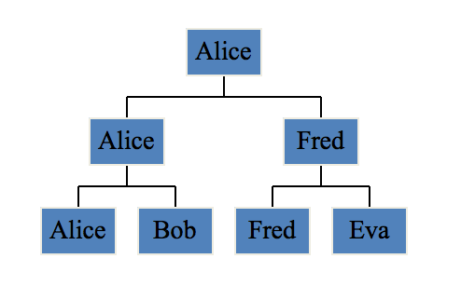
Trees
Notes:
Trees are a type of data structure like arrays or linked lists, but unlike those, trees are not organized linearly. Each item in the tree is a node.
Nodes ONLY have one piece of data and a list of children. Note that there are no circles.
One common application is for representing the possible moves in a game or search problem.

Slide 3
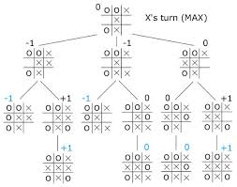

Slide 4
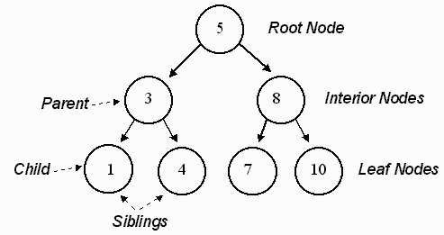
Notes:
Here is a vocab dump.
A tree is a data structure that contains nodes. Each node contains 1 piece of data, here they are numbers.
The node at the very top of the tree is called the root node. The nodes at the bottom of the tree are called the leaf nodes. Leaf nodes have no children.
Parent nodes can have an unlimited number of children, here they all have two because it’s a special kind of tree.
If two nodes share the same parent, they are called siblings nodes.
Tree
Node, each has data
Root
Leaves
Html example

Slide 5
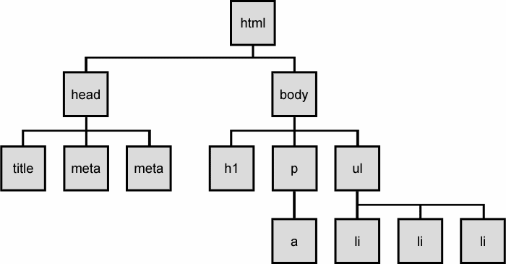
Quiz time!
Notes:
What is the root node of this tree?
What type of node is the title?
How many children does the body node have?
What is the parent of the a node?
Note that in this tree, some parents have 3 children and some have 1. This is a valid tree.
Because each node has an unlimited number of children, it is just called a tree. Or a non-binary tree.

Slide 6
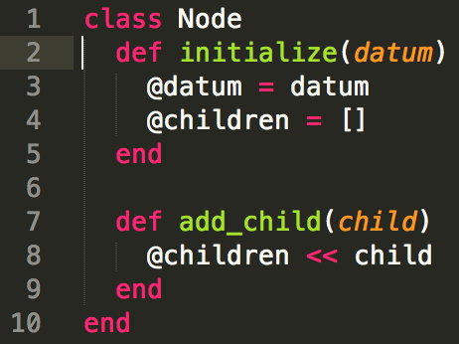
Trees
Notes:
Trees are a type of data structure like arrays or linked lists. Each item in the tree is a node.
Nodes ONLY have one piece of data and a list of children.

Slide 7
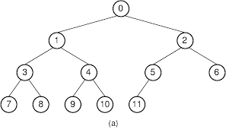
Binary Tree - 2 children max
Notes:
In a binary tree, each parent has AT MOST 2 children. You’ll note that 5 only has 1 child here. That is okay, it’s still a binary tree. It’s just a MAX of 2 children\

Slide 8
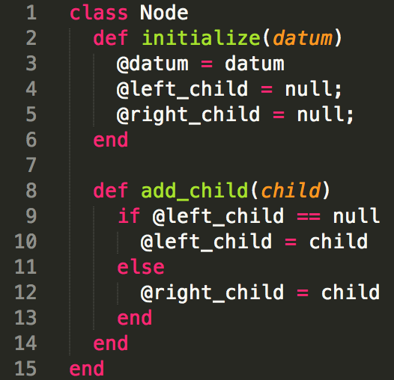
Binary Tree - 2 children max
Notes:
In a binary tree, each parent has AT MOST 2 children. You’ll note that 5 only has 1 child here. That is okay, it’s still a binary tree. It’s just a MAX of 2 children. Now there is one very special type of binary tree.

Slide 9
Breath first search
Notes:
If I wanted to know if 6 was in this tree how would I find it?
There is also breath first search. Instead of going all the way down to the left, then the root, then the right, you go across each row.
So you start with the root, then it’s children
QUEUE
Note that this tree is NOT A BINARY SEARCH TREE

Slide 10
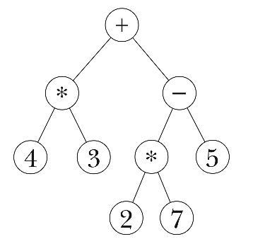
Depth First Search
Notes:
If I wanted to print out every item in this tree I could do breadth first search. If I did I would print out: “ plus, times, minus, 4, 3, times, 5, 2, 7” that doesn’t make sense.
Some trees are made to be used with depth first search.
Starting at the root,
- print the node to the left
- the parent
- the node to the right
One way to search through a tree is called depth first search. To do an in order depth first search you look at all items to the left of the parent, then the parent, then all things right of the parent.
DFS better for visiting every node, or visit every node until we have what we are looking for
If tree is very large, or want to quit when so far from beginning, use bfs

Slide 11
Depth First Search
Starting with the root, at each node:
Check node to left
Check node
Check node to right
Notes:
If I wanted to print out every item in this tree I could do breadth first search. If I did I would print out: “ plus, times, minus, 4, 3, times, 5, 2, 7” that doesn’t make sense.
Some trees are made to be used with depth first search.
Starting at the root,
- print the node to the left
- the parent
- the node to the right
One way to search through a tree is called depth first search. To do an in order depth first search you look at all items to the left of the parent, then the parent, then all things right of the parent.

Slide 12
Depth First Search (DFS)
Recursion
Easiest for visiting every node
Breath First Search (BFS)
Queue (first in first out)
Infinite trees
Want to stop after a certain distance from the root

Slide 13
Binary Search Tree
Notes:
Can you tell me what is special about this tree that makes it a binary search tree.

Slide 14
Hints for doing tree questions
What kind of tree? Is it a binary tree or a binary search tree?
Draw a simple example to solve by hand.
Does it sound like breadth first (queue) or depth first (recursion)?
Solve the answer for a leaf node.
Solve for a tree with only 1 parent and two children.
Extrapolate from there.

Slide 15
Future Learning
What are: in order, pre order, post order traversal?
What is the runtime of searching a tree?
What are examples of when trees are useful?
When is a tree balanced?

Slide 16
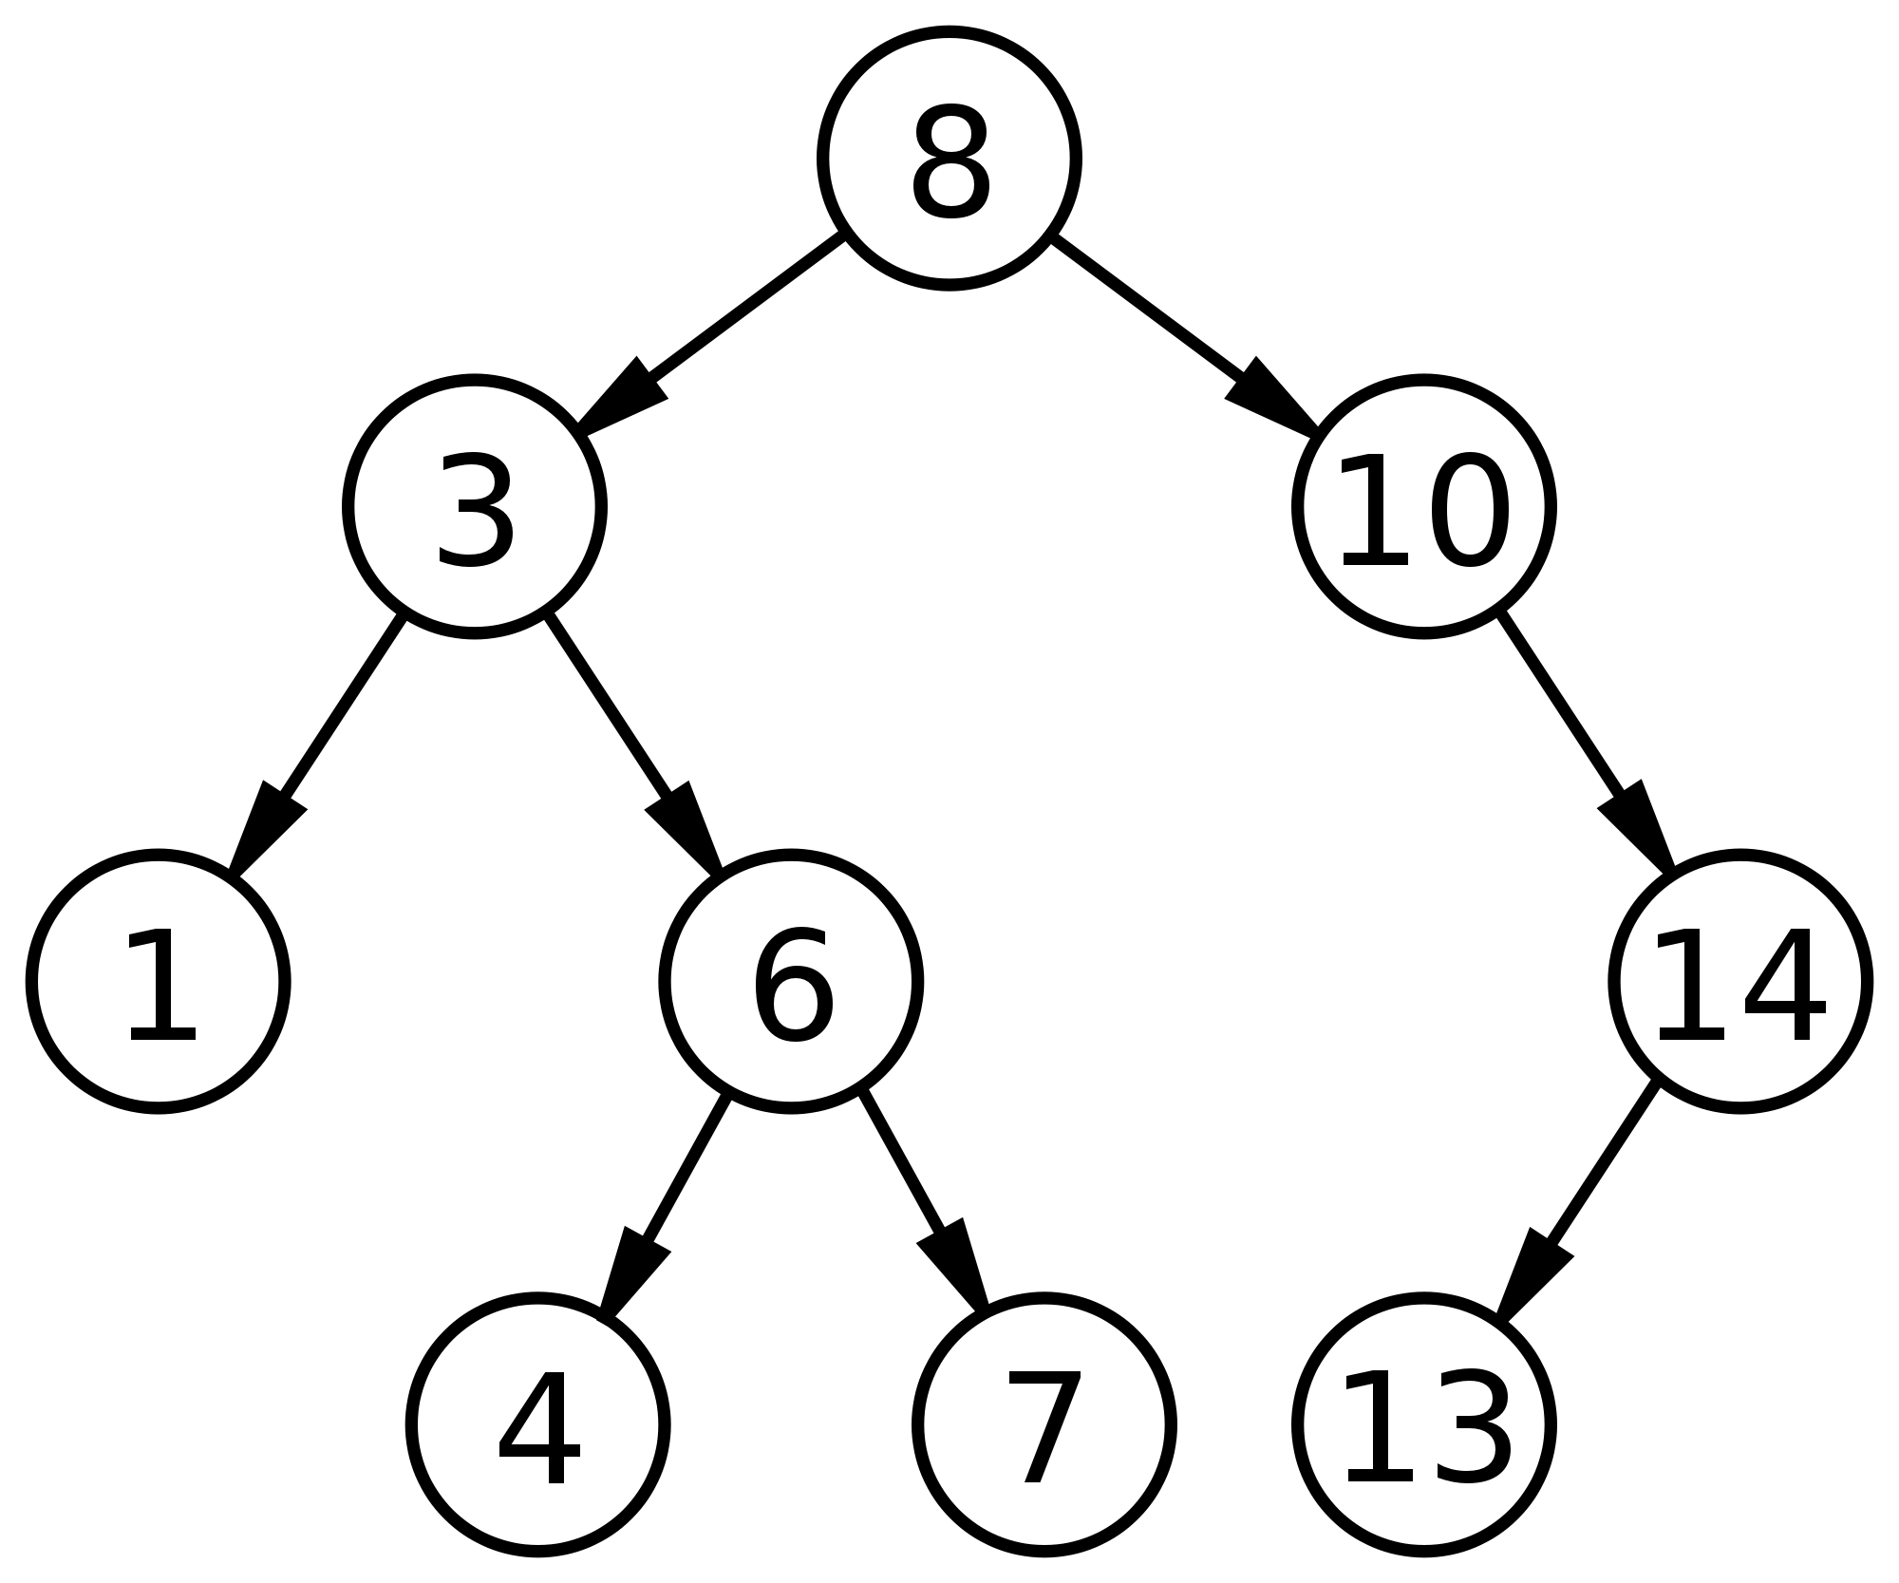
Write the function is_datum_present? that takes the root node of a binary search tree and an integer as arguments and returns true or false if the integer is in the tree.
For example, if you were passed this tree and the number 3 -> the function would return true.

Slide 17
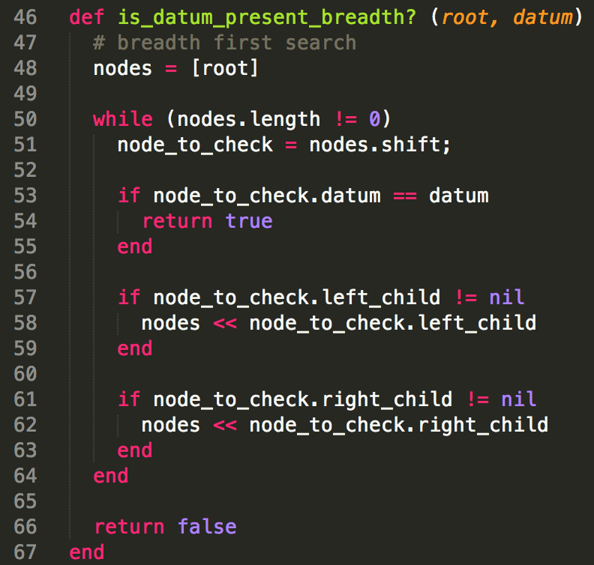
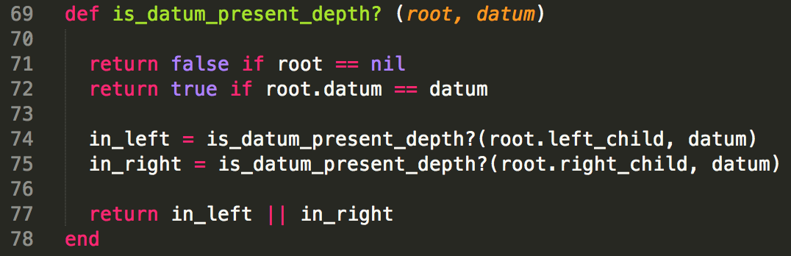
is_datum_present?

Slide 18
Write the function find_max_branch_sum that takes a root node of a binary tree as an argument and returns the sum of the branch with the largest sum.
For example, if you were passed this tree -> the function would return 18.

Slide 19
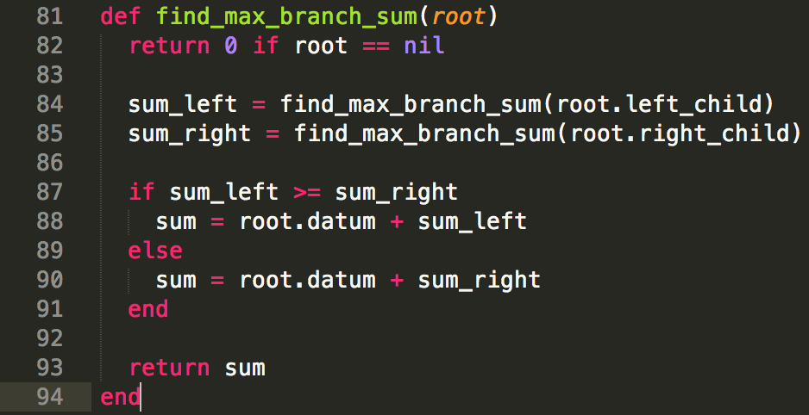

Slide 20
Write the function tree_depth that takes the root node of a binary tree as an argument and returns the depth of the tree (the size of the longest branch).
For example, if you were passed this tree -> the function would return 4.

Slide 21
