Slide 1





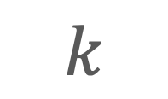

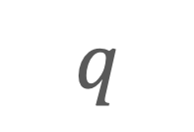

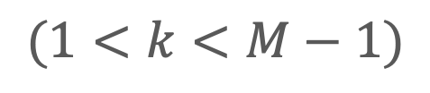
$1/M$ labelling
Complementary labelling
$$q$$
$$k$$
$$q→0$$
$$k=M−1$$
Shannon entropy based labelling
Top-$k$ labelling
$$(1<k<M−1)$$
$$q→1$$
$$q→∞$$
Ordinary labelling
$$k=1$$

Slide 2


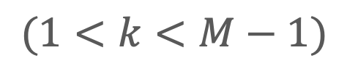






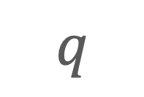
$$q→∞$$
Ordinary labelling
$$k=1$$
$$q$$
$$k$$
Shannon entropy based labelling
$$q→1$$
Top-$k$ labelling
$$(1<k<M−1)$$
$$q=0$$
$1/M$ labelling
Complementary labelling
$$q→−∞$$
$$k=M−1$$

