Slide 1
Stock Performance
Juan Zapien

Slide 2
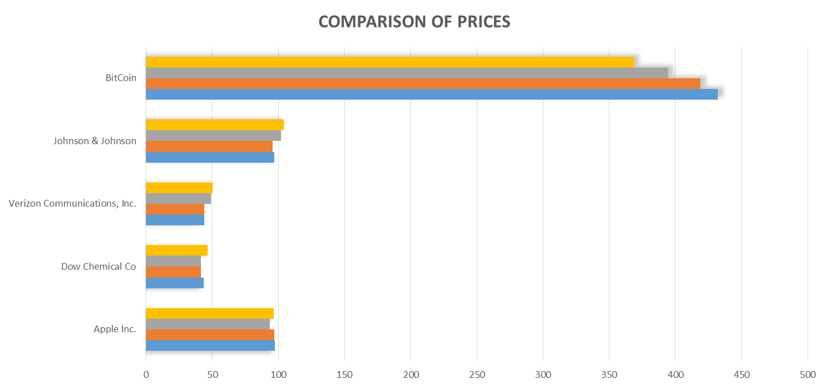
Comparison Of Prices

Slide 3
%Profit/loss

Slide 4
Investment

