Slide 1
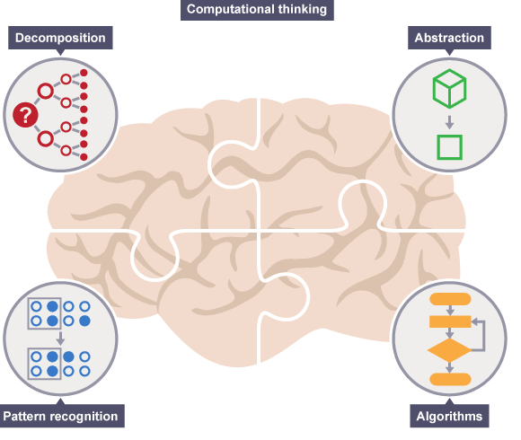
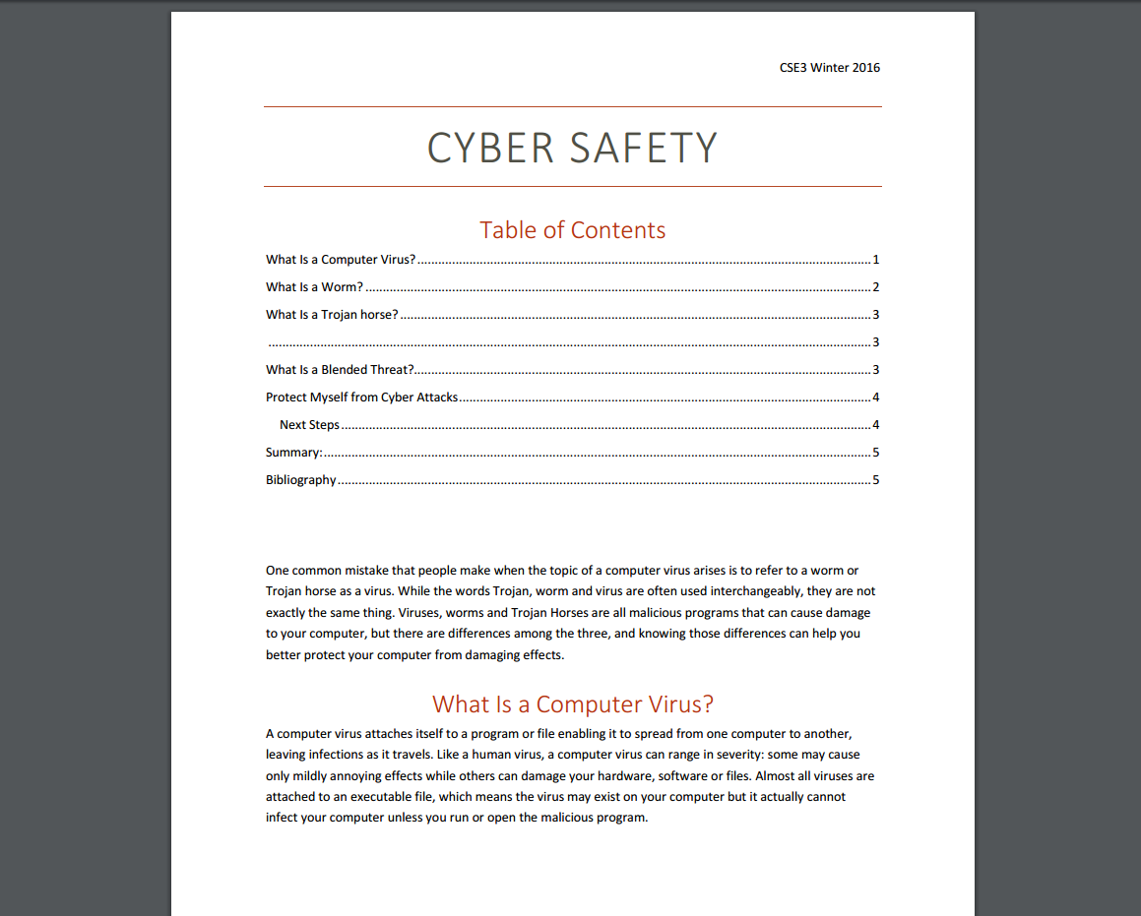
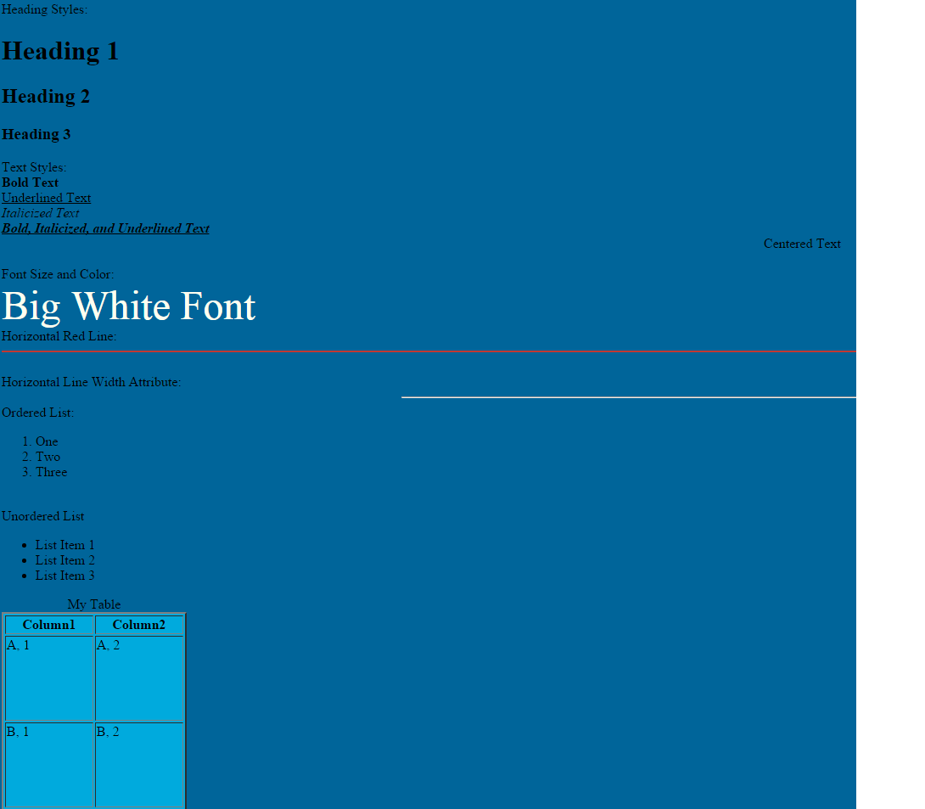
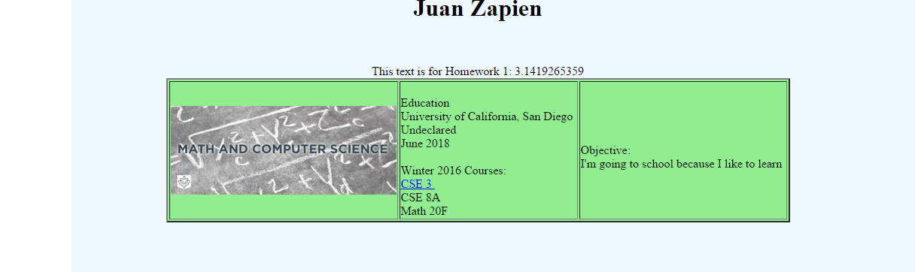
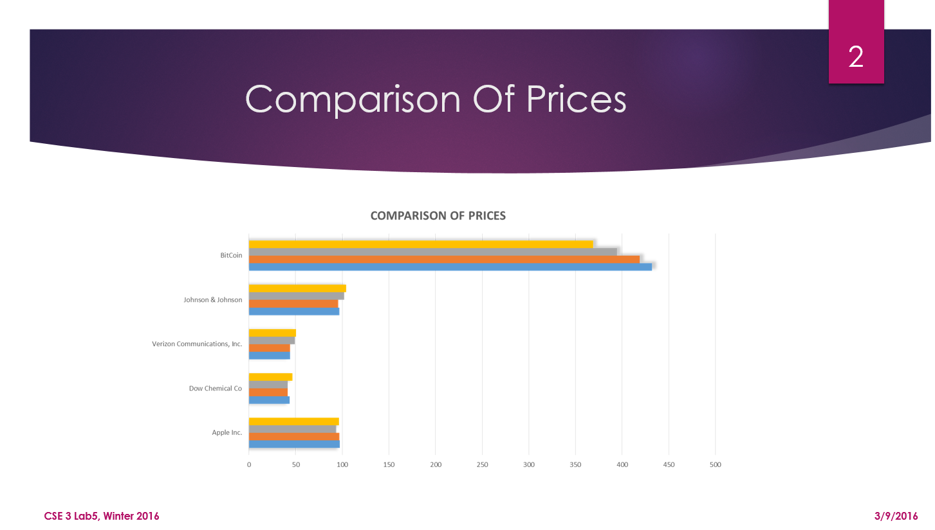
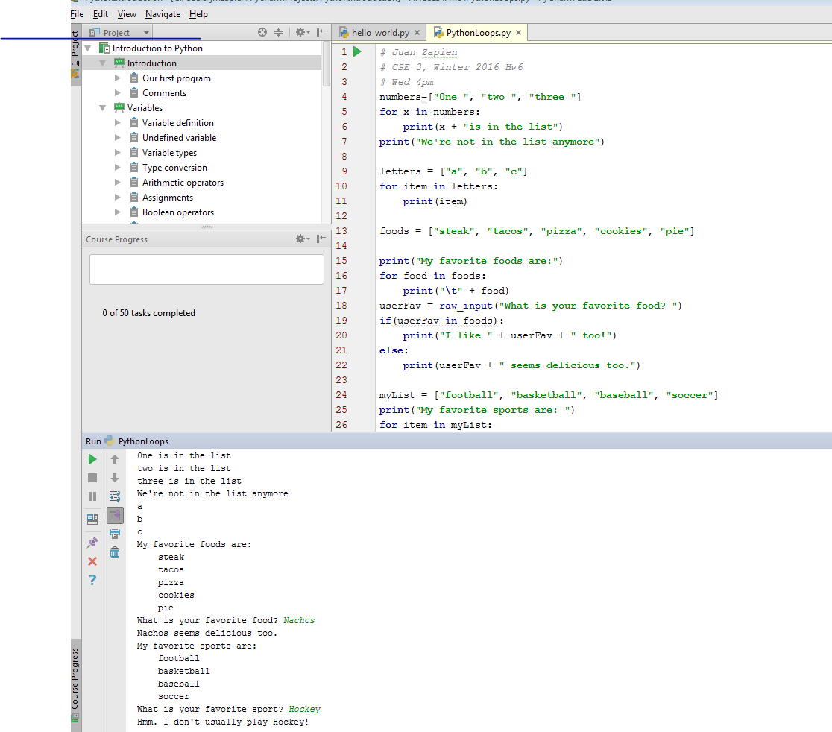
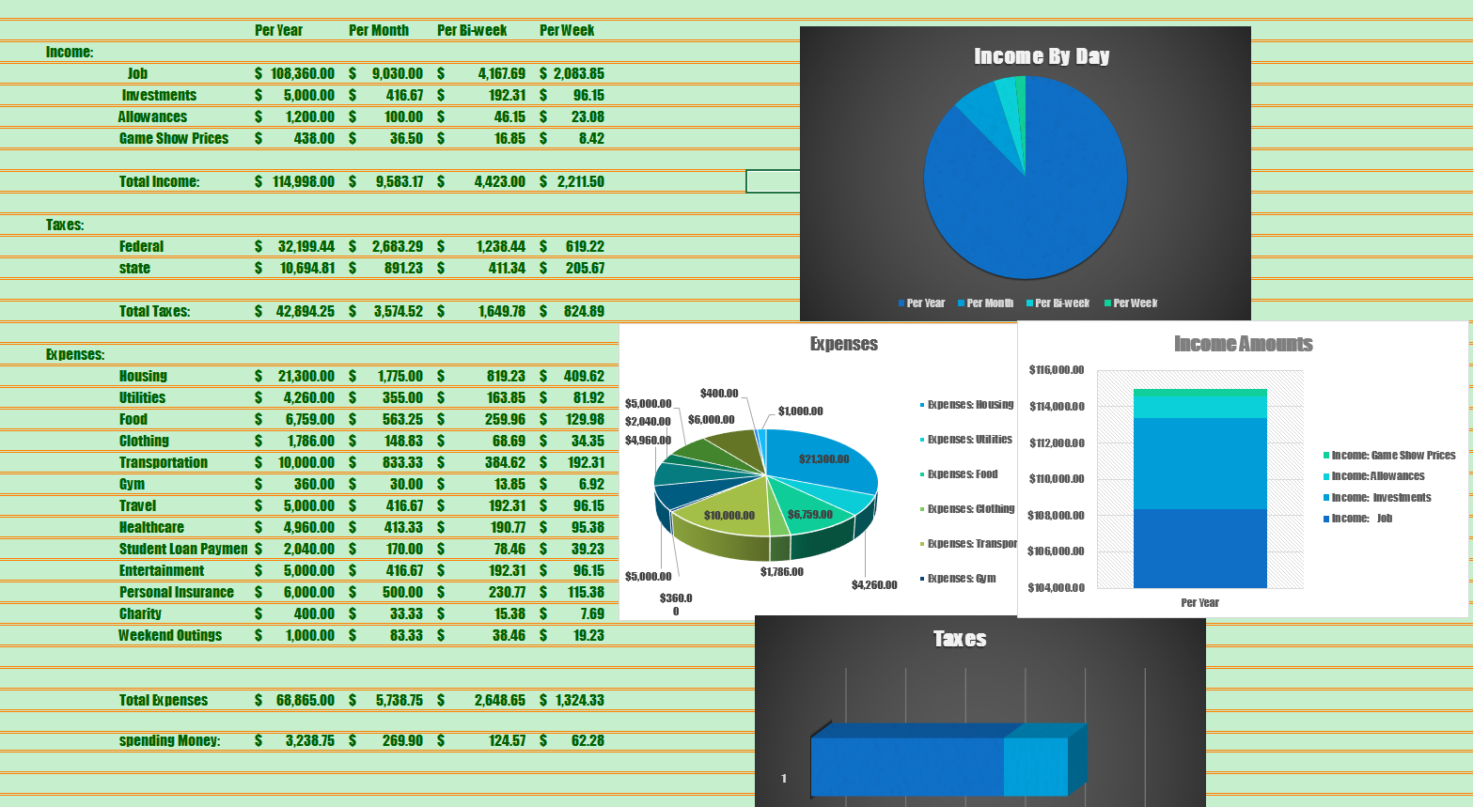
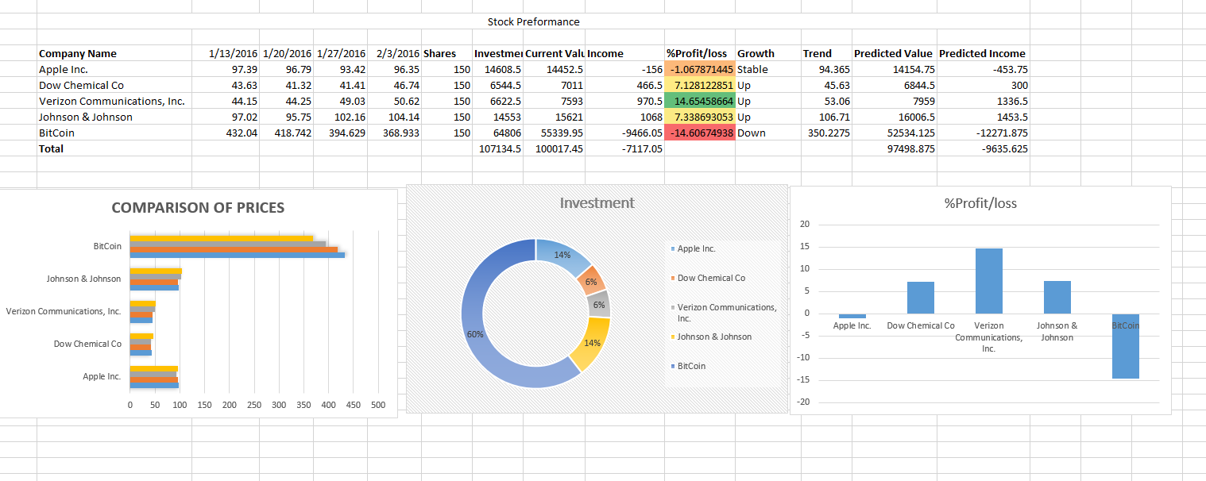
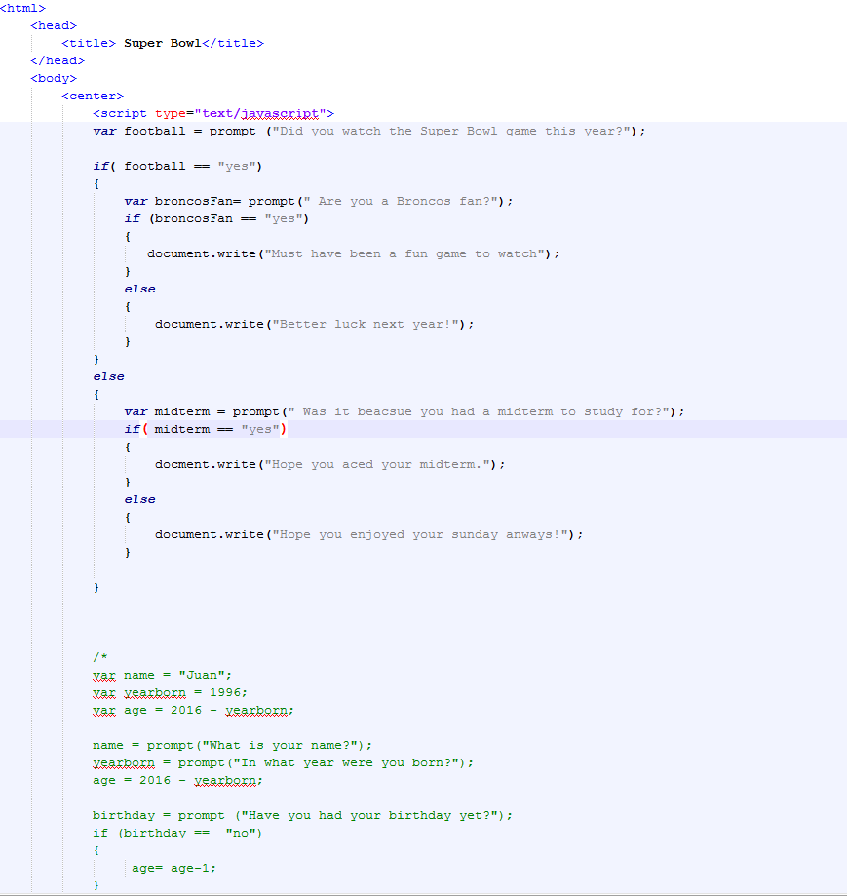
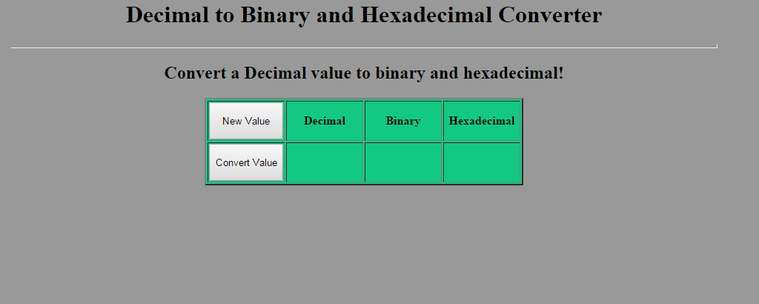
CSE3
Computational Thinking
Juan Zapien
Desktop Publishing with MS Word
Learning all these new skills help me feel more comftrable around computers
In this class I learned a couple of new very helpful tricks on MS Word like how to do a table of contents.
Making information available to the world with HTML and Web Page
HTML is cool program that let’s you bring web pages to life!
Presentation of Information with MS PowerPoint
PowerPoint is fun way to present information to others.
Data Analysis and Visualization with MS Excel
Dynamic Webpage Programming with JavaScript
Excel was very fun program that helps you jot down data and present it effectively .
With java Script I brought pages to life and made pages intractable.
IDLE Programing with Python
PyCharm was a very helpful program to start learning how to code.

