Slide 1
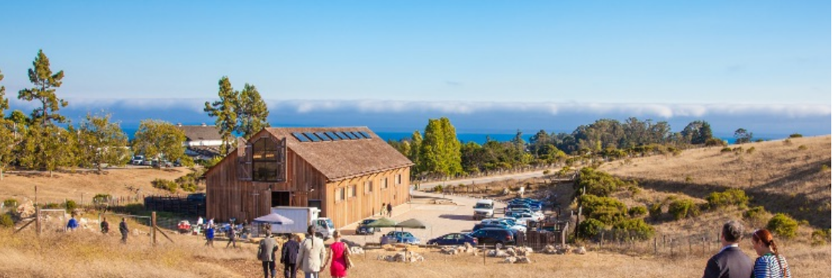

UC Santa Cruz Open Source Symposium
September 27-29 @ UC Santa Cruz

