Slide 1
Interest Rates & U.S. Treasuries:
Discoveries & predictions from monetary policy data

Slide 2
Context & Background:
We’ll explore and try to predict Interest Rates for the the U.S. Federal Government.
These interest rates are the foundation for those for businesses and individuals.
We’ll look at transactions of US Federal Debt obligations (Treasuries).
Monetary policy is often implemented when the Federal Reserve (Fed) conducts “Open Market Operations,” actively buying and selling Treasuries.
The New York branch of the Federal Reserve (NY Fed) is tasked with implementing Monetary Policy by conducting Open Market Operations.
After the 2008 financial crisis, the Fed conducted significant purchases of Treasuries to lower interest rates, a policy known as “Quantitative Easing.”
We will compare predictions from Neural Nets on the 3 month and 30 year rates.

Slide 3
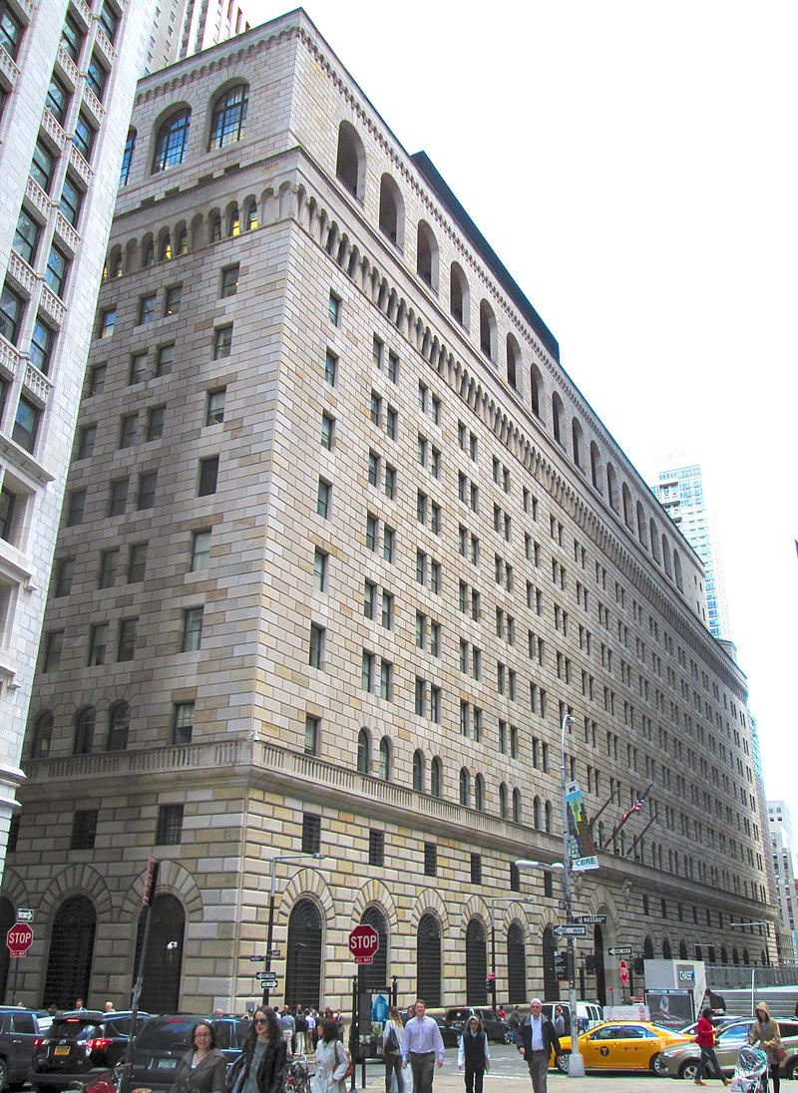
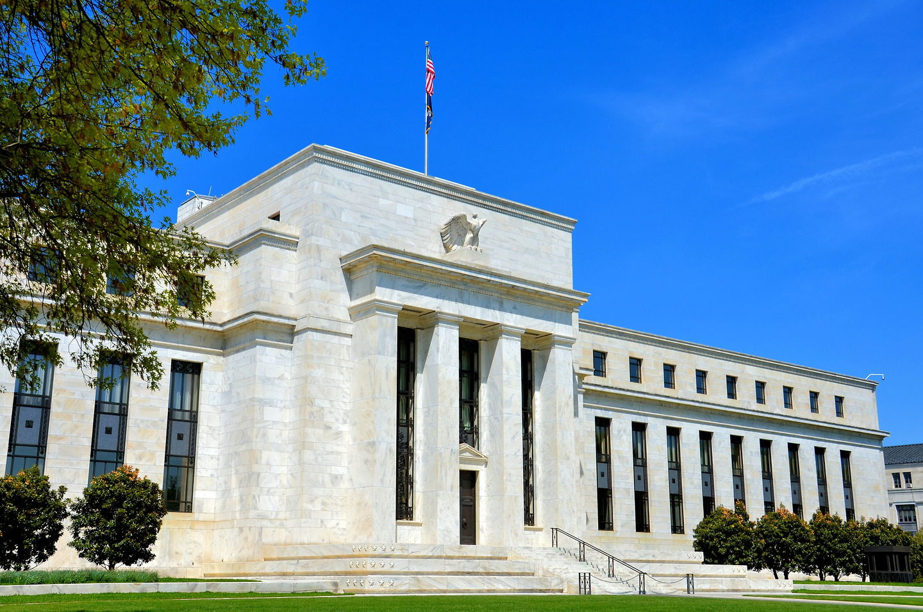
Background: Federal Reserve & Operations
NOT Here
Here
Source: https://en.wikipedia.org/wiki/Federal_Reserve_Bank_of_New_York_Building
Source: https://www.encirclephotos.com/image/eccles-building-federal-reserve-headquarters-in-washington-d-c/

Slide 4



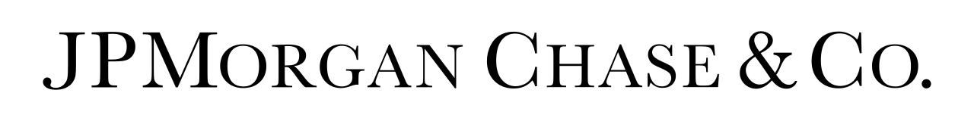
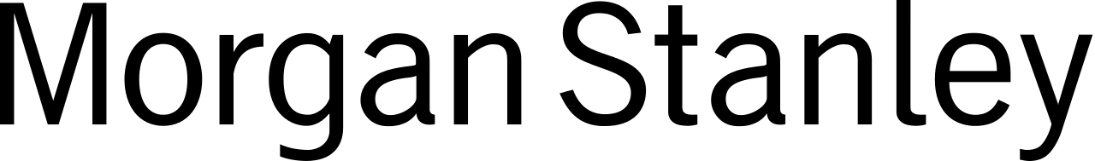
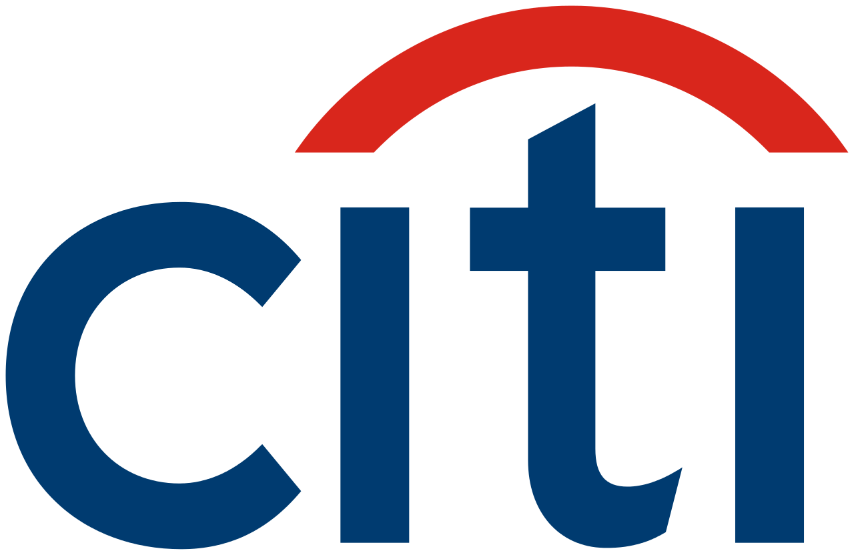

Background: Primary Dealers
Definition & Context:
Primary Dealers are the banks authorized by the Fed to be on the other side (counterparty) when it buys or sells Treasuries.
These banks are the names we all recognize, but specific divisions of them that do business with the Fed.
Transactions with Primary Dealers are how Monetary Policy is implemented in the market for Treasuries.
Source: Wikipedia

Slide 5
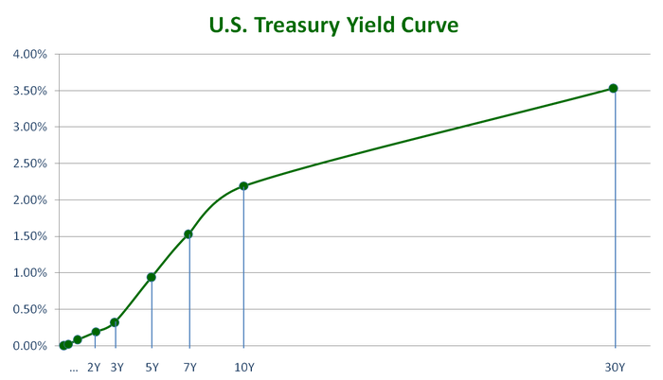
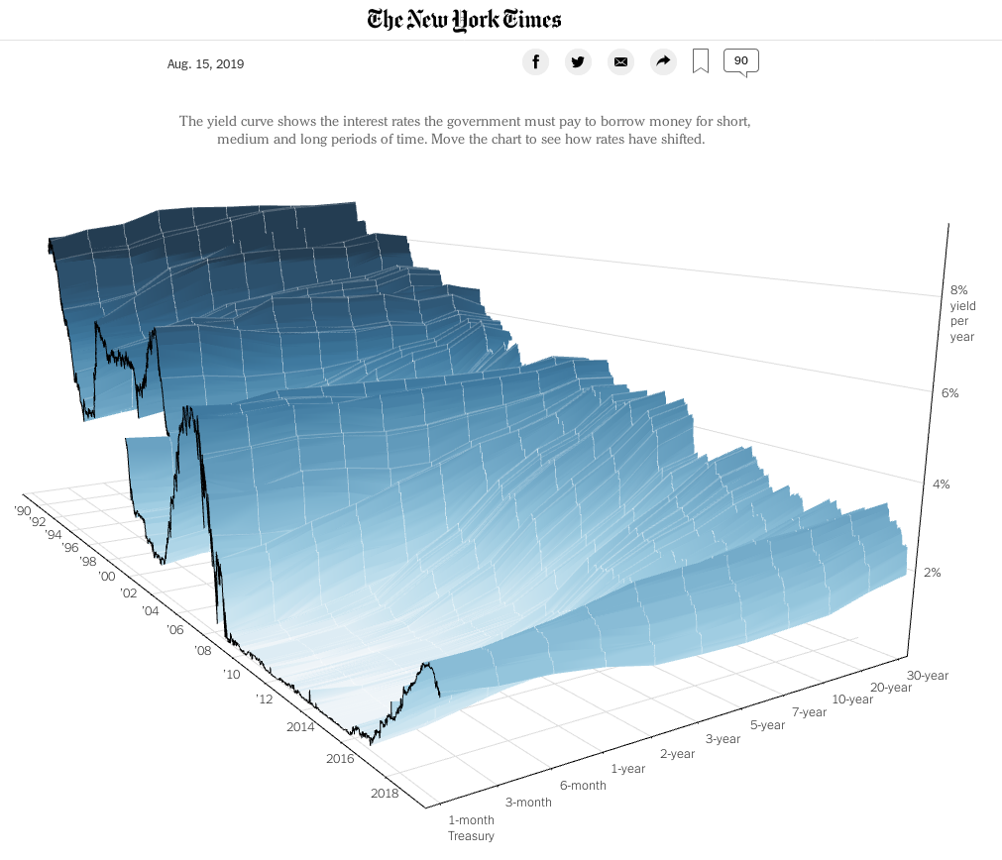
Background: The Yield Curve
The Yield Curve is simply the menu of interest rates for loans of different times (maturity) that you see TODAY.
Interest rates change over time but in different degrees depending on the maturity length.
The U.S. Treasury Yield Curve is different (much lower rates) from that of a business or individual.
Source: https://eiptrading.com/yield-curve/
Source: nytimes via - https://datapleth.io/blog/2019/08/17/2019-08-17_do_we_have_a_yield_curve_problem/

Slide 6
Data Summary & Exploration:
Our data consists of transaction records of Treasuries with the NY Fed by Primary Dealers.
The data was standardized by time to show about 81,000 observations about every half hour.
Transaction features include the type of Treasury, price paid, total purchased, interest rate etc.
Made public starting in 2010, the data we will look at spans a roughly 4.5-year period from mid 2010 to the end of 2014. We are analyzing a specific period of history here.
This is a period when Quantitative Easing was in effect, with significant purchases in the market for US Treasuries by the Fed to lower interest rates at different maturities.
We used Quandl API to join contemporary records of interest rates on the transaction data. This told us how the U.S. Treasury yield curve looked on that transaction date.
We will explore patterns in the transactions by different Primary Dealers. This can offer insight into how the Fed adjusts interest rates at different points on the yield curve at different times.

Slide 7
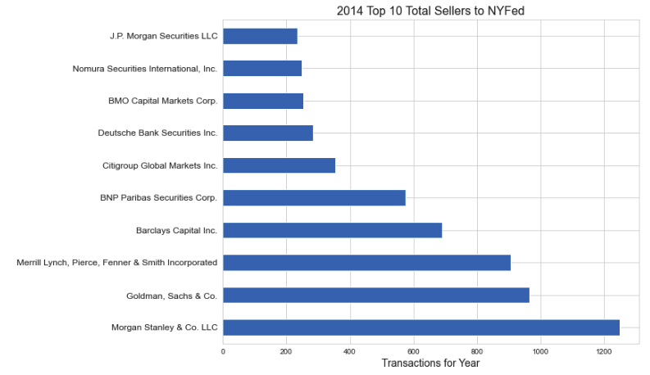
Treasury Transactions by Counterparty:

Slide 8
Quick Vocab: Types of Treasuries
Treasury Bill: Maturity of 1 year or less. (usually smallest interest rates)
Treasury Note: Maturity between 2-10 years.
Treasury Bond: Maturity 10 years or greater. (higher interest rates, all else equal)
Coupon: Interest rate paid on specific Treasury.
Some Treasuries are “Inflation Indexed.”
General Principle: Price values of Treasuries will increase as interest rates fall and visa versa.
The Fed aims to steer interest rates at different maturities (points of the Yield Curve).

Slide 9
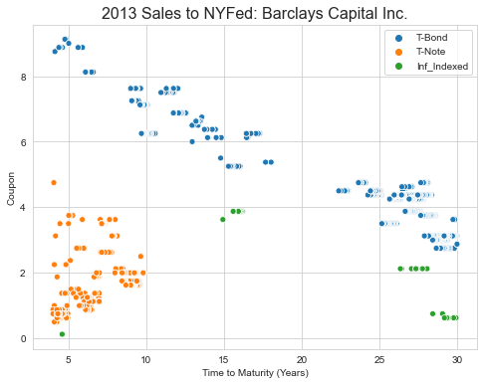
Treasury Transactions by Counterparty:
We can see an example of how the NY Fed was prioritizing different parts of the Yield Curve with its purchases.
Time to Maturity here is when the Treasury will mature at the time the Treasury was Purchased by the Fed.

Slide 10
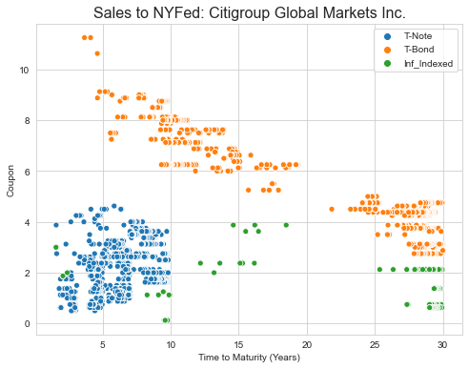
Treasury Transactions: Yield Curve Management

Slide 11
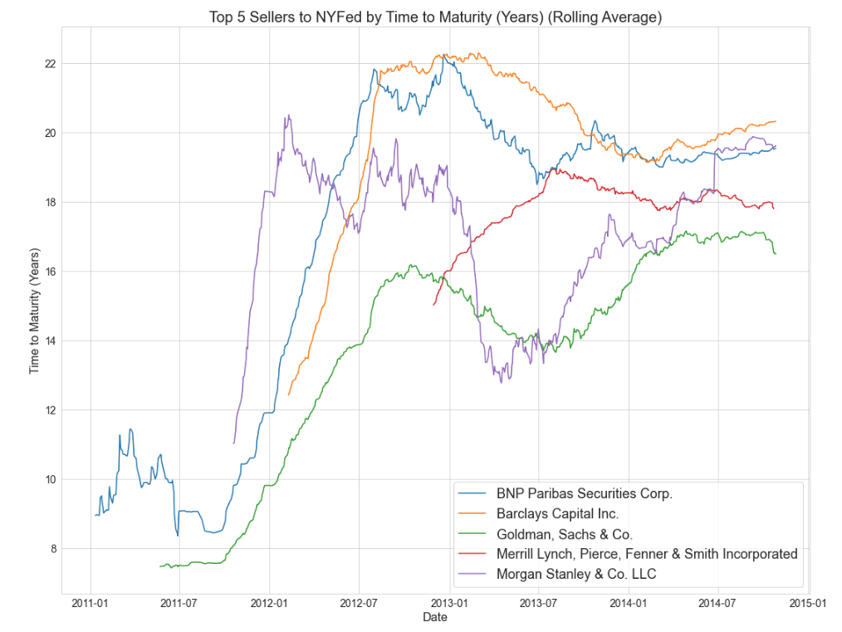

Slide 12
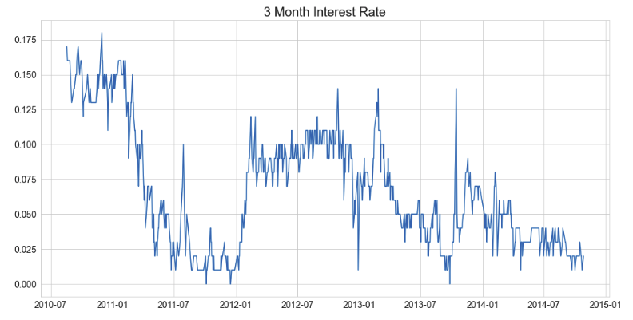
Interest Rate Patterns & Predictions: 3 Month

Slide 13
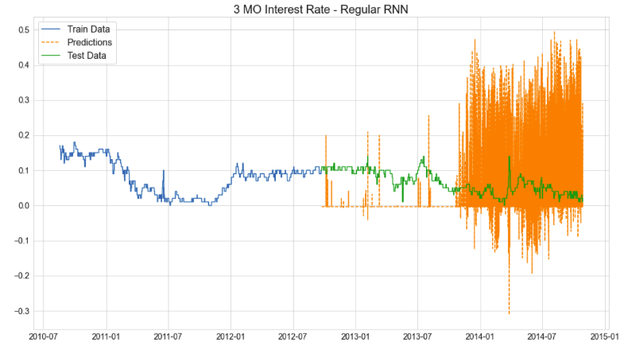
Interest Rate Predictions: 3 Month Rate

Slide 14
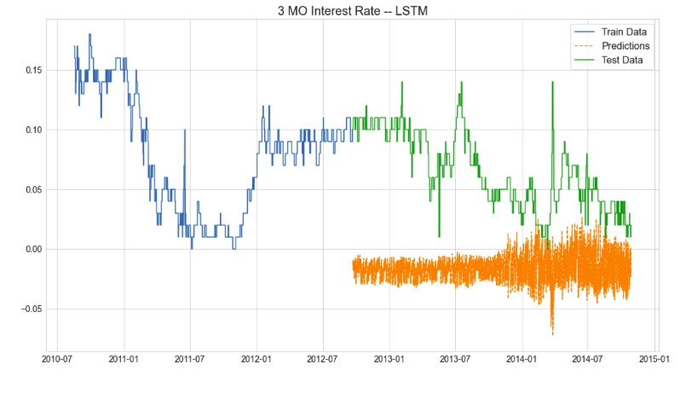
Interest Rate Predictions: 3 Month Rate

Slide 15
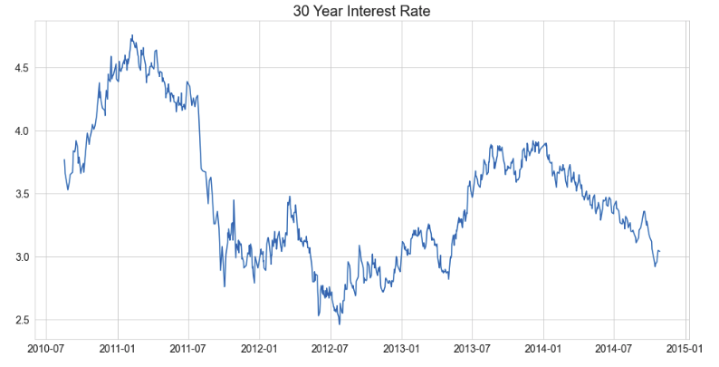
Interest Rate Patterns & Predictions: 30 Year

Slide 16
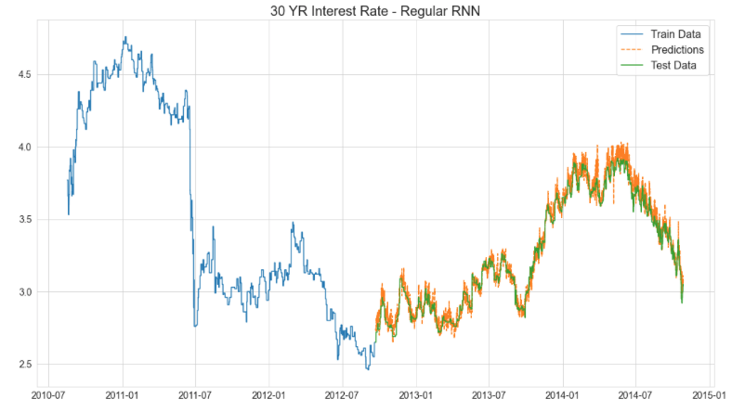
Interest Rate Predictions: 30 Year Rate

Slide 17
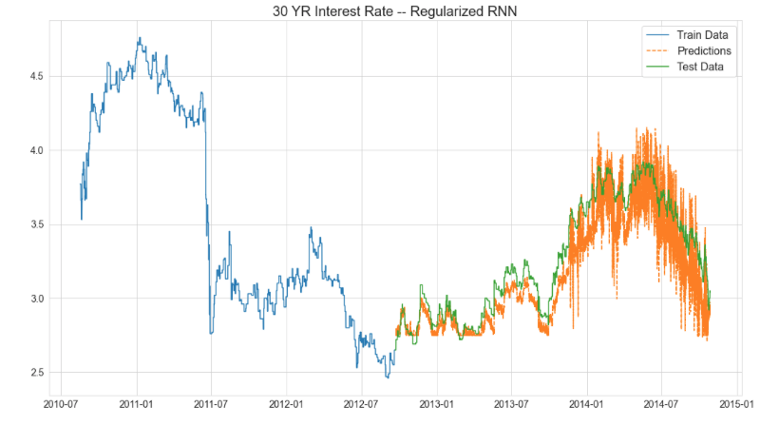
Interest Rate Predictions: 30 Year Rate

Slide 18
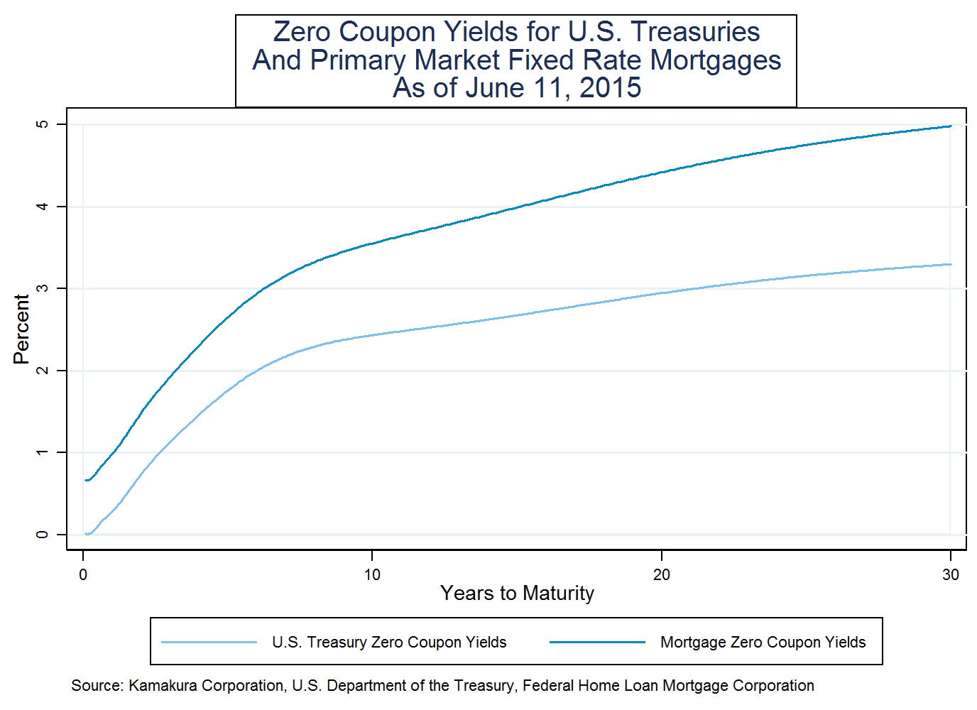
Why Does this Matter?
Monetary Policy directly effects commerce and daily life in obvious and subtle ways.
Interest rates fundamentally relate to perceptions of risk.
The Yield Curve is essentially an expectation of the future and how risky or uncertain it might be.
The Fed applies pressure on different parts of the Yield Curve to steer future production for the entire economy.
Your Interest Rates:
US Government Interest Rates:
http://www.kamakuraco.com/Blog/tabid/231/EntryId/750/Constructing-a-Mortgage-Valuation-Yield-Curve.aspx

Slide 19
Thank You
Questions?

