Slide 1
Smart Home Application-
We are looking for android application(flutter).

Slide 2
SmartHome Application Features
User login
Access validation
Add Devices and Assets
Add/remove home
New account creation
Reset password
Add/remove rooms
Add/remove devices
List Home/Rooms/Devices
Device Control
Device control
Device data sending to cloud
Device control using scene setting
Device limit settings
Device alerts
Device status history
House power consumption
Room power consumption
Report
Device power consumption
DevGroup power consumption
List of alerts
Scene/Theme
Add/remove Scene

Slide 3
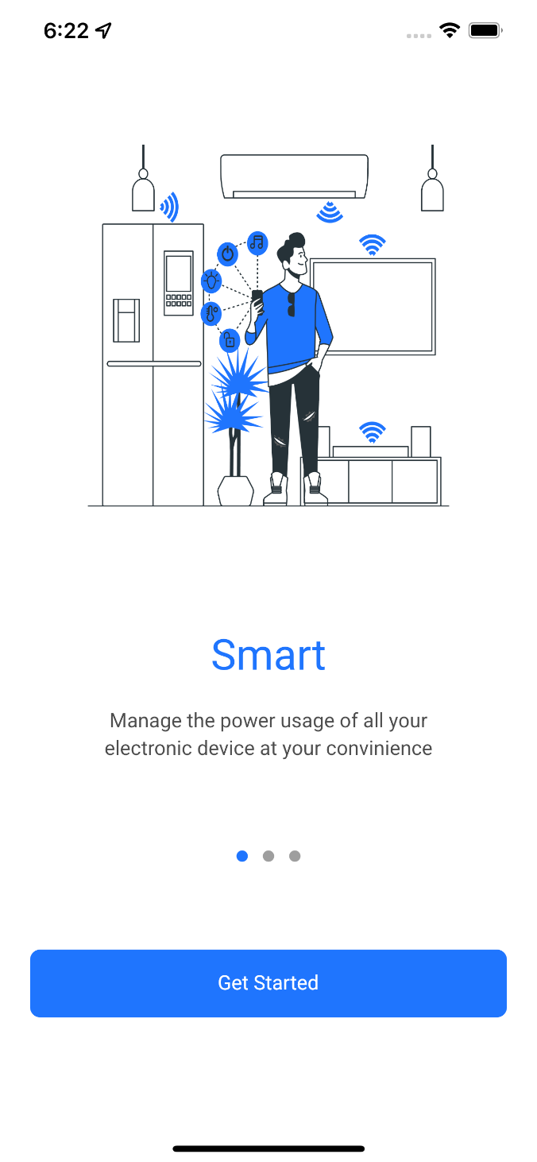
1st Page Select Page: In this page we can select the language you want it is connected by using this function flutter_block it is use to translate the languages and we create all language files for translate.

Slide 4
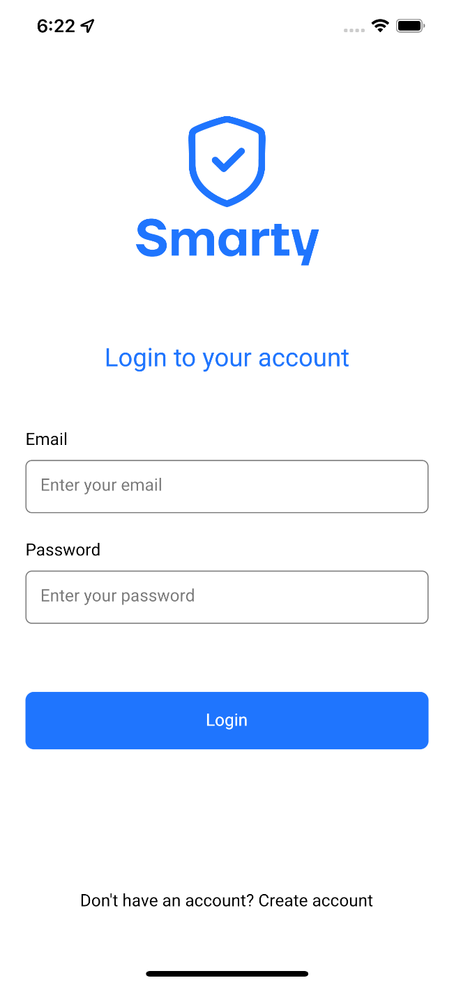
2nd Page
Login Page:
We have to connect with database to give Authorization for login first we have to register first.
If we are giving incorrect Email Address and Password one snake bar give message INCORRECT PASSWORD AND EMAIL ADDRESS.

Slide 5
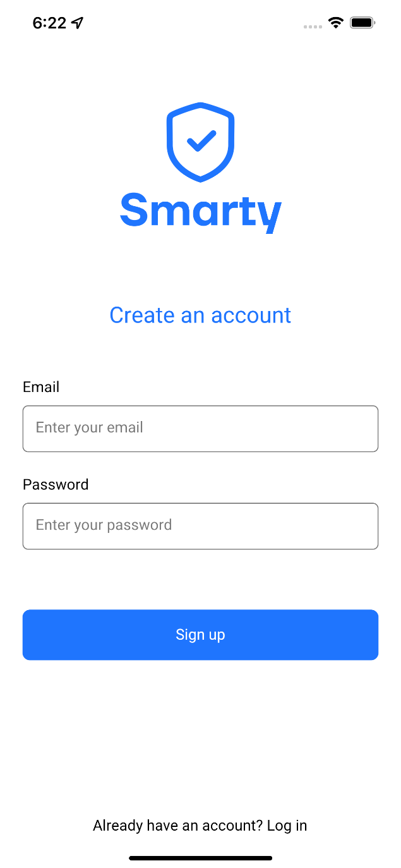
3rd Page Register User: Here if we have to login register first to enter all details in database. In login register it connect with firebase(firebase_auth, firebase_core) to store login credential.

Slide 6
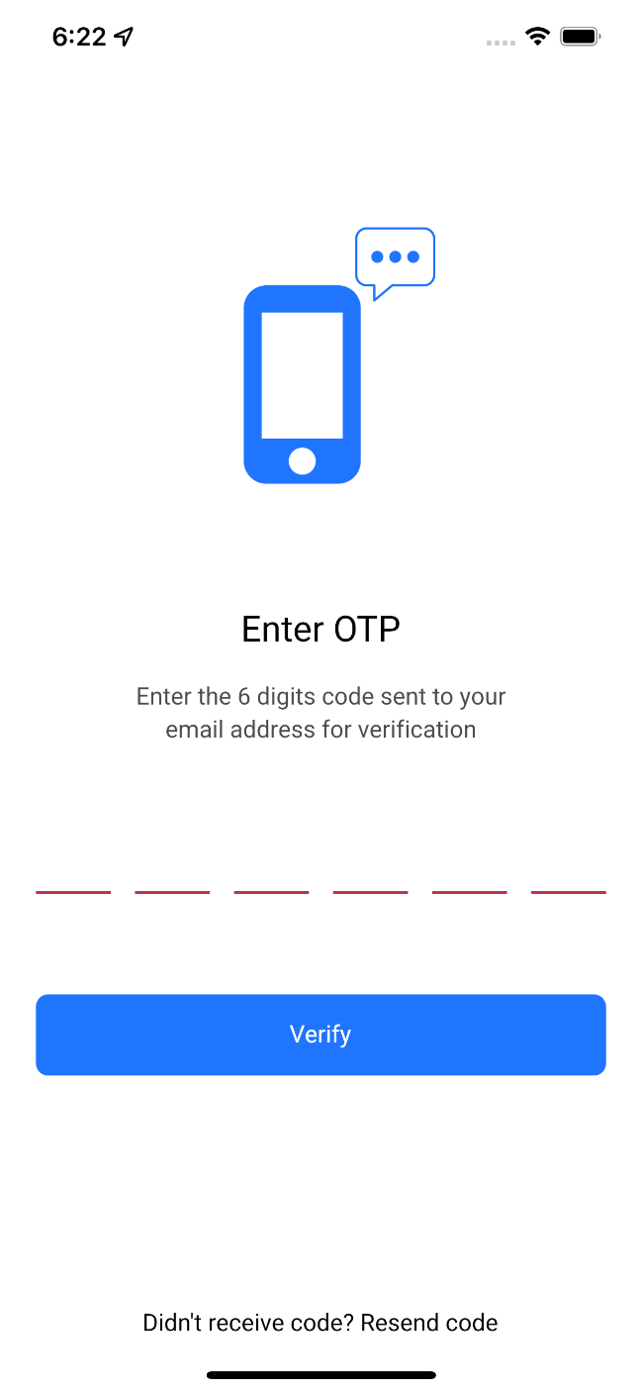
4th Page OTP: If new user register send the otp on email . In this give a mail id and you get otp on mail.

Slide 7
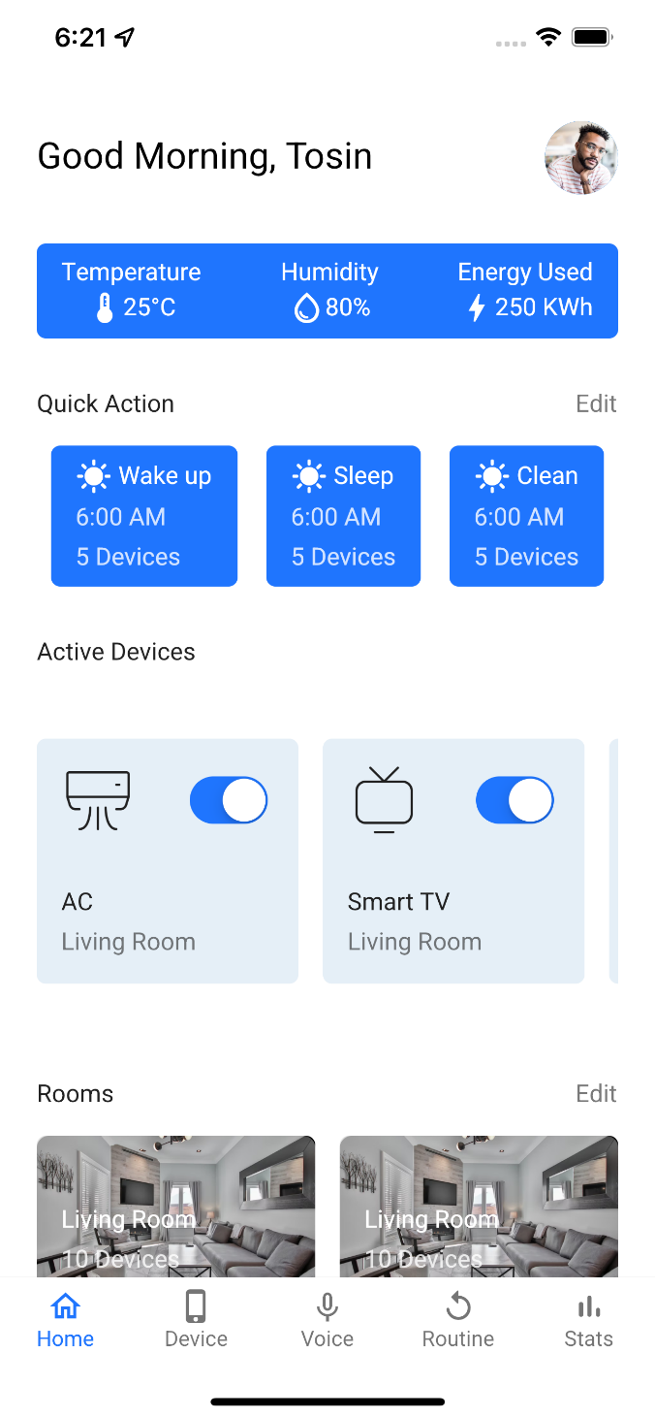
5th Page Mqtt Connection: Connect Mqtt with W10 (wifi module). To connect we need mqtt_client, we give host, topic, client, port. If all the detail is correct and the mqtt broker is working correctly then you can go to next page if not correct it not open the next page. Home Page: In this page we can see the - 1. total energy used 2. routine/quick action 3. how many switches are already ON 4. and total number of rooms

Slide 8
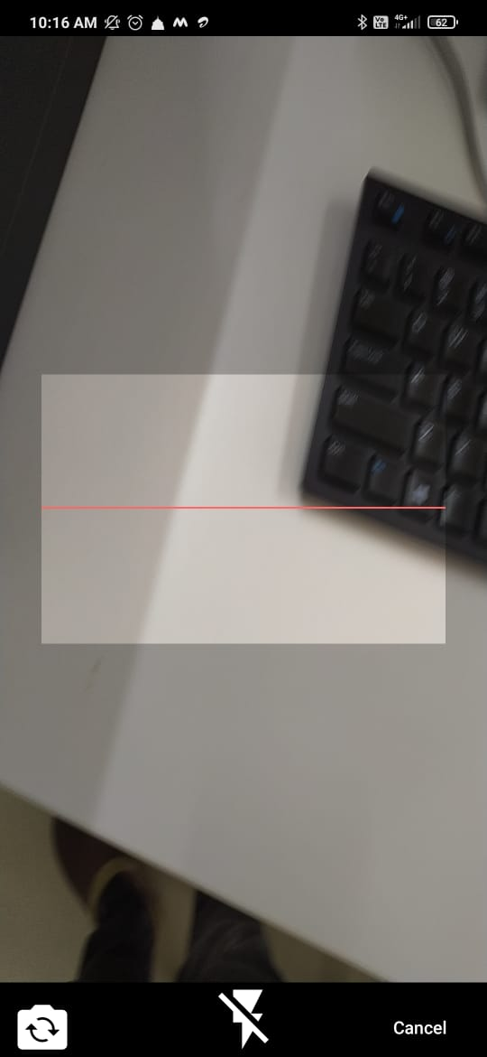
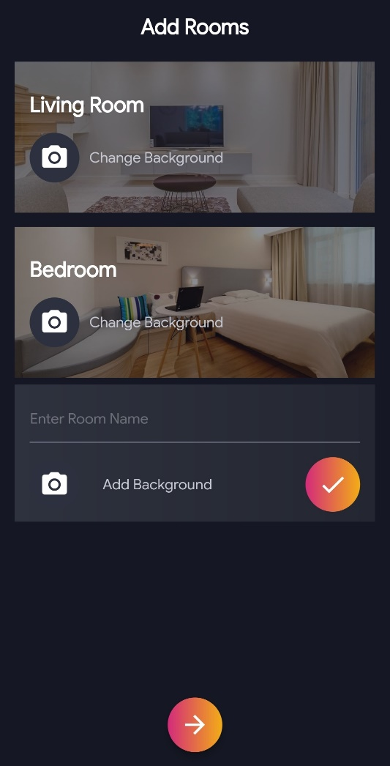
6th Page Scan Add Device: Once we connected to Mqtt then we add mac-address. If we want to add mac-address(Add Room) in this page we can add.

Slide 9
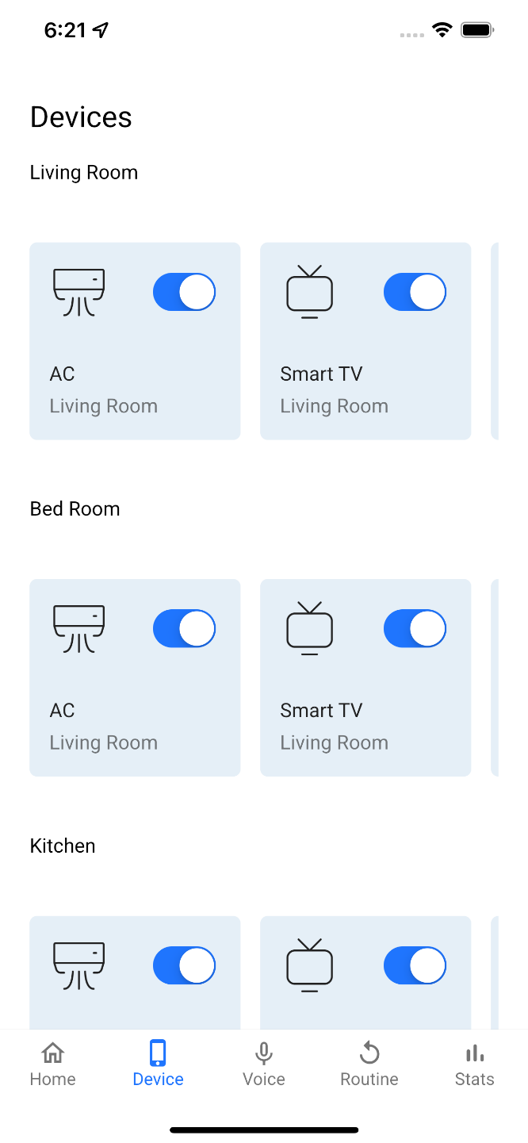
7th Page List of Mac-Address(Rooms): In each room there only four switch. In this page we can see the list of mac-address. Mac-address is listed in this if we select the mac address then we can see the number of switch's to control.

Slide 10
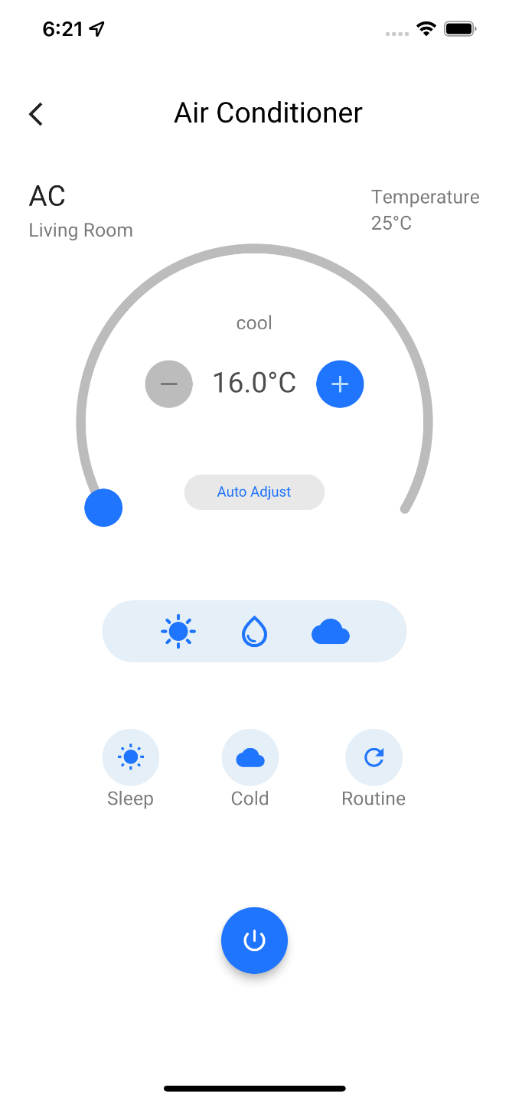
8th Page Switches: Here in mac-address(Room) click we see the four button to turn ON/OFF the devices. In this page we publish the message ON/OFF or control to board with the help of mqtt. Once we off or on then the state has to be same, for that we have to use database.

Slide 11
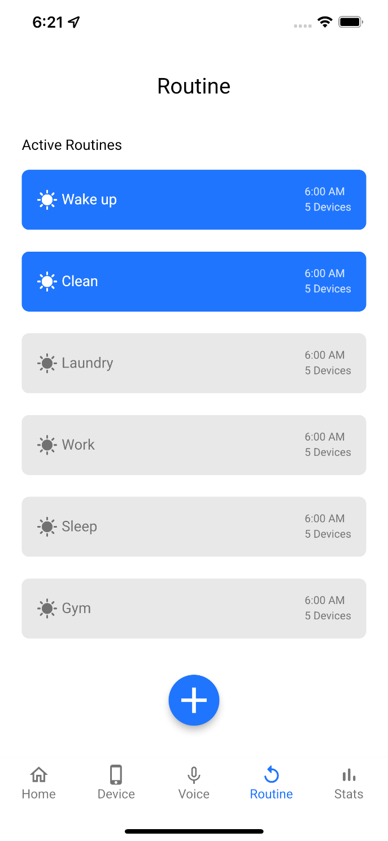
9th Page Schedules: In this page we can schedules to control automatic when we want to turn on/off. Here we can schedule use of start time and end time, days.

Slide 12
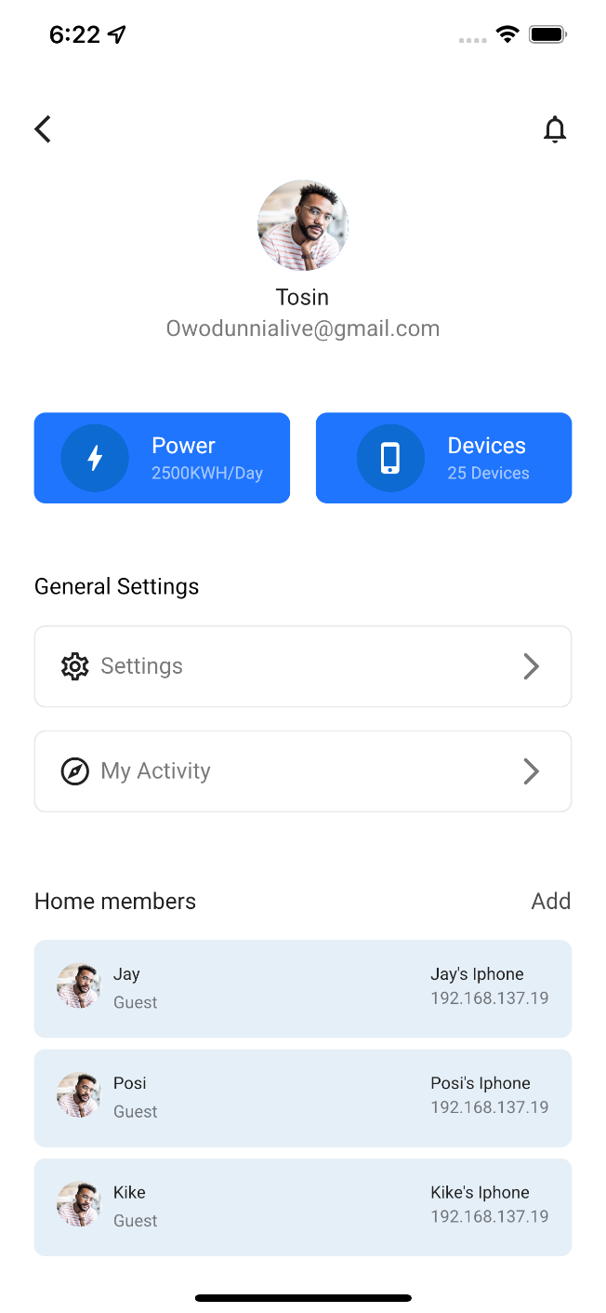
10th Page Logout and edit in device: In this page we create logout option and device edit option, And we can see total power consumption and total device connected

