Slide 1
PHYTEC Embedded Pvt Ltd
EVC and EV Specifications
And
Feasibility from PHYTEC

Slide 2
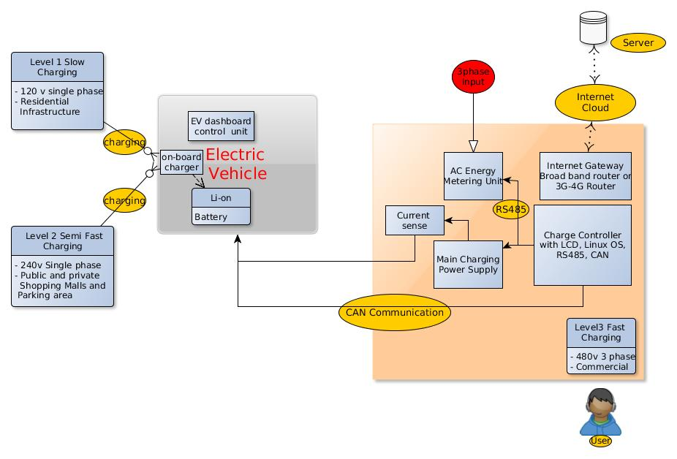
EV Charging Eco System

Slide 3
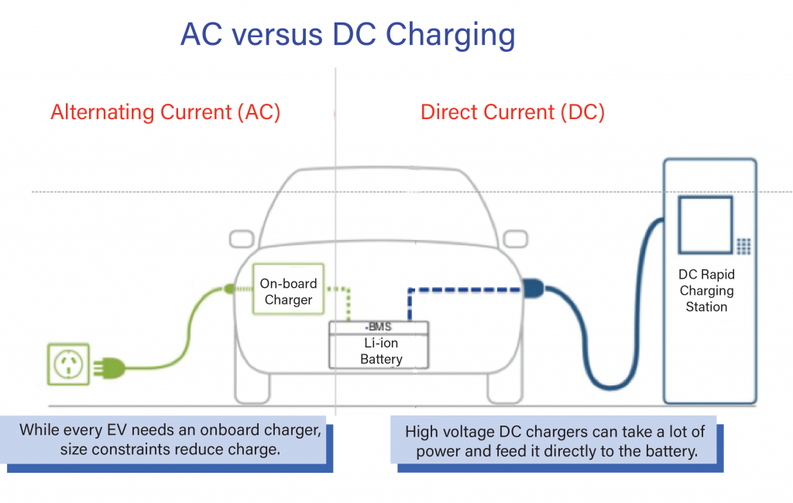
EV Charging Eco System

Slide 4
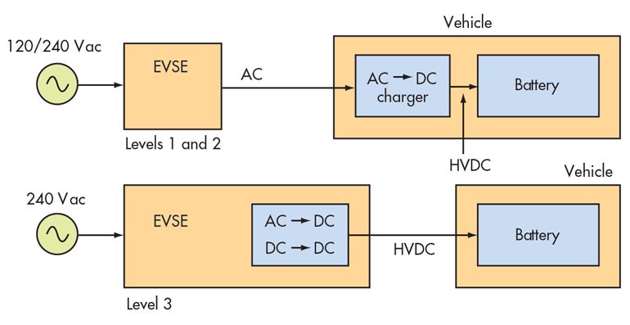
Use cases in electric vehicle charging
AC On-board Charging
Home
6 – 8 hours(over night)
DC Fast Charging
Commercial, Offices and Petrol koisks
15-30 mins/30-60min

Slide 5
Electric Vehicle Charging Infrastructure
 | AC Charging Home, Fleet, Public use |  | DC Fast Charging Public and Large Fleet Use
Type | Level 1 | Level 2 | Level 3
Power | 120v, 1.4kw @12 amp 120v, 1.9kw @16amp | 240v, up to 19.2 kw (80 amp) | 200-500v up to 40kw (80 amp) | 200-500v up to 100kw (200 amp)
Charge Time (Miles of range Per hour of charge) | 3 to 5 miles | 3.3kw – 10 to 14 miles 6.6kw – 20 to 25 miles 9.6kw-40 to 45 miles 19.2kw- up to 60 miles | 40kw – up to 120 miles | 100kw- up to 300 miles

Slide 6


