Slide 1
QWEN CLOUD • TRACK 1 - MEMORYAGENT
OPEN SOURCE • APACHE-2.0
Latch remembers
what must happen.
MementoVM turns future commitments into typed, versioned programs that act once - and forget on purpose.

Slide 2
History is not a plan for the future
Vector memory Retrieves what happened. Similarity can surface stale plans, but it does not encode inhibitors, deadlines, approval policy, or an exactly-once lifecycle.
Prospective memory Compiles what must happen. Typed cues can be revised, inhibited, deferred, approved, executed once, and removed from hot memory after their purpose is complete.
The gap is a control problem - not a retrieval problem.

Slide 3
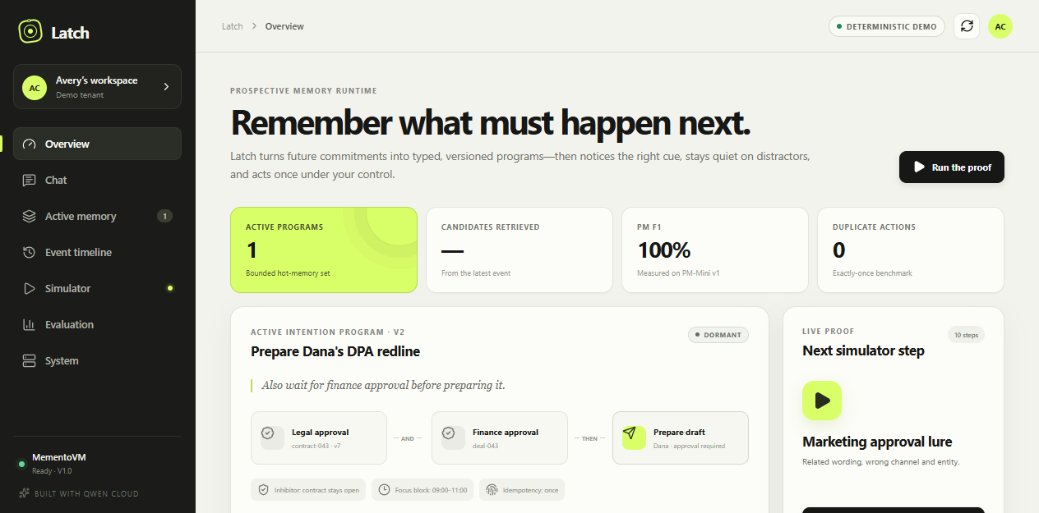
Intent becomes a durable program
Type intent. Inspect every decision. Qwen compiles natural language into an Intention Program. The Memory Debugger exposes versions, predicates, rejected distractors, approval state, and the exact evidence behind action or non-action.

Slide 4
A deterministic runtime surrounds Qwen
01
Chat + events
02
Qwen compiler
03
Schema + policy
04
PostgreSQL
One normalized contract for users, connectors, and simulator.
Structured JSON only; thinking disabled; one repair pass.
Types, tools, risk, and approval rules validated locally.
Versioned programs, cue indexes, jobs, approvals, and audit.
05
Exact cue router
06
Worker + clock
07
Approval + executor
08
Alibaba OSS
Channel, event type, entity, validity, and inhibitor first.
Time and absence monitoring with deterministic demo time.
Action hash, expiry, atomic claim, idempotency key.
Private replay bundles and deployment proof artifacts.

Slide 5
Safety is a database invariant, not a prompt
Typed, immutable programs
Exact before semantic
Every material revision creates a complete version; the prior version is superseded and removed from hot retrieval.
Hard IDs, validity, and inhibitors resolve locally. Only bounded ambiguity is eligible for Qwen adjudication.
Approval bound to one action
Exactly once under retries
External writes require a human decision tied to the version, action hash, and a 30-minute expiry.
A database claim and unique idempotency key suppress duplicate webhooks, clicks, workers, and tool retries.

Slide 6
MementoVM reaches 1.00 PM F1 on PM-Mini
60
original deterministic scenarios across exact cues, lures, stale state, inhibitors, absence, and cancellation.
0
false alarms, misses, and duplicate actions for MementoVM on PM-Mini v1.
10/10
complete judge-scenario runs passed against the live local container stack.
Synthetic release dataset; results characterize PM-Mini v1, not general production performance.

Slide 7
LATCH / MEMENTOVM
Prospective memory is the
missing control plane.
github.com/1aifanatic/mementovm
60-case benchmark • deterministic simulator
Qwen Cloud • Alibaba Cloud deployment profile

