Slide 1
Capstone Project – 1 Airbnb Booking Analysis By – Aishwarye Gangwar

Slide 2
Content
About Airbnb
Data summary
Problems in Data set
Data cleaning
Information about hosts and neighbourhood
Prediction on the bases of our Data set
Busiest host of entire Data set
Traffic across the area and reasons
Most preferable properties
Properties availabilities
Airbnb across the whole neighbourhood
Building a correlational graph
Conclusion

Slide 3
About Airbnb
Airbnb is an American company that operates an online marketplace for lodging, primarily homestays for vacation rentals, and tourism activities. Based in San Francisco, California, the platform is accessible via website and mobile app. Airbnb does not own any of the listed properties; instead, it profits by receiving commission from each booking. The company was founded in 2008 by Brian Chesky, Nathan Blecharczyk, and Joe Gebbia. Airbnb is a shortened version of its original name, AirBedandBreakfast.com.

Slide 4
Data summary
df Airbnb = In our data set, we have 16 columns and 48895 rows.
Columns
[id] = Every Airbnb has a unique number that unique number is defined as an id in this data frame.
[name] = this column have Airbnb property names.
[host id] = Every host can be identified by a unique id that id is represented as the host id.
[host name] = this column have host’s name .
[neighbourhood group] = this column has a whole city included.
[neighbourhood] = this column has a local area around the property.
[availability_365] = how many days each Airbnb is open, represented through this column.

Slide 5
Data summary
[latitude] = the angular distance of an Airbnb north or south of the earth's equator, or of the equator of a celestial object.
[longitude]= the angular distance of an Airbnb east or west of the Greenwich meridian, or west of the standard meridian of a celestial object.
[room type] = every Airbnb has a different type of room that is described in this column.
[price] = this column has the prices of every Airbnb.
[minimum nights] = when a person arrives at any Airbnb he spent how many minimum nights there are represented in this column.
[number of reviews] = how many reviews any Airbnb received to date.
[last review] = it defines a date when Airbnb received the last review.
[reviews per month] = how many reviews per month Airbnb received.
[calculated host listing count] = this column represent the number of hosts has been listed on the property.

Slide 6
Problems in Data set
There are not many problems are there in our data frame. we have very few null values in the name and host name columns .but on the other side we have a large number of null values in a column last review and reviews number per month.
In the price column there are a few 0 values and that can not be possible because there is no Airbnb for free. so this is some kind of data entry problem

Slide 7
Data cleaning
As there are a few columns that we don’t need to have in our data frame so we leave them and just took those columns which we need to have for our further data analysis.
So as we discussed earlier in our previous slide that there are a few 0 in price columns and we need to correct that cause there are no free rooms at Airbnb, we can replace the 0 values on the price column with the median of the rest of the non-zero values in the columns. so with this step we’ll eliminate the zero values from price columns

Slide 8
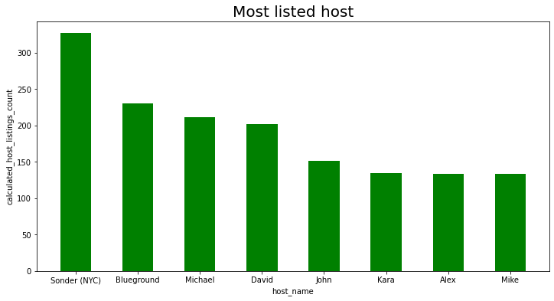
Information about hosts and areas
From our analysis we found out that the Most listed host of our data frame is Sonder(NYC) after that there is Blueground which has the second highest listed on the Airbnb data frame.
Interestingly both of them have been hosting in Manhattan
Manhattan has the most number of hosting that’s why whoever hosting in Manhattan will have more listed Airbnb.

Slide 9
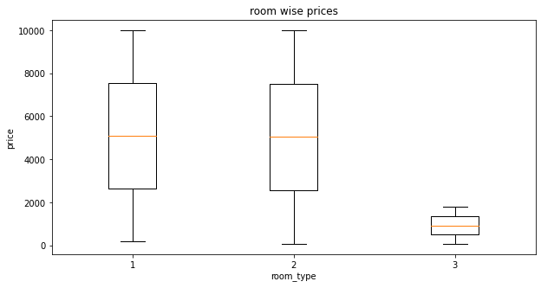
Prediction on the bases of our Data set
Firstly we work with the prices column.
Here we found out that there are a few 0 values so we have to replace them with the median of the rest of the values.
So then we analysis that most of the high prices are of a private room and entire apartment cause most of the people wants to stay in private rooms and the entire home

Slide 10
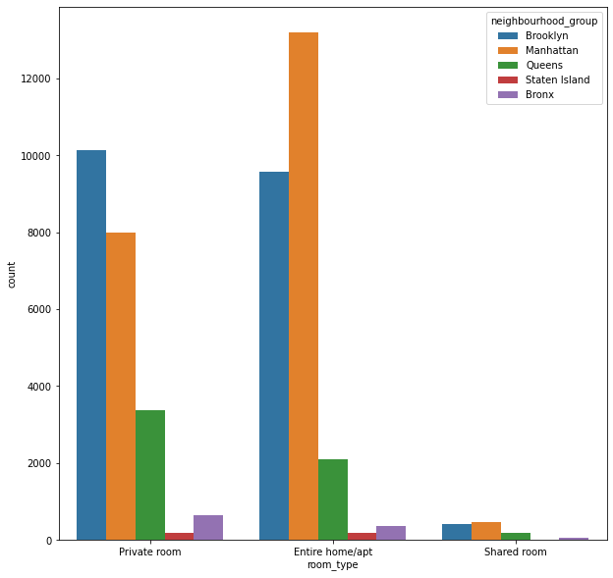
Prediction on the bases of our Data set

Slide 11
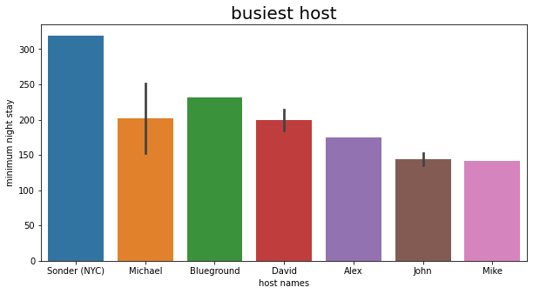
Busiest host
Whichever host has the highest minimum night stay in their Airbnb he or she will be the busiest host cause there’ll be so much work to do in every day.
According to our analysis we found out that sonder(NYC) has the highest minimum night stay and after that Michael has the second busiest host

Slide 12
Traffic across the area and reasons
In this context traffic is defined as how many people are going to that place to stay on Airbnb. We can say that busiest area across the whole data set.
According to our analysis, we found out that Manhattan is having the most traffic across the whole data set. cause Manhattan has most 1250 minimum night stay.
On the second, we have Brooklyn and Brooklyn have a 999 minimum night stay.

Slide 13
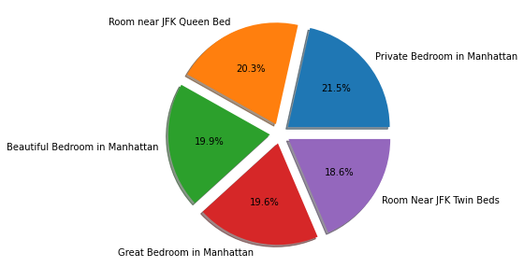
Most preferable properties
We can easily predict the most likable properties by counting the number of reviews and properties gets.
So according to our analysis, we found out that a private bedroom in Manhattan has the most reviews so this Airbnb is the most preferable .and other preferable properties are defined in a pie chart.

Slide 14
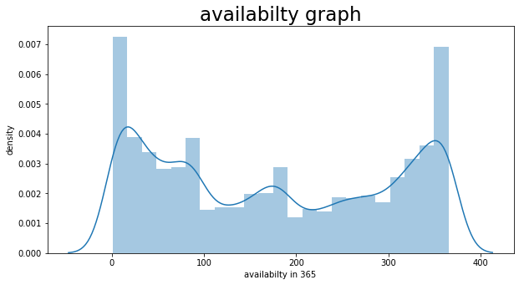
Properties availabilities
various properties are not available throughout the year so in this analysis, we found out the availabilities of every Airbnb.
So we set a mark of 200 days to watch how many properties are available for more than 200 days.
According to our analysis we found out that 42.62 % of properties are only available for more than 200 days.
So the rest 57.38% of properties are not available for more than 200 days.

Slide 15
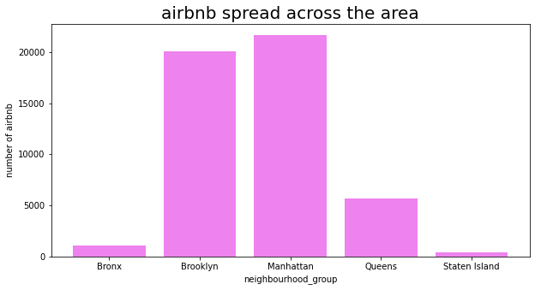
Airbnb across whole neighbourhood
In this analysis we tried to find out how many Airbnb are there in each neighborhood group.
According to our analysis, we found out that Manhattan has the most number of Airbnb and Brooklyn has the second most number of Airbnb.
Staten Island and the Bronx have the least amount of Airbnb.

Slide 16
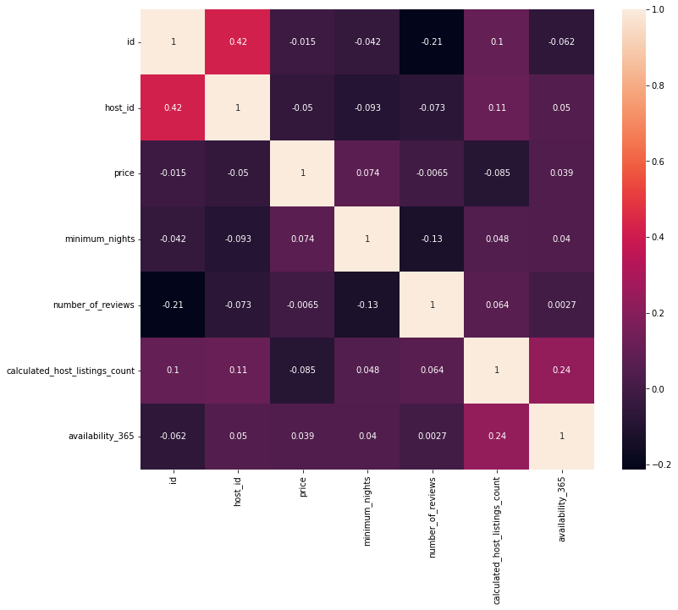
Building a correlational graph
Here we are using a heatmap for defining the correlation between various values.
We can find various relations with every aspect of the data frame.
Some of them are heavily correlated and some of them are mutually apart from each other.

Slide 17
Conclusion
So according to our analysis we found out various of point some of them are listed below
We found out that Sonder(NYC) is the most number of listed hosts among the whole data set.
The Most listed neighborhoods in Manhattan and Brooklyn
Prices of private rooms and entire apartments are on the higher side, cause these kinds of room types are preferred by most people.
Busies host are Sonder(NYC),Blueground and Michael.

Slide 18
Conclusion
5. Most people want to visit Manhattan and Brooklyn cause of that these neighborhoods have the highest amount of traffic.
6. The Most preferable property of this data set is ‘a private bedroom in Manhattan.
7. Only 42.64 % of properties are available for more than 200 days.
8. Manhattan has the most number of Airbnb.

