Slide 1
Data-driven learning W4 L2: associations between variables
Jonas Moons
All images are either own work, public domain, CC-licensed or fair use
Credits on last slide

Slide 2



Check-in

Slide 3
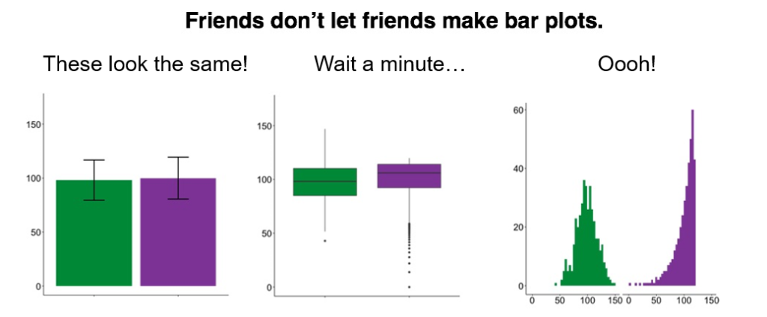
Time for some nerdy humor…
Blog

Slide 4
Bar graphs
Blog

Slide 5
Topics
Terminology
Exploring 1 or 2 qualitative variables
Exploring relation between qualitative & quantitative variables
Hypothesis testing
Correlation

Slide 6
Population and sample
Population is the group of individuals (people, companies) that are the topic of the research
Not always clearly defined
Sample: part of population included in research
Random sampling often preferable (often not possible)
Sample bias: bias due to non-random sampling

Slide 7
Notation
Measure | Sample statistic | Population parameter
Mean |  | μ
Standard deviation | s | σ
Variance | s² | σ²
Size | n | N

Slide 8
Level of measurement
 |  |  | Ratio
 |  | Interval | true zero point
 | Ordinal | equal difference | equal difference
Nominal | ranking | ranking | ranking
distinction | distinction | distinction | distinction
gender | opinion | temperature | age
categorical numerical
qualitative quantitative

Slide 9
Quiz
Heart rate
School grade (1-10)
Hair color

Slide 10
Quiz
Heart rate = ratio
School grade (1-10) = ordinal
Hair color = nominal

Slide 11
Independent and dependent variables
A dependent (Y) variable is studied for changes when the independent (X) variable(s) changes
Example:
independent variables: boredom, age
dependent: social media use
Correlation is not causation! Ice cream sales and drownings are correlated, but ice cream sales don’t cause drownings
Target (Y) and predictor (X) are used more in the machine learning world

Slide 12
Topics
Terminology
Exploring 1 or 2 qualitative variables
Exploring relation between qualitative & quantitative variables
Hypothesis testing
Correlation

Slide 13
Bar charts

Slide 14
Crosstables
 | Gender
Region | Male | Female | Total
Central | 48% | 11% | 37%
North | 33% | 56% | 40%
South | 19% | 33% | 23%
Total | 100% | 100% | 100%
 | Gender
Region | Male | Female | Total
Central | 10 | 1 | 11
North | 7 | 5 | 12
South | 4 | 3 | 7
Total | 21 | 9 | 30
Column percentages: distribution of men/women over regions
 | Gender
Region | Male | Female | Total
Central | 91% | 9% | 100%
North | 58% | 42% | 100%
South | 57% | 43% | 100%
Total | 70% | 30% | 100%
Row percentages: ratio of men/women per region

Slide 15
Exercise 1: exploring qualitative variables
Resources for this exercise:
(Cross)tables in Pandas
Categorical plots in Pandas (scroll down to bar plot)
Choose one of the qualitative variables in the class data set as your independent variable, and a dependent qualitative variable.
Using Seaborn and Pandas, make:
A table with frequencies of your independent variable
A suitable graph of your independent variable
A crosstable with column percentages
A simple bar graph (not stacked) of the relation between the variables
What is your conclusion about the relation between the variables?

Slide 16
Topics
Terminology
Exploring 1 or 2 qualitative variables
Exploring relation between qualitative & quantitative variables
Hypothesis testing
Correlation

Slide 17
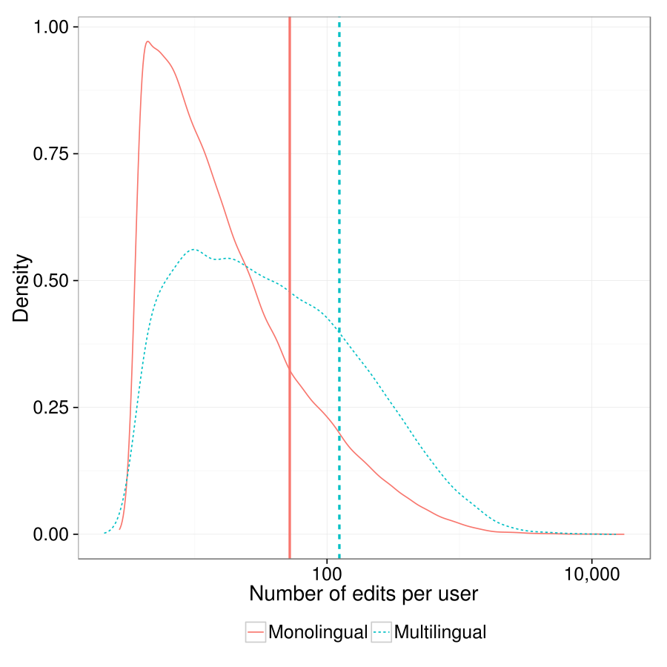
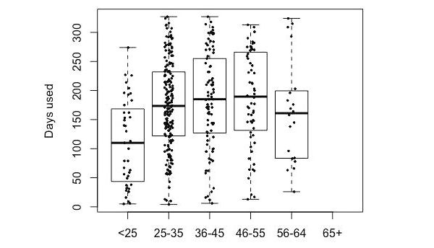
Distributional graphs
There is no example for this topic, but see this documentation for when you work on Assignment 1
Multiple density plots and medians
(note the logarithmic scale!)
Boxplot (with actual data superimposed)

Slide 18
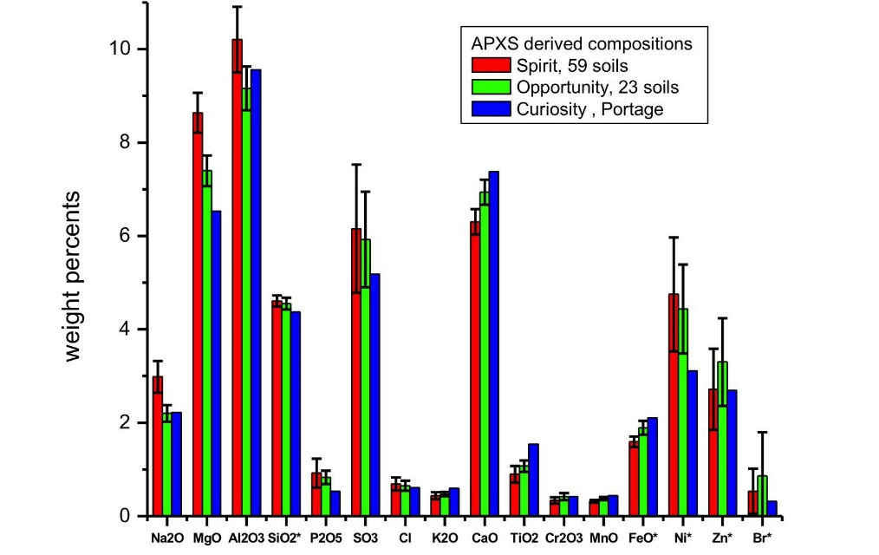
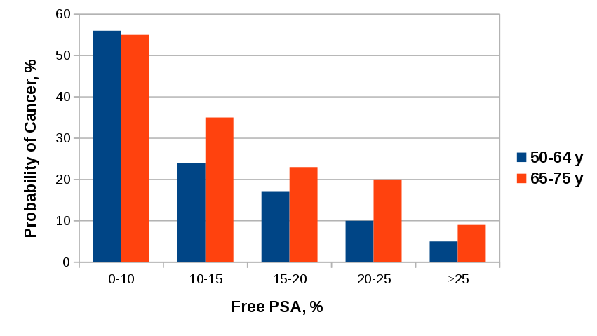
Bar graphs (summary data)
Without error bars (population data)
With error bars (sample data)

Slide 19
Bar graphs
Blog

Slide 20
Topics
Terminology
Exploring 1 or 2 qualitative variables
Exploring relation between qualitative & quantitative variables
Hypothesis testing
Correlation

Slide 21
Hypothesis testing
Research question: ‘Are paid apps rated higher than free apps?’
How to separate ‘real effects’ from sampling ‘noise’? Significance testing provides one answer
Hypotheses are always about the population. You already know the answer for the sample!
You start with the null hypothesis of no difference / no effect, and calculate a p-value (more on that later)
Hypothesis testing can be done in many statistical contexts

Slide 22



Hypothesis testing is like a court case…
Collect evidence
Presume innocence
Not enough evidence
(Not the same as not guilty)
A lot of evidence: guilty!

Slide 23
Hypothesis testing
Collect evidence in sample
→ calculate p-value
Presume no effect/difference
Not enough evidence for effect/difference
(Not the same as no effect/difference)
Lots of evidence: significant result
Difference/effect in population

Slide 24
Hypotheses
Null hypothesis and alternative hypothesis
H₀: µ_{paid_apps} = µ_{free_apps}
H₁: µ_{paid_apps} ≠ µ_{free_apps} (inverse of H₀)
(µ: mean in population)
Enough evidence against H₀ → reject H₀ and accept H₁
Not enough evidence against H₀ → keep H₀ (for the time being)

Slide 25
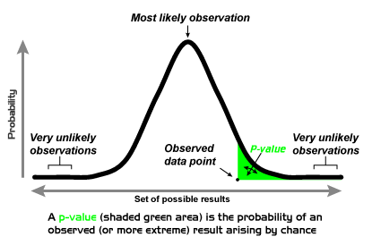
Now the tricky part… p-value
p is not the probability that there is a difference
p is the proportion of hypothetical samples more extreme than what you found, given H₀ (that there is no difference)
If p is too small (usually <0.05), you say: ‘Wow, that’s way too weird (wo)man! I don’t believe this really happened. H₀ must be false.’

Slide 26
T-test
A t-test is a significance test of a mean difference between groups (or between different measurements within people)
Distribution has to be normal (generally when N > 30)
Result: t(30) = 5.21, p = 0.012
Degrees of freedom: closely related to sample size
T-statistic: how big is the difference, compared to the variation within the groups?
P-value
0.012 < 0.05, so significant!

Slide 27
Exercise 2: t-test
See example Notebook: Hypothesis testing
Perform a t-test with:
Independent variable: factor with two levels (gender, OS phone)
Dependent variable: quantitative variable of your choice
Report:
Make a plot of the relation showing the distribution for the two levels (e.g., histogram, violin plot, etc.)
The t-statistic
The p-value
Whether there is a significant relation

Slide 28
Controversy
Seems kind of complicated, right?
You really want to know if there’s a difference, but instead you’re looking for evidence against the absence of a difference
P-values are controversial (possible solution: Bayesian statistics)

Slide 29
Topics
Terminology
Exploring 1 or 2 qualitative variables
Exploring relation between qualitative & quantitative variables
Hypothesis testing
Correlation

Slide 30
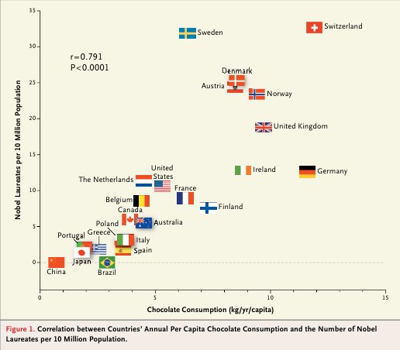
Relation between two quantitative variables: scatterplot
Does chocolate consumption really boost Nobel Award chances?
Maurage, Heeren, & Pesenti (2013)

Slide 31
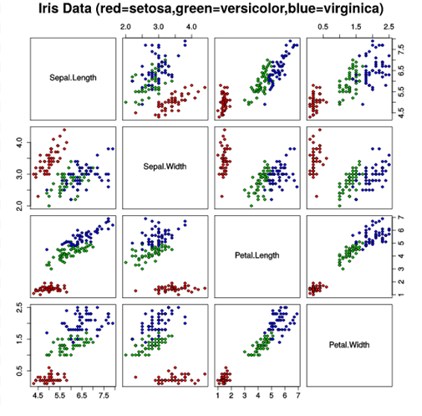
Scatterplot matrix

Slide 32
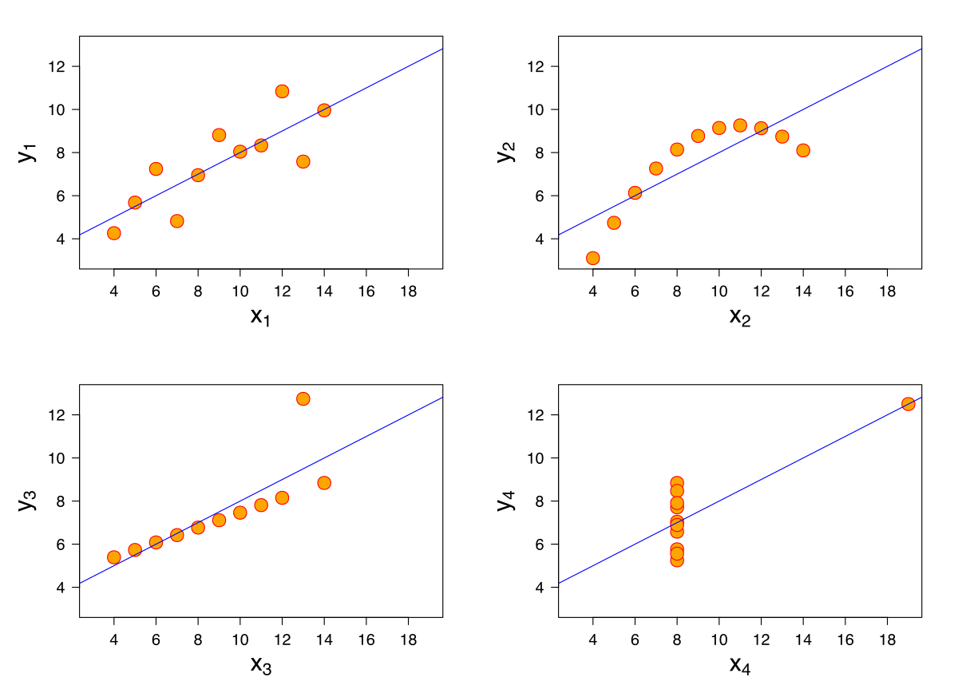
Anscombe’s quartet
All these data sets have the same mean, variance & correlation
Always visualize your data!

Slide 33
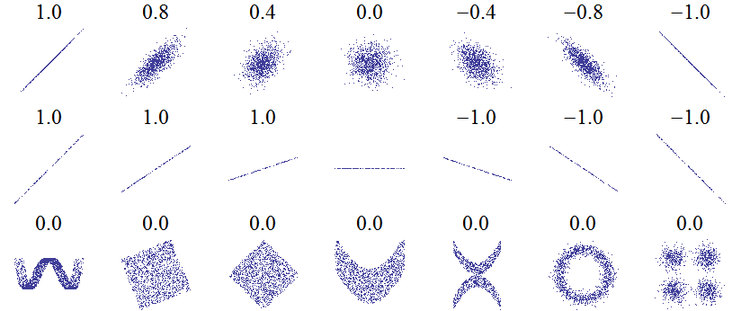
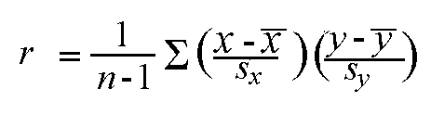
Correlation: Pearson’s r
Linear relations
Linear relations (perfect correlation)
Non-linear relations
r gives a measure of how much two quantative variables ‘move together’
Correlation is normalized. The variation in the X and Y values is ‘cancelled out’, so that the result is always between -1 and 1

Slide 34
Strength
Weak 0.1 < r < 0.3
Moderate 0.3 < r < 0.6
Strong > 0.6
Interpreation depends on context. Most correlations in social science are weak

Slide 35
Exercise 3: correlations
Resources:
Scatterplot matrix in Seaborn
Scatterplot in Seaborn
Correlation in Python
Choose three quantitative variables in the class data set that you expect are correlated
Remember that you can select columns in Pandas by using:
df_subset = df[[‘col_name1’, ‘col_name2’, ‘col_name3’]]
Using Seaborn and Pandas, make:
A scatterplot matrix
A scatterplot of one combination of variables (think about which variable is most suited for x – the independent variable)
Comment on the linearity of the relationship.
Calculate Pearson’s r for this combination
What is your conclusion about the relation between the variables?

Slide 36
Image credit
Nobel Prize and Chocolate by Maurage et al. (fair use)
Scatterplot matrix by Nicoguaro (CC-BY)
Anscombe’s quartet by Schutz (CC-BY-SA)
p-value by Repapetilto (CC-BY-SA)
Mars Curiosity by NASA (PD)
Bar bar plots by Page Piccinini (fair use)
Free PSA bar graph by The RedBurn (CC-BY-SA)
Edit count by Computermacgyver (CC-BY-SA)
Level of measurement by Johan van Berkel (HU)
Gavel by StockMonkeys.com (CC-BY)
Fingerprint by Pixabay.com (PD)

