Slide 1
Data-driven learning W5 L2: Evaluation of linear regression Overfitting and model validation Multiple linear regression
Jonas Moons

Slide 2



Check-in

Slide 3
Decision on assignments
Logistic regression will be cut from the program and from Assignment 1
On Monday, we will start with machine learning
I will cut down Assigment 2 somewhat
In the winter break, I will have a look at the remaining assignments to clarify things
From that point on, the Assignments will remain fixed; of course, help remains available

Slide 4
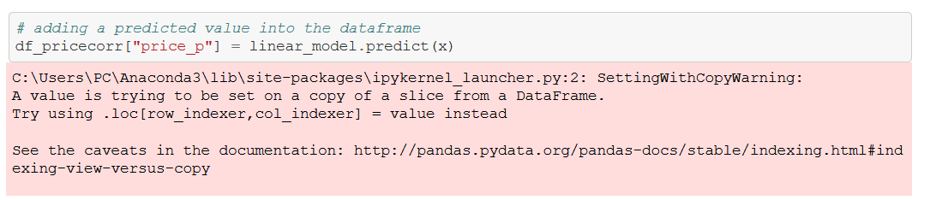
Feedback
Well done!
I made a mistake swapping b₀ and b₁ around, which is why the formula looked weird
predict(x) uses x values, can be single value or array, old or new values. E.g.
predict(70) = 270000 euros
predict([70, 50]) = [270000, 200000]
This warning can be safely ignored, or set this: pd.options.mode.chained_assignment = None

Slide 5
Topics
Evaluation of simple linear regression
Overfitting and model validation
Multiple linear regression

Slide 6
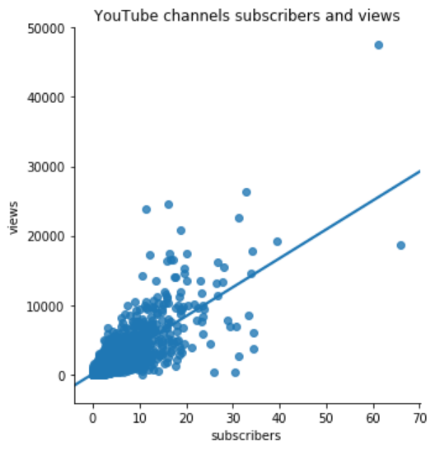

Recap
e ≈ -27,000M
$$Y=b_{0}{+ b}_{1}X+e$$
e ≈ 10,000M
Y = dependent variable: views
X = independent variable: subscribers
Coefficients (constant):
b₀ = intercept: how many views with no subscribers = 46
b₁ = slope: views per subscriber = 416.7
e = error / residual: what’s left over, what we can’t explain
The algorithm that finds the line minimizes the squared errors

Slide 7

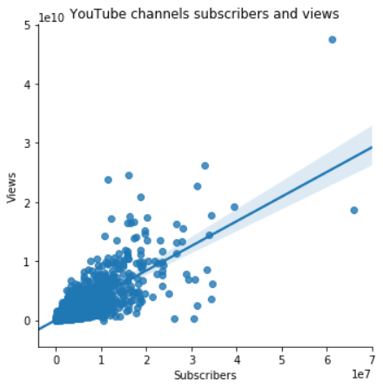

Assumptions of simple linear regression
Linearity (the points are around a straight line, not on a curved line)
Equal variance (the distance between the points and the line does not change very much)
Residuals are normally distributed (ignore this one for now)

Slide 8
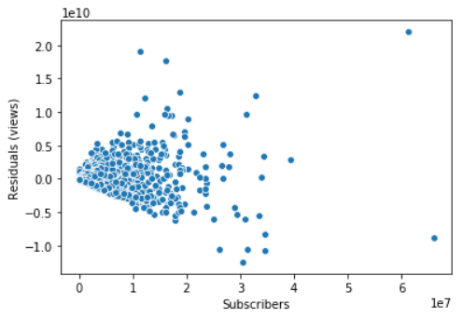
Inspect residuals/errors
Linear model
This means our predictions are poor for high numbers of subscribers!
Residuals (distance from the line)

Slide 9
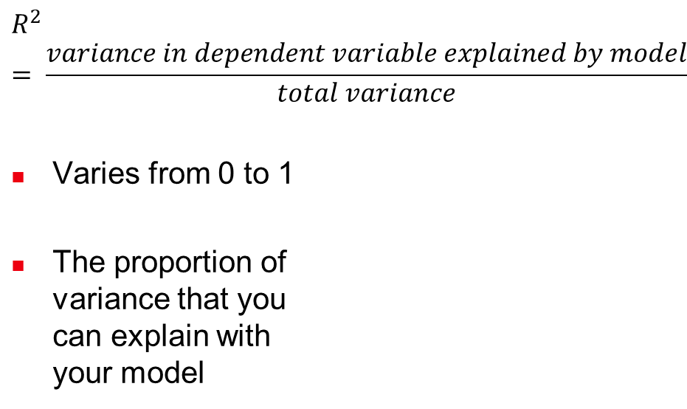
Model fit: R²
$$R^{2}= \frac{variance in dependent variable explained by model}{total variance}$$
Varies from 0 to 1
The proportion of variance that you can explain with your model
R² =0.62
The variation we can explain: 62%
All the variation that
exists in YouTube views (some have many views, some very little)

Slide 10
Model fit: RMSE
Root Mean Squared Error
Take the mean of all the squared errors/residuals (all the ‘sticks’)
Then take the root (√) of that
≈ “How much is your prediction typically off”
e ≈ 10,000M

Slide 11
Exercise 1: model evaluation
Continue in the Notebook with the regression from Exercise 3 from the last lesson. We are going to evaluate the fit of the model, with:
X: surface area in m²
Y: price in euros
Calculate the residuals (e) and add them to the dataframe
Make the following plots:
A scatter plot of (Y, Y’) (Y’ means predicted Y)
A scatter plot of (X, e)
What is your conclusion about the fit? Which houses are predicted better? Cheap or expensive house?
What is the R² of the model?
What is the root mean squared error (RMSE)?

Slide 12
Topics
Evaluation of simple linear regression
Overfitting and model validation
Multiple linear regression

Slide 13
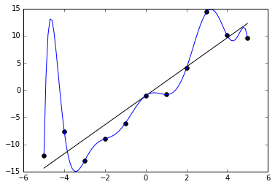
Overfitting

Slide 14
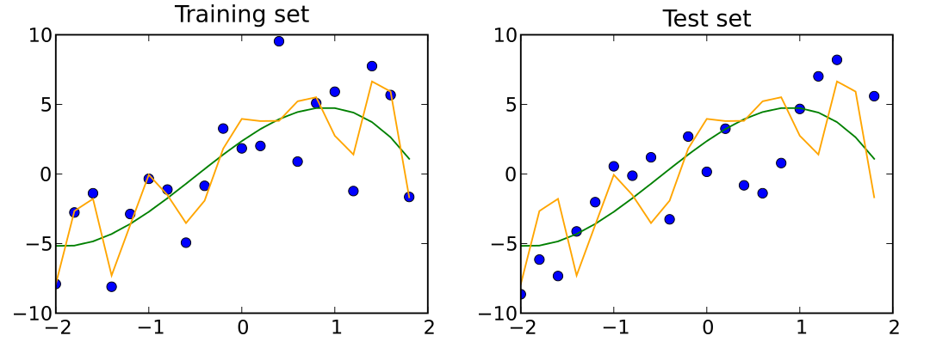
Training and test set
Two models trained on the training data set
Simple model in green
Complex model in orange
The test set is used only to test the data (not to calculate the coefficients / train the model).
The orange model overfits: it fits the training set ‘too well’

Slide 15
Training and test set
Usually in machine learning, we split the data at the beginning into a training (70-80%) and test set (20-30%)
We train the model on the training set
Then, using the model coefficients from the training set, we report performance on the test set
So, in linear regression, we take the line we found with the train data and plot the test data around it

Slide 16
Topics
Evaluation of simple linear regression
Overfitting and model validation
Multiple linear regression

Slide 17

Equation
$$Y=b_{0}{+ b}_{1}X_{1}+{ b}_{2}X_{2}+…+e$$
For instance:
$$wage=2+0.3 ∙ age+0.2∙years_experience+…+e$$

Slide 18
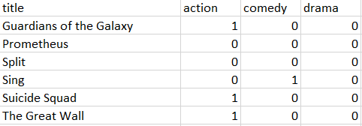
Qualitative variables
Linear regression and other algorithms only accept quantitative variables. So how can we use qualitative variables?
By creating so-called ‘dummy variables’. Pandas can create them automically with pd.get_dummies()

Slide 19
Exercise 2
Use the Notebook multiple_linear_regression
Create a dataframe with 3 variables of your choice from the Funda data set as your independent variables (X). Note: it does not work very well to choose columns that are highly correlated, such as rooms and bedrooms.
Split the data into a test set and a train set
Evaluate model performance by calculating R² and RMSE on the test set
Make a plot of the predicted price vs. the actual price. Which prices are predicted well?

