Slide 1
Data-driven learning W4 L2: associations between variables
Jonas Moons

Slide 2
To do: plaatjes vervangen door openbare

Slide 3
Topics
Exploring 1 or 2 qualitative variables
Exploring relation between qualitative & quantitative variables
Correlation
Hypothesis testing

Slide 4
Level of measurement

Slide 5
Independent and dependent variables
A dependent (Y) variable is studied for changes when the independent (X) variable(s) changes
Example:
independent variables: boredom, age
dependent: social media use
Correlation is not causation! Ice cream sales and drownings are correlated, but ice cream sales don’t cause drownings
Target (Y) and predictor (X) are used more in the machine learning world

Slide 6
Graph types (qualitative data)

Slide 7
Tips for graphs

Slide 8
Crosstables

Slide 9
Exercise 1: exploring qualitative variables
Choose one of the qualitative variables in the class data set as your independent variable, and a dependent qualitative variable
Using Seaborn and Pandas, make:
A table with frequencies of your independent variable
A suitable graph of your independent variable
A crosstable with column percentages
A suitable graph of the relation between the variables
What is your conclusion about the relation between the variables?

Slide 10
Topics
Exploring 1 or 2 qualitative variables
Exploring relation between qualitative & quantitative variables
Correlation
Hypothesis testing

Slide 11
Graph types

Slide 12
Topics
Exploring 1 or 2 qualitative variables
Exploring relation between qualitative & quantitative variables
Correlation
Hypothesis testing

Slide 13
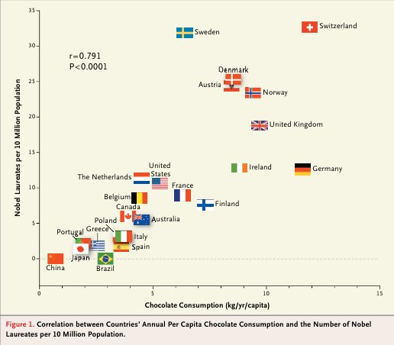
Relation between two quantitative variables: scatterplot
Does chocolate consumption really boost Nobel Award chances?
Maurage, Heeren, & Pesenti (2013)

Slide 14
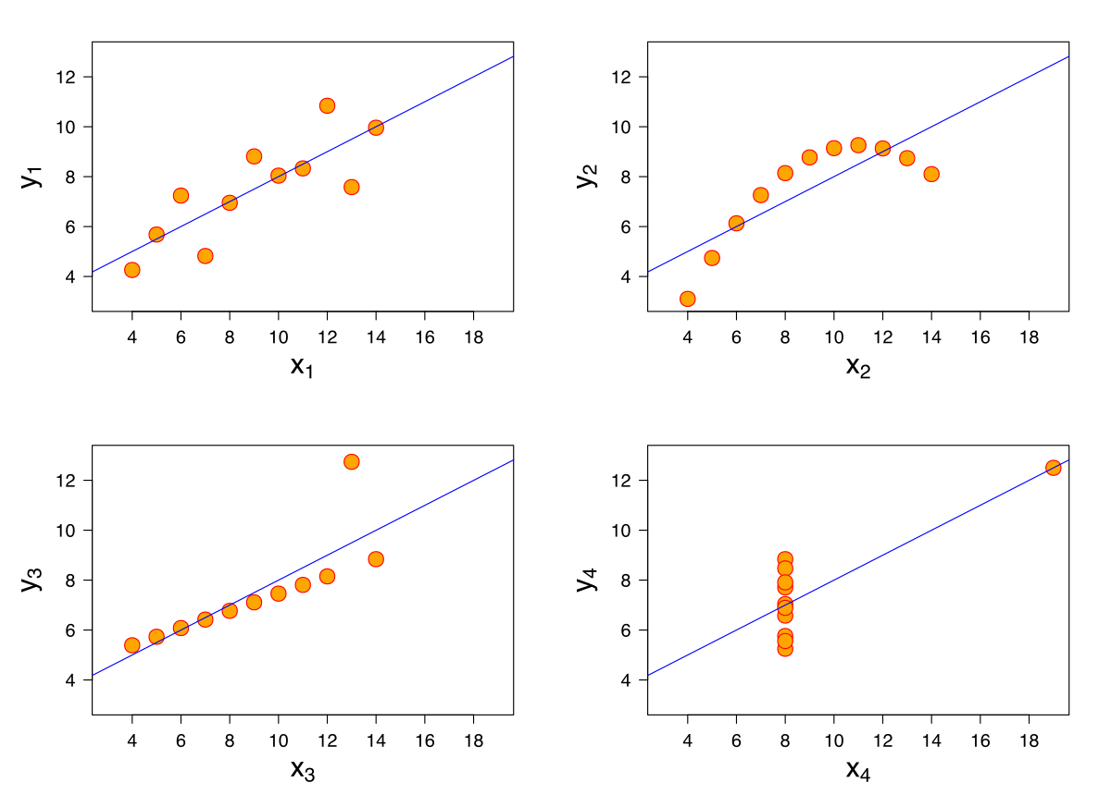
Anscombe’s quartet
All these data sets have the same mean, variance & correlation
Always visualize your data!

Slide 15
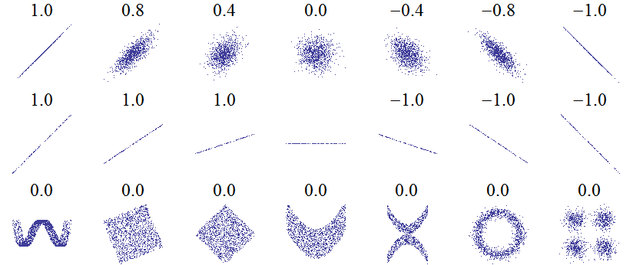
Correlation: Pearson’s r
Linear relations
Linear relations (perfect correlation)
Non-linear relations
r gives a measure of how much two quantative variables ‘move together’
Correlation is normalized. The variation in the X and Y values is ‘cancelled out’, so that the result is always between -1 and 1

Slide 16
Strength
Weak 0.1 < r < 0.3
Moderate 0.3 < r < 0.6
Strong > 0.6
Interpreation depends on context. Most correlations in social science are weak

Slide 17
Scatterplot matrix

Slide 18
Exercise 2: correlations
Choose three quantitative variables in the class data set that you expect are correlated.
Using Seaborn and Pandas, make:
A scatterplot matrix
A scatterplot of one combination of variables
Comment on the linearity of the relationship.
Calculate Pearson’s r for this combination. Is the correlation significant (p < 0.05)?
What is your conclusion about the relation between the variables?

Slide 19
Topics
Exploring 1 or 2 qualitative variables
Exploring relation between qualitative & quantitative variables
Correlation
Hypothesis testing

Slide 20
Hypothesis testing
Research question: ‘Are paid apps rated higher than free apps?’
How to separate ‘real effects’ from sampling ‘noise’? Significance testing provides one answer
Hypotheses are always about the population. You already know the answer for the sample!
You start with the null hypothesis of no difference / no effect, and calculate a p-value (more on that later)
Hypothesis testing can be done in many statistical contexts

Slide 21



Hypothesis testing is like a court case…
Collect evidence
Presume innocence
Not enough evidence
(Not the same as not guilty)
A lot of evidence: guilty!

Slide 22
Hypothesis testing
Collect evidence in sample
→ calculate p-value
Presume no effect/difference
Not enough evidence for effect/difference
(Not the same as no effect/difference)
Lots of evidence: significant result
Difference/effect in population

Slide 23
Hypotheses
Null hypothesis and alternative hypothesis
H₀: µ_{paid_apps} = µ_{free_apps}
H₁: µ_{paid_apps} ≠ µ_{free_apps} (inverse of H₀)
(µ: mean in population)
Enough evidence against H₀ → reject H₀ and accept H₁
Not enough evidence against H₀ → keep H₀ (for the time being)

Slide 24
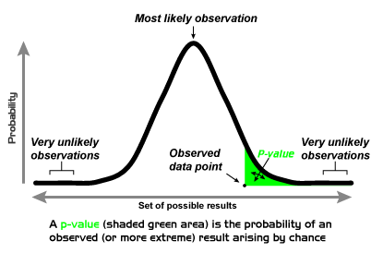
Now the tricky part… p-value
p is not the probability that there is a difference
p is the proportion of hypothetical samples more extreme than what you found, given H₀ (that there is no difference)
If p is too small (usually <0.05), you say: ‘Wow, that’s way too weird (wo)man! I don’t believe this really happened. H₀ must be false.’

Slide 25
Controversy
Seems kind of complicated, right?
You really want to know if there’s a difference, but instead you’re looking for evidence against the absence of a difference
Bayesian statistics instead tries to quantify one’s belief in a difference, but this is tricky too (this is actually a huge debate within statistics, but let’s leave it there…)

Slide 26
T-test
A t-test is a significance test of a mean difference between groups (or between different measurements within people)
Distribution has to be normal (generally when N > 30)
Result: t(30) = 5.21, p = 0.012
Degrees of freedom: closely related to sample size
T-statistic: how big is the difference, compared to the variation within the groups?
P-value
0.012 < 0.05, so significant!

Slide 27
Exercise 3: t-test
Perform a t-test with:
Independent variable: factor with two levels (gender, OS phone)
Dependent variable: quantitative variable of your choice
Report:
The t-statistic with degrees of freedom
The p-value
Whether there is a significant relation

Slide 28
Image credit
Nobel Prize and Chocolate: Maurage et al. (fair use)
p-value

