Slide 1
Data-driven learning W5 L1: Excel training Correlation and linear regression
Jonas Moons

Slide 2



Check-in

Slide 3
Intro

Slide 4
Feedback

Slide 5
Topics
Excel training
Correlation
Simple linear regression
Simple linear regression: model evaluation

Slide 6
Excel: why or why not?
Why: business standard. You have to know it!
Why: easy to use and still quite powerful
Why not: not reproducible (alternative: Open Refine)
Why not: not effective for big datasets
Conclusion: not for serious data science, but very useful for quick ’n dirty stuff

Slide 7
Exercise 1: Excel training

Slide 8
Topics
Excel training
Correlation
Simple linear regression

Slide 9
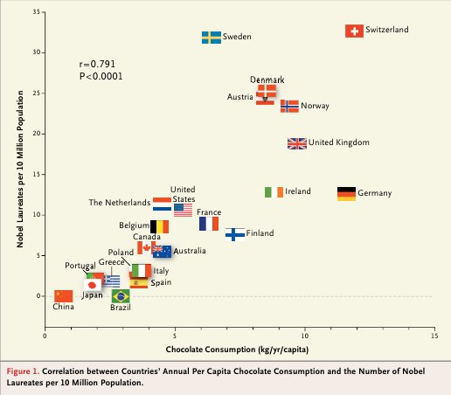
Relation between two quantitative variables: scatterplot
Does chocolate consumption really boost Nobel Award chances?
Maurage, Heeren, & Pesenti (2013)

Slide 10
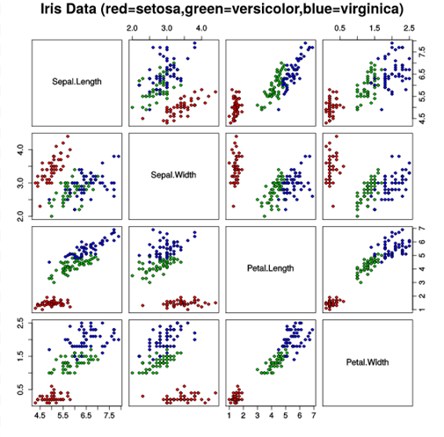
Scatterplot matrix

Slide 11
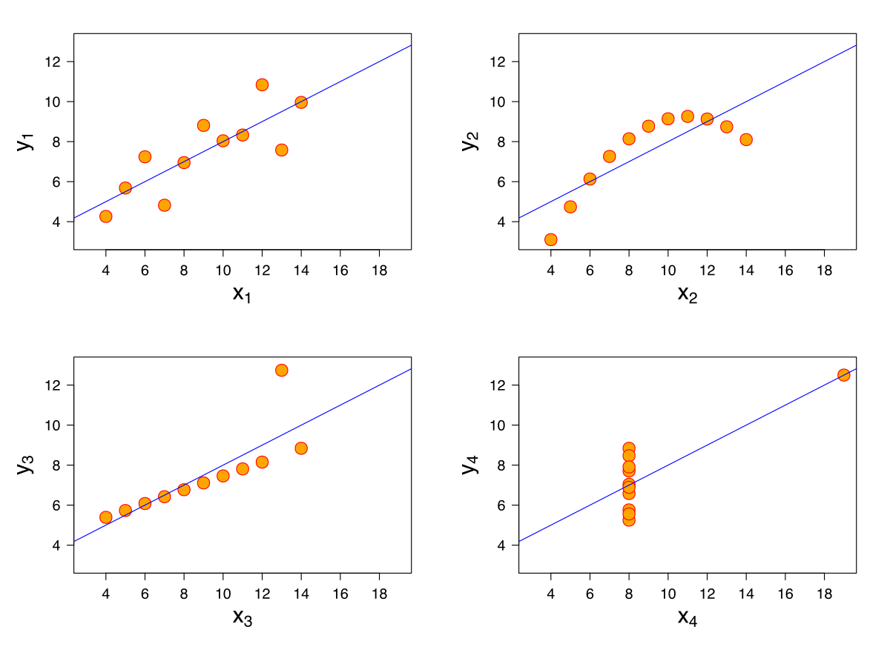
Anscombe’s quartet
All these data sets have the same mean, variance & correlation
Always visualize your data!

Slide 12
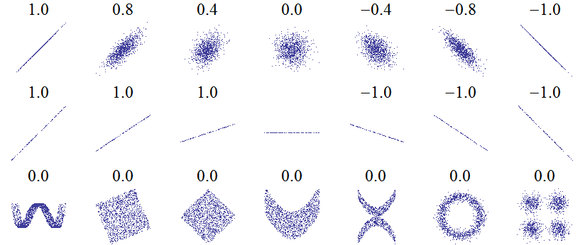
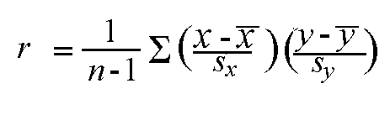
Correlation: Pearson’s r
Linear relations
Linear relations (perfect correlation)
Non-linear relations
r gives a measure of how much two quantitative variables ‘move together’
Correlation is normalized. The variation in the X and Y values is ‘cancelled out’, so that the result is always between -1 and 1

Slide 13
Strength
Weak 0.1 < r < 0.3
Moderate 0.3 < r < 0.6
Strong > 0.6
Interpretation depends on context. Most correlations in social science are weak

Slide 14
Exercise 2: correlations
See the correlation Notebook in Examples
Choose three quantitative variables in the class data set that you expect are correlated
Remember that you can select columns in Pandas by using:
df_subset = df[[‘col_name1’, ‘col_name2’, ‘col_name3’]]
Using Seaborn and Pandas, make:
A scatterplot matrix
A scatterplot of one combination of two variables (think about which variable is most suited for x – the independent variable)
Comment on the linearity of the relationship.
Calculate Pearson’s r for this combination
What is your conclusion about the relation between the variables?

Slide 15
Topics
Excel training
Correlation
Simple linear regression

Slide 16
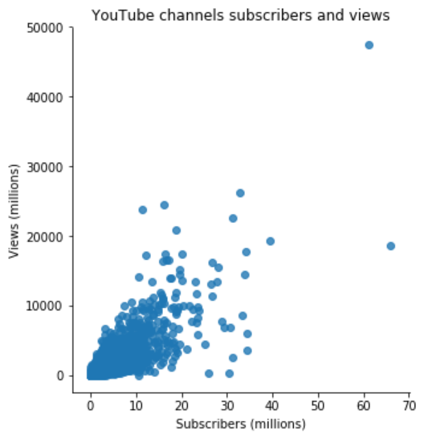
Linear relation
The points in the scatter plot seem to be centered around a line, with some variation
Variance in views seems to increase with subscribers (more on that later)

Slide 17
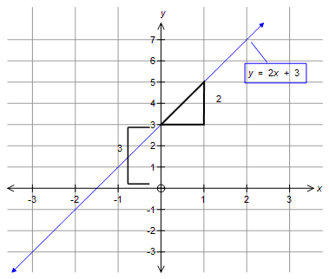
Linear relation

Slide 18
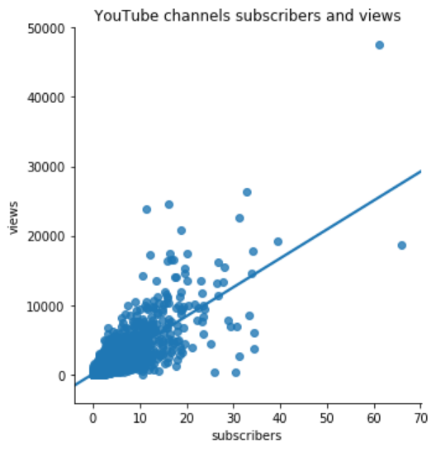

Linear regression formula
e ≈ -27,000M
$$Y=b_{0}{+ b}_{1}X+e$$
e ≈ 10,000M
Y = dependent variable: views
X = independent variable: subscribers
Coefficients (constant):
b₀ = intercept: how many views with no subscribers = 4.5M
b₁ = slope: views per subscriber = 416.7
e = error / residual: what’s left over, what we can’t explain
The algorithm that finds the line minimizes the squared errors

Slide 19

Example data points
$$Y=b_{0}{+ b}_{1}X+e$$
Channel | X (subscribers) | Y (views) | b₀ | b₁ | Y’ (predicted views) | e (residual)
PewDiePie | 66M | 19000M | 4.5M | 416.7 | 28000M | -9000M
(Numbers are rounded down here and there to make it clearer)

Slide 20
Example data points
$$Y=b_{0}{+ b}_{1}X+e$$
Channel | X (subscribers) | Y (views) | b₀ | b₁ | Y’ (predicted views) | e (residual)
PewDiePie | 66M | 19000M | 4.5M | 416.7 | 28000M | -9000M
Taylor Swift | 28M | 16000M | 4.5M | 416.7 | 12000M | 4000M
(Numbers are rounded down here and there to make it clearer)

Slide 21
Example data points
$$Y=b_{0}{+ b}_{1}X+e$$
Channel | X (subscribers) | Y (views) | b₀ | b₁ | Y’ (predicted views) | e (residual)
PewDiePie | 66M | 19000M | 4.5M | 416.7 | 28000M | -9000M
Taylor Swift | 28M | 16000M | 4.5M | 416.7 | 12000M | 4000M
Eminem | 30M | 300M | 4.5M | 416.7 | 13000M | 12700M
(Numbers are rounded down here and there to make it clearer)

Slide 22
Introducing the library and data set
sk-learn is the standard library for statistics and machine learning. We will be working with it a lot.
Scraped Funda dataset: house listings in Amsterdam. Will be used these two weeks.

Slide 23
Exercise 3: linear regression
See the linear_regression Notebook in the Examples folder
Using Seaborn, Pandas and sk-learn:
Import the Funda data set in the Exercises folder.
Make a scatter plot of surface area and price, both with and without a regression line. Which is X and which is Y?
Make a linear model for the relation with sk-learn. Write down the complete formula with X, Y and the coefficients b₀ and b₁ (as numbers).
Predict the price for a house of 70 m²
Use sk-learn to predict the price for all the houses in the dataset. What is the residual for house XXXXXX?

Slide 24
Image credit
Nobel Prize and Chocolate by Maurage et al. (fair use)
Scatterplot matrix by Nicoguaro (CC-BY)
Anscombe’s quartet by Schutz (CC-BY-SA)

