Slide 1
Data-driven learning W7 L2: Recommender systems
Jonas Moons

Slide 2



Check-in

Slide 3
Feedback

Slide 4
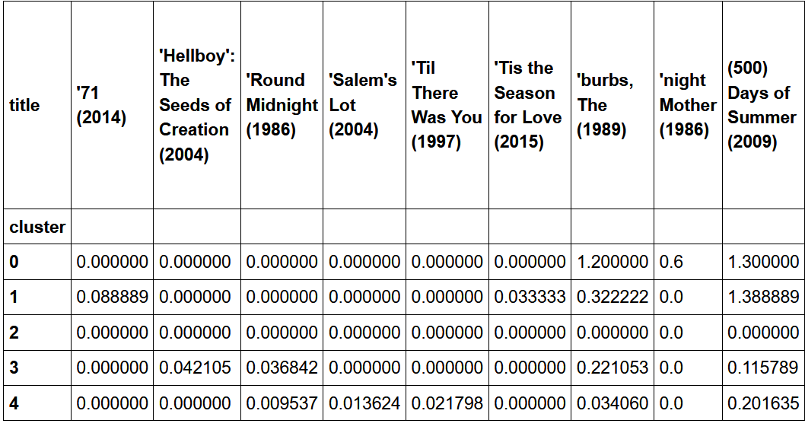
Feedback

Slide 5
Topics
Recommender systems
Collaborative filtering

Slide 6
Recommender systems
Collaborative filtering
Use the distance between users and/or items to recommend similar content
Example: Movielens.org
Content filtering
Use properties of items to recommend items similar to the ones the user liked
Example: Last.fm
Hybrid approach
Combine both approaches
Most big platforms (e.g., Netflix, Facebook) use tailor-made algorithms

Slide 7
Topics
Clustering users
Recommender systems
Collaborative filtering

Slide 8
Nearest-neighbor collaborative filtering
Use the n nearest neighbor users to calculate the predicted rating
Distance can be calculated in various ways, e.g.,
Correlation between users / items
Cosine similarity

Slide 9
Cosine similarity
angle =
33º
angle = 0º
Cosine similarity: user 2&3 are closest

Slide 10
Problems
Sparsity (there are millions of movies: are there enough similar users?)
‘Cold start’
Lack of serendipity / blandness of recommendations
Scalability (the bigger the system, the more time it takes to calculate everything)

Slide 11
Exercise 2: collaborative filtering
In this exercise, you are going to build the building blocks of a recommender system using correlation between items.
Make a user-item pivot table of the Movielens data (or use an old file)
Choose a frequently rated movie. Show its correlation with other movies and look at the top 10 highest correlations. Tip: Pandas has a handy function called corrwith. Check out its documentation.
The correlations at step 2 are not very useful. Why not? Improve your predictions. (This step is actually much harder than it looks. I’m interested in your solutions)

