Slide 1
Data-driven learning W5 L1: Excel training Correlation and linear regression
Jonas Moons

Slide 2



Check-in

Slide 3
Intro

Slide 4
Topics
Excel training
Correlation
Simple linear regression
Simple linear regression: model evaluation

Slide 5
Excel: why or why not?
Why: business standard. You have to know it!
Why: easy to use and still quite powerful
Why not: not reproducible (alternative: Open Refine)
Why not: not effective for big datasets
Conclusion: not for serious data science, but very useful for quick ’n dirty stuff

Slide 7
Topics
Excel training
Correlation
Simple linear regression
Simple linear regression: model evaluation

Slide 8
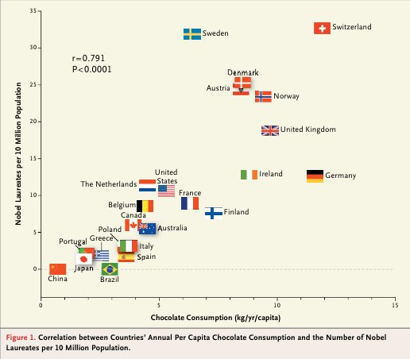
Relation between two quantitative variables: scatterplot
Does chocolate consumption really boost Nobel Award chances?
Maurage, Heeren, & Pesenti (2013)

Slide 9
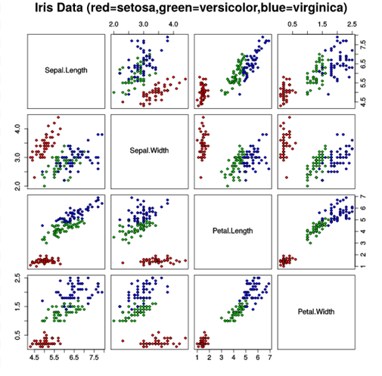
Scatterplot matrix

Slide 10
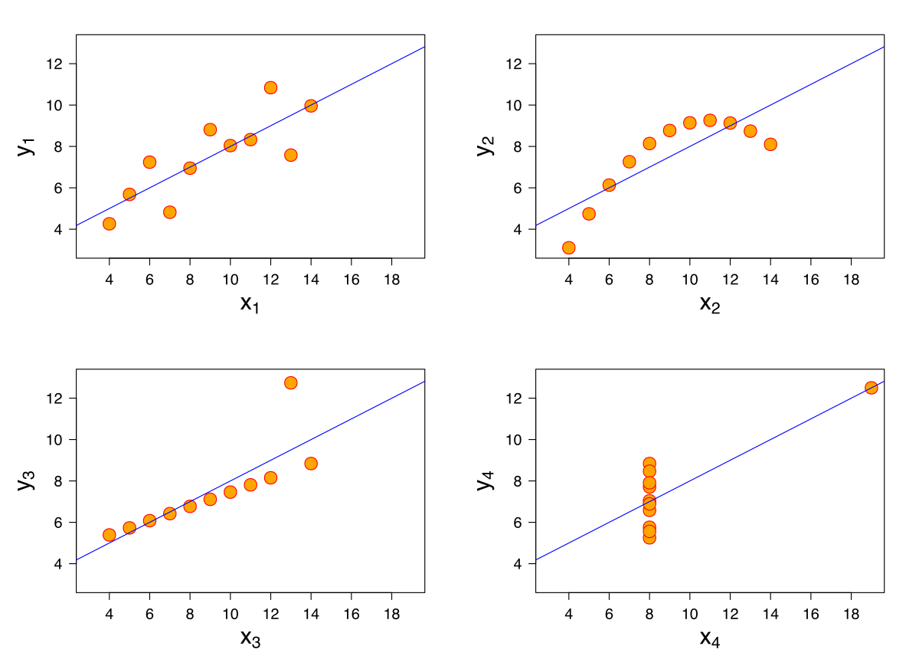
Anscombe’s quartet
All these data sets have the same mean, variance & correlation
Always visualize your data!

Slide 11
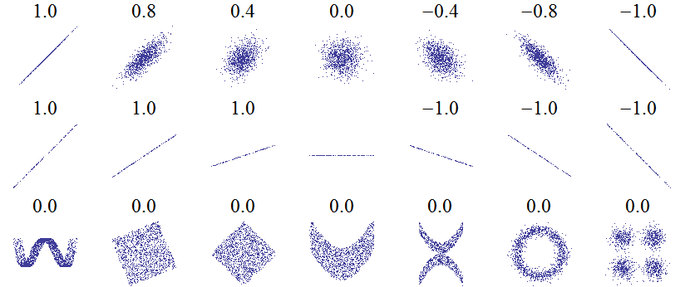
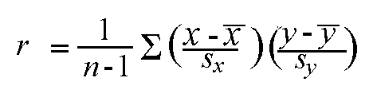
Correlation: Pearson’s r
Linear relations
Linear relations (perfect correlation)
Non-linear relations
r gives a measure of how much two quantative variables ‘move together’
Correlation is normalized. The variation in the X and Y values is ‘cancelled out’, so that the result is always between -1 and 1

Slide 12
Strength
Weak 0.1 < r < 0.3
Moderate 0.3 < r < 0.6
Strong > 0.6
Interpreation depends on context. Most correlations in social science are weak

Slide 13
Exercise 1: correlations
Resources:
Scatterplot matrix in Seaborn
Scatterplot in Seaborn
Correlation in Python
Choose three quantitative variables in the class data set that you expect are correlated
Remember that you can select columns in Pandas by using:
df_subset = df[[‘col_name1’, ‘col_name2’, ‘col_name3’]]
Using Seaborn and Pandas, make:
A scatterplot matrix
A scatterplot of one combination of variables (think about which variable is most suited for x – the independent variable)
Comment on the linearity of the relationship.
Calculate Pearson’s r for this combination
What is your conclusion about the relation between the variables?

Slide 14
Topics
Excel training
Correlation
Simple linear regression
Simple linear regression: model evaluation

Slide 15
Linear relation
The points in the scatter plot seem to be centered around a line, with some variation

Slide 16
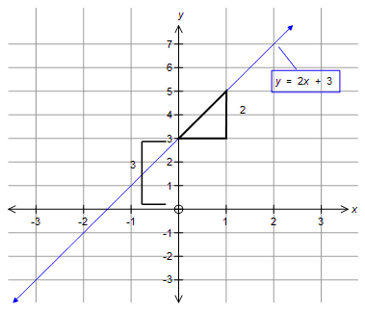
Linear relation

Slide 17
Model lineaire regressie
y = dependent variable
x = independent variable
a = slope
b = intercept
e = error / residual

Slide 18
Topics
Excel training
Correlation
Simple linear regression
Simple linear regression: model evaluation

Slide 19
Image credit
Nobel Prize and Chocolate by Maurage et al. (fair use)
Scatterplot matrix by Nicoguaro (CC-BY)
Anscombe’s quartet by Schutz (CC-BY-SA)

