Slide 1
Data-driven learning W7 L1: Clustering introduction
Jonas Moons

Slide 2



Check-in

Slide 3
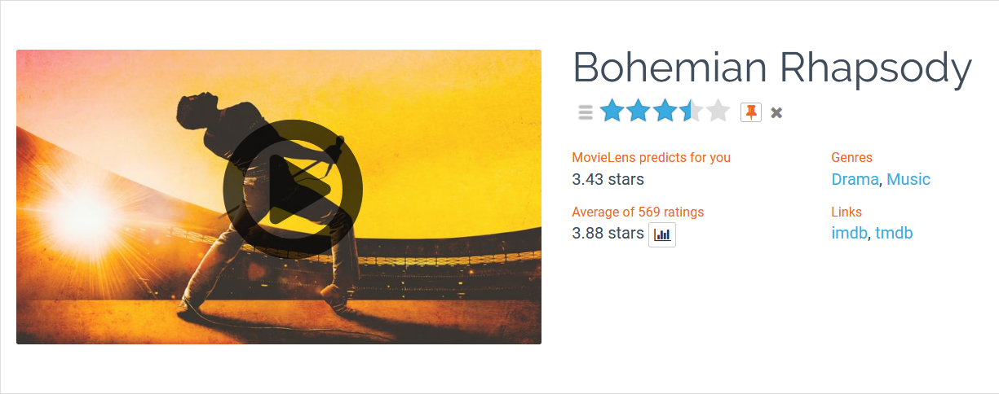
Intro

Slide 4
This week
How to use information from users…
To generate user or item ‘profiles’ with clustering (this lesson)
To make recommendations to users (next lesson)

Slide 5
Topics
MovieLens data set
Clustering
k-means clustering

Slide 6
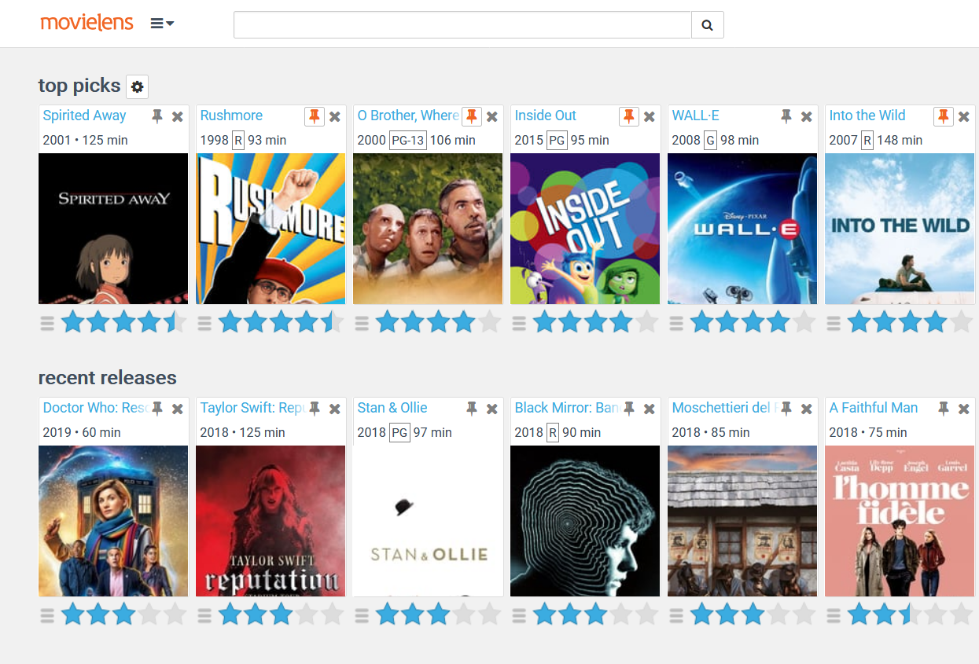

Slide 7
MovieLens data set
Project for movie recommendations and academic research from University of Minnesota (grouplens.org)
Full dataset: 20 million ratings and 465,000 tag applications to 27,000 movies by 138,000 users.
For a better overview, we will work with the smaller dataset with 100,000 ratings to 9,000 movies by 600 users

Slide 8
User-item matrix
 | Pulp Fiction | Toy Story | The Dark Knight | La La Land | Star Wars
User 1 | 4 | - | - | - | 4
User 2 | 3 | 2 | 5 | - | 3
User 3 | 5 | 4 | - | - | 4
User 4 | - | - | 5 | 4 | -
User 5 | 4 | 4 | - | 3 | -

Slide 9
Exercise 1: data wrangling
In this Exercise you are going to prepare the MovieLens dataset for use this week. See the pivot_table Notebook in the Examples folder and the cookbook for reference to material from earlier weeks. See the Exercise folder for the data set.
Inspect the files movies.csv and rating.csv. Using a text editor, add yourself as user 611 and add your scores for 10 movies (don’t spend too much time on this, just pick the ones you recognize). Scores are from 0.5-5 stars with half a star possible.
Load the files in a Notebook and merge them (remember which function to use?).
Look at the pivot_table Notebook in the Examples folder. How might you use a pivot table to make a user-item matrix? Remember: a user-item matrix is a table of the ratings, with users in the rows and items in the columns. What are the items?
Using head(), check if your matrix is correct.
Plot a histogram of all the ratings of a movie of your choice.

Slide 10
Topics
User ratings
Clustering
k-means clustering

Slide 11
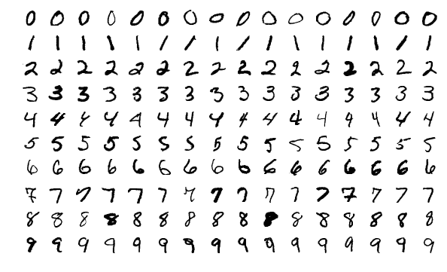
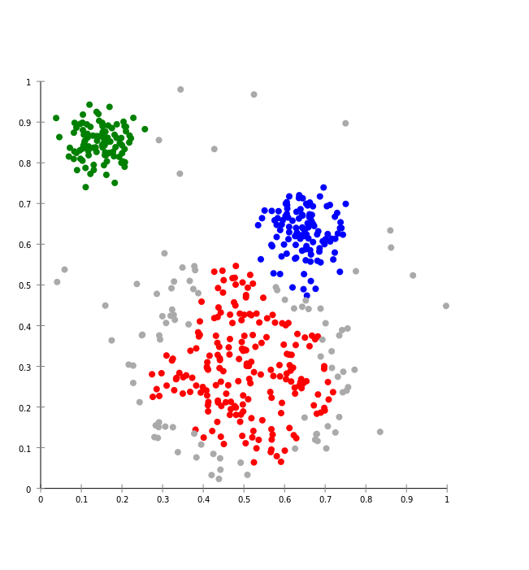

Supervised vs. unsupervised learning
Supervised: use known patterns to predict new cases
Handwriting recognition
Unsupervised: you let the algorithm discover patterns/clusters on its own
Spotify Radio / Discover Weekly
MNIST data set

Slide 12
Why clustering?
To discover interesting and useful clusters in the data and adapt our content or marketing strategy
For instance, different user types based on behavior (user profiling), e.g.
Explicit: likes, favorites, ratings, comments, etc.
Implicit: pages visited, content seen, mouse movements, etc.

Slide 13
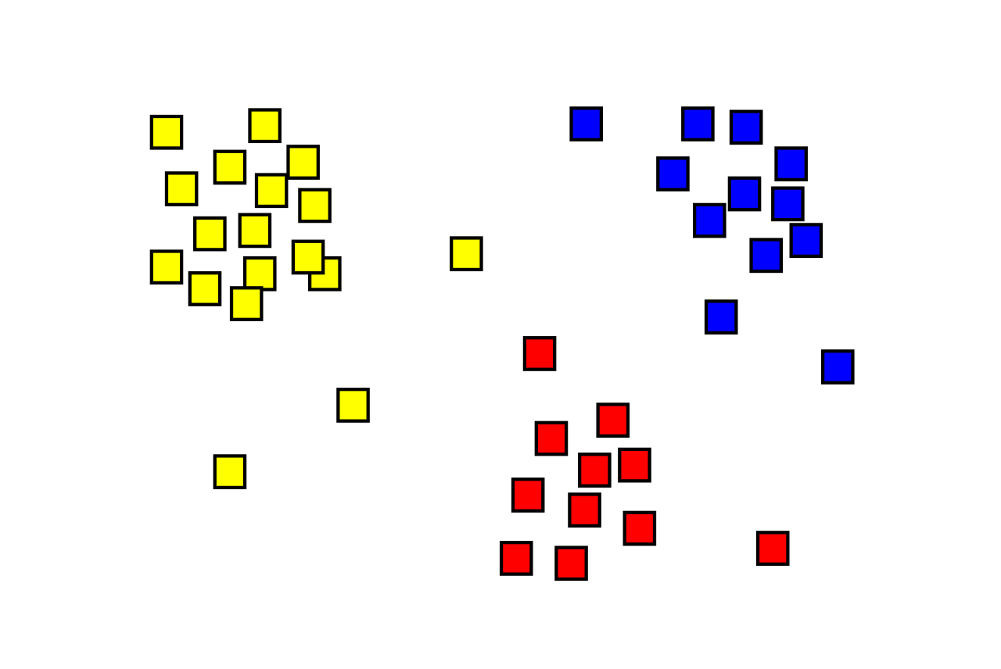
What is clustering?
Assign observations to several clusters
It’s not always clear which solution is ‘correct’
There are many algorithms; we will use k-means (simple to understand but often suboptimal)
Remember: shown as 2-dimensional here but n-dimensional in reality, n being the number of variables used

Slide 14
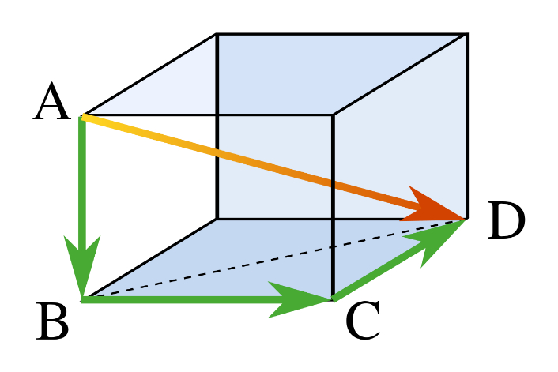
Distance
Each user is represented by a point in space
Each item (movie) is a dimension
The distance between two users can be calculated for any number of dimensions/movies (shown: 3)
User | Movie 1 | Movie 2 | Movie 3
1 | 5 | 3 | 5
2 | 4 | 1 | 2

Slide 15
Topics
MovieLens data set
Clustering
k-means clustering

Slide 16
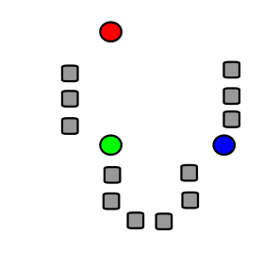
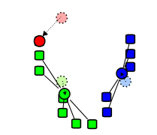
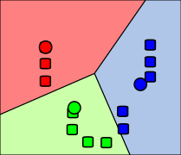
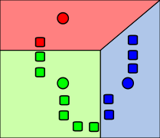
k-means algorithm
1. Start with k cluster centers at random
2. Assign each observation to nearest center
3. Move cluster centers to center of observations
4. Repeat until stable

Slide 17
K-means clustering

Slide 18
Exercise 2: clustering Iris data set
In this exercise, you will explore the logic of clustering using the famous Iris data set. See the Exercises folder for the data set (iris.csv), and the Notebook k-means in the Examples folder.
Read in the csv file.
Using a Seaborn scatterplot, plot the Iris data set with petal length on the x-axis and sepal length on the y-axis. Plot the different Iris species with a different symbol (see the Seaborn documentation).
What possible clusters do you see with the naked eye? How do they relate to the three species?
Using k-means clustering with 3 clusters (using only petal length and sepal length as X variables), create a new variable cluster and use this to make another scatterplot, using color for cluster.
How does k-means perform?
Try out different numbers of clusters to see what happens. What seems like the ‘natural’ number of clusters for this data set?

Slide 19
Problems with clustering
K-means can only make Voronoi cells (straight lines)
Suitable number of clusters often hard to determine in practice

Slide 20
Image credit
Pythagoras by CheCheDaWaff (CC-BY-SA)
K-means algorithm pictures by Weston.pace (CC-BY-SA)
K-means gif by Chire (CC-BY-SA)

