Slide 1
Data-driven learning W7 L2: Recommender systems
Jonas Moons

Slide 2



Check-in

Slide 3
Intro

Slide 4
Feedback

Slide 5
Topics
Clustering users
Recommender systems
Collaborative filtering

Slide 6
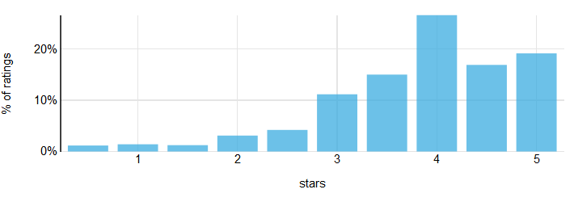
User ratings
Ratings are typically left-skewed and the mean is above the center of the scale
Ratings (especially product ratings) may have a smaller peak at the low end
People vote for their favorites

Slide 7
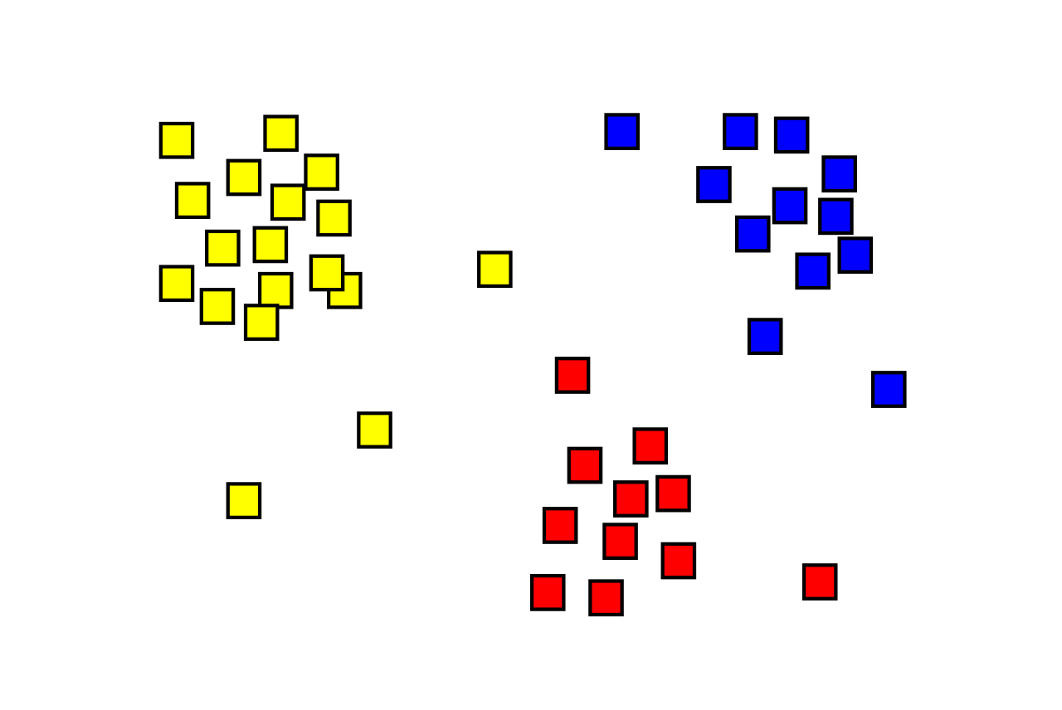
What is clustering?
Assign observations to several clusters
It’s not always clear which solution is ‘correct’
There are many algorithms; we will use k-means (simple to understand but often suboptimal)
Remember: shown as 2-dimensional here but n-dimensional in reality, n being the number of variables used

Slide 8
Exercise 1
For exercise 1, some pre-processing has been done:
Filling the NaN of unrated movies with 0 (not at all a great solution -> why not?)
Ordering the columns of the dataframe from most frequently rated to least frequently rated
Your job is to finish the example code

Slide 9
Exercise 1: clustering users
In this Exercise, you will use the Movielens data to find user clusters with similar taste. The first part has been done, see movielens_clustering in the Examples folder.
What would be a suitable number of clusters to divide moviegoers into?
Apply the k-means algorithm to the Movielens user-item matrix that is in the code. Store the cluster predictions in the original ratings dataframe and continue working with that dataframe (why?).
How many users are there per cluster (which Pandas function do you need?)?
Calculate the mean rating by user cluster using the Pandas pivot_table function. Pandas will sort alphabetically, so you will need to reorder your pivot table with my_pivot.reindex(ratings.count().sort_values(ascending=False).index, axis=1)
Examine the mean ratings of the top rated movies by user cluster. Can you describe the user clusters in plain language (e.g., ‘simple-minded action movie lover’)? This may be hard…

Slide 10
Topics
Clustering users
Recommender systems
Collaborative filtering

Slide 11
Recommender systems
Collaborative filtering
Use the distance between users and/or items to recommend similar content
Example: Movielens.org
Content filtering
Use properties of items to recommend items similar to the ones the user liked
Example: Last.fm
Hybrid approach
Combine both approaches
Most big platforms (e.g., Netflix, Facebook) use tailor-made algorithms

Slide 12
Topics
Clustering users
Recommender systems
Collaborative filtering

Slide 13
Nearest-neighbor collaborative filtering
Use the n nearest neighbor users to calculate the predicted rating
Distance can be calculated in various ways, e.g.,
Correlation between users / items
Cosine similarity

Slide 14
Cosine similarity
angle =
33º
angle = 0º
Cosine similarity: user 2&3 are closest

Slide 15
Problems
Sparsity (there are millions of movies: are there enough similar users?)
‘Cold start’
Lack of serendipity / blandness of recommendations
Scalability (the bigger the system, the more time it takes to calculate everything)

Slide 16
Exercise 2: collaborative filtering
In this exercise, you are going to build the building blocks of a recommender system using correlation between items.
Make a item-user pivot table of the Movielens data, with items in the rows and users in the columns (i.e., the other way around).
Choose a favorite movie of yours. Write a for-loop that creates a dataframe with all correlations with that movie (sorted high to low). Inspect the top movies. Do you agree with the results?
Advanced: refine Step 2 by only showing results for which the correlation can be trusted to be reliable (when is this?).
Even more advanced: create a look-up table / dataframe with all the reliable correlations between movies. A movie service such as Netflix could use this to show users suggestions.

