Slide 1
Data-driven learning W8 L1: Text mining: Naïve Bayes
Jonas Moons

Slide 2



Check-in

Slide 3
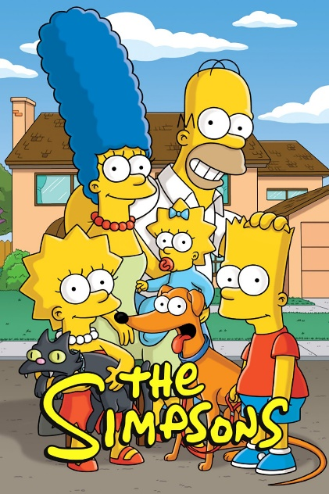
Intro

Slide 4
Feedback

Slide 5
Topics
Natural Language Processing (NLP)
Modeling text
Classification with Naïve Bayes

Slide 6
Natural language processing
Production
Natural language generation
Text-to-speech
Chatbots
Recognition
Speech recognition
Understanding written text
Translation

Slide 7
Challenges
Requires huge corpora and tagged databases
And specialized algorithms and linguistic expertise
Context is everything
Big differences between languages: relatively well developed for English and some other big and/or (Indo-)European languages, not so much for others

Slide 8

Language is complex…
“What are you doing in this classroom?”
We have:
Semantics (what words mean)
Morphology (how words are formed) → ‘do-ing’, ‘are’, word order
Syntax (sentence construction, word order) → what are you …
Pragmatics (meaning in context) → ‘get out!’

Slide 9
Topics
Natural Language Processing (NLP)
Modeling text
Classification with Naïve Bayes

Slide 10

Bag of words
The ‘bag of words’ model treats a document as a collection of words, and a count for each
It ignores semantics, syntax (word order), morphology and pragmatics (e.g., irony)
Very simple but often effective
Word | Count
You | 8
I | 6
And | 5
Will | 5
Be | 4

Slide 11
Tokenizing
Tokenizing is about breaking text up into units (‘words’)
Relatively easy in English…
(But what about ‘New York’, ‘ice cream’)
A lot harder in ‘agglutinative’ languages like Turkish or Finnish

Slide 12
Document-feature matrix
Features / words / variables
 | flouncy | flow | flower | flowery | flowey | flowier
Doc1 | 0 | 0 | 0 | 1 | 0 | 0
Doc2 | 0 | 0 | 0 | 0 | 0 | 0
Doc3 | 0 | 0 | 2 | 0 | 0 | 0
Doc4 | 0 | 0 | 0 | 0 | 0 | 0
Doc5 | 0 | 1 | 0 | 0 | 0 | 0
High-dimensional & sparse: almost entirely empty

Slide 13
Exercise 1: building a text model
During this week, you are going to work with dialog lines from the Simpson’s. Your task during this week is to build a model that distinguishes Bart’s dialogue from Lisa’s dialogue.
Load in the .csv file and have a look at the data set. What will be challenging when building a predictive model?
We will only work with Bart’s and Lisa’s lines. Make the relevant selection in the data set.
Create a document-feature matrix of the text data.
Look at some of the features/words. What are some of the problems with tokenizing as implemented by sklearn?
Advanced: which words does Bart use most frequently? Are these the most important words for classification? Why (not)?

Slide 14
Lemmatization and stemming
Lemmatization: means reducing a word to its grammatical stem
Removing pre- and suffixes for things like gender, number, tense, aspect, etc.
Going, goes, gone, go → go
Falo, falas, fala, falamos, falam, falava, falavas, falávamos, falavam, falei, falaste, falou, falámos, falaram, falarei, falarás, falará, falaremos, falarão, falaria, falarias falaria, falaríamos, falariam,… → falar
Not included in sklearn

Slide 15
Topics
Natural Language Processing (NLP)
Modeling text
Classification with Naïve Bayes

Slide 16
Bayes’ theorem
P(“offer”|spam) = 50%
P(“offer” & spam) = 15%
In spam, the word occurs in 50% of mail
If we encounter the word “offer”, the e-mail is about twice as likely (15/7) to be spam than not
P(spam) = 30%
P(mail) = 70%
The majority of e-mail is not spam
P(“offer”|mail) = 10%
The word “offer”
occurs in 10% of
regular mail
P(“offer” & mail) = 7%

Slide 17
Bayes’ theorem in text mining
We can use Bayes’ theorem to calculate a probability that a text belongs to a certain category (e.g., spam)
The frequency of each word determines the probability
But how do we combine the probabilities of the different words?

Slide 18
Naïve Bayes
If I flip two coins, the probability of one coin being heads does not influence the other: they are independent. We can multiply the probabilities.
The probabilities of two words being in a text (e.g., ‘police’ and ‘crime’) are definitely not independent
Yet this is exactly what is assumed in Naïve Bayes (hence: ‘naïve’), and it works well in practice

Slide 19
Exercise 2: Naïve Bayes
Blablbla

Slide 20
Image credit
Simpons by 20th century Fox, fair use claimed
Sloth meme by author unknown, fair use claimed
Bag by wixin_56: public domain

