Slide 1
Data-driven learning W4 L1: data and distributions
Jonas Moons
All images are either own work, public domain, CC-licensed or fair use
Credits on last slide

Slide 2



Check-in

Slide 3

My background
BSc in AI, MSc in Cognitive neuroscience, course at London School of Economics
Market research
PubLab: methodological/statistical adviser
Interest: understanding human behavior through statistics and machine learning

Slide 4
Topics
Example
Course overview
Data cleaning and ‘munging’
Distributions
Sampling and the normal distribution

Slide 5
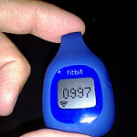
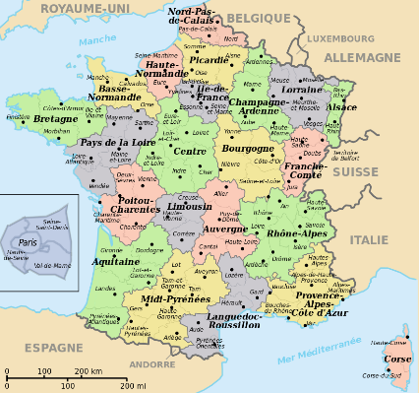

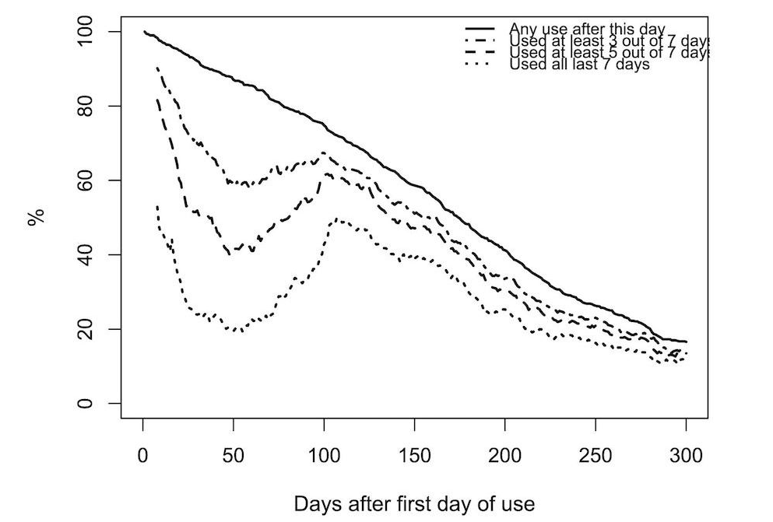

Example: modelling activity tracker usage with Random Forest
JMIR paper

Slide 6
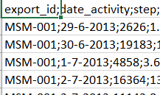
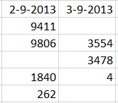
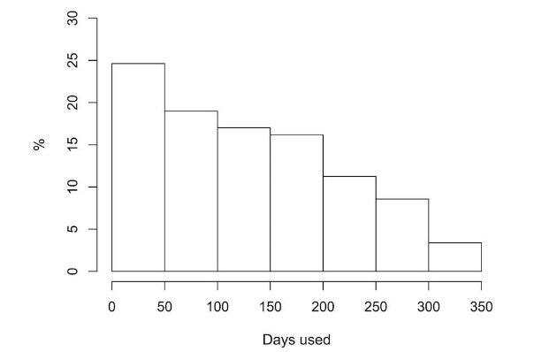
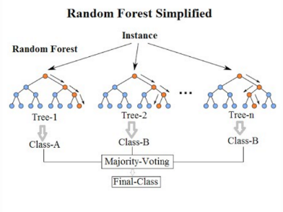
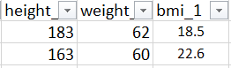
The data science cycle
Data cleaning
Exploratory data analysis / visualization
Feature engineering
Model building and evaluation
Practical application

Slide 7
Course overview
Similar set-up to Data Science Fundamentals
Exercises during class, 5 assignments (1 for each week)
Please post your exercises in the Slack (link to your solution on GitHub)
Tip: work (more) in Spyder, copy to Jupyter Notebook

Slide 8
Schedule
Week | Topics
4 | Understanding and exploring data (distributions, associations, visualization)
5 | Modeling with linear and logistic regression Workshop Excel?
6 | Machine learning: supervised learning
7 | Machine learning: unsupervised learning
8 | Text mining
9 | Work in class on assignments

Slide 9
Topics
Example
Course overview
Data cleaning and ‘munging’
Distributions
Sampling and the normal distribution

Slide 10
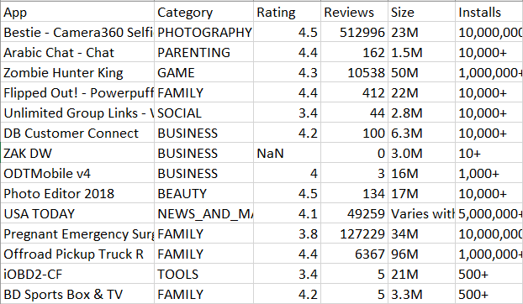
Terminology
Quantitative variable
Case
Qualitative variable: nominal
Factor (statistical model)
Categorical (Pandas)
Qualitative variable: ordinal
(Also: school types, army ranks)

Slide 11
Common problems
Wide form and long form
Missing values and the way they are coded
File encoding issues
Text encoding issues
Date/time issues
Outliers
Faulty data entry
It’s very useful to learn regular expressions (patterns in text) to clean up data

Slide 12

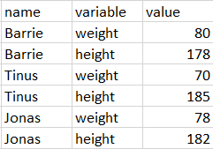
Wide form and long form
Wide form is the most typical and preferred for research: each variable has a column, each case a row
Long form is also common: each variable has a row

Slide 13
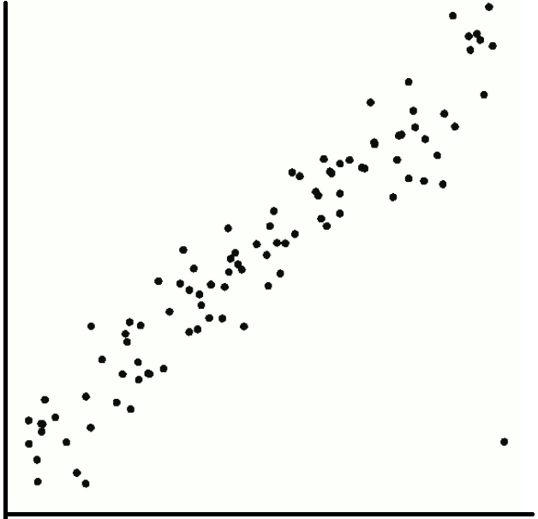
Outliers
Outliers lie far outside the trend
Outliers may indicate faulty data
They may also be interesting edge cases
They may also influence your models (too) strongly, or indicate limitations of your model
Inspect the outliers. Generally only remove with good reason

Slide 14
Exercise 1: data cleaning
See example Notebook: data cleaning
Combine the two files from the Fitbit project (steps and survey data) into a single csv file, and clean up the variable Tour (waist circumference). You will also need these cleaned data for Assignment 1. See Learn for the data.
You will run into several issues. Try and solve them. Here are some hints:
Different world regions use different encodings. How do you see this in the files? Look in the documentation of pd.read_csv() to load both files correctly.
Which variable is the key to combine both files?
Are all values of Tour plausible? What are you going to do about this?

Slide 15
Topics
Example
Course overview
Data cleaning and ‘munging’
Distributions
Sampling and the normal distribution

Slide 16
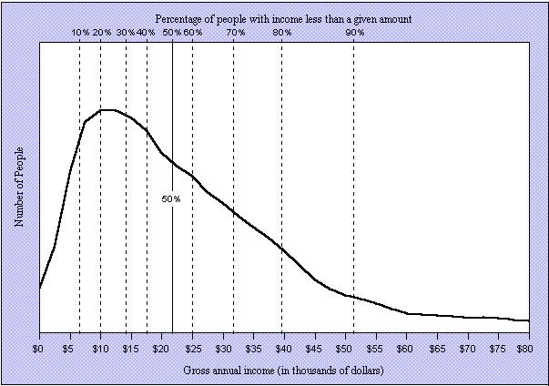
Distributions

Slide 17
Distributions
Central tendency
Variation
Shape

Slide 18
Mean, median and mode
Mean: well, it’s the mean
Influenced by extreme values
Median: middle value
Less influenced by extreme values
Two middle values: mean of those two
Mode: most frequent value
Multiple modes possible
Not always useful / defined

Slide 19
Standard deviation and variance
Variance: average of squared deviations from the mean
Sample:
For population divide by n
Standard deviation

Slide 20
Example
Mean = 5 | Deviation from mean | Squared deviation from mean
2 | -3 | 9
5 | 0 | 0
8 | 3 | 9
Sum |  | 18
var (pop.) |  | 18/n = 18/3 = 6
var (sample) |  | 18/(n-1) = 18/2 = 9
sd (pop.) |  | √6 ≈ 2.45
sd (sample) |  | √9 = 3

Slide 21
Skew
Mean Median Mode
Left skewed
Skewness < 0
Mean < median < mode
Mode Median Mean
Right skewed
Skewness > 0
Mean > median > mode

Slide 22
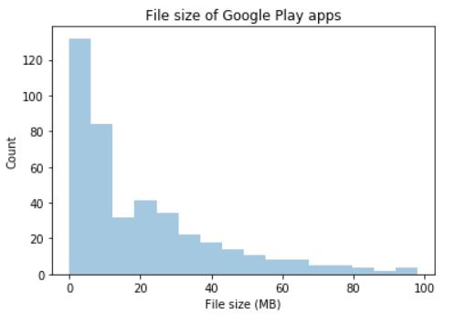
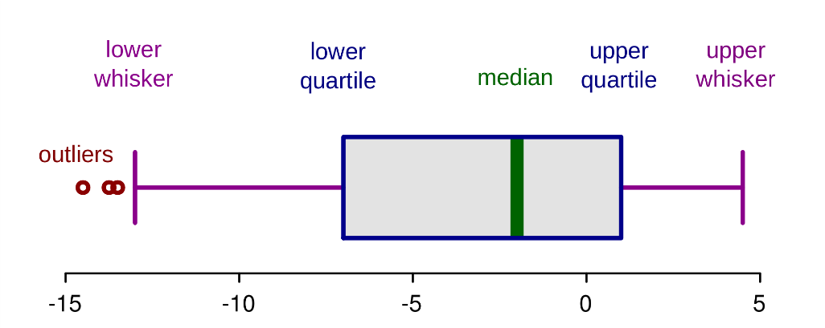
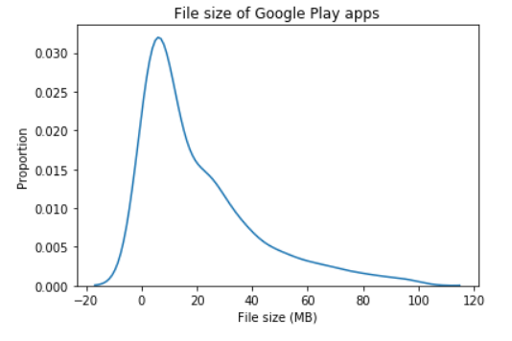
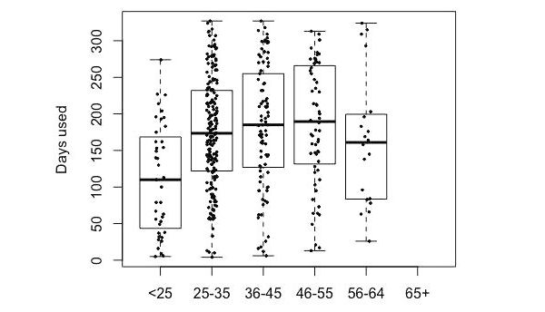
Plots
Histogram
Boxplot
Density plot (not the real data, actually a model!)
Boxplot with actual data superimposed

Slide 23
Exercise 2: distributions
See example Notebook: distributions
Fill in the Google Sheets table with your data. Please leave blank any columns that your feel uncomfortable answering.
Create a csv file from the data
Choose a different variable for each of the reports below:
Measures of variation and central tendency
Boxplot
Histogram
Density plot
Violin plot
For two of the variables, comment on modality and skewness, outliers
Notes:
Use Seaborn for all visualizations
Label your axes and give your figures a title
Plot the data points in some visualizations.
Extra challenge: investigate relations between variables (we will continue with this on Wednesday)

Slide 24
Topics
Example
Course overview
Data cleaning and ‘munging’
Distributions
Sampling and the normal distribution

Slide 25
Population and sample
Population is the group of individuals (people, companies) that are the topic of the research
Not always clearly defined
Sample: part of population included in research
Random sampling often preferable (often not possible)
Sample bias: bias due to non-random sampling

Slide 26
Notation
Measure | Sample statistic | Population parameter
Mean |  | μ
Standard deviation | s | σ
Variance | s² | σ²
Size | n | N

Slide 27

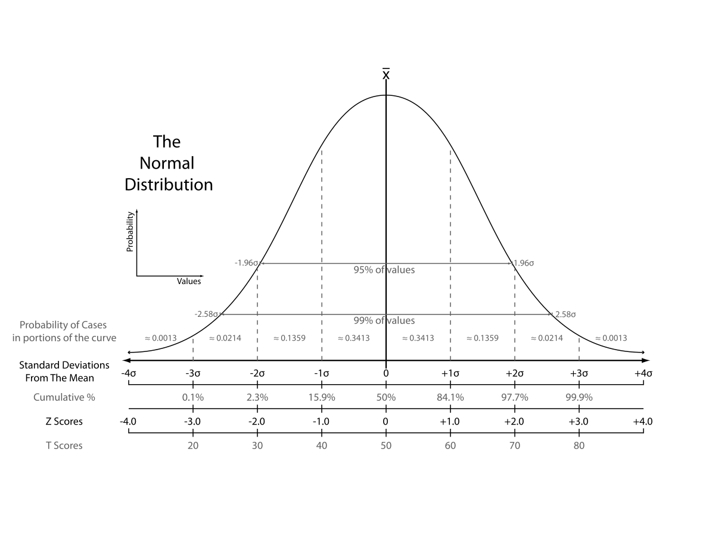
Normal distribution

Slide 28
Why is the normal distribution so important?
Some distributions in real life approach the ND
The ND is assumed in a lot of statistical modelling
Central limit theorem

Slide 29
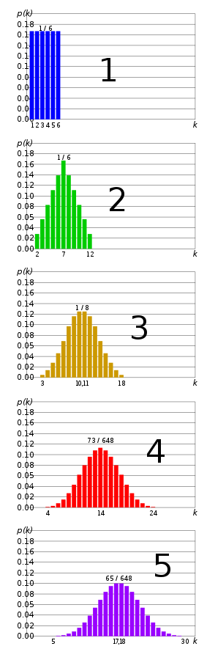
Central limit theorem
Sum of independent, identical distributions approaches normal distributions
See right: sum of 1…5 dice
Same goes for sampling distribution of the mean -> larger n, closer to normal

Slide 30
Exercise 3: sampling
See example Notebook: sampling
Load the class data csv file from the previous exercise
Choose a variable
Create 3 lists:
100 means of random samples (with replacement) of n=1 of your variable
100 means of random samples of n=5
100 means of random samples of n=10
Create density plots of each list. Do you see evidence of the central limit theorem?
Extra challenge: superimpose the density plots in one plot, with differing colors

Slide 31
Image credit
Fitbit by eVidaSana.com (CC-BY)
France by Historicair (PD)
Random Forest by Venkata Jagannath (CC-BY-SA)
Boxplot by Ruediger85 (CC-BY-SA)
Density plot by Jake (CC-BY)
Normal distribution by Heds 1 (PD)

