Slide 1
Data-driven learning W4 L2: associations between variables
Jonas Moons
All images are either own work, public domain, CC-licensed or fair use
Credits on last slide

Slide 2



Check-in

Slide 3
Relations between variables
To add: graph of relation in class data

Slide 4
Topics
Variables: terminology
Exploring 1 or 2 qualitative variables
Exploring relation between qualitative & quantitative variables
Correlation
Hypothesis testing

Slide 5
Level of measurement
 |  |  | Ratio
 |  | Interval | true zero point
 | Ordinal | equal difference | equal difference
Nominal | ranking | ranking | ranking
distinction | distinction | distinction | distinction
gender | opinion | temperature | age
categorical numerical
qualitative quantitative

Slide 6
Quiz
Heart rate
School grade (1-10)
Hair color

Slide 7
Quiz
Heart rate = ratio
School grade (1-10) = ordinal
Hair color = nominal

Slide 8
Independent and dependent variables
A dependent (Y) variable is studied for changes when the independent (X) variable(s) changes
Example:
independent variables: boredom, age
dependent: social media use
Correlation is not causation! Ice cream sales and drownings are correlated, but ice cream sales don’t cause drownings
Target (Y) and predictor (X) are used more in the machine learning world

Slide 9
Topics
Variables: terminology
Exploring 1 or 2 qualitative variables
Exploring relation between qualitative & quantitative variables
Correlation
Hypothesis testing

Slide 10
Bar charts

Slide 11
Tips for graphs
Keep it simple, stupid (KISS)
Don’t use 3D
Don’t use pie charts (too often)
Give a title and label your axes

Slide 12
Crosstables
 | Gender
Region | Male | Female | Total
Central | 48% | 11% | 37%
North | 33% | 56% | 40%
South | 19% | 33% | 23%
Total | 100% | 100% | 100%
 | Gender
Region | Male | Female | Total
Central | 10 | 1 | 11
North | 7 | 5 | 12
South | 4 | 3 | 7
Total | 21 | 9 | 30
Column percentages: distribution of men/women over regions
 | Gender
Region | Male | Female | Total
Central | 91% | 9% | 100%
North | 58% | 42% | 100%
South | 57% | 43% | 100%
Total | 70% | 30% | 100%
Row percentages: ratio of men/women per region

Slide 13
Exercise 1: exploring qualitative variables
Choose one of the qualitative variables in the class data set as your independent variable, and a dependent qualitative variable
Using Seaborn and Pandas, make:
A table with frequencies of your independent variable
A suitable graph of your independent variable
A crosstable with column percentages
A simple bar graph (not stacked) of the relation between the variables
What is your conclusion about the relation between the variables?

Slide 14
Topics
Variables: terminology
Exploring 1 or 2 qualitative variables
Exploring relation between qualitative & quantitative variables
Correlation
Hypothesis testing

Slide 15
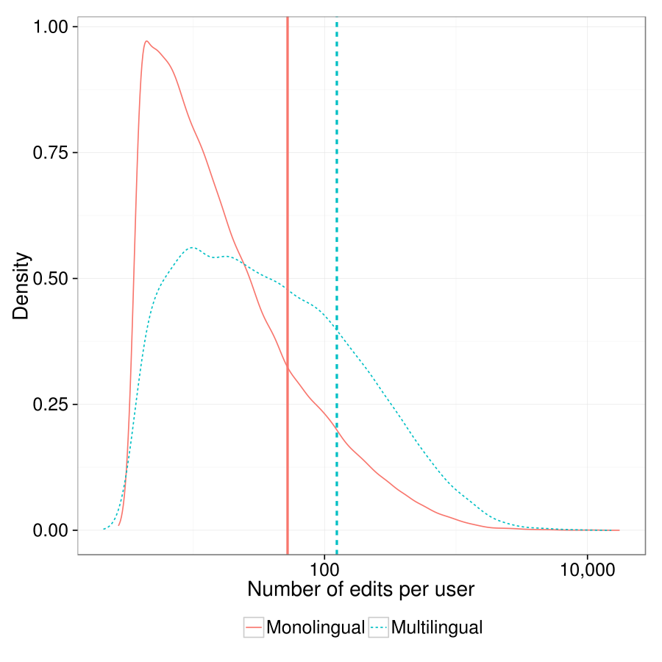
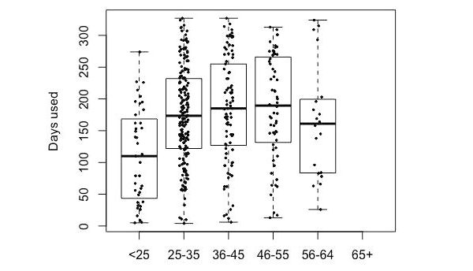
Distributional graphs
There is no exercise for this topic, but see this documentation for when you work on Assignment 1
Multiple density plots and medians
(note the logarithmic scale!)
Boxplot (with actual data superimposed)

Slide 16
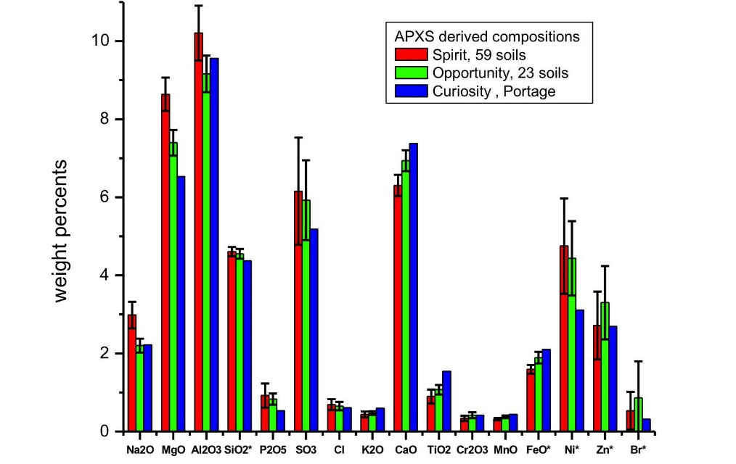
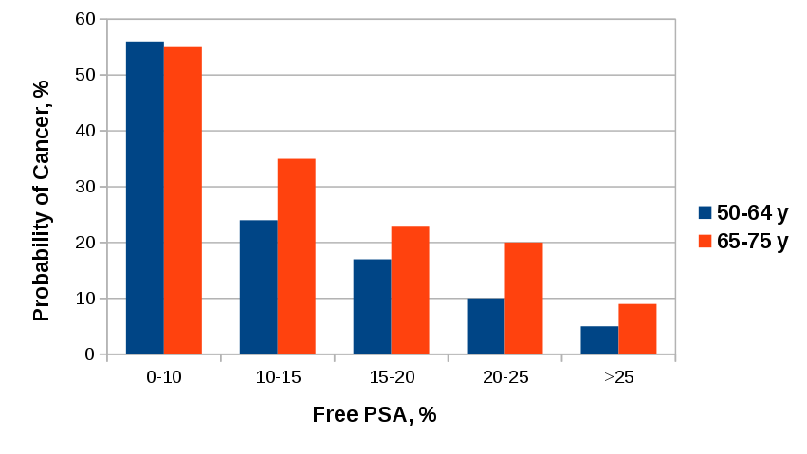
Bar graphs (summary data)
Without error bars (population data)
With error bars (sample data)

Slide 17
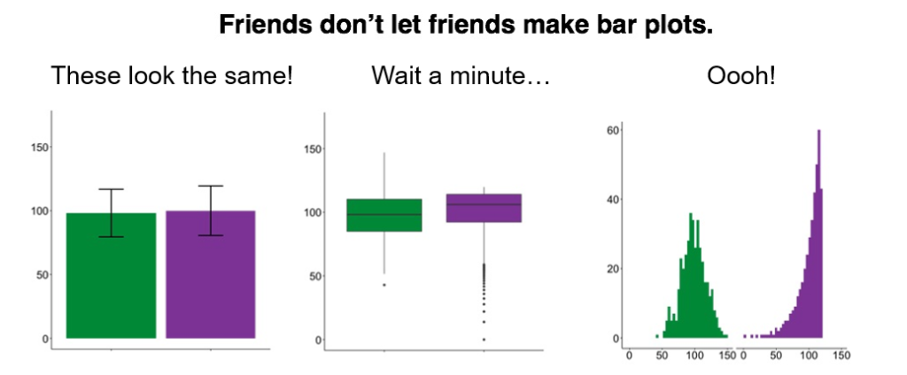
Bar graphs
Blog

Slide 18
Topics
Variables: terminology
Exploring 1 or 2 qualitative variables
Exploring relation between qualitative & quantitative variables
Correlation
Hypothesis testing

Slide 19
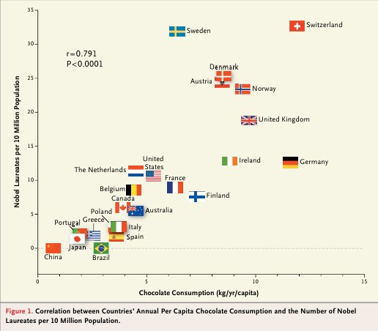
Relation between two quantitative variables: scatterplot
Does chocolate consumption really boost Nobel Award chances?
Maurage, Heeren, & Pesenti (2013)

Slide 20
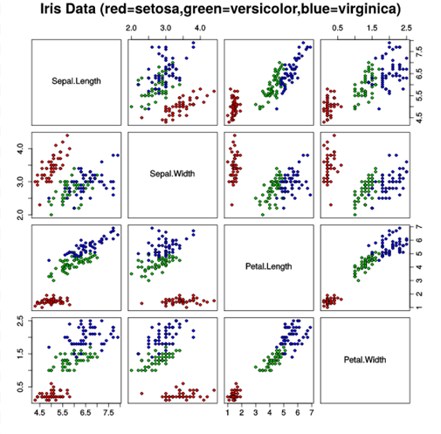
Scatterplot matrix

Slide 21
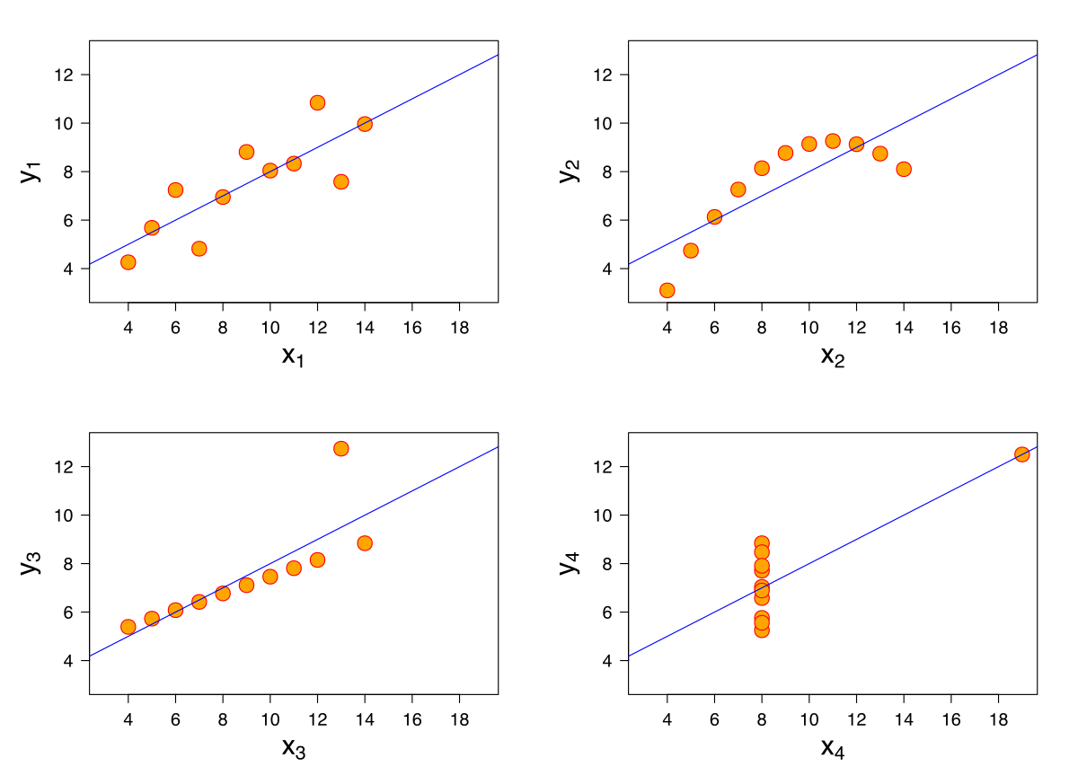
Anscombe’s quartet
All these data sets have the same mean, variance & correlation
Always visualize your data!

Slide 22
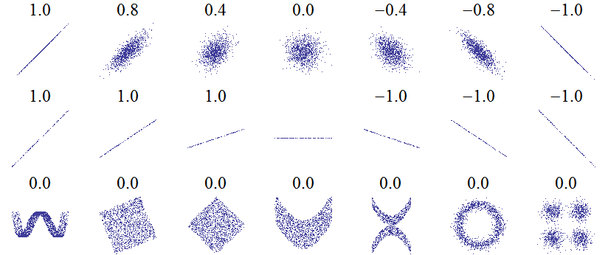
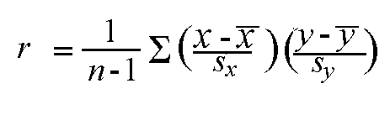
Correlation: Pearson’s r
Linear relations
Linear relations (perfect correlation)
Non-linear relations
r gives a measure of how much two quantative variables ‘move together’
Correlation is normalized. The variation in the X and Y values is ‘cancelled out’, so that the result is always between -1 and 1

Slide 23
Strength
Weak 0.1 < r < 0.3
Moderate 0.3 < r < 0.6
Strong > 0.6
Interpreation depends on context. Most correlations in social science are weak

Slide 24
Exercise 2: correlations
Choose three quantitative variables in the class data set that you expect are correlated.
Using Seaborn and Pandas, make:
A scatterplot matrix
A scatterplot of one combination of variables (think about which variable is most suited for x – the independent variable)
Comment on the linearity of the relationship.
Calculate Pearson’s r for this combination. Is the correlation significant (p < 0.05)?
What is your conclusion about the relation between the variables?

Slide 25
Topics
Variables: terminology
Exploring 1 or 2 qualitative variables
Exploring relation between qualitative & quantitative variables
Correlation
Hypothesis testing

Slide 26
Hypothesis testing
Research question: ‘Are paid apps rated higher than free apps?’
How to separate ‘real effects’ from sampling ‘noise’? Significance testing provides one answer
Hypotheses are always about the population. You already know the answer for the sample!
You start with the null hypothesis of no difference / no effect, and calculate a p-value (more on that later)
Hypothesis testing can be done in many statistical contexts

Slide 27



Hypothesis testing is like a court case…
Collect evidence
Presume innocence
Not enough evidence
(Not the same as not guilty)
A lot of evidence: guilty!

Slide 28
Hypothesis testing
Collect evidence in sample
→ calculate p-value
Presume no effect/difference
Not enough evidence for effect/difference
(Not the same as no effect/difference)
Lots of evidence: significant result
Difference/effect in population

Slide 29
Hypotheses
Null hypothesis and alternative hypothesis
H₀: µ_{paid_apps} = µ_{free_apps}
H₁: µ_{paid_apps} ≠ µ_{free_apps} (inverse of H₀)
(µ: mean in population)
Enough evidence against H₀ → reject H₀ and accept H₁
Not enough evidence against H₀ → keep H₀ (for the time being)

Slide 30
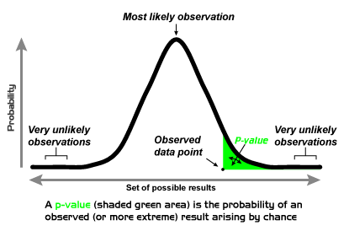
Now the tricky part… p-value
p is not the probability that there is a difference
p is the proportion of hypothetical samples more extreme than what you found, given H₀ (that there is no difference)
If p is too small (usually <0.05), you say: ‘Wow, that’s way too weird (wo)man! I don’t believe this really happened. H₀ must be false.’

Slide 31
Controversy
Seems kind of complicated, right?
You really want to know if there’s a difference, but instead you’re looking for evidence against the absence of a difference
Bayesian statistics instead tries to quantify one’s belief in a difference, but this is tricky too (this is actually a huge debate within statistics, but let’s leave it there…)

Slide 32
T-test
A t-test is a significance test of a mean difference between groups (or between different measurements within people)
Distribution has to be normal (generally when N > 30)
Result: t(30) = 5.21, p = 0.012
Degrees of freedom: closely related to sample size
T-statistic: how big is the difference, compared to the variation within the groups?
P-value
0.012 < 0.05, so significant!

Slide 33
Exercise 3: t-test
Perform a t-test with:
Independent variable: factor with two levels (gender, OS phone)
Dependent variable: quantitative variable of your choice
Report:
The t-statistic with degrees of freedom
The p-value
Whether there is a significant relation

Slide 34
Image credit
Nobel Prize and Chocolate by Maurage et al. (fair use)
Scatterplot matrix by Nicoguaro (CC-BY)
Anscombe’s quartet by Schutz (CC-BY-SA)
p-value by Repapetilto (CC-BY-SA)
Mars Curiosity by NASA (PD)
Bar bar plots by Page Piccinini (fair use)
Free PSA bar graph by The RedBurn (CC-BY-SA)
Edit count by Computermacgyver (CC-BY-SA)
Level of measurement by Johan van Berkel (HU)
Gavel by StockMonkeys.com (CC-BY)
Fingerprint by Pixabay.com (PD)

