Slide 1
Data-driven learning W5 L1: Excel training Correlation and linear regression
Jonas Moons

Slide 2



Check-in

Slide 3
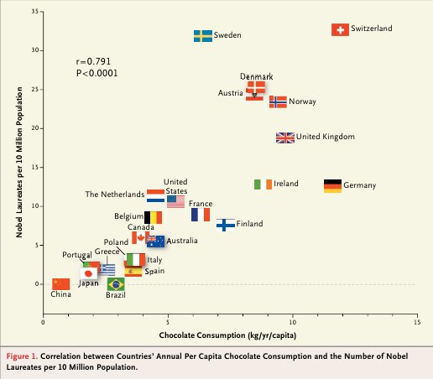
Does chocolate consumption really boost Nobel Award chances?
Maurage, Heeren, & Pesenti (2013)

Slide 4
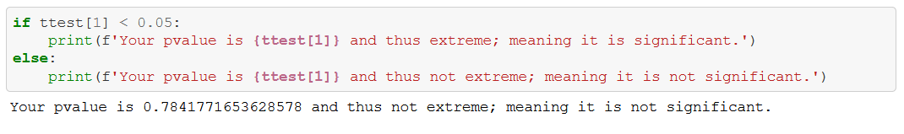
Feedback exercises
If you don’t have the latest version of Seaborn: pip install seaborn –upgrade in Anaconda prompt (thanks Leon)
Remember: p < 0.05 means it is a significant difference (counterintuitive for many)
IF-statement: nicely done! 👍

Slide 5
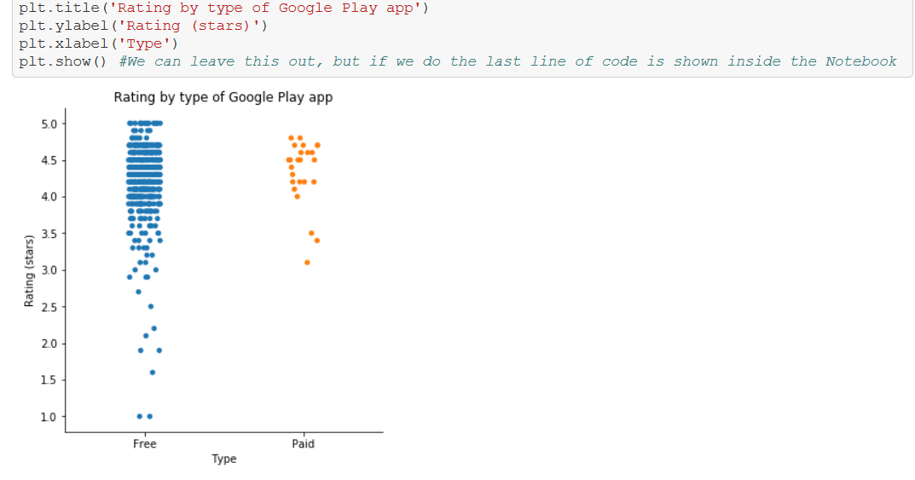
Feedback exercises
Don’t forget pretty, informative labels (capitalization, etc.)
You can also use
df[‘rating’].name = ‘Rating (stars)’
And then Seaborn should pick it up, but it doesn’t always seem to work. So I will use Matplotlib functions (plt)

Slide 6
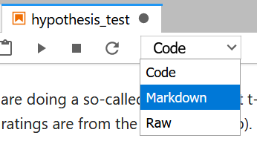


Feedback exercises
Use Markdown cells for text that is not directly referring to the code
Markdown cheatsheet

Slide 7
Topics
Excel training
Correlation
Simple linear regression

Slide 8
Excel: why or why not?
Why: business standard. You have to know it!
Why: easy to use and still quite powerful
Why not: not reproducible (alternative: Open Refine)
Why not: not effective for big datasets
Conclusion: not for serious data science, but very useful for quick ’n dirty stuff

Slide 9
Exercise 1: Excel training

Slide 10
Topics
Excel training
Correlation
Simple linear regression

Slide 11
Relation between two quantitative variables: scatterplot
Does chocolate consumption really boost Nobel Award chances?
Maurage, Heeren, & Pesenti (2013)

Slide 12
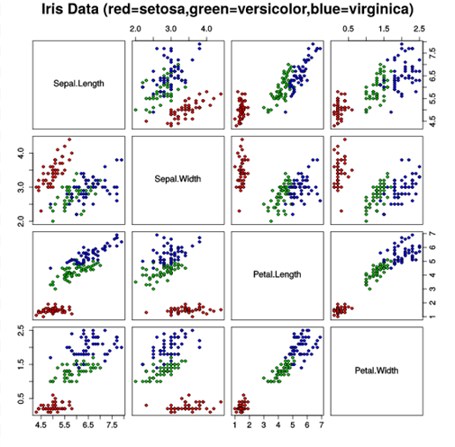
Scatterplot matrix

Slide 13
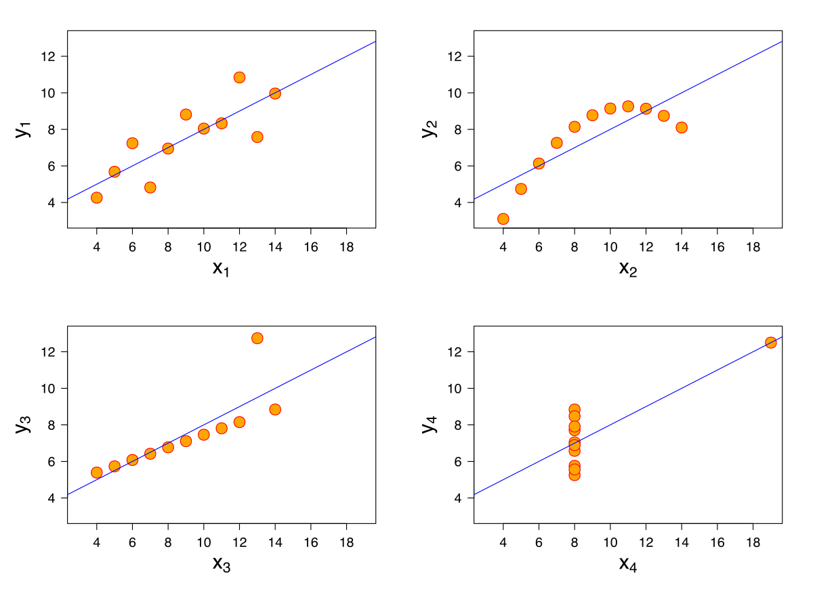
Anscombe’s quartet
All these data sets have the same mean, variance & correlation
Always visualize your data!

Slide 14
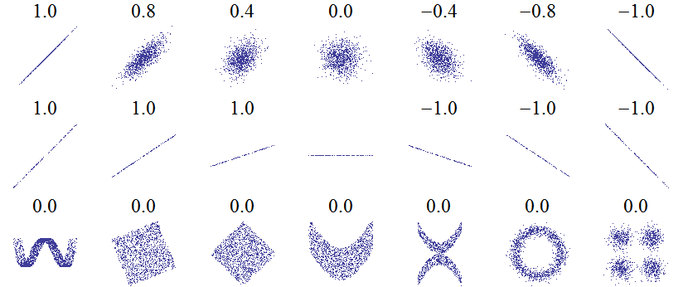
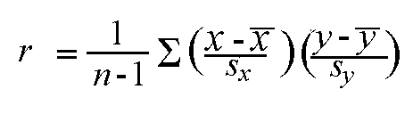
Correlation: Pearson’s r
Linear relations
Linear relations (perfect correlation)
Non-linear relations
r gives a measure of how much two quantitative variables ‘move together’
Correlation is normalized. The variation in the X and Y values is ‘cancelled out’, so that the result is always between -1 and 1

Slide 15
Strength
Weak 0.1 < r < 0.3
Moderate 0.3 < r < 0.6
Strong > 0.6
Interpretation depends on context. Most correlations in social science are weak

Slide 16
Introducing the library and data set
sk-learn is the standard library for statistics and machine learning. We will be working with it a lot. Used in theird exercise
Scraped Funda data set: house listings in Amsterdam. Will be used these two weeks.

Slide 17
Exercise 2: correlations
See the correlation Notebook in Examples
Choose three quantitative variables in the Funda data set that you expect are correlated. Include price.
Remember that you can select columns in Pandas by using:
df_subset = df[[‘col_name1’, ‘col_name2’, ‘col_name3’]]
After you do step (1) below, you will find that you need to some pre-processing (some values are implausible). Rather than replacing them with NaN (like in the Fitbit example), it seems better to remove these rows completely. Remember how to subset a dataframe?
Using Seaborn and Pandas, make:
A scatterplot matrix
A scatterplot of one combination of two variables (think about which variable is most suited for x – the independent variable)
Comment on the linearity of the relationship.
Calculate Pearson’s r for this combination
What is your conclusion about the relation between the two variables?

Slide 18
Topics
Excel training
Correlation
Simple linear regression

Slide 19
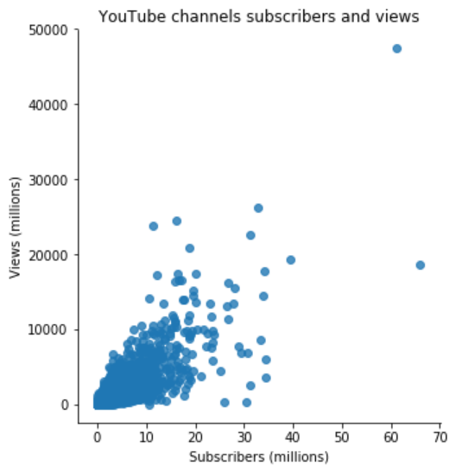
Linear relation
The points in the scatter plot seem to be centered around a line, with some variation
Variance in views seems to increase with subscribers (more on that on Wednesday)

Slide 20
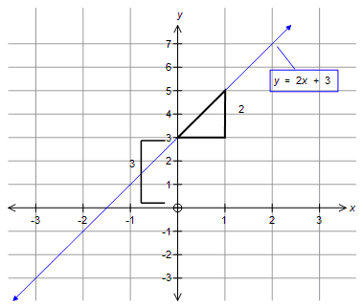
Linear relation

Slide 21
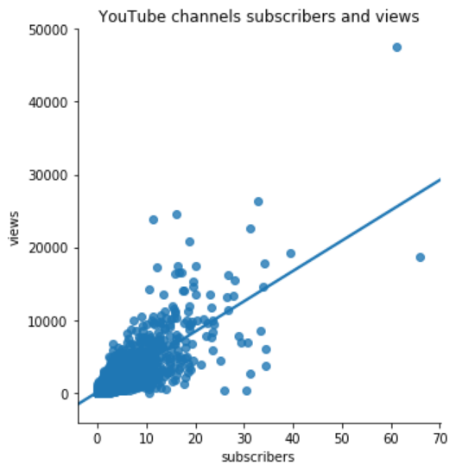

Linear regression formula
e ≈ -27,000M
$$Y=b_{0}{+ b}_{1}X+e$$
e ≈ 10,000M
Y = dependent variable: views
X = independent variable: subscribers
Coefficients (constant):
b₀ = intercept: how many views with no subscribers = 4.5M
b₁ = slope: views per subscriber = 416.7
e = error / residual: what’s left over, what we can’t explain
The algorithm that finds the line minimizes the squared errors

Slide 22

Example data points
$$Y=b_{0}{+ b}_{1}X+e$$
Channel | X (subscribers) | Y (views) | b₀ | b₁ | Y’ (predicted views) | e (residual)
PewDiePie | 66M | 19000M | 4.5M | 416.7 | 28000M | -9000M
(Numbers are rounded down here and there to make it clearer)

Slide 23
Example data points
$$Y=b_{0}{+ b}_{1}X+e$$
Channel | X (subscribers) | Y (views) | b₀ | b₁ | Y’ (predicted views) | e (residual)
PewDiePie | 66M | 19000M | 4.5M | 416.7 | 28000M | -9000M
Taylor Swift | 28M | 16000M | 4.5M | 416.7 | 12000M | 4000M
(Numbers are rounded down here and there to make it clearer)

Slide 24
Example data points
$$Y=b_{0}{+ b}_{1}X+e$$
Channel | X (subscribers) | Y (views) | b₀ | b₁ | Y’ (predicted views) | e (residual)
PewDiePie | 66M | 19000M | 4.5M | 416.7 | 28000M | -9000M
Taylor Swift | 28M | 16000M | 4.5M | 416.7 | 12000M | 4000M
Eminem | 30M | 300M | 4.5M | 416.7 | 13000M | 12700M
(Numbers are rounded down here and there to make it clearer)

Slide 25
Exercise 3: linear regression
See the linear_regression Notebook in the Examples folder
Using Seaborn, Pandas and sk-learn:
Import the Funda data set (or continue in the same Notebook as Ex. 2)
Clean up the price variable as in Exercise 2. Make a scatter plot of price and surface area, both with and without a regression line. Which should be X and which should be Y?
Train a linear model for the relation using sk-learn. Write down the complete formula with X, Y and the coefficients b₀ and b₁ (as numbers). Use a Markdown cell.
Predict the price for a house of 70 m²
Use sk-learn to predict the price for all the houses in the dataset. What is the prediction for Slichtenhorststraat 10? What is the residual? Note: how to get this value is not in the example Notebook, but perhaps you can figure out how to retrieve it.

Slide 26
So…
Is it a good model?
You’ll learn more about how to evaluate linear regression models on Wednesday

Slide 27
Image credit
Nobel Prize and Chocolate by Maurage et al. (fair use)
Scatterplot matrix by Nicoguaro (CC-BY)
Anscombe’s quartet by Schutz (CC-BY-SA)

