Slide 1
Data-driven learning W5 L2: Evaluation of linear regression Overfitting and model validation Multiple linear regression
Jonas Moons

Slide 2



Check-in

Slide 3
Intro

Slide 4
Topics
Evaluation of simple linear regression
Overfitting and model validation
Multiple linear regression

Slide 5
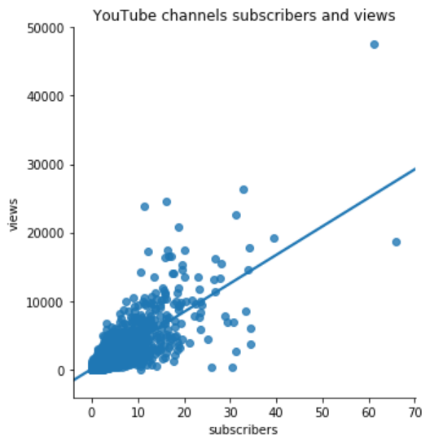


Assumptions of simple linear regression
Linearity (the points are around a straight line, not on a curved line)
Equal variance (the distance between the points and the line does not change very much)
Residuals are normally distributed (ignore this one for now)

Slide 6
Inspect residuals/errors

Slide 7
Transformations
Sometimes a transformation of a variable can improve the model fit
Typical transformations include:
¹⁰log(x)
√(x)
Remember to apply the reverse transformation

Slide 8
Exercise 1: evaluation
Continue in the Notebook with the regression from Exercise 3 from the last lesson. We are going to evaluate the fit of the model, with:
X: surface area in m²
Y: price in euros
What is the R² of the model?
What is the mean squared error (MSE)?
Calculate the residuals (e) and add them to the dataframe
Make the following plots:
A scatter plot of (Y, Y’) (Y’ means predicted Y)
A scatter plot of (X, e)
What is your conclusion about the fit? Which houses (with
Try to improve the model fit by transforming one or both of the variables

Slide 9
Topics
Evaluation of simple linear regression
Overfitting and model validation
Multiple linear regression

Slide 10
Experience overfitting

Slide 11
Exercise 2: model validation
Split data into two
Train on train set
Plot train & test set (?)
Calculate R^2 for both, MSE

Slide 12
Topics
Evaluation of simple linear regression
Overfitting and model validation
Multiple linear regression

Slide 13
Qualitative variables

Slide 14
Exercise 3
Fit model with multiple variables?
Write down formula
Colinearity? -> leave out bedrooms?
Evaluate mode performance
Predict value

