Slide 1
Feedback
Jonas Moons
All images are either own work, public domain, CC-licensed or fair use
Credits on last slide

Slide 2
Linear regression
Select variables based on how well they predict, using a correlation matrix and/or scatterplot matrix

Slide 3
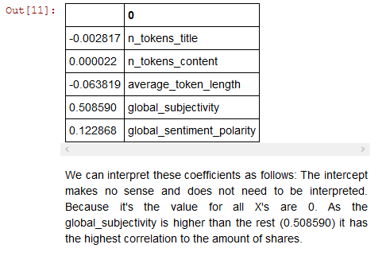
Linear regression
Only when variables are normalized!

Slide 4
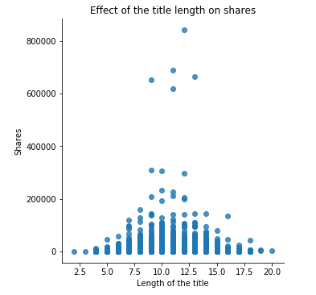
Non-linear relations
What transformation could you apply on length?
e.g. |11.5 – length|
| | = absolute value, always positive

Slide 5
Which model?
 | Interpretation: easy | Interpretation: black box
Classification | Decision tree | k-NN Random Forest Naïve Bayes
Regression | Linear regression | k-NN Random Forest
Read online blogs and/or in journal articles
Try out performance
Settle on an algorithm first, then optimize

