Slide 1
Data-driven learning W6 L2: Machine learning: supervised learning Decision trees and Random Forest
Jonas Moons

Slide 2



Check-in

Slide 3
Intro

Slide 4
Feedback

Slide 5
Recap
‘the study of algorithms and statistical models that computer systems use to progressively improve their performance on a specific task.’ (Wikipedia)
Supervised learning vs. unsupervised learning
Classification vs. regression
Algorithm: k-nearest neighbor

Slide 6
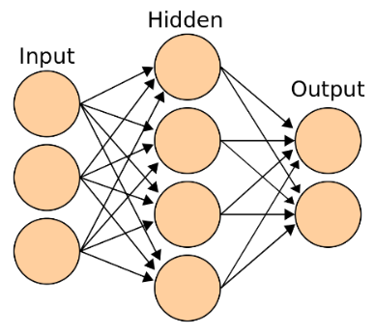
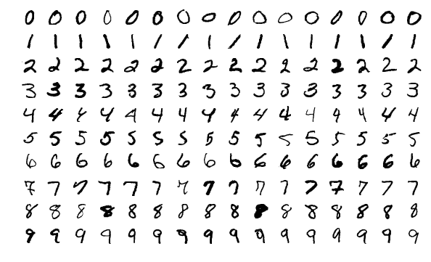
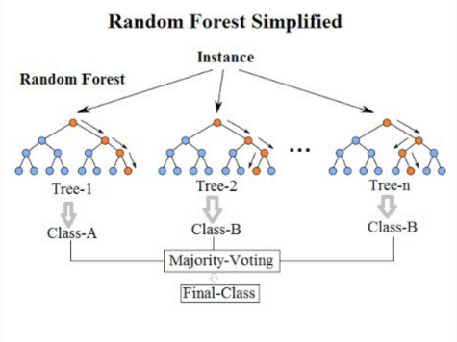


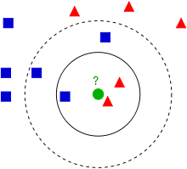
More machine learning…
Algorithms
Applications
Neural network (deep learning)
playground
Random Forest
k-nearest neighbor
And many, many more…

Slide 7
Topics
Decision tree
Parameter setting
Random Forest

Slide 8
Decision tree: intuition
I need a volunteer…

Slide 9
Decision tree algorithm
Choose a Y variable to predict
At each node of the tree calculate the X variable & cut-off point that produces the optimal split for the Y variable
Optimal: large variance (difference) between branches, small variance (similarity) within branch
Stop when you have ‘pure’ leaves
Predict
iPhone users
Uses Mac computer
Into design

Slide 10
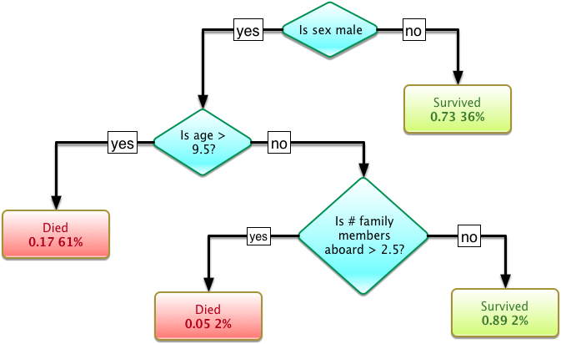
Titanic decision tree
36%: percentage of all cases
0.17: proportion survived

Slide 11
Pros and cons of decision tree
Advantages
Easy to interpret
Not a ‘black box’ algorithm
Easy to communicate to other professionals, e.g. clinicians
Disadvantes
Overfits easily (pruning helps)
Not a very strong algorithm in terms of prediction

Slide 12
Pruning
Pruning removes nodes from the tree using a certain algorithm
Many methods of pruning
Pruning reduces overfitting

Slide 13
Exercise 1
Decision tree

Slide 14
Topics
Decision tree
Parameter setting
Random Forest

Slide 15
Topics
Decision tree
Parameter setting
Random Forest

Slide 16
Random Forest
Random Forest is an extension of decision tree (Ho, 1995; Breiman, 2001)
Intuition:
Grow many different trees
Train each on a different sample of the data
Let them vote on the case to be predicted
Random Forest improves accuracy (at the cost of interpretability)

Slide 17

Random Forest

Slide 18
Feature importance

Slide 19
Exercise 2
Random Forest

Slide 20
Time for working on assignments

Slide 21
Image credit
MNIST data set by Josef Steppan (CC-BY-SA)
Spam by Etonic (CC-BY-SA)
k-NN by Antti Ajanki (CC-BY-SA)
Neural network by Cburnett (CC-BY-SA)
Titanic survival tree by DIary (CC-BY-SA)
Random Forest by Venkata Jagannath (CC-BY-SA)

