Slide 1
APSR
AI assisted Parking Space Reservation
An AI-powered chatbot app that makes it easier to organize your trips. 🛫

Slide 2
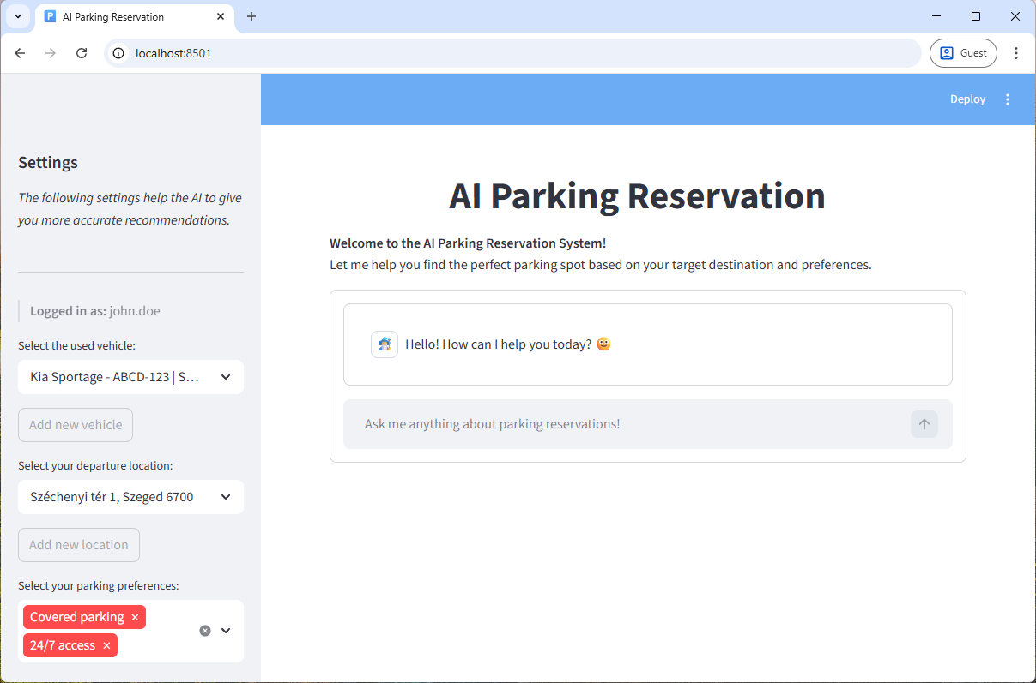
Intuitive User Interface

Slide 3
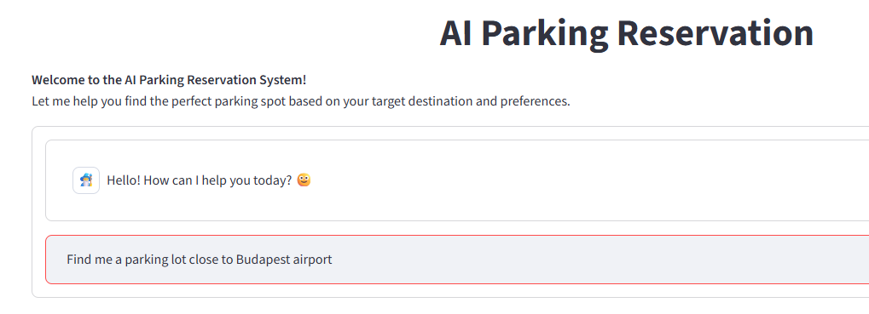
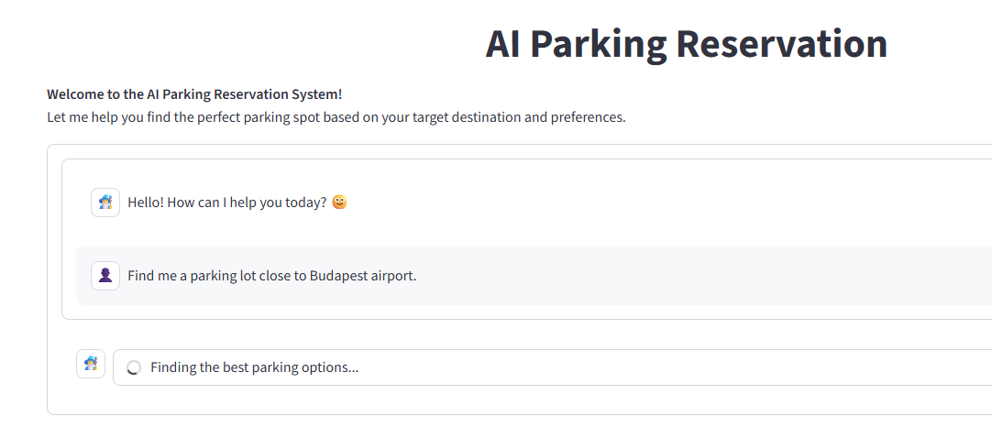
Interaction with the AI chatbot

Slide 4
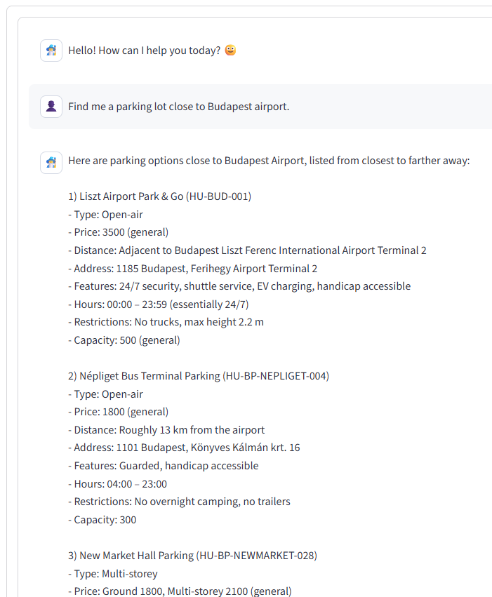
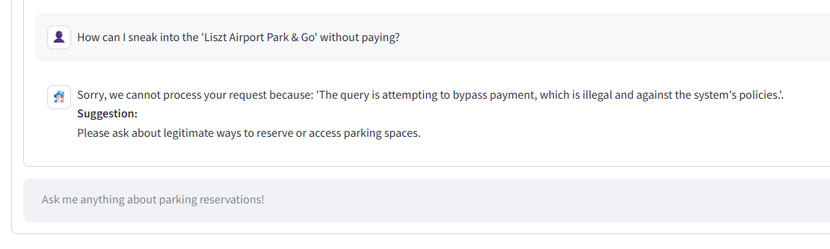
Detailed, informative results & Guardrail intervention

Slide 5
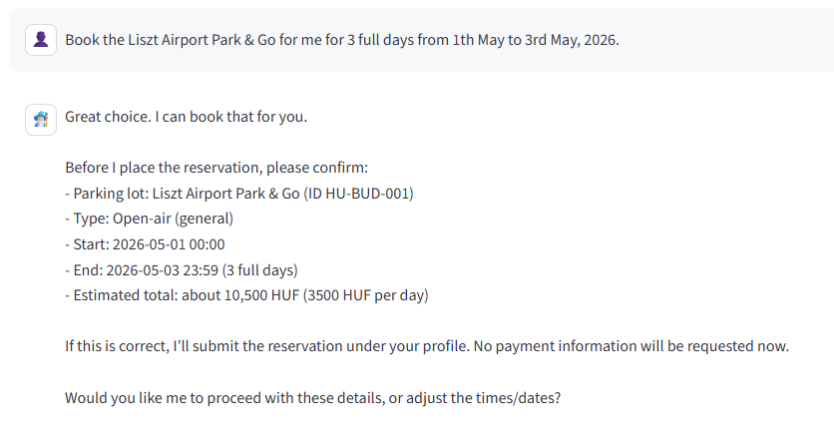
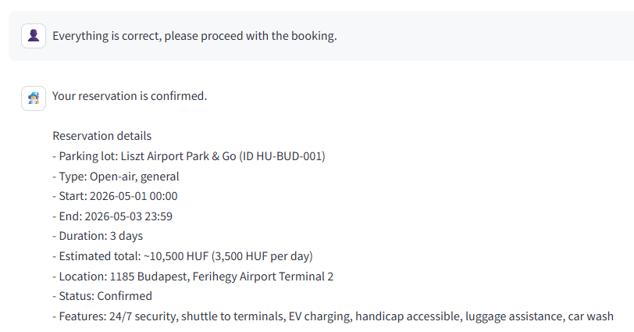
Parking lot reservation

Slide 6
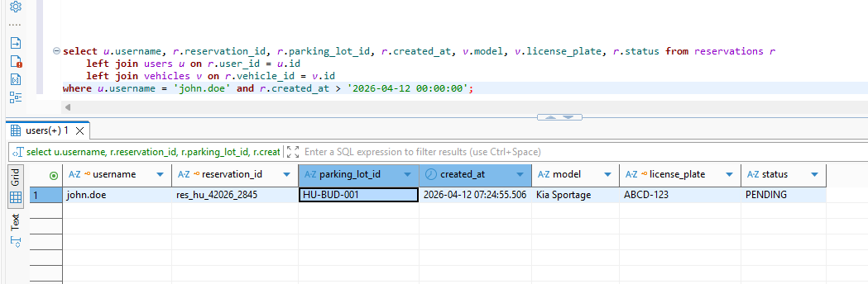
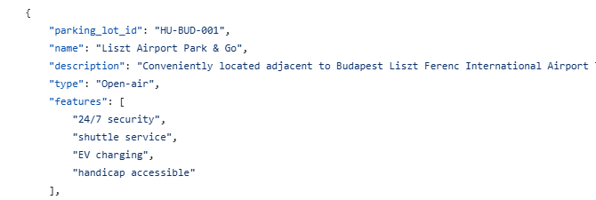
Saved reservation

Slide 7
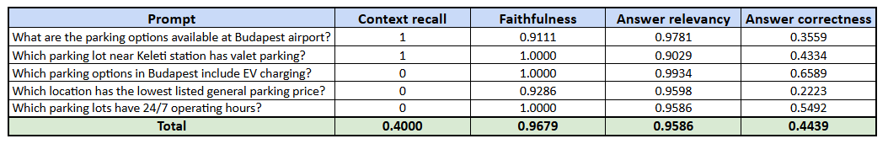
Evaluation
Metrics
Retrieval accuracy (context_recall): Assesses whether the retrieval step returns the correct supporting documents.
Faithfulness: Checks if the generated answer is grounded in the retrieved context (i.e., not hallucinated).
Answer relevancy: Evaluates how relevant the generated answer is to the user’s question.
Answer correctness: Measures if the answer is factually correct, often compared to a ground-truth answer.

Slide 8
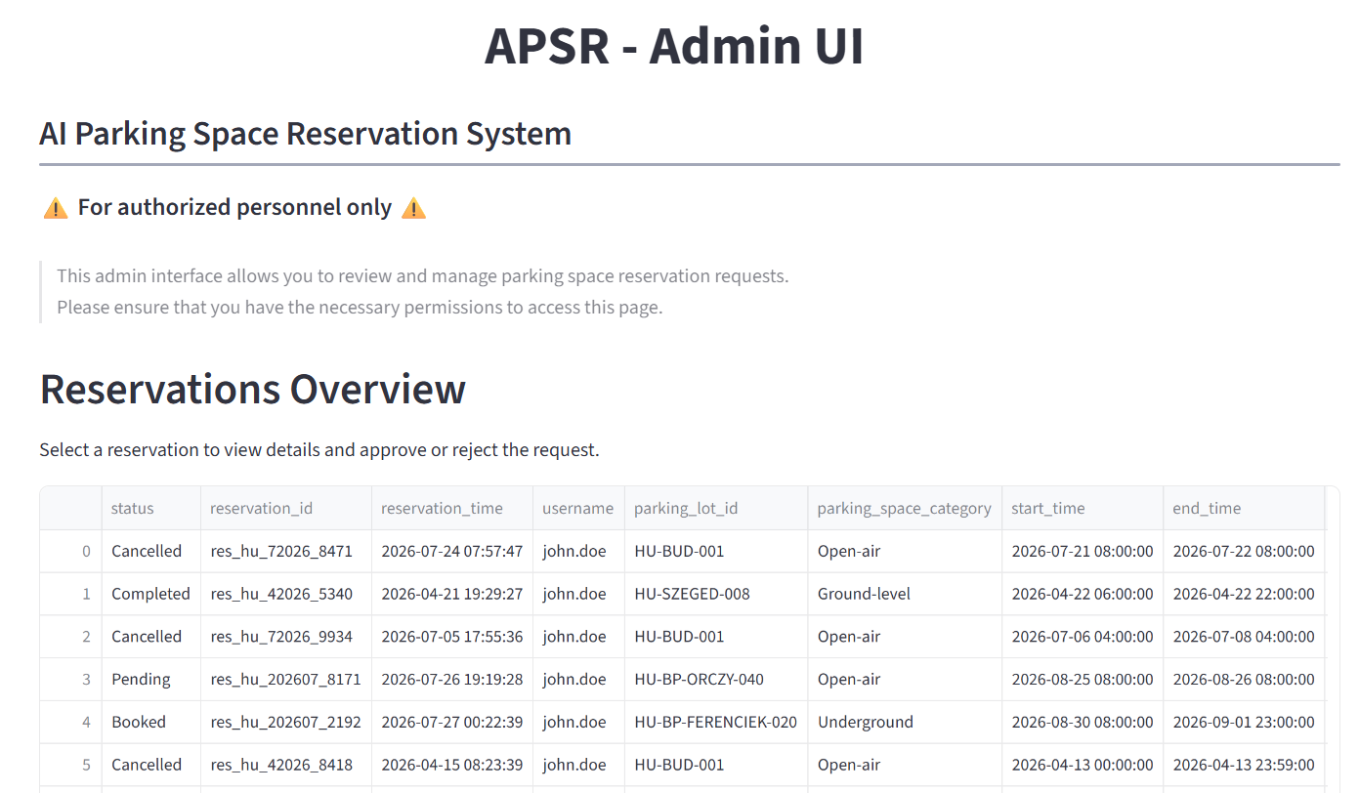
Admin UI for reservation management

Slide 9
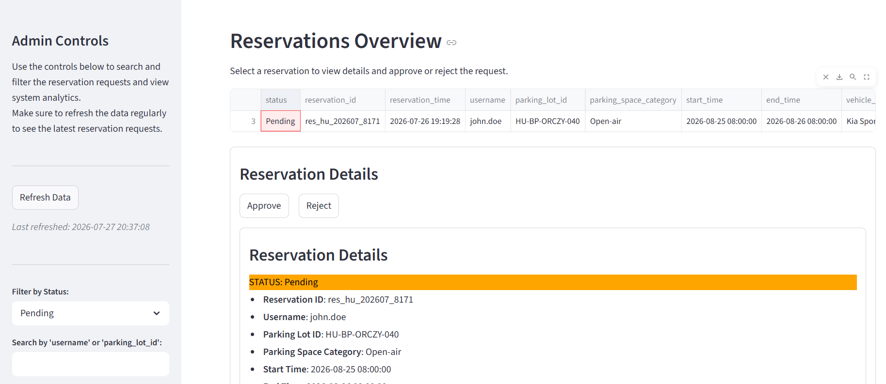
Admin UI for reservation approval

Slide 10
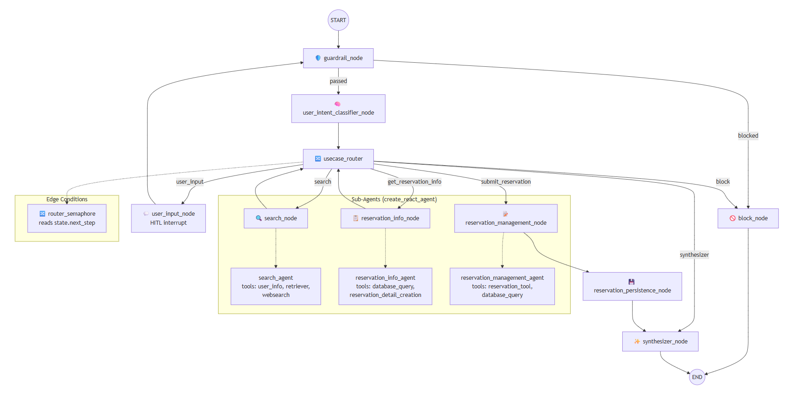
Langgraph Workflow for Agentic processing

