Slide 1
Python Implementations
CPython
Stackless Python
PyPy
Jython
MicroPython
Programs or environments which provides support for the execution of programs written in the Python language
Python implementations (python.org)

Slide 2
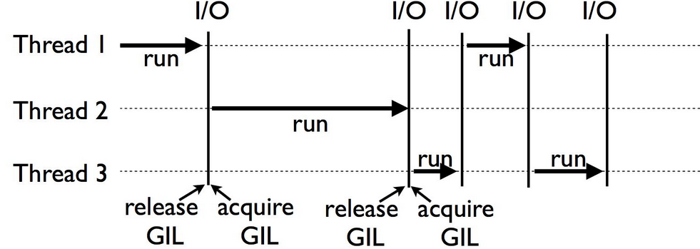
CPython The reference implementation of the Python programming language
Guido van Rossum's reference version of the Python computing language that most often called simply ”Python”.
Features:
Multi-platform
Global interpreter lock (GIL)
Garbage collected
Precompiled interpreted
Python source code (.py)
Python bytecode (.pyc)
CPython Virtual Machine
CPython Compiler
CPython interpreter
Windows
Linux
Mac
Notes:
GIL: "An interpreter that uses GIL always allows exactly one thread to execute at a time."
https://en.wikipedia.org/wiki/Global_interpreter_lock
Garbage collection:
Reference counting - DEFAULT (can't disable)
Generational garbage collection - CUSTOMIZABLE

Slide 3
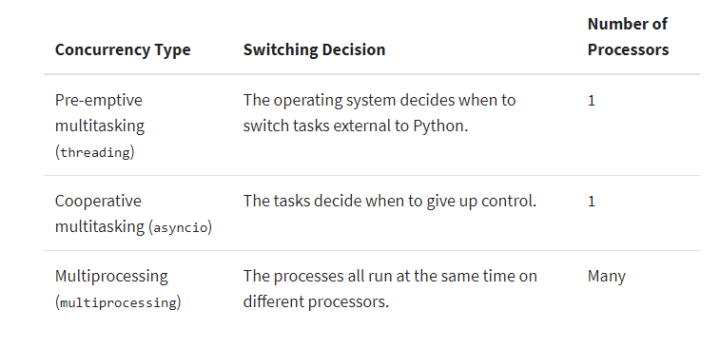
CPython
Limitations:
Lack of performance optimizations
Slower than C, C++ or Java
Missing native JIT compiler
Multi-threading (multi-processing) is not supported.
Notes:
Influencing factors of performance:
Interpreted
statically typed
no JIT compiler
limited by design:
maintainers want CPython to be the most broadly compatible
20 years ago no phones with 4 CPUs

Slide 4
Stackless Python Branch of CPython supporting microthreads
Allows to take the advantage of thread-based programming in python. Avoid using the C call stack instead its own stack.
Stackless Python uses the C stack, but the stack is cleared between function calls.
Features:
Microthreads: tasklets wrap functions allowing them to be launched as microthreads (not real concurrency)
Channels can be used for bidirectional communication between tasklets
Scheduler is built in. It can be used to schedule tasklets either cooperatively or preemptively
Serialization: tasklets can be serialized to disk through pickling for later resumption of execution.
Lightweight
Has scheduler to manage tasklets
Support preemptive scheduling
Communication between tasklets
Exceptions within tasklets are expected to reach the scheduler (hard to track down issues)
Debugging is not likely to work
Notes:
Allows lightweight thread-based programming without performance and complexity problems.

Slide 5
PyPy A fast python implementation with a JIT compiler
Pros
Cons
Total speed
Use JIT compiler instead of AOT compilation
Translated code gets cached
Stackless
Use Stackless Python
Memory usage Memory-intensive python programs take lesser space when running on pypy
Compatible with most of the python libraries (Django, Flask, Numpy, Scipy,…)
Debuggers work as well as in python
Limited CPU architecture support
Not work on all Linux distro
Support only 2 version
pypy: python-2.7.13
pypy3: python-3.6.9
Currently the speed is noticeable only on python code
Startup times can be higher
C extensions are limited and need to be recompiled for PyPy
x86 (IA-32) and x86_64
ARM platforms (ARMv6 or ARMv7, with VFPv3)
AArch64
PowerPC 64bit both little and big endian
System Z (s390x)

Slide 6
Jython Python running on the Java Virtual Machine
Jython is a Python compiler written in Java
It compiles Python source code into JVM bytecode (class, jar,…) that runs on a standard JRE
Python programs compiled with Jython
can call standard Java libraries
can be called by code written in Java.

Slide 7
Jython
Python (CPython)
Jython
Written in C and Python
Multi-platform
Compiles to .pyc
Extend with C
GIL (Global interpreter lock)
Python Garbage Collection
Written in 100% Java
Runs on any JVM
Compiles to .class
Extend with Java
Multi-threaded
Java garbage collection

Slide 8
Jython
Pros
Cons
Reusability of Java features and legacy codes, classes,…
Java bytecode compilation
Multi-threading
Only Python 2.7 is supported
Python 3.x has been under development for a long time
Lack of android support

Slide 9
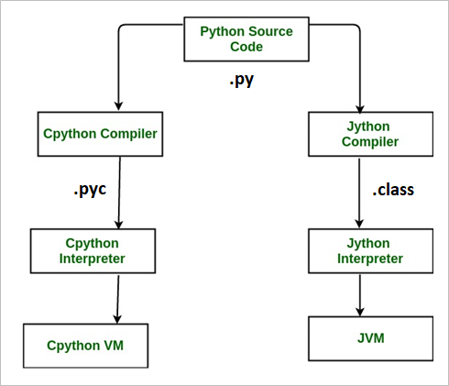
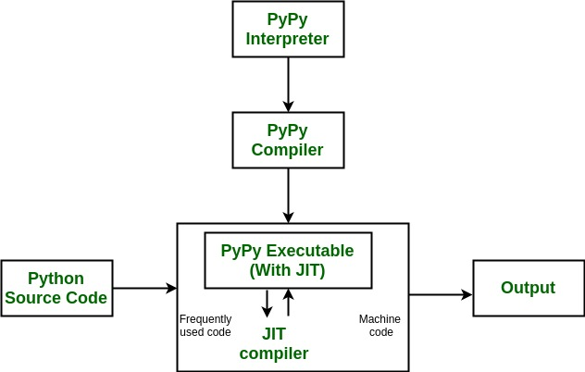
Comparison of the different interpreters
CPython
Jython
PyPy
Notes:
Stackless:
In this context Stackless is exactly same as CPython.
Stackless is completely compatible with Standard Python, it just adds some functionality.
The interpreter is changed internally, but there is no change of behavior, unless the Stackless features are used.

Slide 10
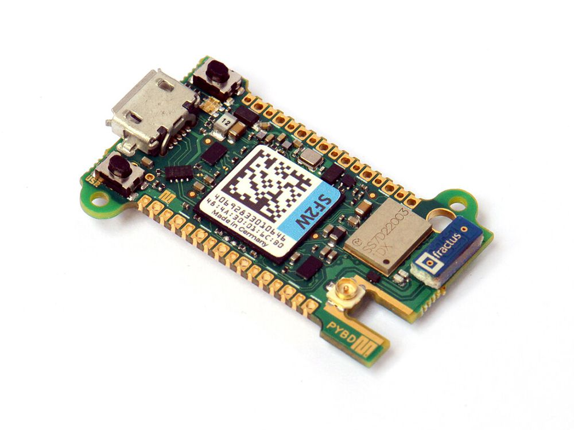
MicroPython Python running on micro controllers
Using Microcontrollers
Get the one best suited for your task
Download firmware for said microcontroller.
Find the reference manual for the controller Pins
Use software to write the specific program onto the controller

Slide 11
MicroPython
Micropython VS Arduino
 | Micropython | Arduino
OS | Micropython (Mostly) | C
Compile time | Fast | Slow
Run time | Slower | Faster
Code Storage | Controller(Bytecode in mem.) | PC (Only bytecode on controller)
Why Micropython?
Ecosystem
256k storage 16k mem
Advanced features(list comprehension, exception handling)
We are going to use it anyhow

Slide 12
References useful links & articles
General references in the topic
Alternative Python Implementations
12 Pythons for every programming need
Python Global Interpreter Lock (GIL)
Python Garbage Collection: What It Is and How It Works
Speed Up Your Python Program With Concurrency
Comparing Python to Other Languages

Slide 13
References useful links & articles
CPython
How Does Python Code Run: CPython And Python Difference
Stackless Python
Stackless-python
PyPy
Getting Started with PyPy
CPython vs PyPy Memory Usage
Jython
The Definitive Guide to Jython (official documentation)
Jython - Quick Guide (tutorialspoint.com)
MicroPython
Pyboard 1.0 reference
Sandbox

