Slide 1
HVIA DATA & AI SOLUTIONS · CASE STUDY 3 · COTTONIL
×10.8
Cottonil grew 10.8× in six years. What holds the next step back?
×2.1
What eight years of sales say, the six problems behind the growth, and the automations we built to act on them.
net revenue
pieces sold
2019 → 2025
841M
540,000
74,660
8 years
EGP net revenue
orders
buyers
Oct 2018 – Oct 2026
Prepared by Amir · October 2026 · All figures computed from the client extract and re-checked by an independent audit

Slide 2
THE BUSINESS IN NUMBERS
An 841M EGP business that peaks every November and December
841.3M
289.2M
Revenue by month of year
Index, average month = 100, calendar years 2019–2025
EGP net revenue, Oct 2018 – Oct 2026
EGP in the last 12 months (Oct 2025 – Sep 2026)
540,000
74,660
orders · 3.40M pieces
buyers out of 85,000 registered customers
38.3%
3 channels
gross margin, the same every year since 2019
stores 49% · wholesale 38% · online 13% of net
Source: Cottonil sales extract, 19 Oct 2018 – 18 Oct 2026 · net before tax · EGP
2

Slide 3
HOW WE CHECKED OUR OWN WORK
We tested our first readings. Five of them changed
First reading
What checking showed
What we did
Stock
36.2 months of stock means overstock
Stores hold 6.2 months, the warehouse 30.0, and stock does not move with sales
No stock decision until a stock ledger exists
✕
✓
Purchasing
We buy about 100× what we sell
Each product gets about the same order quantity whatever it sells (correlation 0.03)
Ask which business the purchase orders cover
✕
✓
Marketing
Campaigns claim 44.6× the real orders
The figure is clicks × a fixed rate, not orders; orders carry no campaign ID
No ROI claim; ask for a campaign ID and a holdout
✕
✓
Customers
Each new customer group is less loyal
2018 and 2024 joiners order at the same rate; the list grew 6×, orders 2.1×
Lead with orders per customer: 2.79 → 0.99
✕
✓
Discount
Margin stays flat whatever the discount
Line margin falls from 41.0% to 29.2% as the discount deepens
Built the discount guardrail
✕
✓
Sales and customer records pass every check, so every decision in this deck rests on them. 28 of 28 headline numbers were reproduced by an independent audit.
Source: Cottonil sales extract, 19 Oct 2018 – 18 Oct 2026 · net before tax · EGP
3

Slide 4
PROBLEM 1 OF 6
Growth comes from price, not from selling more pieces
×5.1 vs ×2.1
Revenue, price per piece and pieces sold
Index, 2019 = 100, calendar years
price per piece vs pieces sold, 2019 → 2025
Revenue grew ×10.8 from 2019 to 2025, mostly from a higher price per piece. 2026 so far: revenue +32.6%, pieces +8.1%.
If price rises slow, growth slows. Volume is the part Cottonil controls.
Recommend
Who acts: CFO, Commercial director
Track price vs volume every month in the weekly digest.
Test the next price rise in a few branches before rolling it out.
Limit how growth is made up, not proof of pricing power: no competitor price or price test.
Source: Cottonil sales extract, 19 Oct 2018 – 18 Oct 2026 · net before tax · EGP
4

Slide 5
PROBLEM 2 OF 6
Two men's categories carry 42.6% of revenue
42.6%
Share of net revenue by category
Full history, top 6 of 16 categories, %
of net revenue from men's boxers and men's tops
The top 10 of 139 products make 36.1% of revenue. Socks move 26.8% of all pieces but only 13.8% of revenue.
A shock to one men's line (supply, a competitor, fashion) hits the whole year.
Recommend
Who acts: Head of merchandising
Protect stock of the top 10 products before late October.
Grow women's and kids' lines by offering them to existing men's buyers.
Limit based on catalogue categories; the data has no substitution or stock-out signal.
Source: Cottonil sales extract, 19 Oct 2018 – 18 Oct 2026 · net before tax · EGP
5

Slide 6

PROBLEM 3 OF 6
Each customer orders less: 2.79 → 0.99 orders a year
23,063
Orders per registered customer per year
Registered orders ÷ registered customers, calendar years
buyers (30.9%) with no order in over a year
The customer list grew 6× while their orders grew 2.1×.
2,645 of the quiet buyers are high-value, with 58.2M EGP of past spend.
Built
Who acts: CRM manager
Reactivation workflow: monthly list, one Arabic message per category, 10% held back to measure the lift, sent only after the CRM manager says yes.
Scenario: each 1% who return once ≈ 102K EGP.
Limit the data cannot say why customers stop; 19% of orders have no customer.
Source: Cottonil sales extract, 19 Oct 2018 – 18 Oct 2026 · net before tax · EGP
6

Slide 7
PROBLEM 4 OF 6
Every discount point comes out of margin
41.0% → 29.2%
Gross margin by line discount
All order lines, full history, %
gross margin, full-price lines vs lines discounted 15–25%
Return rates stay flat at about 2.5% in every band, so deeper discounts buy no extra loyalty.
A 10% cap would have kept 1.84M EGP in the last 12 months, if the same lines still sold.
Built
Who acts: Commercial director, Finance
Discount guardrail: a daily check against the last 28 days, with an alert and one action.
Policy: discounts above 15% need sales-manager approval.
Limit no price experiment, so how much volume a cap would lose is unknown.
Source: Cottonil sales extract, 19 Oct 2018 – 18 Oct 2026 · net before tax · EGP
7

Slide 8
PROBLEM 5 OF 6
Profit grew because costs grew slower than sales
29.1% → 13.6%
Operating costs and EBITDA proxy
% of net revenue, calendar years
operating costs as % of net revenue, 2019 → 2025
Gross margin stayed near 38.3% every year, so the higher profit came from costs, not from pricing.
It holds only while revenue keeps outgrowing costs.
Check first
Who acts: CFO
Payroll covers 185 of 640 staff in 2025. If all were paid, the 2025 EBITDA proxy would turn negative.
Confirm real headcount before quoting any profit figure.
Limit payroll and campaign spend may sit outside these tables.
Source: Cottonil sales extract, 19 Oct 2018 – 18 Oct 2026 · net before tax · EGP
8

Slide 9
PROBLEM 6 OF 6
One in five orders has no customer attached
19.1%
Orders with and without a customer attached
All 540,000 orders, Oct 2018 – Oct 2026
of orders (102,961) have no customer ID
The share is the same in every channel and every year, and these orders are worth the same.
These buyers cannot be thanked, reached again, or counted as returning.
Recommend
Who acts: Retail operations
Ask for a phone number at the till (e-receipt or loyalty points).
Target: halve the anonymous share in 6 months; track it in the weekly digest.
Limit every customer figure in this deck undercounts by about 19%.
Source: Cottonil sales extract, 19 Oct 2018 – 18 Oct 2026 · net before tax · EGP
9

Slide 10
FROM PROBLEMS TO OWNERS
Six problems, six owners. Two already have a working fix
#
Problem
Who acts
Status
Value (scenario)
1
Growth comes from price, not pieces
CFO, Commercial
Recommend
—
2
42.6% of revenue from two men's categories
Merchandising
Recommend
—
3
Each customer orders less (2.79 → 0.99)
CRM manager
Built
≈102K EGP per 1% of 2,645 who return
4
Every discount point comes out of margin
Commercial, Finance
Built
up to 1.84M EGP a year at a 10% cap
5
Profit rests on costs growing slower
CFO
Check first
confirm headcount first
6
One in five orders has no customer
Retail operations
Recommend
—
Built = running in n8n today. Scenario values assume volume holds; they are not forecasts.
Source: Cottonil sales extract, 19 Oct 2018 – 18 Oct 2026 · net before tax · EGP
10

Slide 11




HOW THE SOLUTIONS RUN
Numbers come from SQL, n8n runs the routine, people decide
Raw extract
Supabase
n8n
People
Cleaned once
Postgres 17 + pgvector
Runs the routine
Decide and act
23 CSV tables, read-only
Python builds 13 clean files
Totals checked before load
1.95M rows in 11 tables
9 certified views
46-entry knowledge base
Every run and question logged
Guardrail · daily 08:00
Reactivation · 1st of month
Weekly digest · Monday
Data assistant · on demand
Telegram alerts and approvals
Dashboard and chat
No number from memory
A human says yes
Measured, not assumed
The AI model (via OpenRouter) writes text only; every figure is a SQL result.
Nothing reaches customers without the CRM manager.
A 10% holdout shows what a campaign really added.
Source: n8n workflows and Supabase functions built for this case, October 2026
11

Slide 12
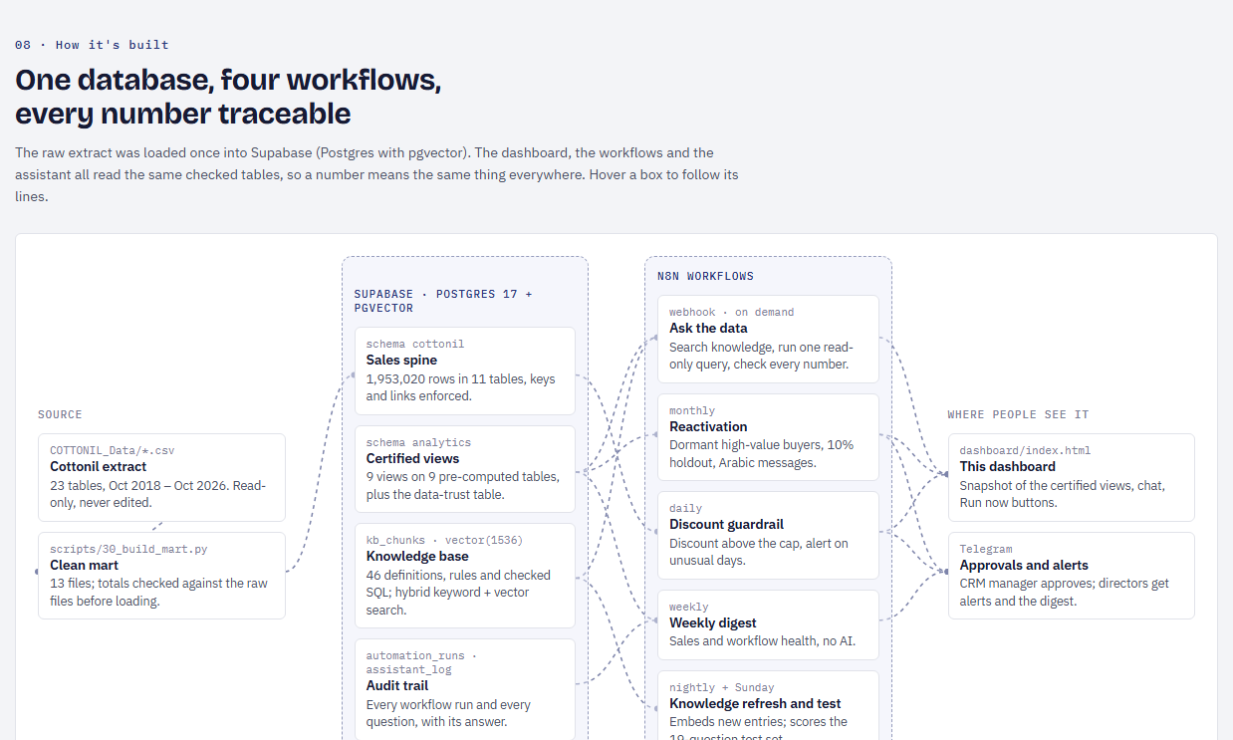
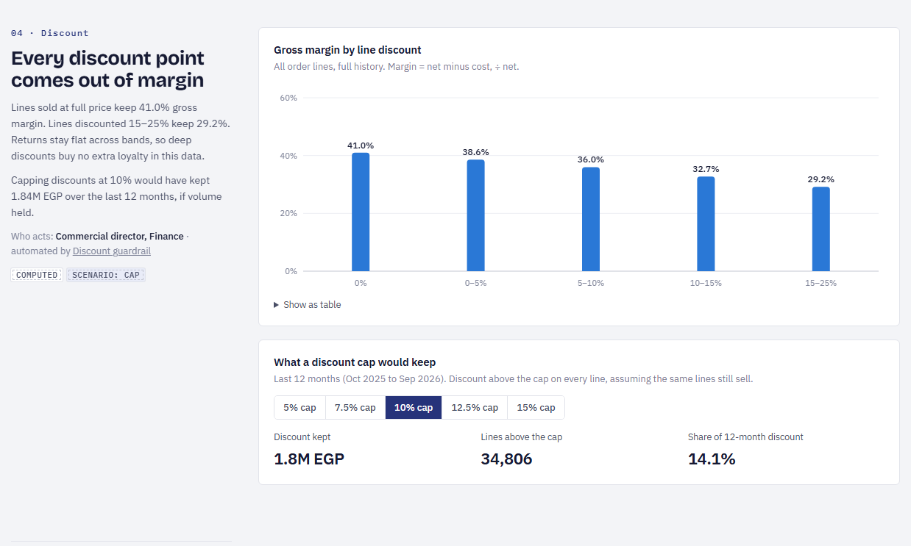
THE DASHBOARD
One page tells the story, and every number has a source
How it's built
Discount cap simulator
Hover a box to follow its lines from the raw files to Telegram
Pick a cap, see the EGP it would have kept (scenario)
Source: dashboard/index.html, 9 tabs, data snapshot from Supabase (scripts/38_dashboard_snapshot.sql)
12

Slide 13
IT RUNS TODAY
A real alert, a real approval, and an answer with its source
Discount guardrail · Telegram
Reactivation · Telegram
?
Ask the data · dashboard
Replay of 12 Aug 2026 · status ALERT
Run #10 · approved by the CRM manager
Answer with number, period and source
⚠️ تنبيه خصومات — 2026-08-12
30 سطر فاتورة بخصم أكتر من 15%.
الخصم اللي اتدى فوق سقف 10%: 9,489 جنيه (4.12× متوسط آخر 28 يوم).
أكتر قناة: Wholesale / reseller (7,290 جنيه)
المطلوب: راجع موافقات خصم الجملة النهارده.
حملة استرجاع العملاء #10
العملاء: 2,374 هيتبعتلهم، و271 holdout للقياس.
مشترياتهم السابقة: 58,158,124 جنيه.
من غير خصومات. توافق؟
✅ موافق ❌ رفض
Ask in Arabic or English.
Every answer shows the number, the period, the view it came from and the SQL behind it.
Questions the data cannot answer, or that ask for a customer's personal details, are refused with the reason.
Live demo: run the guardrail from the dashboard, then ask the assistant a question.
Source: messages produced by the live n8n workflows on 25 Oct 2026; the guardrail replays a past day
13

Slide 14
THE NEXT 90 DAYS
Switch on what is built, measure it, then decide the policy
1
DAYS 1–30
2
DAYS 31–60
3
DAYS 61–90
Switch on
Measure
Decide
Guardrail alerts go to the commercial director
Rule: discounts above 15% need approval
Hand reactivation run #10 to CRM
Start phone capture at the till
Compare buying in contacted vs holdout customers
Review guardrail alerts weekly with Finance
Add price vs volume to the weekly digest
Set the discount cap from what the alerts show
Test the next price rise in a few branches
Connect the real stock ledger, behind a data check
What is at stake: up to 1.84M EGP a year in discounts above 10%, and 58.2M EGP of past spend from quiet high-value buyers (scenario).
Source: Cottonil sales extract, 19 Oct 2018 – 18 Oct 2026 · net before tax · EGP
14

Slide 15
ONE IDEA YOU DID NOT ASK FOR
A data-trust guard before any number goes out
Three questions for Cottonil
1
Returns
Every morning, before the dashboard, the alerts or the assistant use a number, one check confirms each source still makes sense: totals reconcile, and stock and purchases move with sales.
If a source breaks, the number is held back and the team is told why. When Cottonil connects its real stock and purchasing data, the guard is what makes those numbers safe to use.
27,940 returned orders are marked Completed or Delivered. Which status is right?
2
Customer type
98.1% of wholesale orders come from customers tagged Retail. Which tag drives pricing?
3
Branch dates
Thank you
38,040 orders are dated before their branch opened. Is opening_date a re-opening?
Dashboard, workflows and the full method are available for review.

