Slide 1
Best Practices & Guidelines
BC
TC
Guidelines
(Checkliste)
Regeln
Tutorials
ArchitekturBlueprints
Success Stories
Patterns
Outer-Space Demos
Quickstarts
Next Steps:
Branch auf camunda.org mit Strukturaufschlag
Diskussion auf camunda-bpm-xx Mailingliste
Füllen mit Inhalten

Slide 2
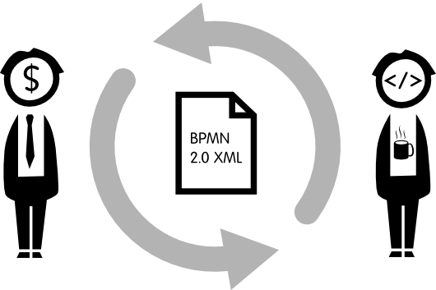
checklist contains
Modeling
Guidelines
and Rules
Rule
Cataloge
Tutorials
ArchitekturBlueprints
Success Stories
Modeling
Patterns
Outer-Space Demos
Quickstarts

Slide 3
Modeling
Guidelines
and Rules
Tutorials
Architecture
Blueprints
checklist
Modeling
Patterns
references & links
Demos
Success Stories
Quickstarts

Slide 4
BPMN 2.0 Methodology
Modeling
Guidelines
and Rules
Tutorials
Demos
Modeling
Patterns
Quickstarts
checklists
Success Stories
Architecture
Blueprints

Slide 5
Checklists
BPMN 2.0 Methodology
Modeling
Guidelines
and Rules
Tutorials
Demos
Modeling
Patterns
Quickstarts
Success Stories
Architecture Blueprints
Technical Aspects
User Guide

