Slide 1
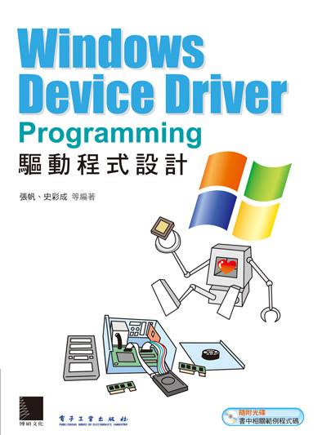
Windows Device Driver
Programming

Slide 2
Agenda
環境設定
Windows Driver 基礎觀念 (2018/12/11)
驅動程式基礎架構 (2018/12/21)
Windows記憶體管理 (2018/12/28)
Windows內核函式 (2018/01/14)
派遣函式 (2018/01/18)
驅動程式的同步處理 (2018/02/22)
計時器 (2018/02/22)

Slide 3
Agenda
Windows I/O Driver

Slide 4
安裝開發環境
Visual Studio 2017 + WDK10 + Windows SDK
https://docs.microsoft.com/zh-tw/windows-hardware/drivers/download-the-wdk
https://developer.microsoft.com/zh-tw/windows/downloads/windows-10-sdk
環境設定

Slide 5
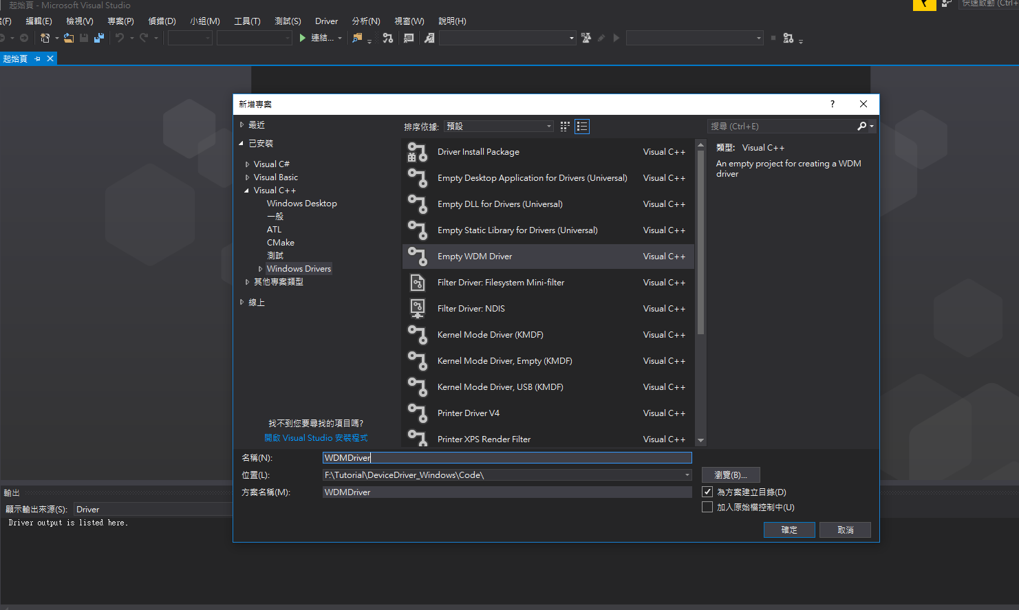
新增專案
環境設定

Slide 6
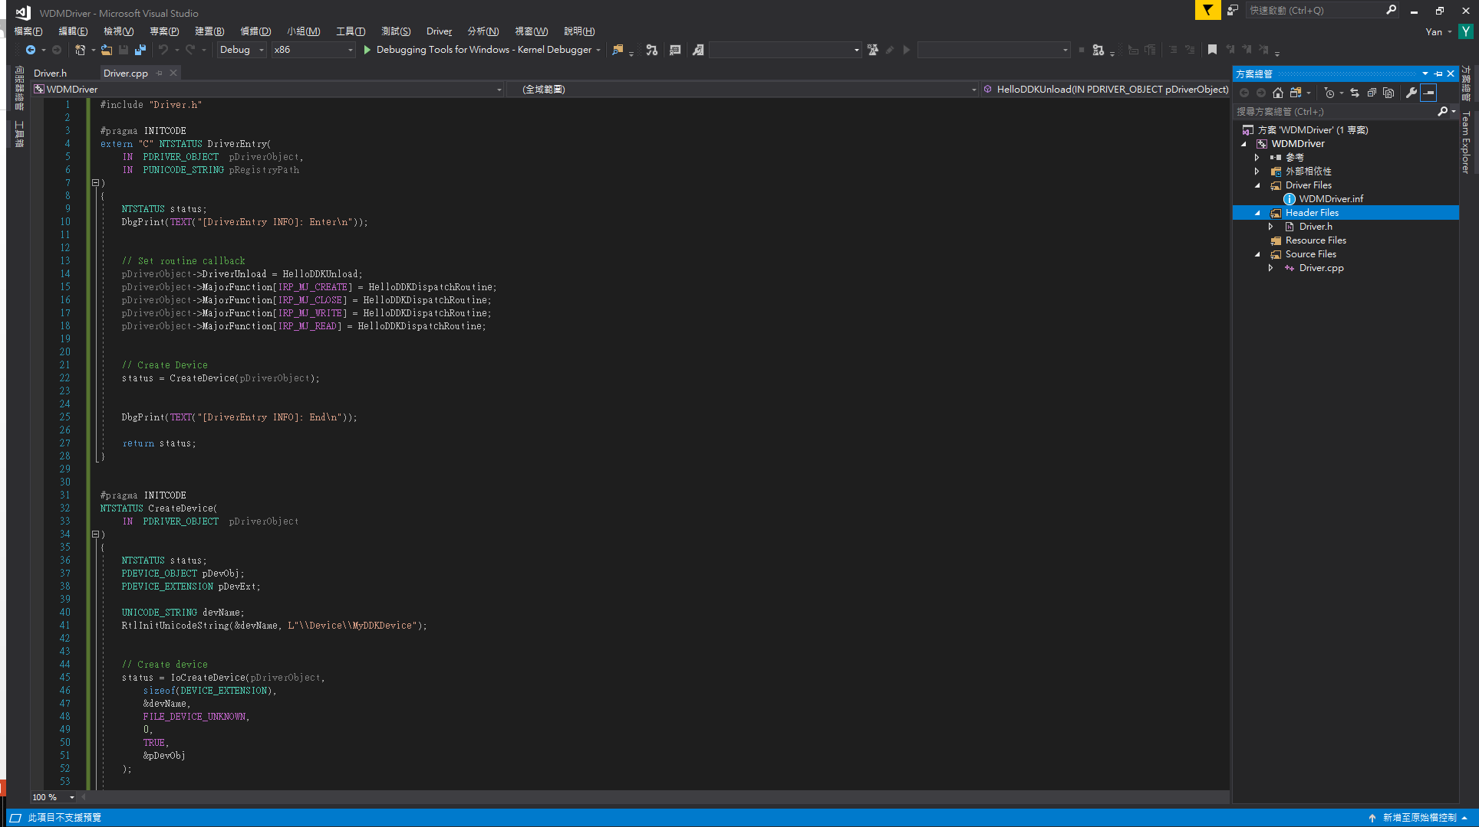
撰寫程式碼
環境設定

Slide 7
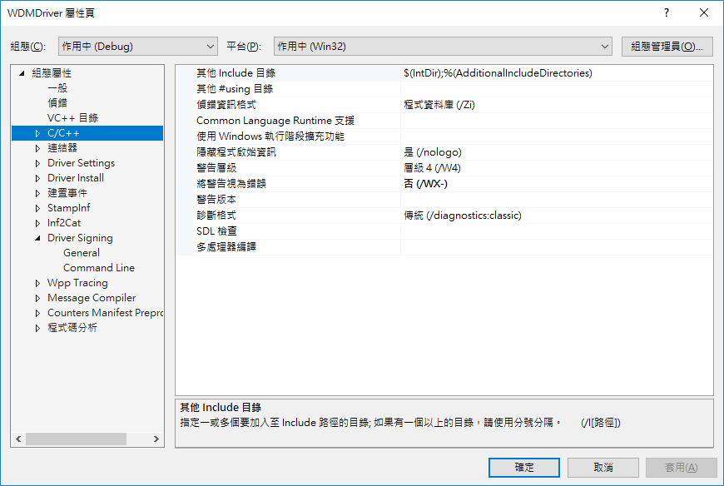
變更設定
環境設定

Slide 8
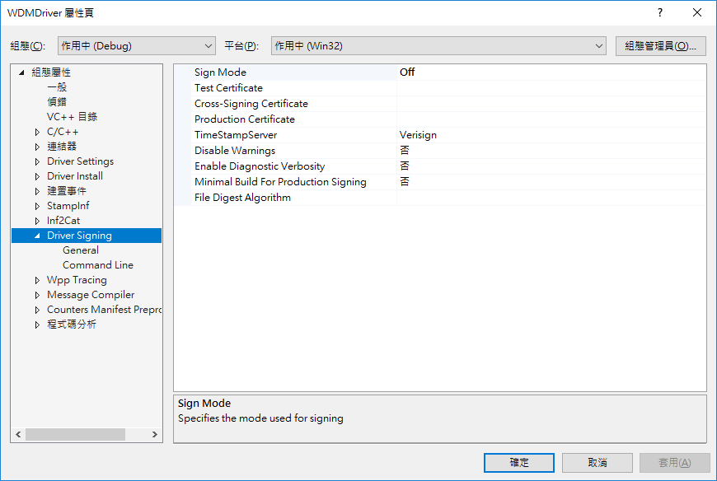
變更設定
環境設定

Slide 9
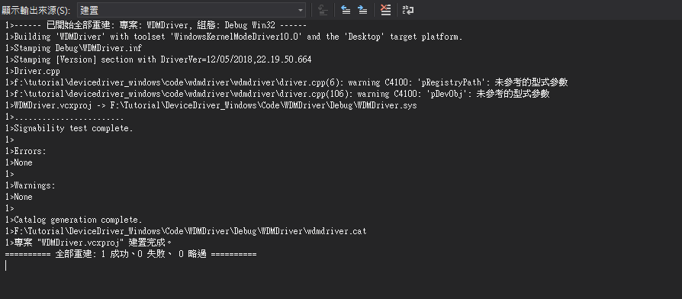
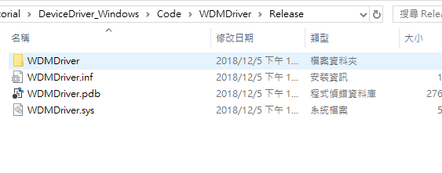
編譯
環境設定

Slide 10
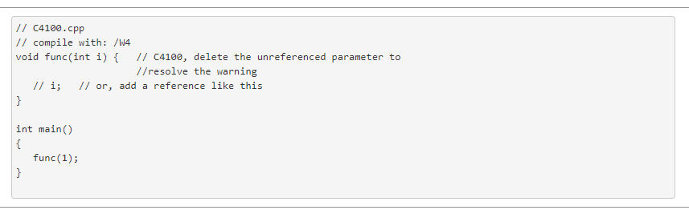
編譯
環境設定

Slide 11
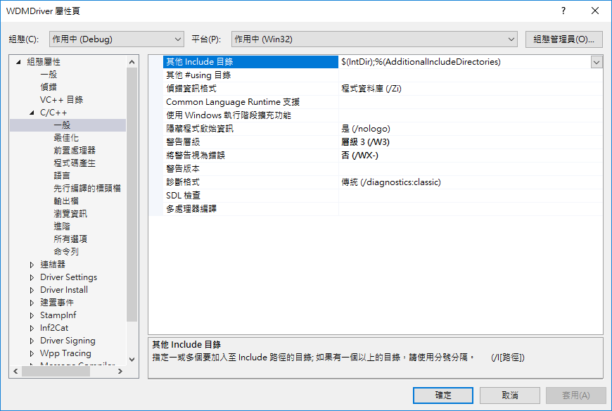
編譯
環境設定

Slide 12
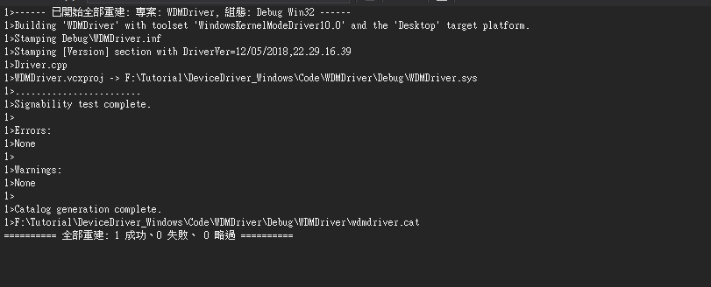
編譯
環境設定

Slide 13
Windows Driver 基礎觀念
作業系統分層
從應用程式到驅動程式
Windows Driver 基礎觀念

Slide 14
作業系統分層

Slide 15
應用程式
Win32 子系統
Native API
使用者模式
內核模式
系統服務函式
內核
物件管理器
硬體抽象層
硬體
作業系統分層

Slide 16
應用程式
Win32 子系統
Native API
使用者模式
內核模式
系統服務函式
內核
物件管理器 |  |  | 驅動程式
I/O管理器 | 物件管理器 | 處理程序管理器
虛擬記憶體管理器 | 配置管理器 | 其他元件
物件管理器
硬體抽象層
硬體
作業系統分層

Slide 17
從應用程式到驅動程式

Slide 18
應用程式
Win32 子系統
Native API
使用者模式
內核模式
系統服務函式
內核
物件管理器
硬體抽象層
硬體
從應用程式到驅動程式

Slide 19
應用程式 (.exe)
Win32 子系統
(Kernel32.dll)
CreateFile API
Native API
(ntdll.dll)
NtCreateFile Native API
使用者模式
內核模式
系統服務函式
NtCreateFile 系統服務
新建並發送IRP
裝置驅動程式
I/O 管理器
READ_PORT_BUFFER_UCHAR
硬體抽象層
硬體
從應用程式到驅動程式

Slide 20
驅動程式基礎架構

Slide 21
NT (New Technology)
WDM (Windows Driver Model)
WDF (Windows Driver Foundation)
驅動程式基礎架構

Slide 22
NT (New Technology)
WDM (Windows Driver Model)
WDF (Windows Driver Foundation)
KMDF (Kernel)
UMDF (User)
驅動程式基礎架構

Slide 23
NT (New Technology)
WDM (Windows Driver Model)
WDF (Windows Driver Foundation)
KMDF (Kernel)
UMDF (User)
驅動程式基礎架構

Slide 24
NT & WDM
 | NT | WDM
Header | ntddk.h | wdm.h
PnP / Power / WMI | X | O
驅動程式基礎架構

Slide 25
NT & WDM
 | NT | WDM
Header | ntddk.h | wdm.h
PnP / Power / WMI | X | O
AddDevice
IRP_MJ_PNP
驅動程式基礎架構

Slide 26
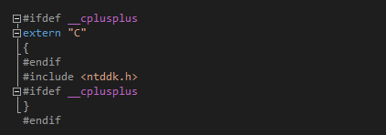
NT Driver Sample
驅動程式基礎架構

Slide 27
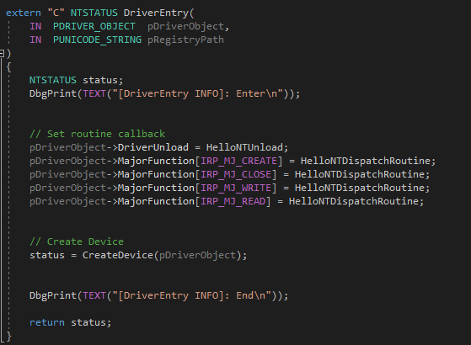
NT Driver Sample
驅動程式基礎架構

Slide 28
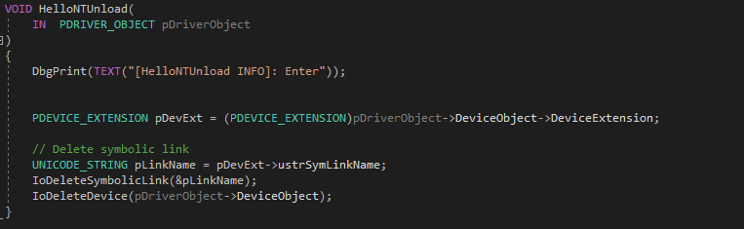
NT Driver Sample
驅動程式基礎架構

Slide 29
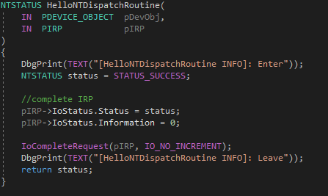
NT Driver Sample
驅動程式基礎架構

Slide 30
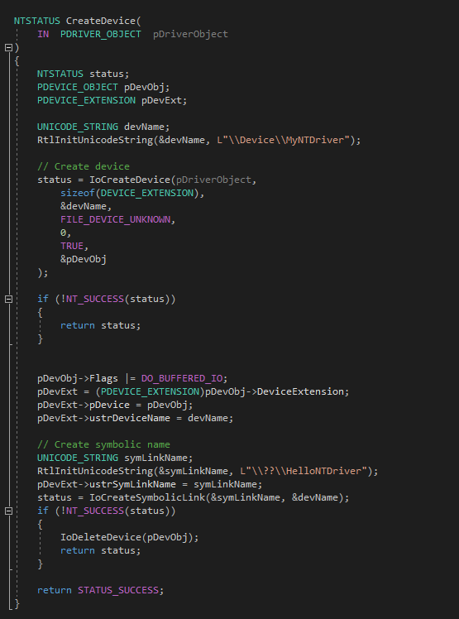
NT Driver Sample
驅動程式基礎架構

Slide 31
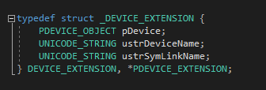
NT Driver Sample
驅動程式基礎架構

Slide 32
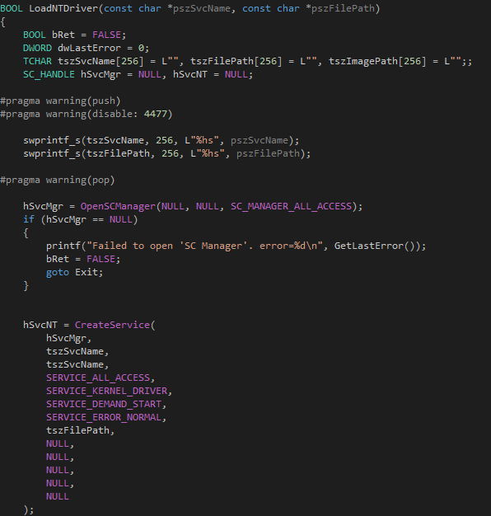
Install NT Driver
驅動程式基礎架構

Slide 33
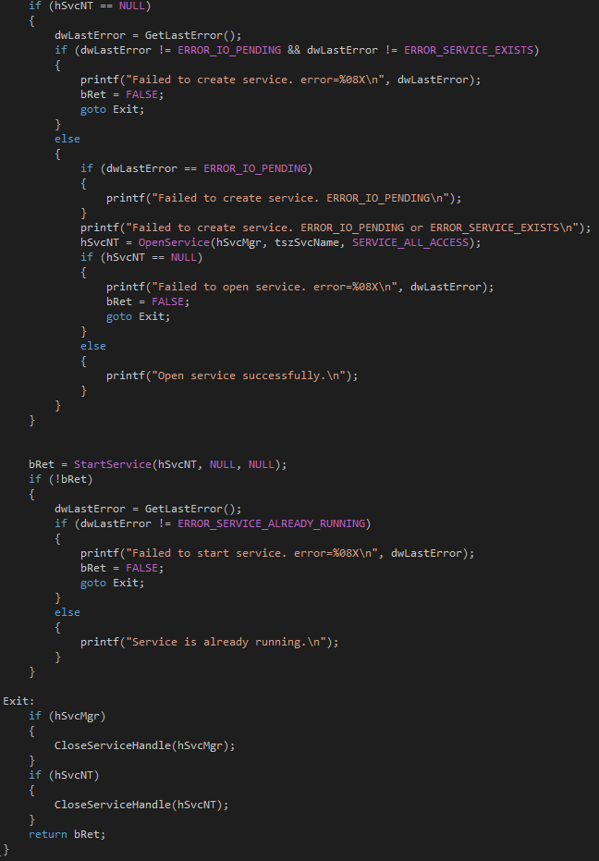
Install NT Driver
驅動程式基礎架構

Slide 34
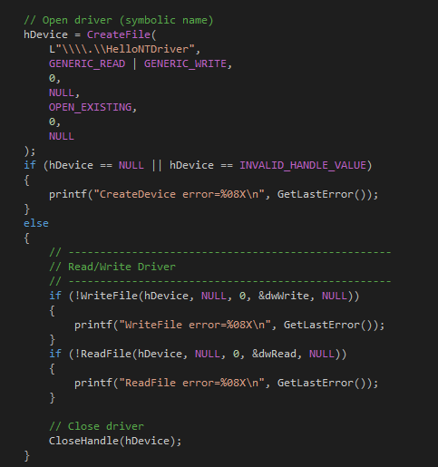
Control NT Driver
驅動程式基礎架構

Slide 35
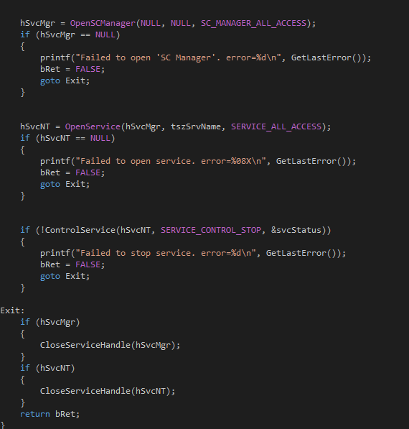
Uninstall Driver
驅動程式基礎架構

Slide 36
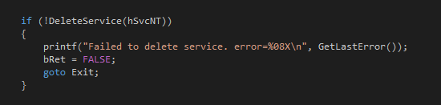
Uninstall Driver
驅動程式基礎架構

Slide 37

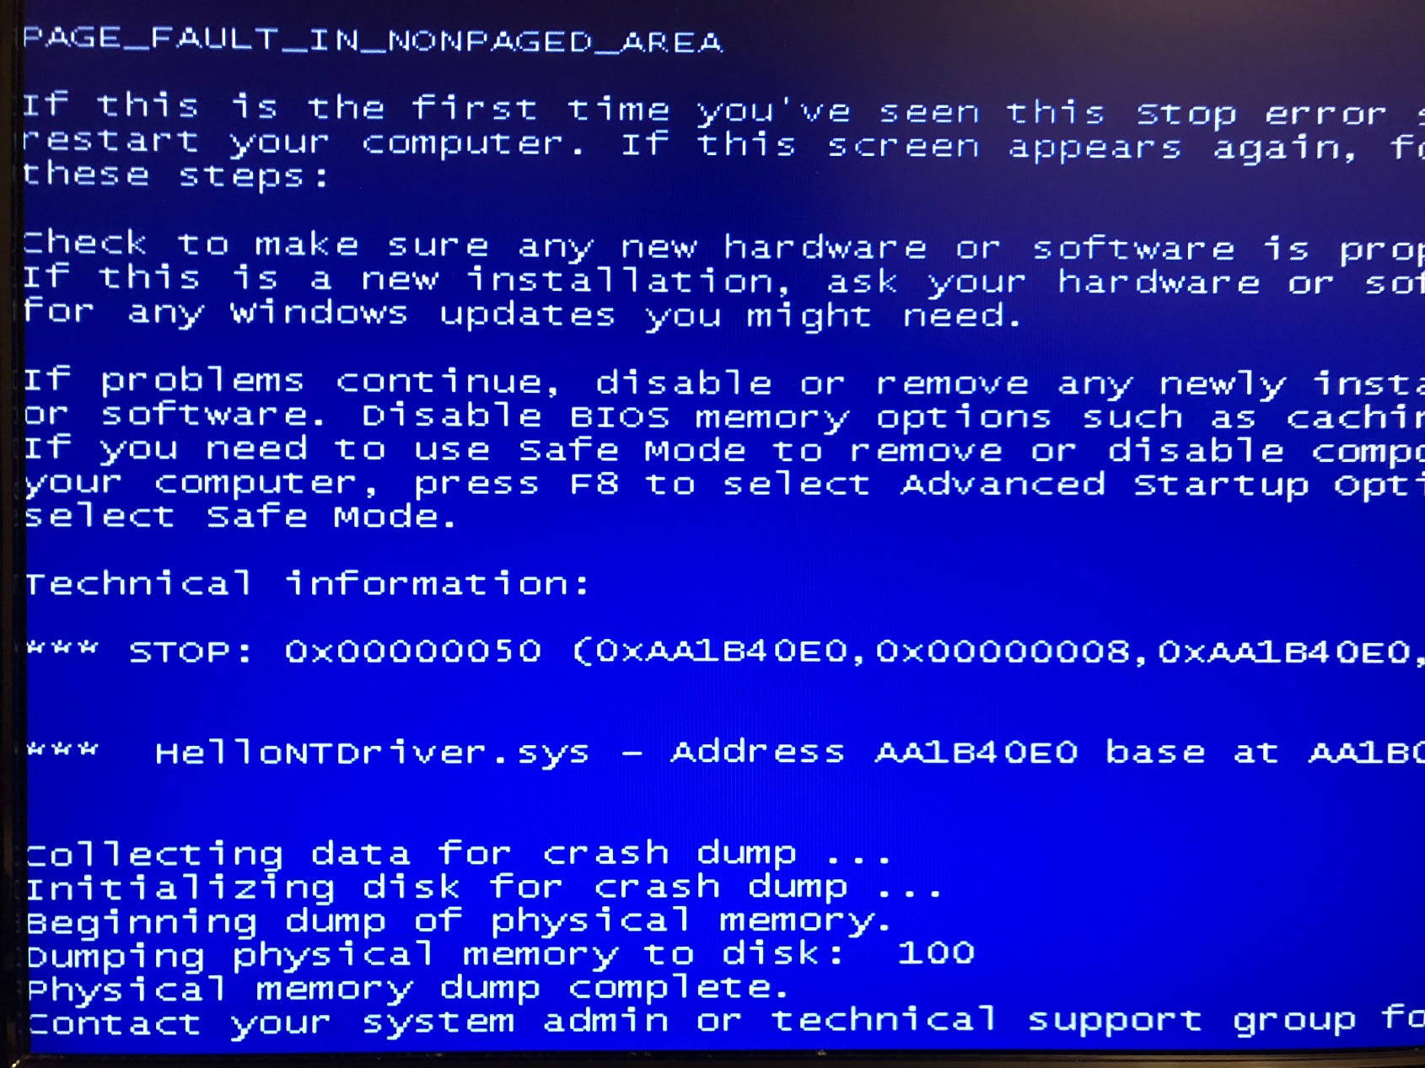
Issue
驅動程式基礎架構

Slide 38
Windows記憶體管理

Slide 39
分頁與非分頁
分頁記憶體
可以被交換至檔案中
IRQL < DIPATCH_LEVEL
非分頁記憶體
不可被交換至檔案中
Windows記憶體管理

Slide 40
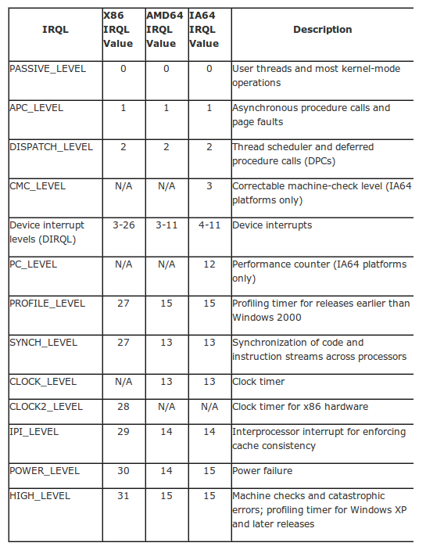
分頁與非分頁
分頁記憶體
可以被交換至檔案中
IRQL < DIPATCH_LEVEL
非分頁記憶體
不可被交換至檔案中
Windows記憶體管理

Slide 41
分頁與非分頁
#define INITCODE code_seg("INIT")
// 當Function執行完後就從記憶體中卸除
#define PAGECODE code_seg("PAGE")
// 把Function載入分頁記憶體中
#define LOCKEDCODE code_seg()
// 把Function載入非分頁記憶體中
Windows記憶體管理

Slide 42
配置記憶體
PVOID ExAllocatePool(POOL_TYPE PoolType, SIZE_T NumberOfBytes);
PVOID ExAllocatePoolWithTag(POOL_TYPE PoolType, SIZE_T NumberOfBytes, ULONG Tag );
Windows記憶體管理

Slide 43
配置記憶體
PVOID ExAllocatePool(POOL_TYPE PoolType, SIZE_T NumberOfBytes);
PVOID ExAllocatePoolWithTag(POOL_TYPE PoolType, SIZE_T NumberOfBytes, ULONG Tag );
PVOID ptr = ExAllocatePoolWithTag(PagedPool, 1024, ‘None’)
Windows記憶體管理

Slide 44
Link List
void InitializeListHead(PLIST_ENTRY ListHead );
void InsertHeadList(PLIST_ENTRY ListHead, PLIST_ENTRY Entry );
void InsertTailList(PLIST_ENTRY ListHead, PLIST_ENTRY Entry );
PLIST_ENTRY RemoveHeadList( PLIST_ENTRY ListHead );
PLIST_ENTRY RemoveTailList( PLIST_ENTRY ListHead );
BOOLEAN RemoveEntryList( PLIST_ENTRY Entry );
Windows記憶體管理

Slide 45
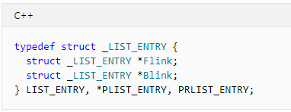
Link List
void InitializeListHead(PLIST_ENTRY ListHead );
void InsertHeadList(PLIST_ENTRY ListHead, PLIST_ENTRY Entry );
void InsertTailList(PLIST_ENTRY ListHead, PLIST_ENTRY Entry );
PLIST_ENTRY RemoveHeadList( PLIST_ENTRY ListHead );
PLIST_ENTRY RemoveTailList( PLIST_ENTRY ListHead );
BOOLEAN RemoveEntryList( PLIST_ENTRY Entry );
Windows記憶體管理

Slide 46
Lookaside
每次申請固定大小的記憶體
申請和回收的操作十分頻繁
Windows記憶體管理

Slide 47
Lookaside
void ExInitializePagedLookasideList( PPAGED_LOOKASIDE_LIST Lookaside, PALLOCATE_FUNCTION Allocate, PFREE_FUNCTION Free, ULONG Flags, SIZE_T Size, ULONG Tag, USHORT Depth );
void ExInitializeNPagedLookasideList( PNPAGED_LOOKASIDE_LIST Lookaside, PALLOCATE_FUNCTION Allocate, PFREE_FUNCTION Free, ULONG Flags, SIZE_T Size, ULONG Tag, USHORT Depth );
PVOID ExAllocateFromPagedLookasideList( PPAGED_LOOKASIDE_LIST Lookaside );
PVOID ExAllocateFromNPagedLookasideList( PNPAGED_LOOKASIDE_LIST Lookaside );
void ExFreeToPagedLookasideList( PPAGED_LOOKASIDE_LIST Lookaside, PVOID Entry );
void ExFreeToNPagedLookasideList( PNPAGED_LOOKASIDE_LIST Lookaside, PVOID Entry );
void ExDeletePagedLookasideList( PPAGED_LOOKASIDE_LIST Lookaside );
void ExDeleteNPagedLookasideList( PNPAGED_LOOKASIDE_LIST Lookaside );
Windows記憶體管理

Slide 48
Related APIs
void RtlCopyMemory( Destination, Source, Length );
void RtlMoveMemory( Destination, Source, Length );
void RtlFillMemory( Destination, Length, Fill );
void RtlZeroMemory( Destination, Length );
void RtlEqualMemory( Destination, Source, Length );
Windows記憶體管理

Slide 49
Related APIs
void RtlCopyMemory( Destination, Source, Length );
void RtlMoveMemory( Destination, Source, Length );
void RtlFillMemory( Destination, Length, Fill );
void RtlZeroMemory( Destination, Length );
void RtlEqualMemory( Destination, Source, Length );
Windows記憶體管理

Slide 50
Windows內核函式

Slide 51
ANSI / Unicode String
typedef struct _STRING {
USHORT Length;
USHORT MaximumLength;
PCHAR Buffer;
} STRING;
typedef struct _UNICODE_STRING {
USHORT Length;
USHORT MaximumLength;
PWSTR Buffer;
} UNICODE_STRING, *PUNICODE_STRING;
Windows內核函式

Slide 52
Related APIs
NTSYSAPI VOID RtlInitAnsiString( PANSI_STRING DestinationString, __drv_aliasesMem PCSZ SourceString );
void RtlInitUnicodeString( PUNICODE_STRING DestinationString, PCWSTR SourceString );
NTSYSAPI VOID RtlCopyString( PSTRING DestinationString, const STRING *SourceString );
NTSYSAPI VOID RtlCopyUnicodeString( PUNICODE_STRING DestinationString, PCUNICODE_STRING SourceString );
NTSYSAPI LONG RtlCompareString( const STRING *String1, const STRING *String2, BOOLEAN CaseInSensitive );
NTSYSAPI LONG RtlCompareUnicodeString( PCUNICODE_STRING String1, PCUNICODE_STRING String2, BOOLEAN CaseInSensitive );
NTSYSAPI VOID RtlUpperString( PSTRING DestinationString, const STRING *SourceString );
NTSYSAPI NTSTATUS RtlUpcaseUnicodeString( PUNICODE_STRING DestinationString, PCUNICODE_STRING SourceString, BOOLEAN AllocateDestinationString );
NTSYSAPI NTSTATUS RtlUnicodeStringToInteger( PCUNICODE_STRING String, ULONG Base, PULONG Value );
NTSYSAPI NTSTATUS RtlIntegerToUnicodeString( ULONG Value, ULONG Base, PUNICODE_STRING String );
NTSYSAPI NTSTATUS RtlUnicodeStringToAnsiString( PANSI_STRING DestinationString, PCUNICODE_STRING SourceString, BOOLEAN AllocateDestinationString );
NTSYSAPI NTSTATUS RtlAnsiStringToUnicodeString( PUNICODE_STRING DestinationString, PCANSI_STRING SourceString, BOOLEAN AllocateDestinationString );
Windows內核函式

Slide 53
File Access
NTSYSAPI NTSTATUS ZwCreateFile( PHANDLE FileHandle, ACCESS_MASK DesiredAccess, POBJECT_ATTRIBUTES ObjectAttributes, PIO_STATUS_BLOCK IoStatusBlock, PLARGE_INTEGER AllocationSize, ULONG FileAttributes, ULONG ShareAccess, ULONG CreateDisposition, ULONG CreateOptions, PVOID EaBuffer, ULONG EaLength );
void InitializeObjectAttributes( p, n, a, r, s );
__kernel_entry NTSYSCALLAPI NTSTATUS NtOpenFile( PHANDLE FileHandle, ACCESS_MASK DesiredAccess, POBJECT_ATTRIBUTES ObjectAttributes, PIO_STATUS_BLOCK IoStatusBlock, ULONG ShareAccess, ULONG OpenOptions );
NTSYSAPI NTSTATUS ZwSetInformationFile( HANDLE FileHandle, PIO_STATUS_BLOCK IoStatusBlock, PVOID FileInformation, ULONG Length, FILE_INFORMATION_CLASS FileInformationClass );
NTSYSAPI NTSTATUS ZwQueryInformationFile( HANDLE FileHandle, PIO_STATUS_BLOCK IoStatusBlock, PVOID FileInformation, ULONG Length, FILE_INFORMATION_CLASS FileInformationClass );
NTSYSAPI NTSTATUS ZwWriteFile( HANDLE FileHandle, HANDLE Event, PIO_APC_ROUTINE ApcRoutine, PVOID ApcContext, PIO_STATUS_BLOCK IoStatusBlock, PVOID Buffer, ULONG Length, PLARGE_INTEGER ByteOffset, PULONG Key );
NTSYSAPI NTSTATUS ZwReadFile( HANDLE FileHandle, HANDLE Event, PIO_APC_ROUTINE ApcRoutine, PVOID ApcContext, PIO_STATUS_BLOCK IoStatusBlock, PVOID Buffer, ULONG Length, PLARGE_INTEGER ByteOffset, PULONG Key );
Windows內核函式

Slide 54
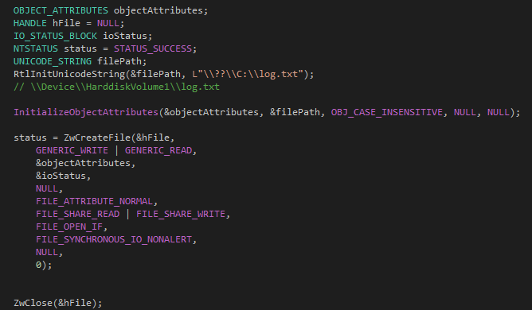
File Access
Windows內核函式

Slide 55
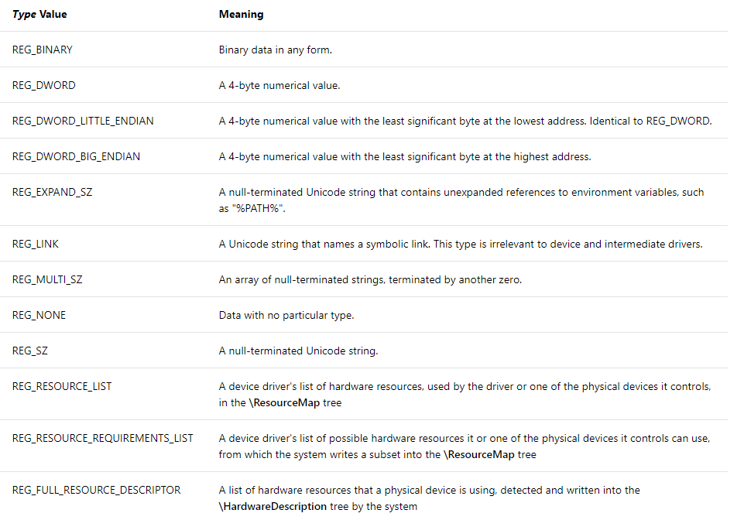
Registry Access
NTSYSAPI NTSTATUS ZwCreateKey( PHANDLE KeyHandle, ACCESS_MASK DesiredAccess, POBJECT_ATTRIBUTES ObjectAttributes, ULONG TitleIndex, PUNICODE_STRING Class, ULONG CreateOptions, PULONG Disposition );
NTSYSAPI NTSTATUS ZwOpenKey( PHANDLE KeyHandle, ACCESS_MASK DesiredAccess, POBJECT_ATTRIBUTES ObjectAttributes );
NTSYSAPI NTSTATUS ZwSetValueKey( HANDLE KeyHandle, PUNICODE_STRING ValueName, ULONG TitleIndex, ULONG Type, PVOID Data, ULONG DataSize );
Windows內核函式

Slide 56
Registry Access
NTSYSAPI NTSTATUS ZwCreateKey( PHANDLE KeyHandle, ACCESS_MASK DesiredAccess, POBJECT_ATTRIBUTES ObjectAttributes, ULONG TitleIndex, PUNICODE_STRING Class, ULONG CreateOptions, PULONG Disposition );
NTSYSAPI NTSTATUS ZwOpenKey( PHANDLE KeyHandle, ACCESS_MASK DesiredAccess, POBJECT_ATTRIBUTES ObjectAttributes );
NTSYSAPI NTSTATUS ZwSetValueKey( HANDLE KeyHandle, PUNICODE_STRING ValueName, ULONG TitleIndex, ULONG Type, PVOID Data, ULONG DataSize );
NTSYSAPI NTSTATUS ZwQueryValueKey( HANDLE KeyHandle, PUNICODE_STRING ValueName, KEY_VALUE_INFORMATION_CLASS KeyValueInformationClass, PVOID KeyValueInformation, ULONG Length, PULONG ResultLength );
NTSYSAPI NTSTATUS ZwQueryKey( HANDLE KeyHandle, KEY_INFORMATION_CLASS KeyInformationClass, PVOID KeyInformation, ULONG Length, PULONG ResultLength );
NTSYSAPI NTSTATUS ZwEnumerateKey( HANDLE KeyHandle, ULONG Index, KEY_INFORMATION_CLASS KeyInformationClass, PVOID KeyInformation, ULONG Length, PULONG ResultLength );
NTSYSAPI NTSTATUS ZwEnumerateValueKey( HANDLE KeyHandle, ULONG Index, KEY_VALUE_INFORMATION_CLASS KeyValueInformationClass, PVOID KeyValueInformation, ULONG Length, PULONG ResultLength );
NTSYSAPI NTSTATUS ZwDeleteKey( HANDLE KeyHandle );
Windows內核函式

Slide 57
Registry Access
NTSYSAPI NTSTATUS RtlCreateRegistryKey( ULONG RelativeTo, PWSTR Path );
NTSYSAPI NTSTATUS RtlCheckRegistryKey( ULONG RelativeTo, PWSTR Path );
NTSYSAPI NTSTATUS RtlQueryRegistryValues( ULONG RelativeTo, PCWSTR Path, PRTL_QUERY_REGISTRY_TABLE QueryTable, PVOID Context, PVOID Environment );
NTSYSAPI NTSTATUS RtlWriteRegistryValue( ULONG RelativeTo, PCWSTR Path, PCWSTR ValueName, ULONG ValueType, PVOID ValueData, ULONG ValueLength );
NTSYSAPI NTSTATUS RtlDeleteRegistryValue( ULONG RelativeTo, PCWSTR Path, PCWSTR ValueName );
Windows內核函式

Slide 58
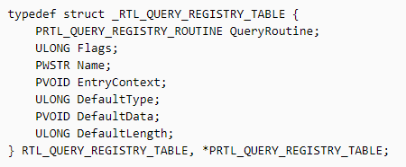
Registry Access
NTSYSAPI NTSTATUS RtlCreateRegistryKey( ULONG RelativeTo, PWSTR Path );
NTSYSAPI NTSTATUS RtlCheckRegistryKey( ULONG RelativeTo, PWSTR Path );
NTSYSAPI NTSTATUS RtlQueryRegistryValues( ULONG RelativeTo, PCWSTR Path, PRTL_QUERY_REGISTRY_TABLE QueryTable, PVOID Context, PVOID Environment );
NTSYSAPI NTSTATUS RtlWriteRegistryValue( ULONG RelativeTo, PCWSTR Path, PCWSTR ValueName, ULONG ValueType, PVOID ValueData, ULONG ValueLength );
NTSYSAPI NTSTATUS RtlDeleteRegistryValue( ULONG RelativeTo, PCWSTR Path, PCWSTR ValueName );
Windows內核函式

Slide 59
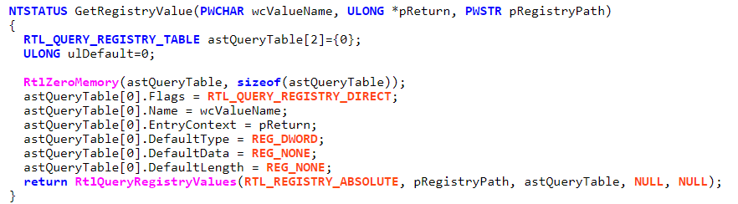
Registry Access
NTSYSAPI NTSTATUS RtlCreateRegistryKey( ULONG RelativeTo, PWSTR Path );
NTSYSAPI NTSTATUS RtlCheckRegistryKey( ULONG RelativeTo, PWSTR Path );
NTSYSAPI NTSTATUS RtlQueryRegistryValues( ULONG RelativeTo, PCWSTR Path, PRTL_QUERY_REGISTRY_TABLE QueryTable, PVOID Context, PVOID Environment );
NTSYSAPI NTSTATUS RtlWriteRegistryValue( ULONG RelativeTo, PCWSTR Path, PCWSTR ValueName, ULONG ValueType, PVOID ValueData, ULONG ValueLength );
NTSYSAPI NTSTATUS RtlDeleteRegistryValue( ULONG RelativeTo, PCWSTR Path, PCWSTR ValueName );
Windows內核函式

Slide 60
派遣函式

Slide 61
I/O Request Packet (IRP)
應用程式 (.exe)
Win32 子系統
(Kernel32.dll)
CreateFile API
Native API
(ntdll.dll)
NtCreateFile Native API
使用者模式
內核模式
系統服務函式
NtCreateFile 系統服務
新建並發送IRP
裝置驅動程式
I/O 管理器
READ_PORT_BUFFER_UCHAR
硬體抽象層
硬體
派遣函式

Slide 62
I/O Request Packet (IRP)
應用程式 (.exe)
Win32 子系統
(Kernel32.dll)
CreateFile API
Native API
(ntdll.dll)
NtCreateFile Native API
使用者模式
內核模式
系統服務函式
NtCreateFile 系統服務
新建並發送IRP
裝置驅動程式
I/O 管理器
READ_PORT_BUFFER_UCHAR
硬體抽象層
硬體
派遣函式

Slide 63
Major Function
派遣函式

Slide 64
Major Function
IRP 類型 | 來源
IRP_MJ_CLEANUP | CloseHandle
IRP_MJ_DEVICE_CONTROL | DeviceIOControl
IRP_MJ_PNP | 隨插即用 (NT式不支援)
IRP_MJ_POWER | 作業系統處理電源訊息
IRP_MJ_QUERY_INFORMATION | GetFileSize
IRP_MJ_READ | ReadFile
IRP_MJ_SET_INFORMATION | GetFileSize
IRP_MJ_SHUTDOWN | 關閉系統前
IRP_MJ_SYSTEM_CONTROL | 系統內部產生的控制資訊,類似於Kernel呼叫DeviceIOControl
IRP_MJ_WRITE | WriteFile
派遣函式

Slide 65
Major Function
IRP 類型 | 來源
IRP_MJ_CLEANUP | CloseHandle
IRP_MJ_DEVICE_CONTROL | DeviceIOControl
IRP_MJ_PNP | 隨插即用 (NT式不支援)
IRP_MJ_POWER | 作業系統處理電源訊息
IRP_MJ_QUERY_INFORMATION | GetFileSize
IRP_MJ_READ | ReadFile
IRP_MJ_SET_INFORMATION | GetFileSize
IRP_MJ_SHUTDOWN | 關閉系統前
IRP_MJ_SYSTEM_CONTROL | 系統內部產生的控制資訊,類似於Kernel呼叫DeviceIOControl
IRP_MJ_WRITE | WriteFile
派遣函式

Slide 66
Dispatch Process
派遣函式

Slide 67
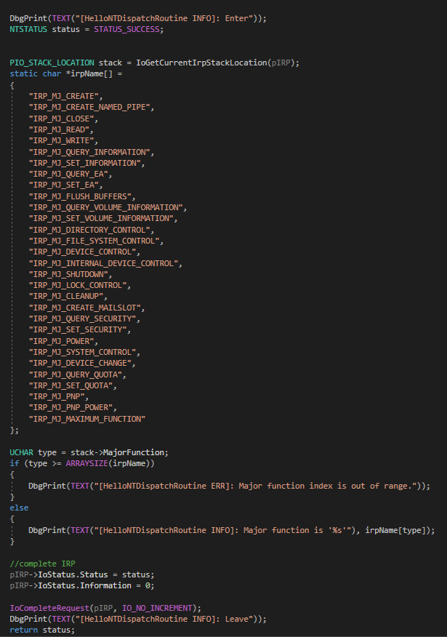
Dispatch Process
派遣函式

Slide 68
Access Driver
派遣函式

Slide 69
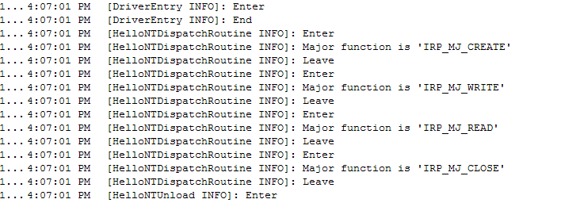
Access Driver
派遣函式

Slide 70
緩衝區讀寫操作
DO_BUFFERED_IO
DO_DIRECT_IO
Neither DO_BUFFERED_IO nor DO_DIRECT_IO
派遣函式

Slide 71
緩衝區讀寫操作
DO_BUFFERED_IO
DO_DIRECT_IO
Neither DO_BUFFERED_IO nor DO_DIRECT_IO
派遣函式

Slide 72
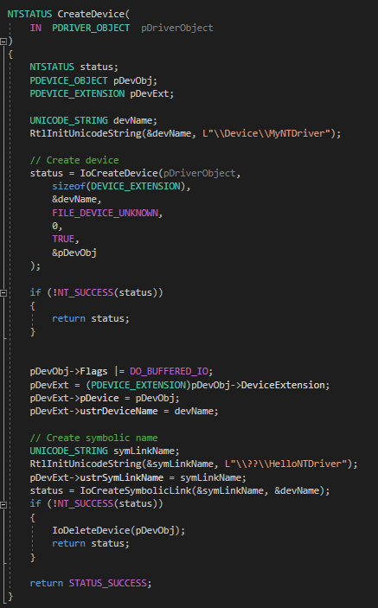
DO_BUFFERED_IO
派遣函式

Slide 73
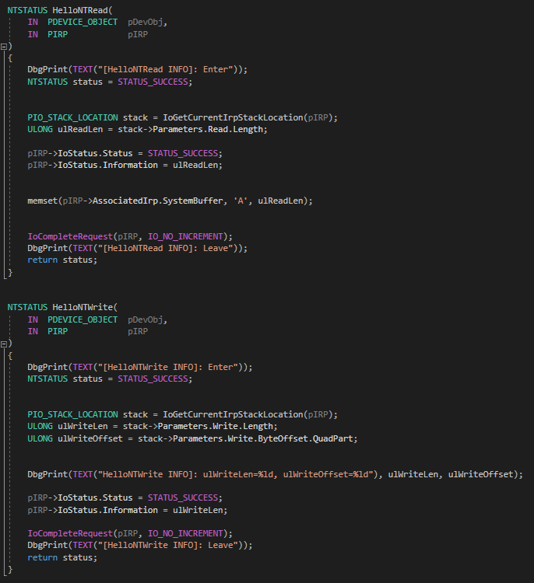
DO_BUFFERED_IO
派遣函式

Slide 74
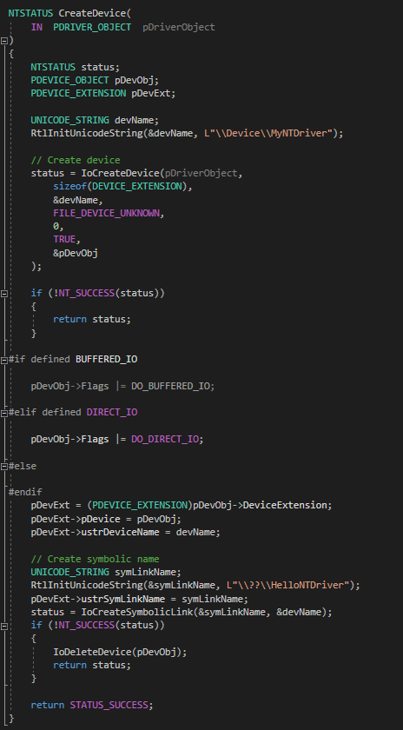
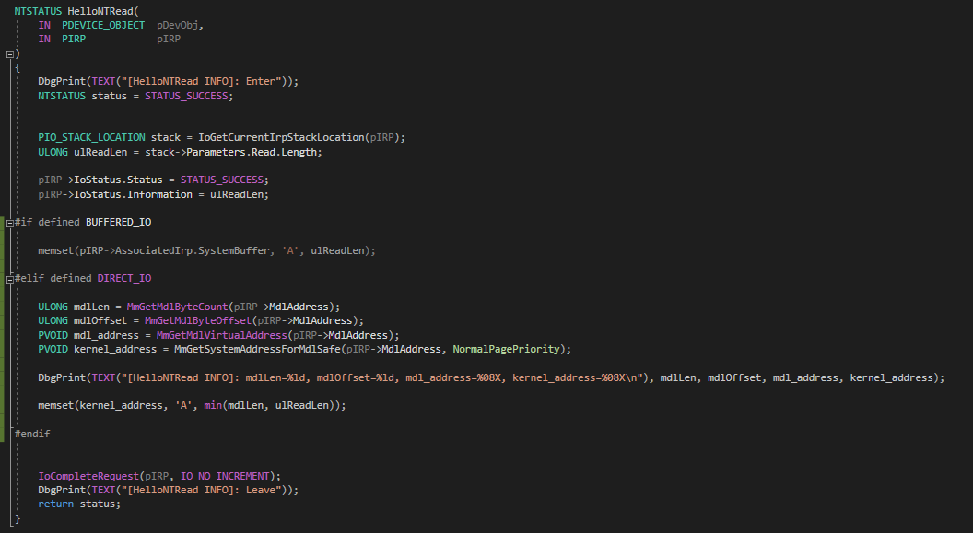
DO_DIRECT_IO
派遣函式

Slide 75
DO_DIRECT_IO
派遣函式

Slide 76
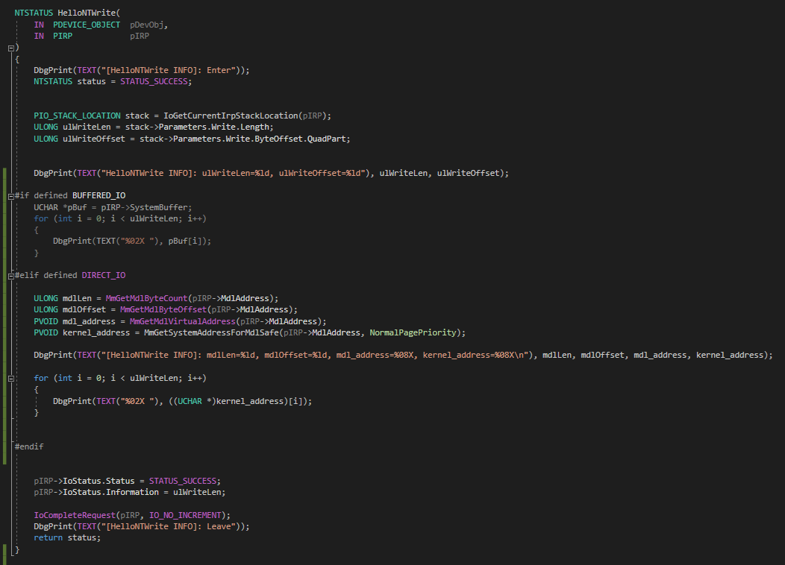
DO_DIRECT_IO
派遣函式

Slide 77
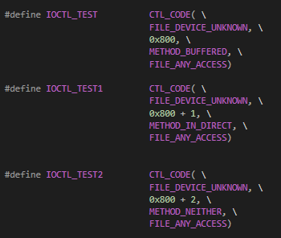
DeviceIOControl
DO_BUFFERED_IO
DO_IN_DIRECT / DO_OUT_DIRECT
Neither DO_BUFFERED_IO nor DO_DIRECT_IO
派遣函式

Slide 78
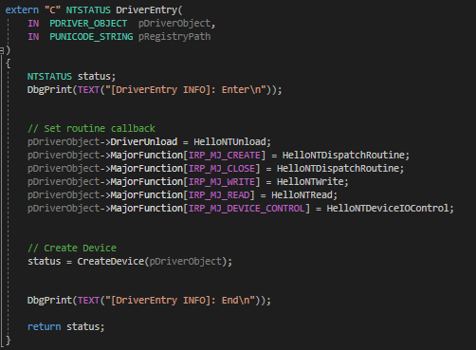
DeviceIOControl
派遣函式

Slide 79
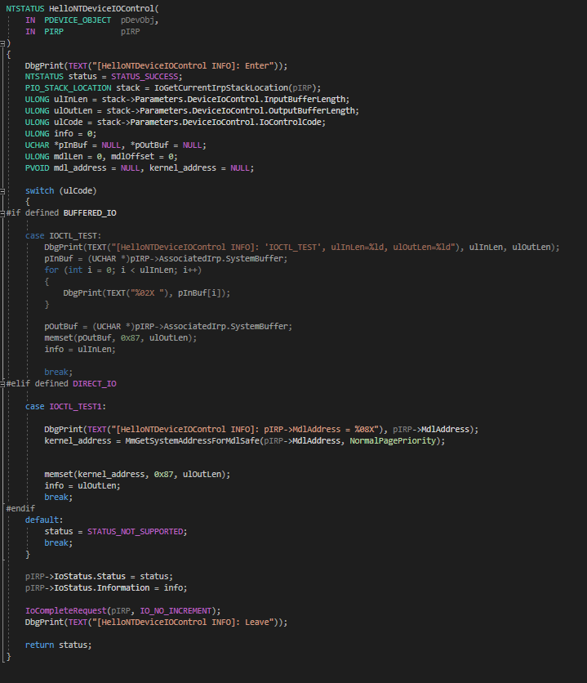
DeviceIOControl
派遣函式

Slide 80
驅動程式的同步處理

Slide 81
Spin Lock
Mutex
Semaphore
Event
驅動程式的同步處理

Slide 82
Related APIs
void KeInitializeSpinLock( PKSPIN_LOCK SpinLock );
void KeAcquireSpinLock( a, b );
void KeAcquireSpinLockAtDpcLevel( a );
void KeReleaseSpinLock( a, b );
void KeReleaseSpinLockFromDpcLevel( a );
void KeInitializeMutex( PRKMUTEX Mutex, ULONG Level );
LONG KeReleaseMutex( PRKMUTEX Mutex, BOOLEAN Wait );
void KeInitializeSemaphore( PRKSEMAPHORE Semaphore, LONG Count, LONG Limit );
LONG KeReadStateSemaphore( PRKSEMAPHORE Semaphore );
LONG KeReleaseSemaphore( PRKSEMAPHORE Semaphore, KPRIORITY Increment, LONG Adjustment, BOOLEAN Wait );
void KeInitializeEvent( PRKEVENT Event, EVENT_TYPE Type, BOOLEAN State );
LONG KeSetEvent( PRKEVENT Event, KPRIORITY Increment, BOOLEAN Wait );
LONG KeResetEvent( PRKEVENT Event );
NTSTATUS KeWaitForSingleObject( PVOID Object, KWAIT_REASON WaitReason, __drv_strictType(KPROCESSOR_MODE / enum _MODE,__drv_typeConst)KPROCESSOR_MODE WaitMode, BOOLEAN Alertable, PLARGE_INTEGER Timeout );
驅動程式的同步處理

Slide 83
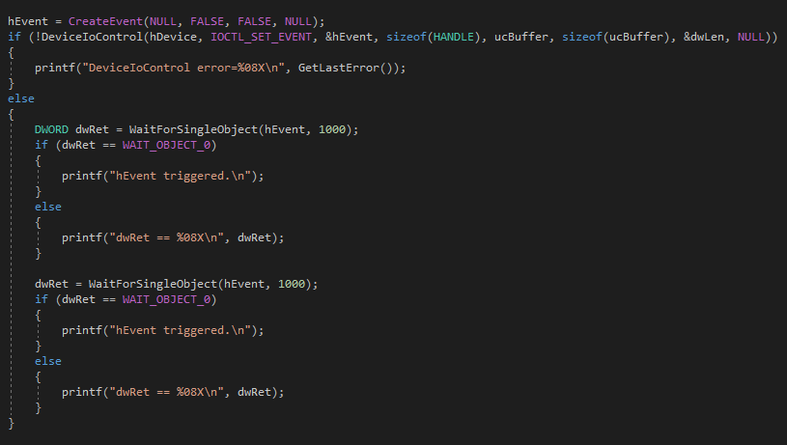
Synchronize With Application
NTSTATUS ObReferenceObjectByHandle( HANDLE Handle, ACCESS_MASK DesiredAccess, POBJECT_TYPE ObjectType, KPROCESSOR_MODE AccessMode, PVOID *Object, POBJECT_HANDLE_INFORMATION HandleInformation );
驅動程式的同步處理

Slide 84
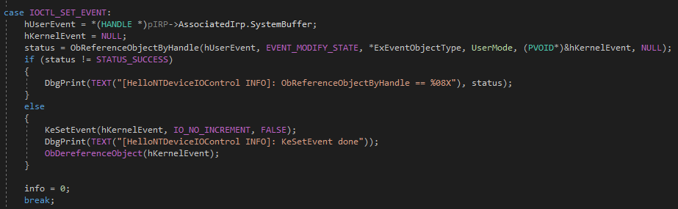
Synchronize With Application
NTSTATUS ObReferenceObjectByHandle( HANDLE Handle, ACCESS_MASK DesiredAccess, POBJECT_TYPE ObjectType, KPROCESSOR_MODE AccessMode, PVOID *Object, POBJECT_HANDLE_INFORMATION HandleInformation );
驅動程式的同步處理

Slide 85
計時器

Slide 86
Related APIs
NTSTATUS IoInitializeTimer( PDEVICE_OBJECT DeviceObject, PIO_TIMER_ROUTINE TimerRoutine, __drv_aliasesMem PVOID Context );
void IoStartTimer( PDEVICE_OBJECT DeviceObject );
void IoStopTimer( PDEVICE_OBJECT DeviceObject );
void KeInitializeTimer( PKTIMER Timer );
void KeInitializeDpc( __drv_aliasesMem PRKDPC Dpc, PKDEFERRED_ROUTINE DeferredRoutine, __drv_aliasesMem PVOID DeferredContext );
BOOLEAN KeSetTimer( PKTIMER Timer, LARGE_INTEGER DueTime, PKDPC Dpc );
BOOLEAN KeSetTimerEx( PKTIMER Timer, LARGE_INTEGER DueTime, LONG Period, PKDPC Dpc );
BOOLEAN KeCancelTimer( PKTIMER Arg1 );
void KeFlushQueuedDpcs( );
NTSTATUS KeDelayExecutionThread( KPROCESSOR_MODE WaitMode, BOOLEAN Alertable, PLARGE_INTEGER Interval );
NTHALAPI VOID KeStallExecutionProcessor( ULONG MicroSeconds );
計時器

Slide 87
Windows I/O Driver

Slide 88
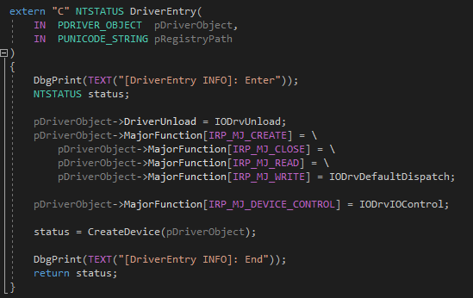
Driver Entry
Windows I/O Driver

Slide 89
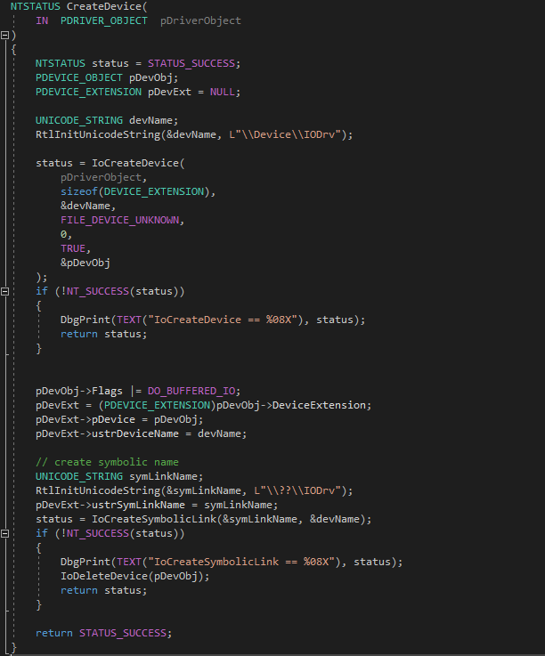
Create Device
Windows I/O Driver

Slide 90
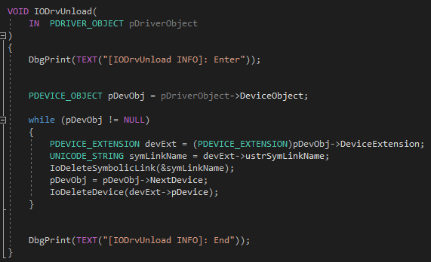
Driver Unload
Windows I/O Driver

Slide 91
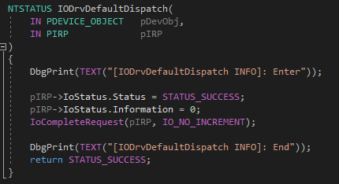
Default Dispatch
Windows I/O Driver

Slide 92
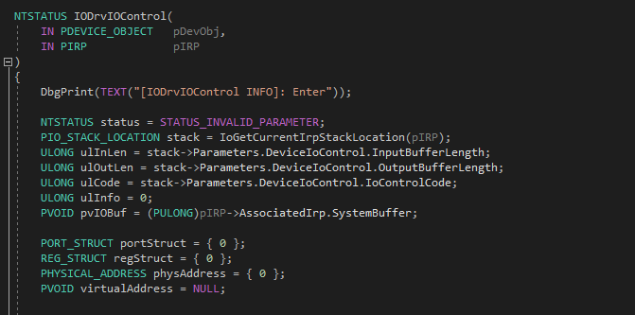
I/O Control Dispatch
Windows I/O Driver

Slide 93
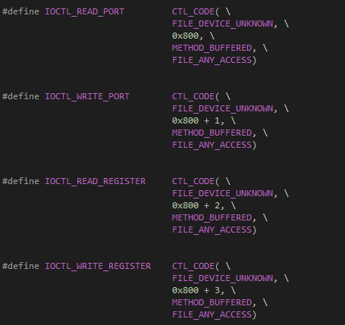
I/O Control Dispatch
Windows I/O Driver

Slide 94
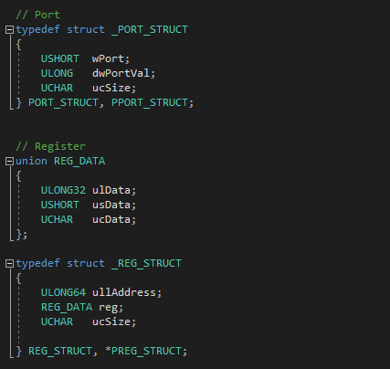
I/O Control Dispatch
Windows I/O Driver

Slide 95
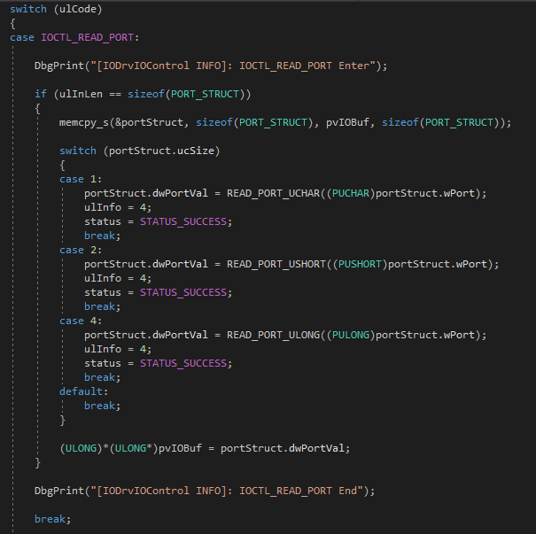
I/O Control Dispatch – R/W Port
Windows I/O Driver

Slide 96
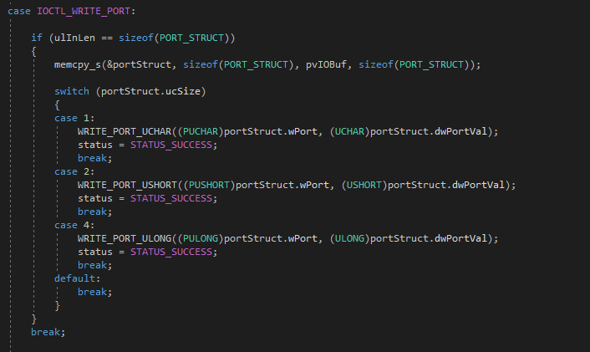
I/O Control Dispatch – R/W Port
Windows I/O Driver

Slide 97
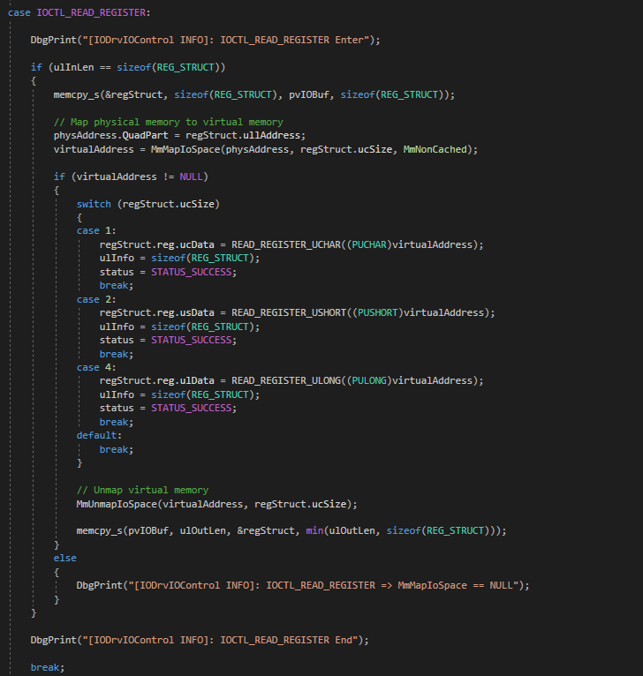
I/O Control Dispatch – R/W Register
Windows I/O Driver

Slide 98

I/O Control Dispatch – R/W Register
Windows I/O Driver

Slide 99

I/O Control Dispatch
Windows I/O Driver

Slide 100

Access From Application
Windows I/O Driver

Slide 101


Access From Application
Windows I/O Driver

Slide 102

Access From Application
Windows I/O Driver

Slide 103

Access From Application
Windows I/O Driver

Slide 104

Access From Application
Windows I/O Driver

Slide 105

Access From Application
Windows I/O Driver

Slide 106

Result
Windows I/O Driver

Slide 107

Result
Windows I/O Driver

Slide 108
Q&A

