Slide 1



Countering Violent Extremism

Slide 2

Violent Extremism
Ideologically motivated violence.
Radicalization through social media .
The strong search for meaning and sense of identity by individuals.

Slide 3
Challenges while countering extremism
Privacy policies of social media into account.
Solving a problem before it arises – an ethical and practical question.
APPROACH
Vulnerable Groups
Extremists

Slide 4
Our motive:
Pursue, Prevent, Protect, Prepare.
Serve positive thoughts for currently happening contradictory topics.
Myth debunking.
Extend international communication to discuss issues.
Need of socialization among alienated individuals.
Not just awareness rather a measurable impact.

Slide 5
Our Plan:
Hey we have got a GAME!!!!!
Target:
1.Popular of course.
2.Sentimental Analysis.
3.Socialization.
4. Not limited to particular audience.

Slide 6
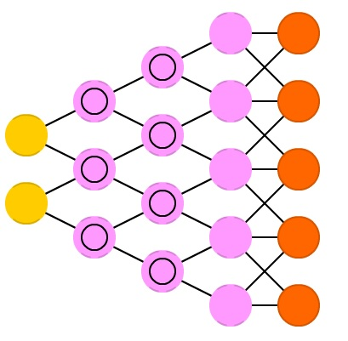

Our Plan:
Framework:
Diversion to assess Convergence to feed positive
sentiments/personality thoughts(depends on sentimental analysis).
Avatar

Slide 7

Our Plan:
Forum:
TRIGGERING
WORDS

Slide 8
What do we achieve:
Forum connects people; popularize the game
Weekly sentimental analysis(ML)
S->S->S
Overall analysis
Of society
Myths Debunk
Weekly new themes => Dynamic Game

Slide 9
Prototype

