Slide 1
Alert and Action
Microsoft Power Platform
Govern
&
Grow
1. Secure
2. Monitor
3. Alert and Action
4. Deploy
5. Nurture
6. Infrastructure
7. Support

Slide 2
Alert and Action: What we plan to cover
1. Secure
2. Monitor
3. Alert and Action
4. Deploy
Product discovery: understand the origin of apps & flows | Review out-of-box analytics | Leverage management connectors & PowerShell to automate your policies | Understand managed vs unmanaged solutions
Know your environments | Configure audit logs | Welcome new makers and foster best practices | Learn the Application Lifecycle Management (ALM) toolset and best practices
Learn the 5 layers of security + the one that maters most | Leverage management connectors & PowerShell as powerful reporting tools | Identify and empower champions
Setup data loss prevention policies

Slide 3
Now let’s alert and action
1. Secure
2. Monitor
3. Alert and Action
4. Deploy

Slide 4
Scenarios
Get notifications when resources are created and follow-up actions with app creators
Drive company policies
Automate environment creation

Slide 5
Automate with PowerShell cmdlets
The PowerShell Cmdlets place full control in the hands of admins to automate the governance policies necessary - aka.ms/powerappspowershell.
Separate cmdlets for app creators and administrators
Can be used with other service to automate full processes
e.g. Create User, Assign License, Create Environment all in one script

Slide 6
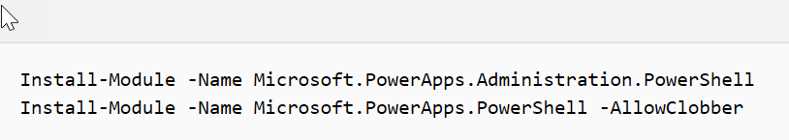
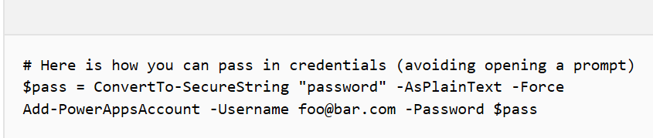
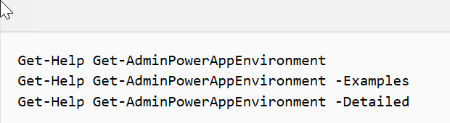
Getting started with PowerShell
Installing
Setting Credentials
Exploring Help
https://docs.microsoft.com/power-platform/admin/powerapps-powershell#powerapps-cmdlets-for-administrators-preview
Notes:
credentials are refreshed for up to ~8 hours before you’re required to sign in again to continue using the cmdlets.

Slide 7
Working with Environments and CDS
Environments
CDS
New-AdminPowerAppEnvironment
Set-AdminPowerAppEnvironmentDisplayName
Get-AdminPowerAppEnvironment
Get-AdminPowerAppEnvironmentLocations
Remove-AdminPowerAppEnvironment
New-AdminPowerAppCdsDatabase
Get-AdminPowerAppCdsDatabaseLanguages
Get-AdminPowerAppCdsDatabaseCurrencies

Slide 8
Working with PowerApps Canvas apps
Canvas Apps
Canvas Permissions
Get-AdminPowerApp
Remove-AdminPowerApp
Get-AdminPowerAppConnectionReferences
Set-AdminPowerAppAsFeatured
Clear-AdminPowerAppAsFeatured
Set-AdminPowerAppAsHero
Clear-AdminPowerAppAsHero
Set-AdminPowerAppApisToBypassConsent
Clear-AdminPowerAppApisToBypassConsent
Get-AdminPowerAppRoleAssignment
Remove-AdminPowerAppRoleAssignment
Set-AdminPowerAppRoleAssignment
Set-AdminPowerAppOwner

Slide 9
Working with Microsoft Flow
Flow
Flow Permissions
Get-AdminFlow
Enable-AdminFlow
Disable-AdminFlow
Remove-AdminFlow
Remove-AdminFlowApprovals
Get-AdminFlowOwnerRole
Set-AdminFlowOwnerRole
Remove-AdminFlowOwnerRole
Flow Approvals
Get-FlowApprovalRequest
Get-FlowApproval
RespondTo-FlowApprovalRequest

Slide 10
Working with Connectors
Connectors
Permissions
Get-AdminPowerAppConnection
Remove-AdminPowerAppConnection
Get-AdminPowerAppConnectionRoleAssignment
Set-AdminPowerAppEnvironmentConnectionRoleAssignment
Remove-AdminPowerAppConnectionRoleAssignment
Notes:
Same methods apply to custom connectors as well

Slide 11
Working with other tenant resources
Users
Data Loss Prevention
Get-AdminPowerAppsUserDetails
Get-AdminFlowUserDetails
Remove-AdminFlowUserDetails
Get-AdminDlpPolicy
New-AdminDlpPolicy
Remove-AdminDlpPolicy
Set-AdminDlpPolicy
Add-ConnectorToBusinessDataGroup
Remove-ConnectorFromBusinessDataGroup
Add-CustomConnectorToPolicy
Remove-CustomConnectorFromPolicy
Tenant Settings
Get-TenantSettings
Set-TenantSettings
$settings = @{ DisableEnvironmentCreationByNonAdminUsers = $true }
Set-TenantSettings $settings
Environment creation setting just launched in May ‘19

Slide 12

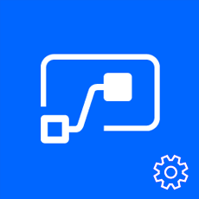


Build the policies you need with the PowerApps, Microsoft Flow Management Connectors
Full control
Power Platform APIs in an accessible connector interface, provide admin access to resources
Customization
Build the policies you need to implement administration + governance requirements
Power Platform for Admins
Flow Management
PowerApps for Admins
PowerApps for App Makers

Slide 13
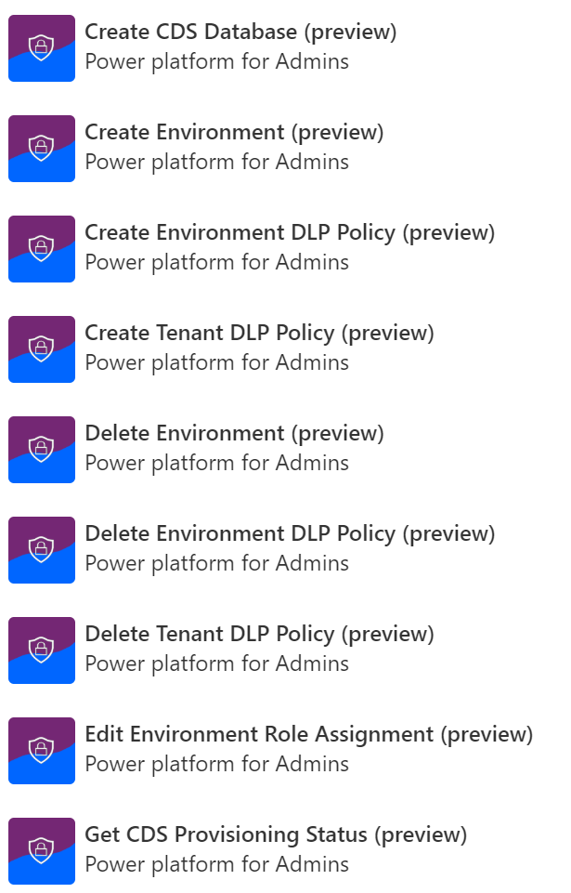
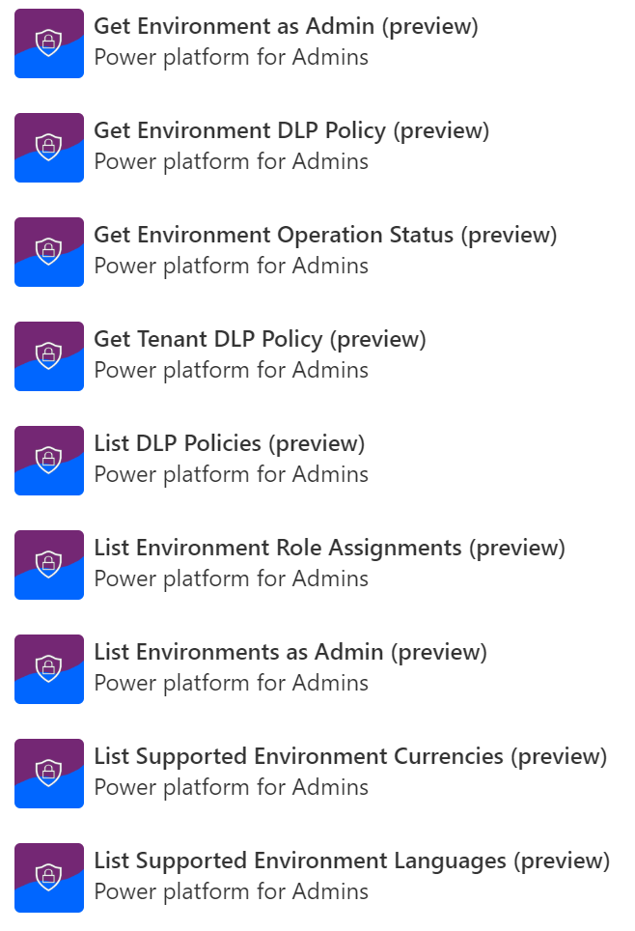
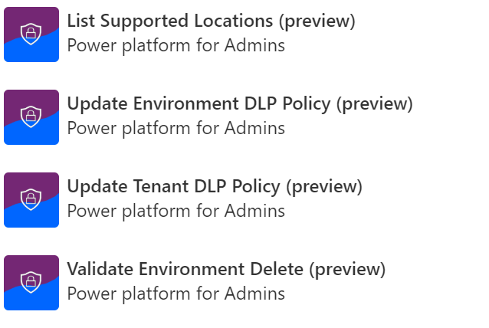
Power Platform for Admins

Slide 14
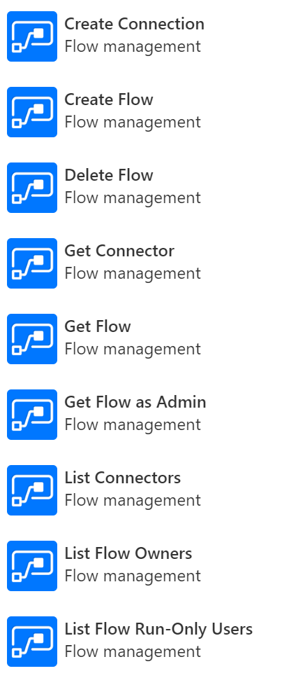
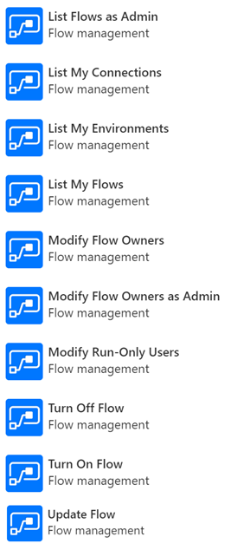
Flow Management

Slide 15
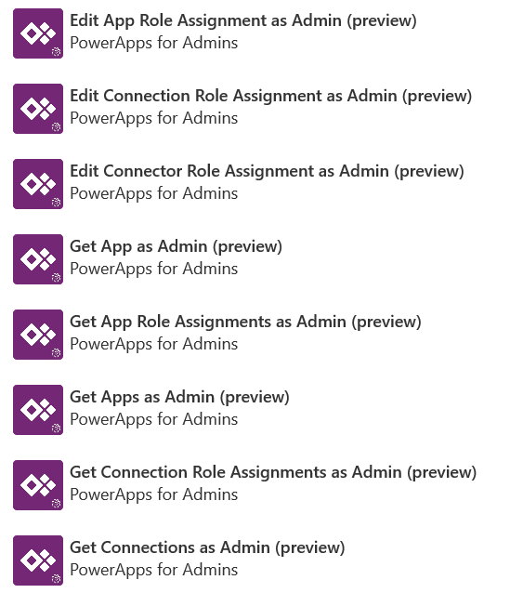
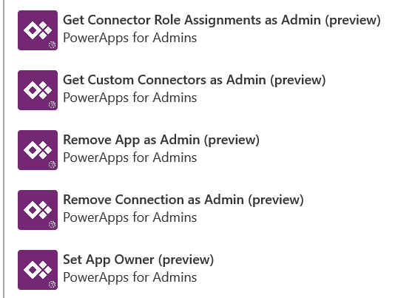
PowerApps for Admins

Slide 16
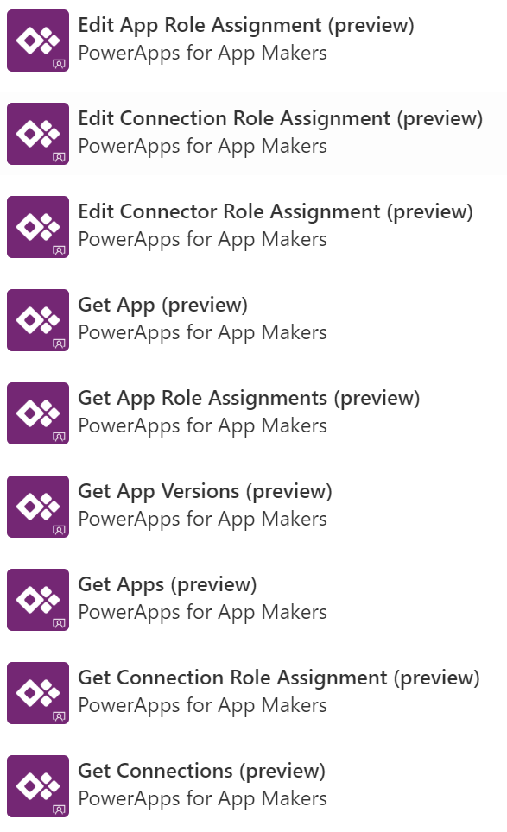
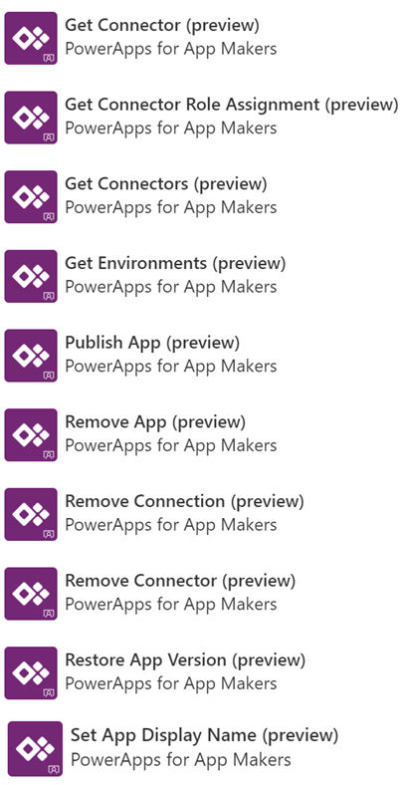
PowerApps for Makers

Slide 17
Taking action, some examples…
Easier with PowerShell | Easier with Management Connectors
Pull numbers of environments, apps, and flows | Build your own admin PowerApp
Bulk create multiple environments with CDS | Automate environment creation with approvals
Cleaning up environments no longer needed | Get alerts when new resources are created
Change owner of app after someone leaves | Create your own governance processes for: Canvas app creation Flow creation Specific connector usage
Report how many using premium connectors or data gateways

Slide 18
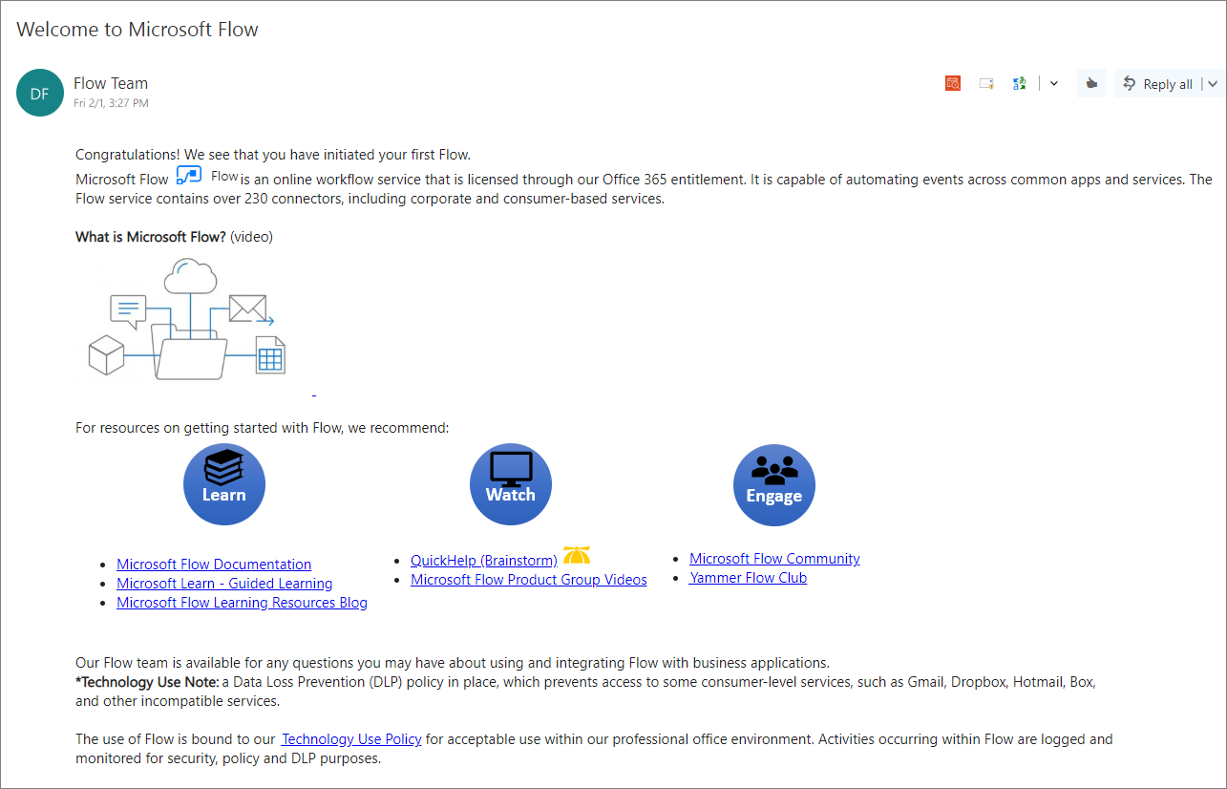
Welcome new makers and identify champions
Best
Practice
#1
Welcome new makers
Detect when new flow has been created
Check to see if they are part of makers AAD Group
If new, send welcome email with company and public resources
Invite them to Internal Yammer Club
https://aka.ms/powerwelcomeemail

Slide 19
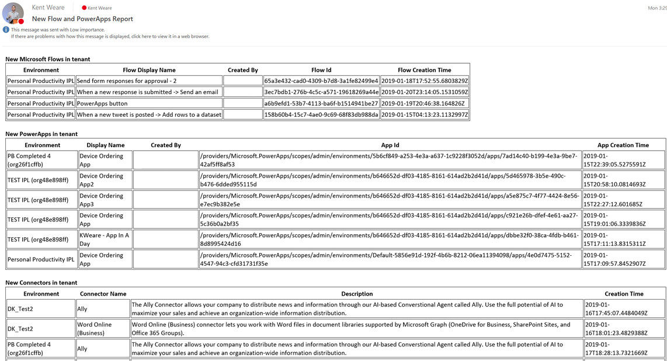
Welcome new makers and identify champions
Best
Practice
#2
Welcome new makers
Detect when new flow has been created
Check to see if they are part of makers AAD Group
If new, send welcome email with company and public resources
Invite them to Internal Yammer Club
https://aka.ms/powerwelcomeemail
Identify champions
New Flow, PowerApps and Connectors Digest
Sent Daily
Oversight
Empower new users
https://aka.ms/newmakerdigest

Slide 20
Establish and automate your audit process
Best
Practice
#3
Create your own workflows using the management connectors that permit or restrict behavior based on your organization’s policies (e.g. create an attestation process for assets in the default env)
Canvas app, flow creation | aka.ms/restrictappcreators
Specific connector usage | aka.ms/restrictflowconnector aka.ms/restrictappconnector
Newly added connectors | aka.ms/newconnectornotification

Slide 21
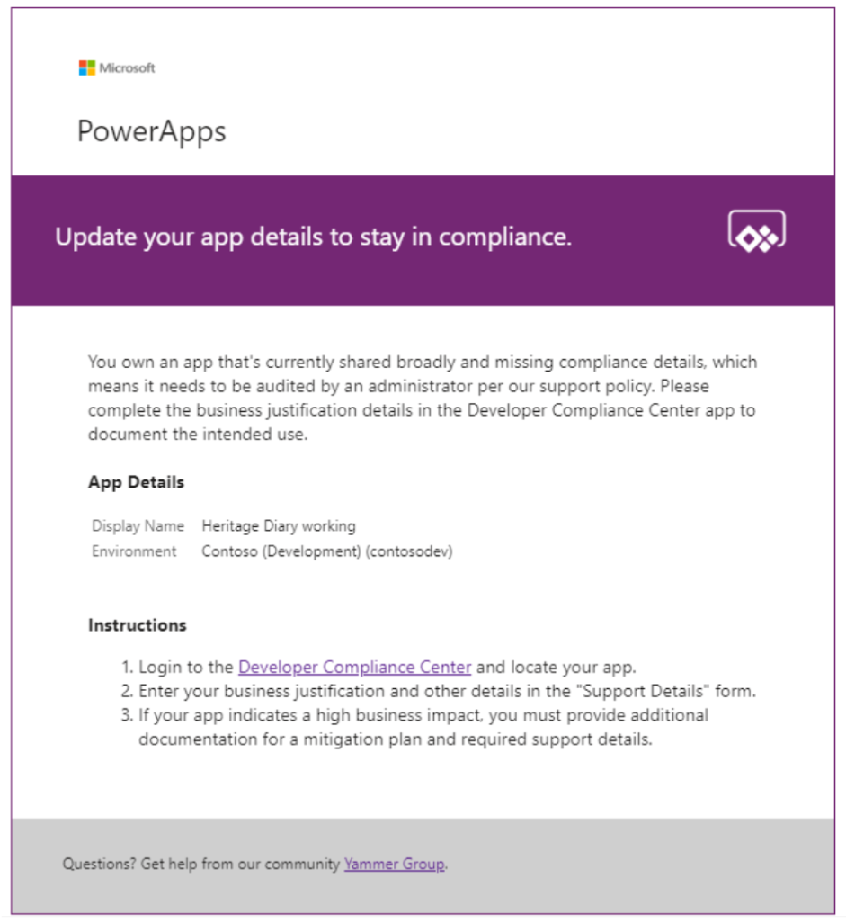
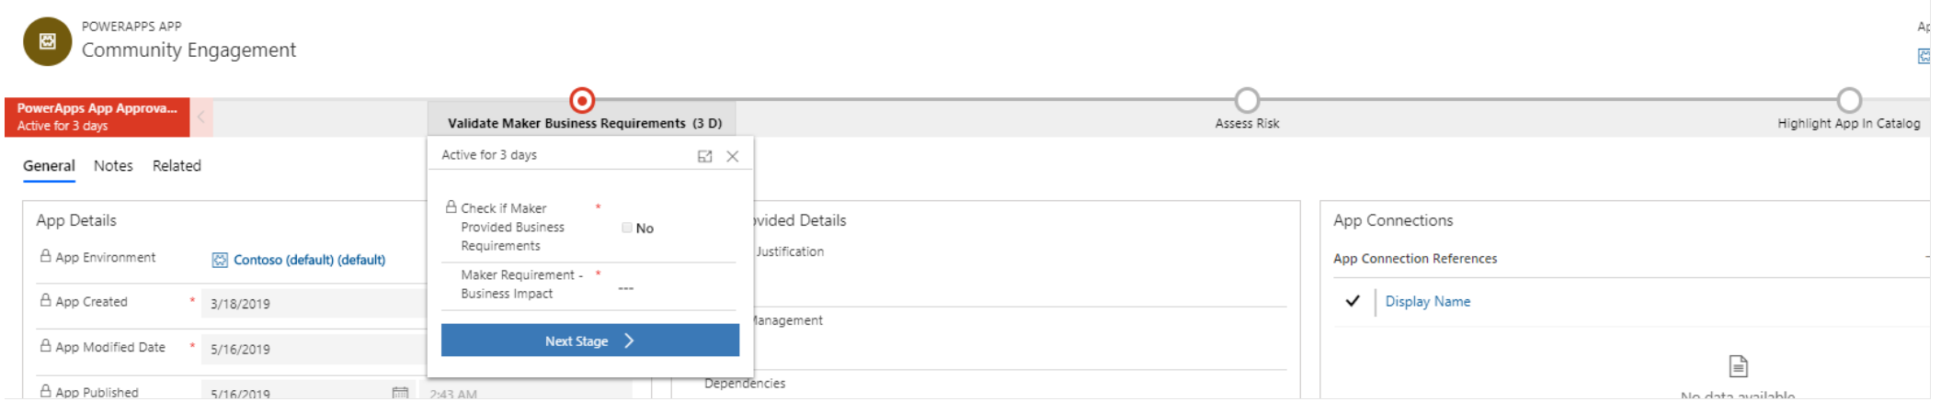
Establish and automate your audit process
Best
Practice
#4
Create your own workflows using the management connectors that permit or restrict behavior based on your organization’s policies (e.g. create an attestation process for assets in the default env)
CoE starter kit comes with its own audit workflow:
Apps are identified by a flow based on criteria such as the app is shared with > 20 Users or at least 1 group and the business justification details have not been provided.
Developer Compliance Center where the maker can provide a justification
Admin business process workflow for approval

Slide 22
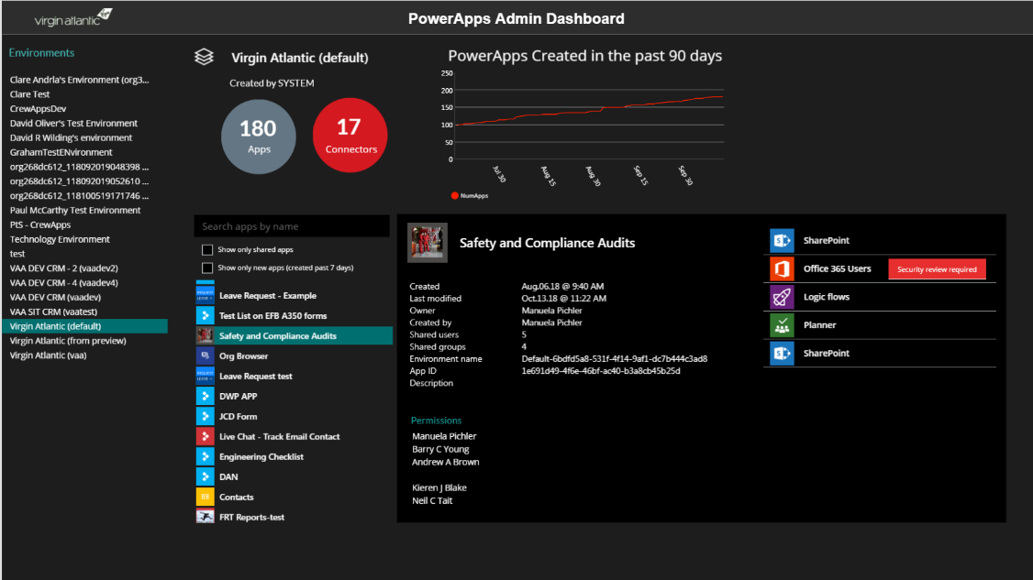
“A PowerApp to rule all PowerApps” (Virgin Atlantic)
Top level stats - # of apps, connectors, and app growth
List of environments
App details
Creator
Date created
Who is the app shared with
Description
…and more
Search and filter
show only shared apps
show new apps
List all connectors used by the app
List all apps in the environment
This is a PowerApp that uses the PowerApps Admin connectors – http://aka.ms/adminconnectors

Slide 23
Proactive Engagement
Welcome Email
Detect when new flow has been created
Check to see if they are part of Flow Makers AAD Group
If new, send welcome email with company and public resources
Invite them to Internal Yammer Club

Slide 24
Identify and empower champions
New Flow, PowerApps and Connectors Digest
Sent Daily
Oversight
Identify new makers
Empower new users

Slide 25
Module Review
PowerShell and connectors allow you to automate actions you would manually take in the portals
Use these tools to tailor a governance process to your specific requirements
Notes:
Start Time xx:xx / Length: 2 minutes
Review the objectives for this module.
Ask participants to use the Text tool to write on the screen if they had any questions about the module.

Slide 27
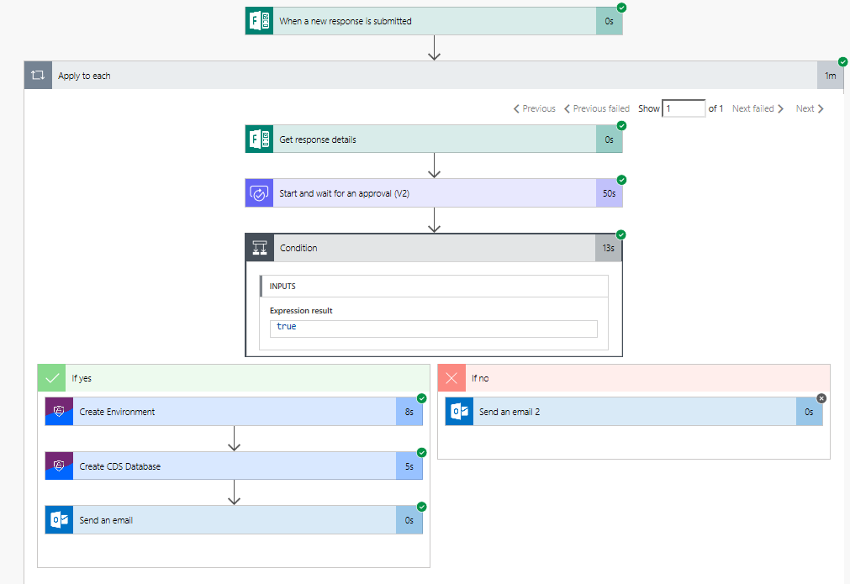
Flow example
Notes:
This is the flow you will build in the HOL, that uses Forms and an approval process and then creates the environment and CDS

Slide 28
“A PowerApp to rule all PowerApps” (Virgin Atlantic)
Top level stats - # of apps, connectors, and app growth
List of environments
App details
Creator
Date created
Who is the app shared with
Description
…and more
Search and filter
show only shared apps
show new apps
List all connectors used by the app
List all apps in the environment
This is a PowerApp that uses the PowerApps Admin connectors – http://aka.ms/adminconnectors

Slide 29
What we plan to cover
Using PowerShell cmdlets to automate actions
Using connectors to build automation and apps
Notes:
Start Time xx:xx / Length: 2 minutes
Review the learning objectives.

