Slide 1
Self-joins
Renaming is mandatory if table used more than once in a query
Example
Give the last names and salaries of employees and their managers whenever the employee earns more than the manager.
SELECT E.Lname, E.Salary, M.Lname, M.Salary
FROM EMPLOYEE E, EMPLOYEE M
WHERE E.Super_ssn = M.Ssn and E.Salary > M.Salary;
EMPLOYEE
Fname | Minit | Lname | Ssn | Bdate | Address | Sex | Salary | Super_ssn | Dno
E
Fname | Minit | Lname | Ssn | Bdate | Address | Sex | Salary | Super_ssn | Dno
M
Fname | Minit | Lname | Ssn | Bdate | Address | Sex | Salary | Super_ssn | Dno

Slide 2
Group by
The GROUP BY clause is a SQL command that is used to group rows that have the same values.
It is used in conjunction with aggregate functions to produce summary reports from the database
The queries that contain the GROUP BY clause are called grouped queries and only return a single row for every grouped item.

Slide 3
Group by syntax
SELECT column1, column2 , aggregate function(col)
FROM table_name
WHERE [ conditions ]
GROUP BY column1, column2 [ grouping attributes]
HAVING [ group conditions ]
ORDER BY column1, column2 [attribute list]
Assemble all tables according to From clause (“,” means to use ×).
Keep only tuples matching Where clause.
Group into blocks based on Group By clause.
Keep only blocks matching Having clause.
Create one tuple for each block using Select clause.
Order resulting tuples according to Order By clause.

Slide 4
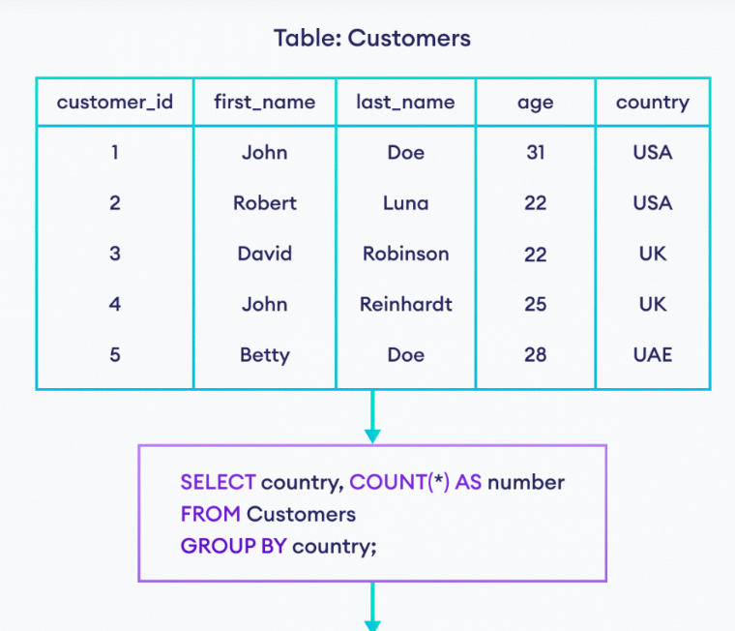
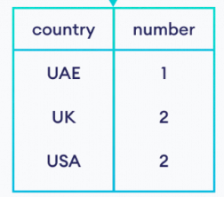

Slide 5
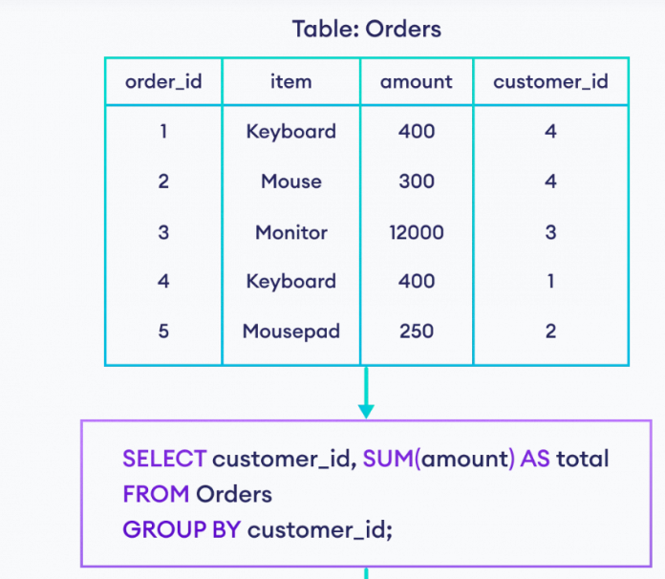
To find the total amount for each customer who has placed an order.

Slide 6
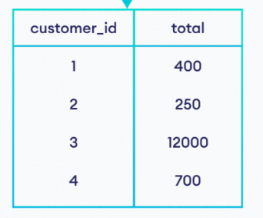

Slide 7
Exercise
employee_number | last_name | first_name | salary | dept_id
1001 | Smith | John | 62000 | 500
1002 | Anderson | Jane | 57500 | 500
1003 | Everest | Brad | 71000 | 501
1004 | Horvath | Jack | 42000 | 501
SELECT dept_id, SUM(salary) AS total_salaries FROM employees
GROUP BY dept_id;
dept_id | total_salaries
500 | 119500
501 | 113000
List dept id and total salary of all employees for each department

Slide 8
GROUP BY
product_id | product_name | category_id
1 | Pear | 50
2 | Banana | 50
3 | Orange | 50
4 | Apple | 50
5 | Bread | 75
6 | Sliced Ham | 25
7 | Kleenex | NULL
SELECT category_id, COUNT(*) AS total_products FROM products
WHERE category_id IS NOT NULL
GROUP BY category_id
ORDER BY category_id;
category_id | total_products
25 | 1
50 | 4
75 | 1
Print total no of products in each product category in the sorted order

Slide 9
Having
HAVING filters records that work on summarized GROUP BY results.
HAVING applies to summarized group records, whereas WHERE applies to individual records.
Only the groups that meet the HAVING criteria will be returned.
HAVING requires that a GROUP BY clause is present.
WHERE and HAVING can be in the same query.

Slide 10
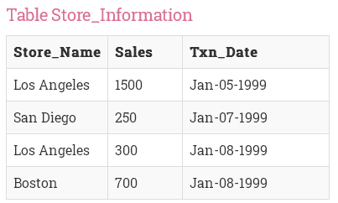

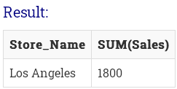
Having clause
Store_Name | Sales | Txn_Date
Los Angeles | 1500 | Jan-05-1999
Los Angeles | 300 | Jan-08-1999
San Diego | 250 | Jan-07-1999
Boston | 700 | Jan-08-1999

Slide 11
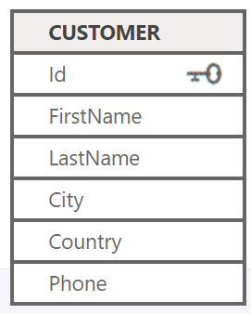
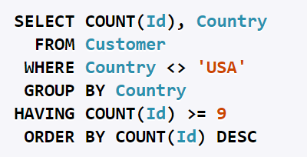
Example
List the number of customers in each country, except the USA, sorted high to low. Only include countries with 9 or more customers.

Slide 12

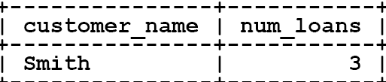
eXAMPLE
Borrower (loan-id: int, customer-name: String, branch-name: string)

Slide 13
Exercise
Emp
Emp_id | E_name | Dept | Salary
1 | Ram | HR | 10000
2 | Amit | MRKT | 20000
3 | Ravi | HR | 30000
4 | Simon | MRKT | 40000
5 | Nitin | IT | 50000
List number of employees works in each department
select Dept, count(*),
from emp
group by Dept;
Dept | Count
HR | 2
MRKT | 2
IT | 1

Slide 14

Exercise
Loan (loan-number: int, branch-name: String, amount: real)

Slide 15
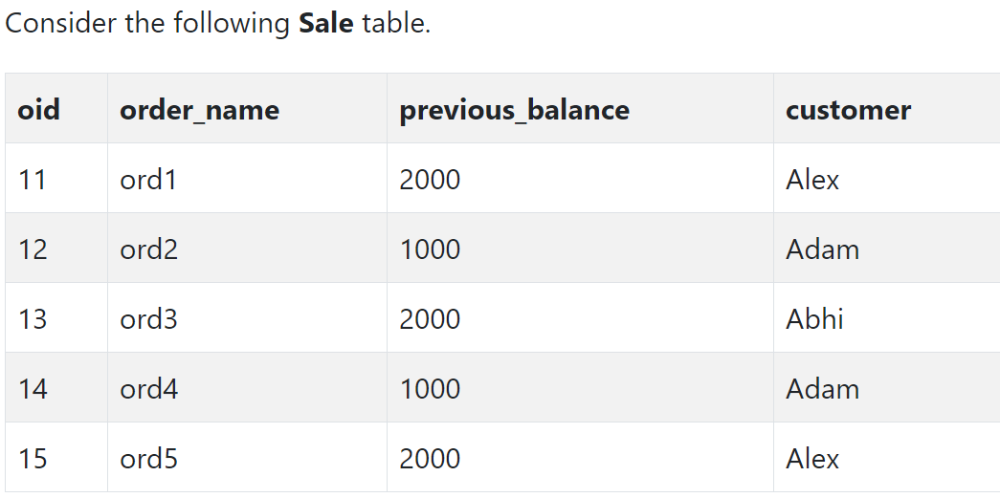
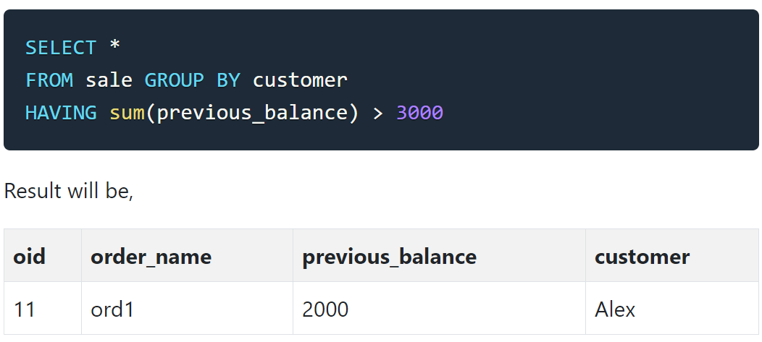
Exercise
Suppose we want to find the customer whose
previous_balance sum is more than 3000

Slide 16
Subquery (or) nested query
Subquery or Inner query or Nested query is a query within another SQL query.
SQL subquery is usually added in the WHERE Clause of the SQL statement.
Subqueries are an alternate way of returning data from multiple tables
Subqueries can be used with the following SQL statements along with the comparison operators like =, <, >, >=, <= etc.
The comparison operator can also be a multiple-row operator, such as IN, ANY, SOME, or ALL.
The inner query executes first before its parent query so that the results of the inner query can be passed to the outer query.

Slide 17
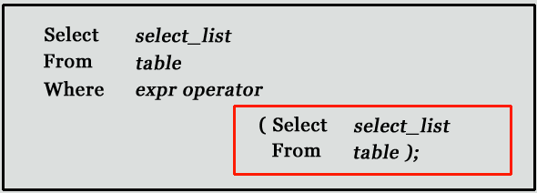
Non correlated subquery

Slide 18
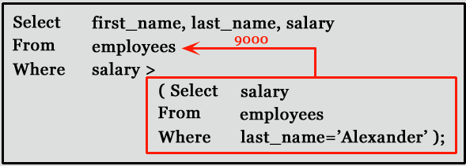
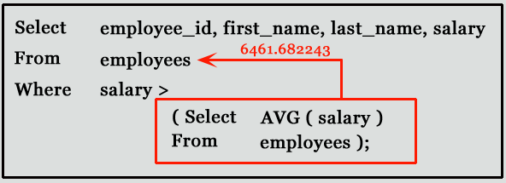
List all the employees whose salary is greater than “Alexander”
List the employees who are earning greater than average salary

Slide 19
Multi row operators
The ‘ALL’, ‘ANY’, ’SOME’, ’IN’ operator compares value to every value returned by the subquery.
IN – True if the operand is equal to one of the list element
ANY – True if any of the subquery values meet
the condition
SOME – True if any of the subquery values meet
the condition
ALL – True if all the subquery values meet the
condition

Slide 20
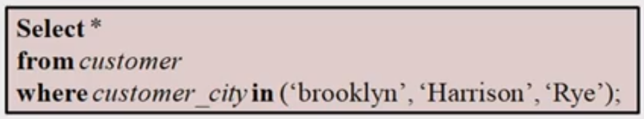
IN

Slide 21
ALL Operator
The SQL ALL operator is a logical operator that compares a single value with a single-column set of values returned by a subquery.
WHERE
column_name comparison_operator ALL (subquery)
ALL operator must be preceded by a comparison operator such as >, >=, <, <=, <>, = and followed by a subquery
If the subquery returns no row, the condition in the WHERE clause is always true

Slide 22
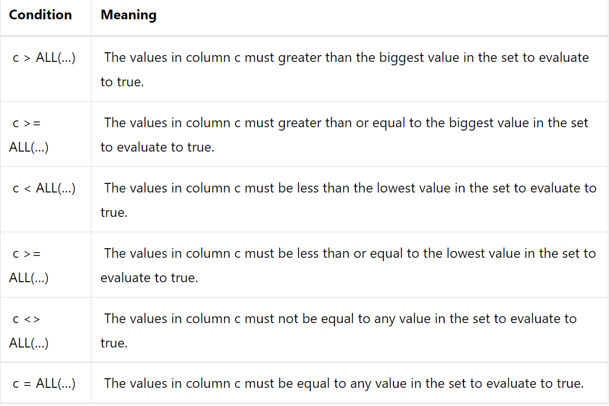

Slide 23
ANy
The ANY operator is a logical operator that compares a value with a set of values returned by a subquery.
The ANY operator must be preceded by a comparison operator >, >=, <, <=, =, <> and followed by a subquery.
WHERE column_name comparison_operator ANY
(subquery)
If the subquery returns no row, the condition evaluates to false.

Slide 24
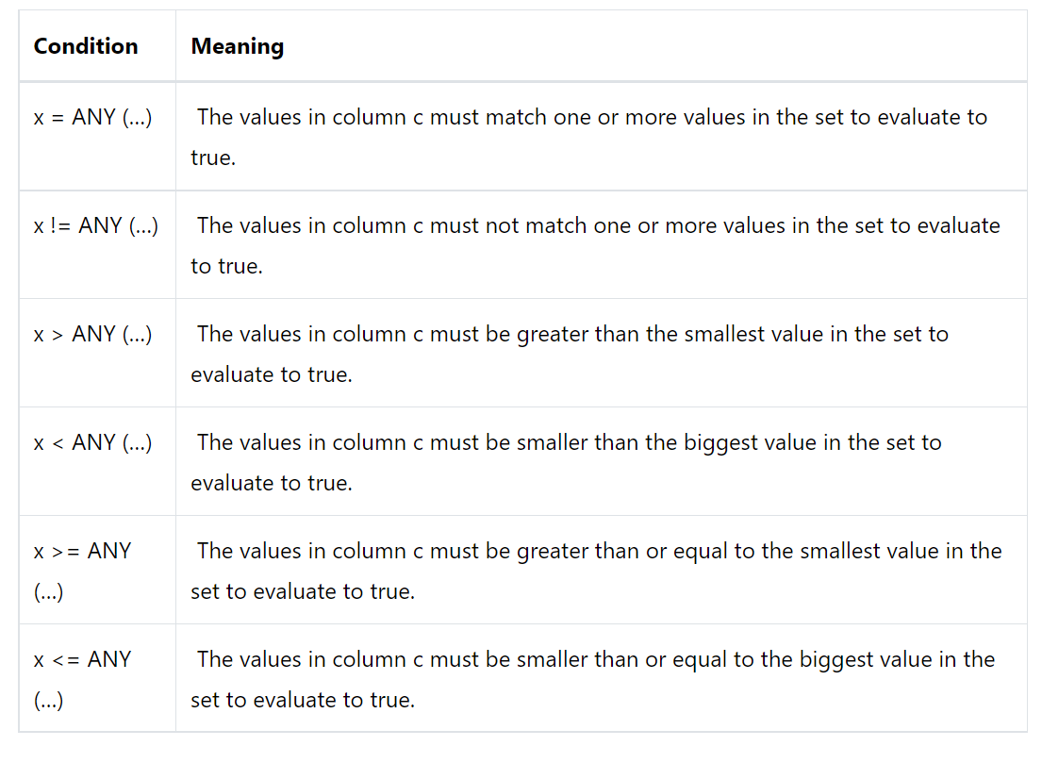

Slide 25
SELECT
first_name, last_name, salary
FROM
employees
WHERE
salary = ANY (
SELECT AVG(salary)
FROM employees
GROUP BY
department_id)
ORDER BY
first_name,
last_name,
salary;

Slide 26
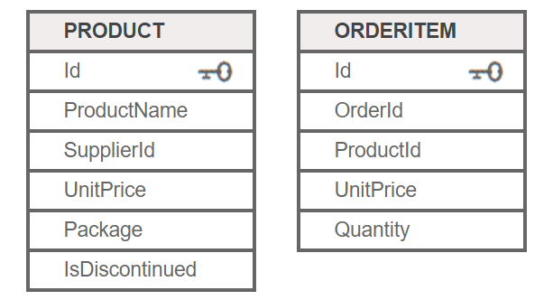
subquery
List the names of products that have been ordered more than 100
SELECT ProductName
FROM Product
WHERE Id IN (SELECT ProductId
FROM OrderItem
WHERE Quantity>100)

Slide 27
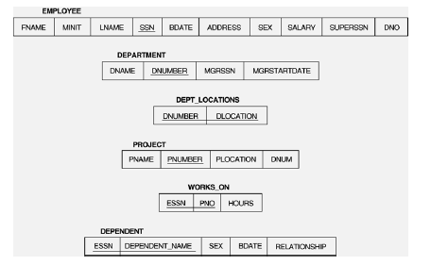
Sub query
Retrieve the name and address of all employees who work for the 'Research' department.
SELECT FNAME, LNAME, ADDRESS FROM EMPLOYEE
WHERE DNO IN (SELECT DNUMBER
FROM DEPARTMENT
WHERE DNAME='Research' )

Slide 28
Employee Table :
Employee No | Employee Name | Department
1 | Rohan | SQL
2 | Rajiv | PL SQL
3 | Ram | Java
Salary Table :
Employee No | Salary
1 | 25000
2 | 35000
3 | 45000
Fetch the all records of Employees who’s salary is greater that 25000.
Select * from Employee
where Employee_No In (Select Employee_No From Salary
where Salary > 25000);

Slide 29
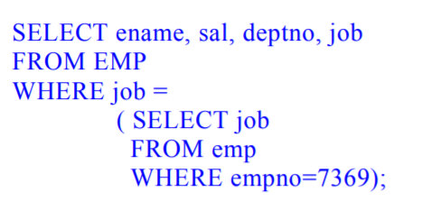
Example
Select the ename, sal, deptno, job of employee whose job is same as employee no 7369

Slide 30
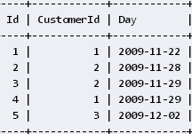
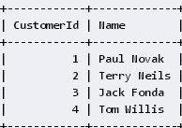
Reservations
Customers
SELECT Name
FROM Customers
WHERE CustomerId=(SELECT CustomerId
FROM Reservations
WHERE Id=2);
Find the name of the customer whose reservation id is 2
Write the same query using Join operation
Select name
From customers C, reservations R
Where C.CustomerId=R.CustomerId and R.Id=2;

Slide 31
Reservations
Customers
Find the names of the customer who have reservations
SELECT Name
FROM Customers
WHERE CustomerId IN (SELECT DISTINCT CustomerId
FROM Reservations);

Slide 32
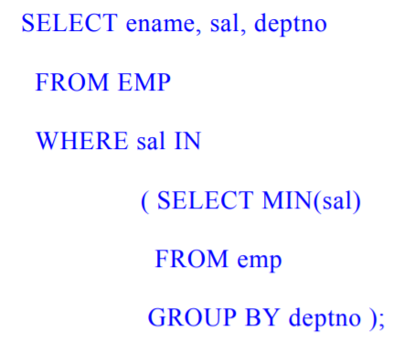
example
Print name , salary and dept no of the employees receiving least salary in each department

Slide 33
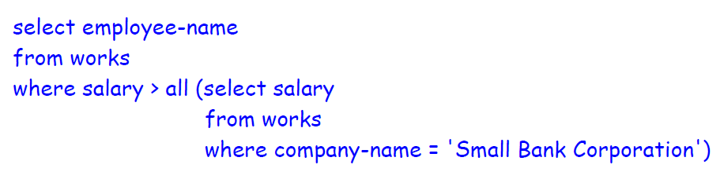
employee(employee-name, street, city)
works(employee-name, company-name, salary)
company(company-name, city)
manages(employee-name, manager-name)
Find the names of all employees in the database who earn more than every employee of 'Small Bank Corporation'. Assume that all people work for at most one company.

Slide 34
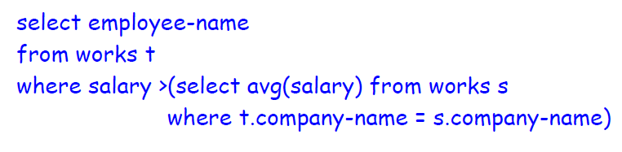
employee(employee-name, street, city)
works(employee-name, company-name, salary)
company(company-name, city)
manages(employee-name, manager-name)
Find the names of all employees who earn more than the average salary of all employees of their company. Assume that all people work for at most one company.

