Slide 1

Unsupervised Learning to Enhance Gene Regulatory Pathway Prediction with GNN
Yibo Chen

Slide 2
Outline
Data Curation
Baseline model (GCN, GAT, Graph Transformer)
Dimension Reduction (t-SNE, UMAP, GATAE, VGATAE)
Clustering (Kmeans, Spectral Clustering, fuzzy Cmeans)
Models with clustering information

Slide 3
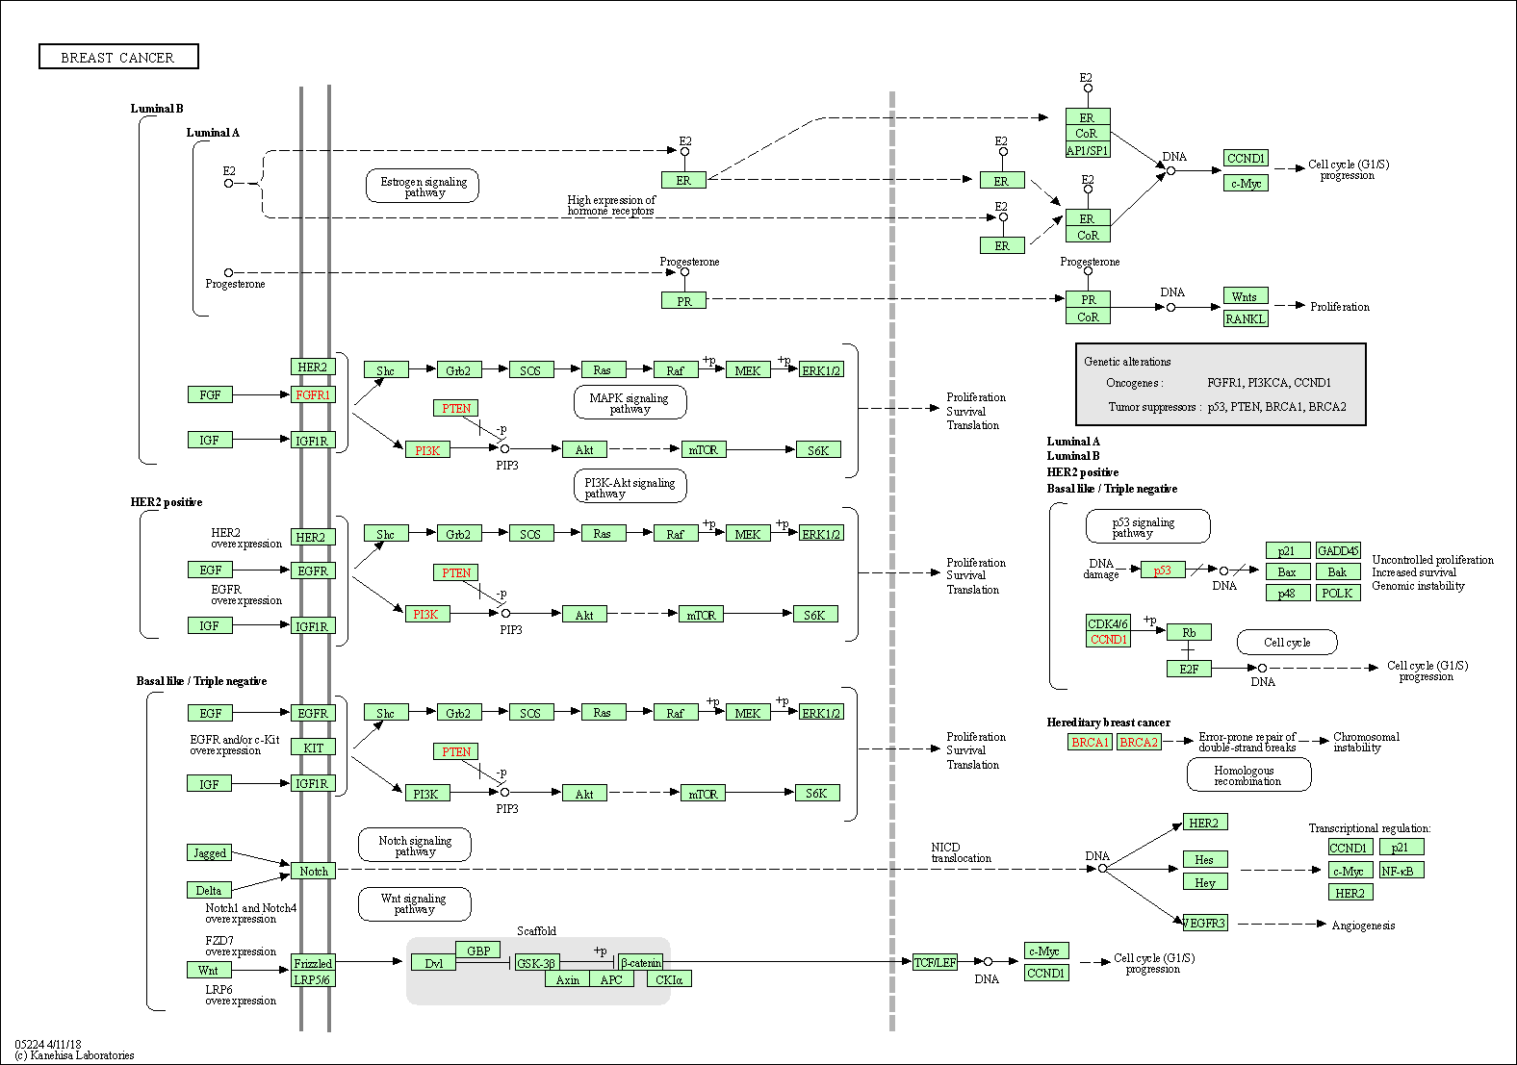
Data Preparation
KEGG Pathway Database
[KEGG: Kyoto Encyclopedia of Genes and Genomes, Kanehisa, M. , 2000]

Slide 4
Data Preparation
Acquire data from KEGG using KGML (XML format) through KEGG API
Preprocess data into csv format
Train, val, test divided based on pathway maps
(70% 15% 15%, 356 pathway maps in total)
Exclude entities in the validation and test set that are non-existent in training
Get rid of minority relations ('dissociation’, 'methylation', 'repression', 'state change', 'dephosphorylation', 'ubiquitination’), which account for less than 1%
Exclude overlap relations.
Add 50% no_interaction relations. (Recognize no interaction as well)

Slide 5
Final Data
Edge Statistics
Node Statistics
Data Set | Compound | Binding/ Association | Activation | Phosphorylation | No_relation | Inhibition | Expression
Train | 19259 (19%) | 5570 (6%) | 27615 (27%) | 5032 (5%) | 34669 (34%) | 6283 (6%) | 3163 (3%)
Val | 708 (4%) | 443 (2%) | 7284 (40%) | 1042 (6%) | 6143 (34%) | 1780 (10%) | 729 (4%)
Test | 2652 (19%) | 405 (3%) | 4019 (28%) | 993 (7%) | 4813 (34%) | 589 (4%) | 732 (5%)
Data Set | Pathway map | Genes | Compound | Drug | Glycan
Train | 86 | 4514 | 195 | 12 | 9
Val | 14 | 1400 | 48 | 0 | 0
Test | 38 | 1434 | 53 | 0 | 0

Slide 6
Load Data into Model
Data preprocess
Python, networkx, multiDiGraph (for a directed graph with multiple edge types)
Node property: KEGG ID
Edge property: subtype (e.g. Activation), source, type (e.g. Protein-Protein Interaction)
Global node index for train, val, and test
Use node index for generating initial node embedding that will be learned along the training
Cross entropy loss
Details (learning rate scheduler, early stop, drop out, Adam, relu)

Slide 7
Baseline Models
Model Preparation
Graph Convolutional networks (32 node embedding, 32 hidden layers)
Graph Attention networks (32 node embedding, 32 hidden layers, 5 attention heads)
Graph Transformer (32 node embedding, 32 hidden layers, 5 attention heads)
Implemented using pytorch geometric
[Semi-Supervised Classification with Graph Convolutional Networks, Thomas N. Kipf. , 2016]
[Graph Attention Networks, Petar Veličković. , 2018]
[A Generalization of Transformer Networks to Graphs, Vijay Prakash Dwivedi. , 2020]

Slide 8
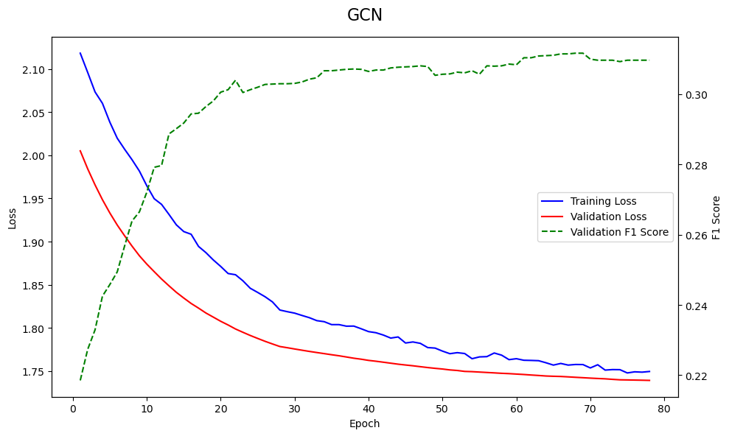
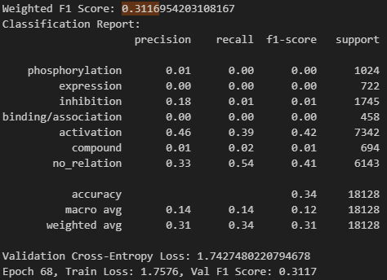
GCN Performance
Weighted F-1 on the Validation set.
GCN: 68 epoch, 0.3117

Slide 9
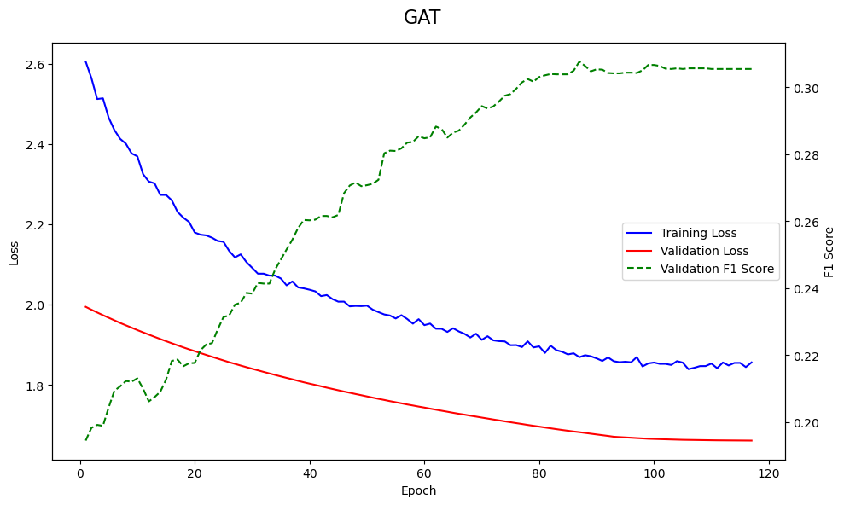
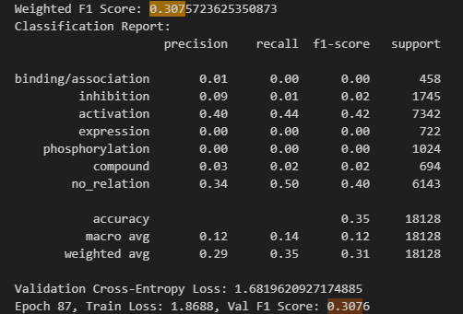
GAT Performance
Weighted F-1 on the Validation set.
GAT: 87 epoch, 0.3076

Slide 10
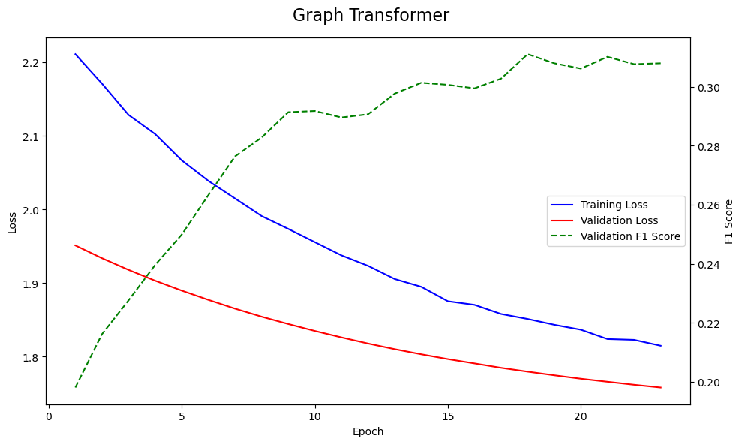
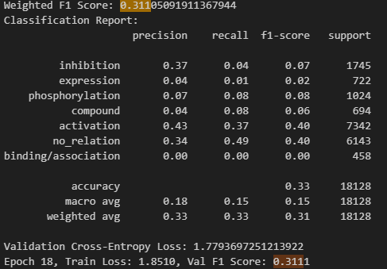
Graph Transformer Performance
Weighted F-1 on the Validation set.
Graph Transformer: 18 epoch, 0.3111

Slide 11
Data Preparation for Clustering
Clustering
Python networkx, MultiGraph(), an undirected graph with multiple types of edges.
An arbitrary weight to assigned each types of edges
Katz Similarity (beta = 1, max_power = 5)
Katz Similarity Matrix
Relations | No relation | Activation | Inhibition | Phosphorylation | Compound | Binding/ Association | Expression
Weight | 0 | 0.8 | 0.8 | 0.8 | 0.5 | 0.5 | 0.5

Slide 12
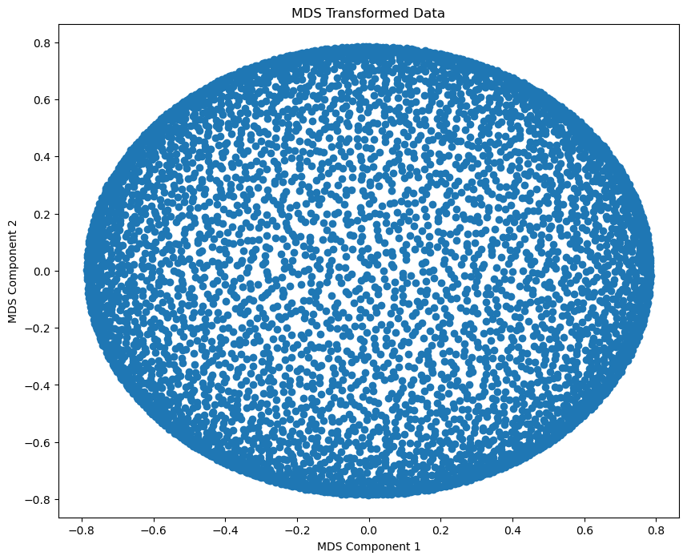
Visualize Katz Similarity Matrix using MDS
Clustering

Slide 13
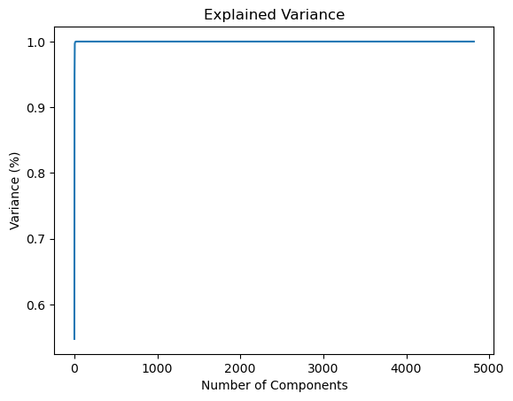
Dimension Reduction
Clustering
PCA

Slide 14
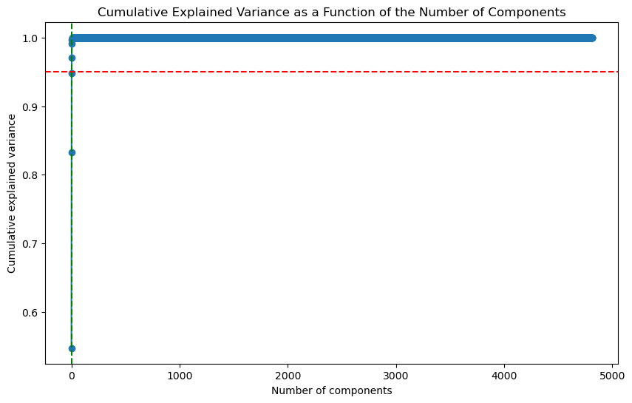
Dimension Reduction
Clustering
SVD

Slide 15
Other Dimension Reduction or Clustering Method
Clustering
Techniques | Why it doesn’t work?
Spectral Clustering | Spectral Embedding works better on dense matrix, but gene pathway graph is sparse Using eigengap heuristic to determine the optimal number of clusters, find the result is 2
NMF | Optimal cluster number is 4
Laplacian Eigenmap | Same as Spectral Clustering
Isomap | Optimal cluster number is 4
Louvian | Works on undirected graph

Slide 16
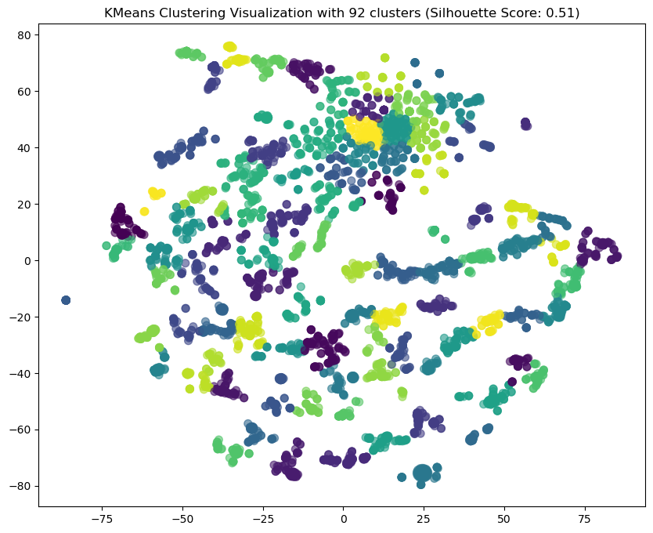
Dimension Reduction: t-SNE
Clustering
Optimal Cluster Number
identified by Infomap: 92
Problem: Work on symmetric matrix,
so the direction information is lost.

Slide 17
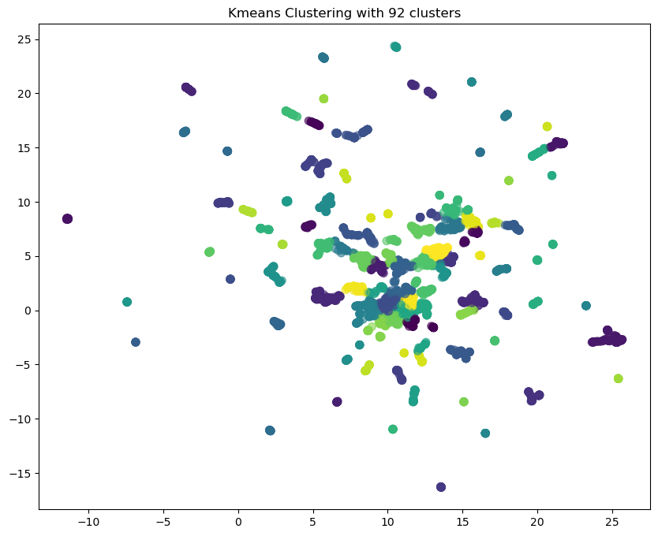
Dimension Reduction: UMAP
Clustering
Optimal Cluster Number
identified by Infomap: 92
Problem: Work on symmetric matrix,
so the direction information is lost.

Slide 18
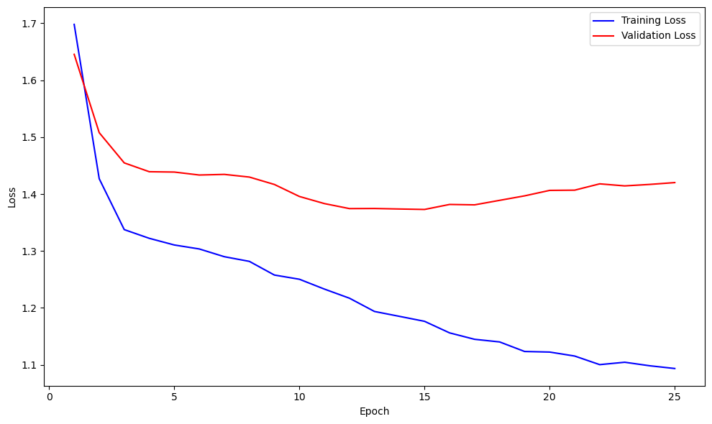
Graph Autoencoder
Embedding layer (number of nodes, 16)
GCN layer (16, 32)
GATConv layer (32, 16)
Reconstruction loss (cross-entropy)
Best val Loss: 1.3730
Training loss: 1.1765

Slide 19
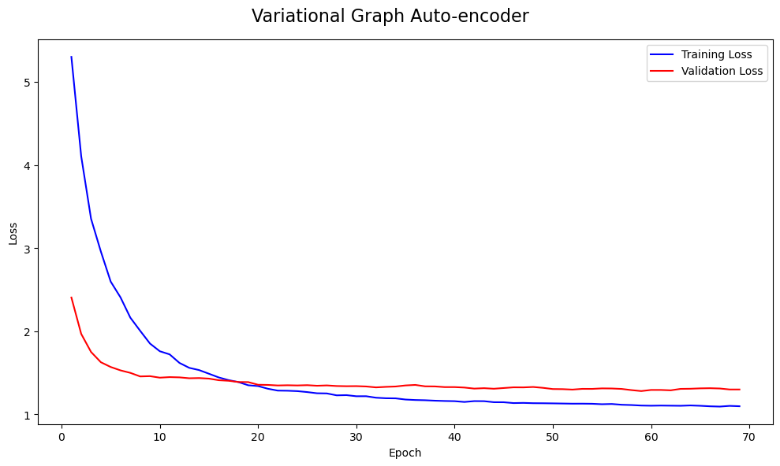
Variational Graph Autoencoder
Embedding layer (number of nodes, 16)
GCN layer (16, 32)
GATConv_mu layer (32, 16) +
GATConv_logvariance (32, 16)
Reconstruction loss (cross-entropy)
Best validation loss: 1.280
Training loss: 1.106

Slide 20
Clustering
Optimal cluster number decided by infomap
Kmeans
The result of Kmeans is encoded using 8 dimension one-hot encodeing (92 clusters)
Then concatenated with the node embedding as the input.
Fuzzy Cmeans
The result of Fuzzy Cmeans is encoded using 92 dimension embedding
Then concatenated with the node embedding as the input

Slide 21
Results
Graph transformer:
Input | Training Loss | Validation Loss | Validation F-1
Node embedding (32) | 1.851 | 1.779 | 0.311
Node embedding (32) + fixed Kmeans cluster feature (8) | 1.634 | 1.642 | 0.357
Node embedding (32) + learned Kmeans cluster feature (8) | 1.762 | 1.707 | 0.336
Node embedding (32) + fixed fuzzy cluster features (92) | 1.452 | 1.460 | 0.377

Slide 22
Future work
Finish hyper-parameter tuning and testing :)
Incorporate large language models like BioBert, ProteinBert for generating node embedding
Incorporate gene expression data or enrichment analysis
Try more GNN models (e.g. GraphSAGE, DistMult)

