Slide 1
CS 267: Optimizing for
Uniprocessors—A Case Study in Matrix Multiplication
Katherine Yelick
yelick@cs.berkeley.edu
http://www.cs.berkeley.edu/~yelick/cs267

Slide 2
Recap and Plan
Scaled speedup: operate near the memory boundary
Memory systems on modern processors are complicated.
The performance of a simple program can depend on the details of the micro-architecture.
Today we will study matrix multiplication optimizations
  An important kernel in some scientific problems
  Closely related to other algorithms, e.g., transitive closure on a graph using Floyd-Warshall
  Optimization ideas can be used in other problems
  The best case for optimization payoffs
  The most well-studied algorithm in high performance computing

Slide 3
Outline
Performance Modeling
Matrix-Vector Multiply (Warmup)
Matrix Multiply Cache Optimizations
Bag of Tricks
Research in Matrix Multiply

Slide 4
Using a Simple Model of Memory to Optimize
Assume just 2 levels in the hierarchy, fast and slow
All data initially in slow memory
  m = number of memory elements (words) moved between fast and slow memory
  t_{m} = time per slow memory operation
  f = number of arithmetic operations
  t_{f} = time per arithmetic operation << t_{m}
  q = f / m average number of flops per slow element access
Minimum possible time = f* t_{f} when all data in fast memory
Actual time
  f * t_{f} + m * t_{m} = f * t_{f} * (1 + t_{m}/t_{f} * 1/q)
Larger q means time closer to minimum f * t_{f}
Computational Intensity: Key to algorithm efficiency
Key to machine efficiency

Slide 5
Warm up: Matrix-vector multiplication
{implements y = y + A*x}
for i = 1:n
for j = 1:n
y(i) = y(i) + A(i,j)*x(j)
A(i,:)
=
+
*
y(i)
y(i)
x(:)

Slide 6
Warm up: Matrix-vector multiplication
{read x(1:n) into fast memory}
{read y(1:n) into fast memory}
for i = 1:n
{read row i of A into fast memory}
for j = 1:n
y(i) = y(i) + A(i,j)*x(j)
{write y(1:n) back to slow memory}
m = number of slow memory refs = 3n + n²
f = number of arithmetic operations = 2n²
q = f / m ~= 2
Matrix-vector multiplication limited by slow memory speed

Slide 7
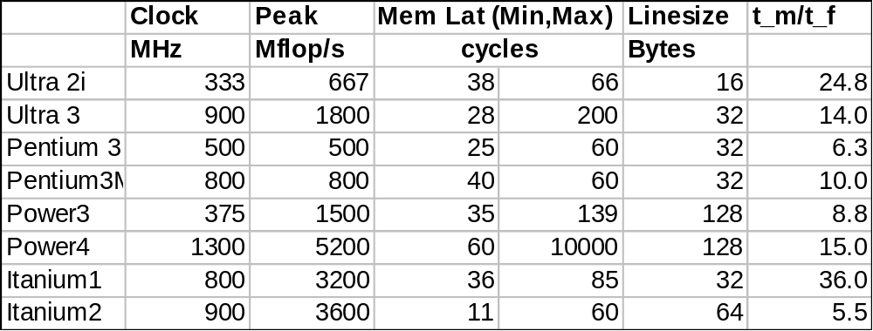
Modeling Matrix-Vector Multiplication
Compute time for nxn = 1000x1000 matrix
Time
  f * t_{f} + m * t_{m} = f * t_{f} * (1 + t_{m}/t_{f} * 1/q)
  = 2*n² * (1 + 0.5 * t_{m}/t_{f})
For t_{f} and t_{m}, using data from R. Vuduc’s PhD (pp 352-3)
  http://bebop.cs.berkeley.edu/pubs/vuduc2003-dissertation.pdf
  For t_{m} use words-per-cache-line / minimum-memory-latency
machine
“balance”
(q must
be at least
this for
peak
speed)

Slide 8
What Simplifying Assumptions
What simplifying assumptions did we make in this analysis?
  Ignored parallelism in processor between memory and arithmetic within the processor
    Sometimes drop arithmetic term in this type of analysis
  Assumed fast memory was large enough to hold three vectors
    Reasonable if we are talking about any level of cache
    Not if we are talking about registers (~32 words)
  Assumed the cost of a fast memory access is 0
    Reasonable if we are talking about registers
    Not necessarily if we are talking about cache (1-2 cycles for L1)
  Memory latency is constant
Could simplify even further by ignoring memory operations in X and Y vectors
  Mflop rate/element = 2 / (2* t_{f} + t_{m})

Slide 9
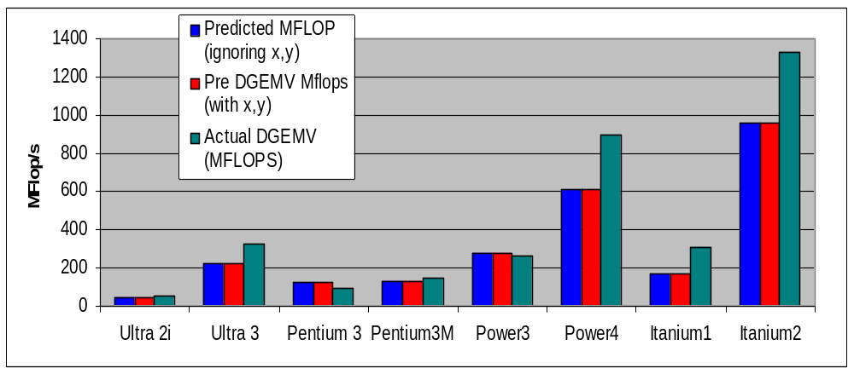
Validating the Model
How well does the model predict actual performance?
  Using DGEMV: Most highly optimized code for the platform
Model sufficient to compare across machines
But under-predicting on most recent ones due to latency estimate

Slide 10
“Naïve” Matrix Multiply
{implements C = C + A*B}
for i = 1 to n
for j = 1 to n
for k = 1 to n
C(i,j) = C(i,j) + A(i,k) * B(k,j)
Algorithm has 2*n³ = O(n³) Flops and operates on 3*n² words of memory
C(i,j)
C(i,j)
A(i,:)
=
+
*
B(:,j)

Slide 11
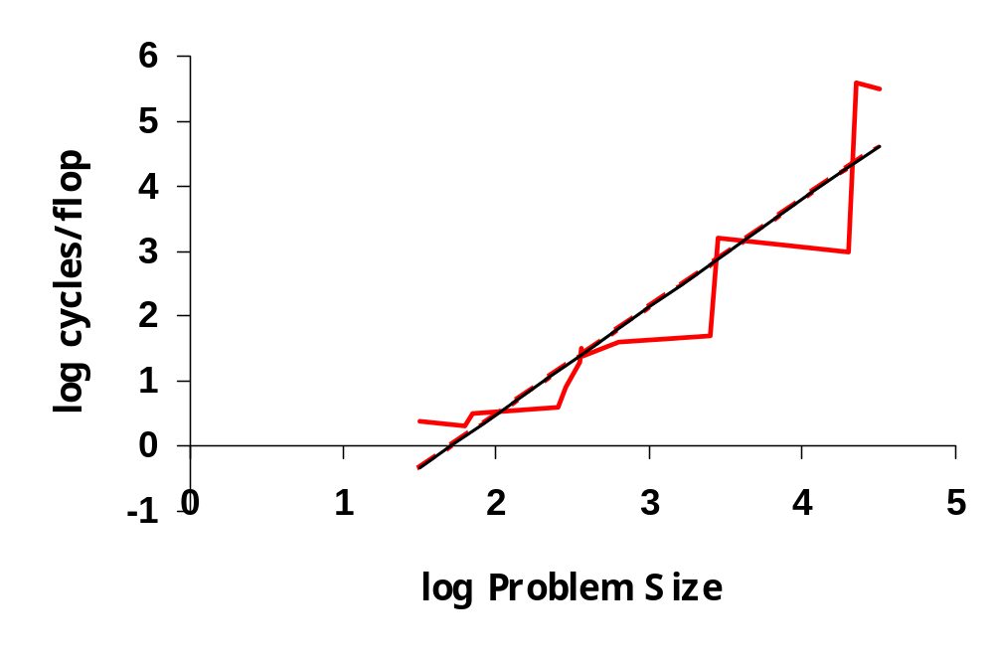
Matrix Multiply on RS/6000
12000 would take
1095 years
T = N^{4.7}
Size 2000 took 5 days
O(N³) performance would have constant cycles/flop
Performance looks much closer to O(N⁵)
Slide source: Larry Carter, UCSD

Slide 12
Note on Matrix Storage
A matrix is a 2-D array of elements, but memory addresses are “1-D”
Conventions for matrix layout
  by column, or “column major” (Fortran default); A(i,j) at A+i+j*n
  by row, or “row major” (C default) A(i,j) at A+i*n+j
Column major matrix in memory
Column major
Row major
0
5
10
15
0
1
2
3
1
6
11
16
4
5
6
7
2
7
12
17
8
9
10
11
3
8
13
18
12
13
14
15
4
9
14
19
16
17
18
19
Blue row of matrix is stored in red cachelines
cachelines
Figure source: Larry Carter, UCSD

Slide 13
“Naïve” Matrix Multiply
{implements C = C + A*B}
for i = 1 to n
for j = 1 to n
for k = 1 to n
C(i,j) = C(i,j) + A(i,k) * B(k,j)
Reuse
value from a
register
Stride-N
access to
one row*
Sequential
access through
entire matrix
When cache (or TLB or memory) can’t hold entire B matrix, there will be a miss on every line.
When cache (or TLB or memory) can’t hold a row of A, there will be a miss on each access
*Assumes column-major order
Slide source: Larry Carter, UCSD

Slide 14
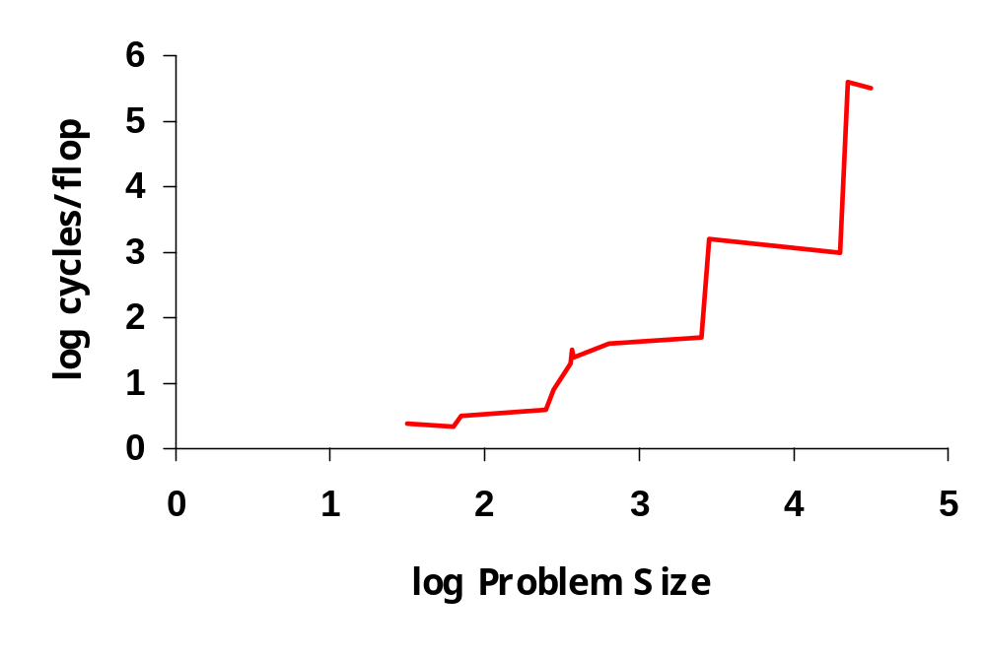
Matrix Multiply on RS/6000
Page miss every iteration
TLB miss every
iteration
Cache miss every
16 iterations
Page miss every 512 iterations
Slide source: Larry Carter, UCSD

Slide 15
“Naïve” Matrix Multiply
{implements C = C + A*B}
for i = 1 to n
{read row i of A into fast memory}
for j = 1 to n
{read C(i,j) into fast memory}
{read column j of B into fast memory}
for k = 1 to n
C(i,j) = C(i,j) + A(i,k) * B(k,j)
{write C(i,j) back to slow memory}
C(i,j)
C(i,j)
A(i,:)
=
+
*
B(:,j)

Slide 16
“Naïve” Matrix Multiply
Number of slow memory references on unblocked matrix multiply
m = n³ read each column of B n times
+ n² read each row of A once
+ 2n² read and write each element of C once
= n³ + 3n²
So q = f / m = 2n³ / (n³ + 3n²)
~= 2 for large n, no improvement over matrix-vector multiply
C(i,j)
C(i,j)
A(i,:)
=
+
*
B(:,j)

Slide 17
Blocked (Tiled) Matrix Multiply
Consider A,B,C to be N by N matrices of b by b subblocks where b=n / N is called the block size
for i = 1 to N
for j = 1 to N
{read block C(i,j) into fast memory}
for k = 1 to N
{read block A(i,k) into fast memory}
{read block B(k,j) into fast memory}
C(i,j) = C(i,j) + A(i,k) * B(k,j) {do a matrix multiply on blocks}
{write block C(i,j) back to slow memory}
C(i,j)
C(i,j)
A(i,k)
=
+
*
B(k,j)

Slide 18
Blocked (Tiled) Matrix Multiply
Recall:
m is amount memory traffic between slow and fast memory
matrix has nxn elements, and NxN blocks each of size bxb
f is number of floating point operations, 2n³ for this problem
q = f / m is our measure of algorithm efficiency in the memory system
So:
m = N*n² read each block of B N³ times (N³ * n/N * n/N)
+ N*n² read each block of A N³ times
+ 2n² read and write each block of C once
= (2N + 2) * n²
So computational intensity q = f / m = 2n³ / ((2N + 2) * n²)
~= n / N = b for large n
So we can improve performance by increasing the blocksize b
Can be much faster than matrix-vector multiply (q=2)

Slide 19
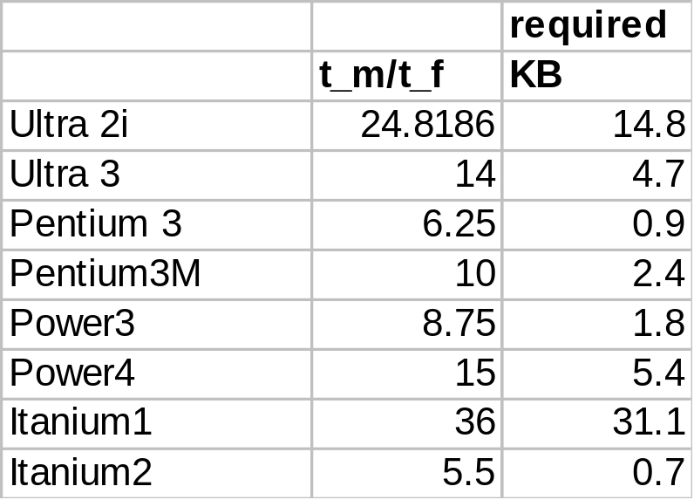
Using Analysis to Understand Machines
The blocked algorithm has computational intensity q ~= b
The larger the block size, the more efficient our algorithm will be
Limit: All three blocks from A,B,C must fit in fast memory (cache), so we cannot make these blocks arbitrarily large
Assume your fast memory has size M_{fast}
3b² <= M_{fast}, so q ~= b <= sqrt(M_{fast}/3)
To build a machine to run matrix multiply at the peak arithmetic speed of the machine, we need a fast memory of size
M_{fast} >= 3b² ~= 3q² = 3(T_{m}/T_{f})²
This sizes are reasonable for L1 cache, but not for register sets
Note: analysis assumes it is possible to schedule the instructions perfectly

Slide 20
Limits to Optimizing Matrix Multiply
The blocked algorithm changes the order in which values are accumulated into each C[i,j] by applying associativity
The previous analysis showed that the blocked algorithm has computational intensity:
q ~= b <= sqrt(M_{fast}/3)
There is a lower bound result that says we cannot do any better than this (using only algebraic associativity)
Theorem (Hong & Kung, 1981): Any reorganization of this algorithm (that uses only algebraic associativity) is limited to q = O(sqrt(M_{fast}))

Slide 21
Basic Linear Algebra Subroutines
Industry standard interface (evolving)
Vendors, others supply optimized implementations
History
  BLAS1 (1970s):
    vector operations: dot product, saxpy (y=α*x+y), etc
    m=2*n, f=2*n, q ~1 or less
  BLAS2 (mid 1980s)
    matrix-vector operations: matrix vector multiply, etc
    m=n^2, f=2*n^2, q~2, less overhead
    somewhat faster than BLAS1
  BLAS3 (late 1980s)
    matrix-matrix operations: matrix matrix multiply, etc
    m >= 4n^2, f=O(n^3), so q can possibly be as large as n, so BLAS3 is potentially much faster than BLAS2
Good algorithms used BLAS3 when possible (LAPACK)
  See www.netlib.org/blas, www.netlib.org/lapack

Slide 22
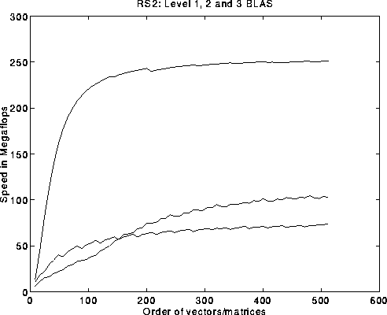
BLAS speeds on an IBM RS6000/590
Peak speed = 266 Mflops
Peak
BLAS 3
BLAS 2
BLAS 1
BLAS 3 (n-by-n matrix matrix multiply) vs BLAS 2 (n-by-n matrix vector multiply) vs BLAS 1 (saxpy of n vectors)

Slide 23
Search Over Block Sizes
Performance models are useful for high level algorithms
  Helps in developing a blocked algorithm
  Models have not proven very useful for block size selection
    too complicated to be useful
      See work by Sid Chatterjee for detailed model
    too simple to be accurate
      Multiple multidimensional arrays, virtual memory, etc.
Some systems use search
  Atlas – being incorporated into Matlab
  BeBOP – http://www.cs.berkeley.edu/~richie/bebop

Slide 24
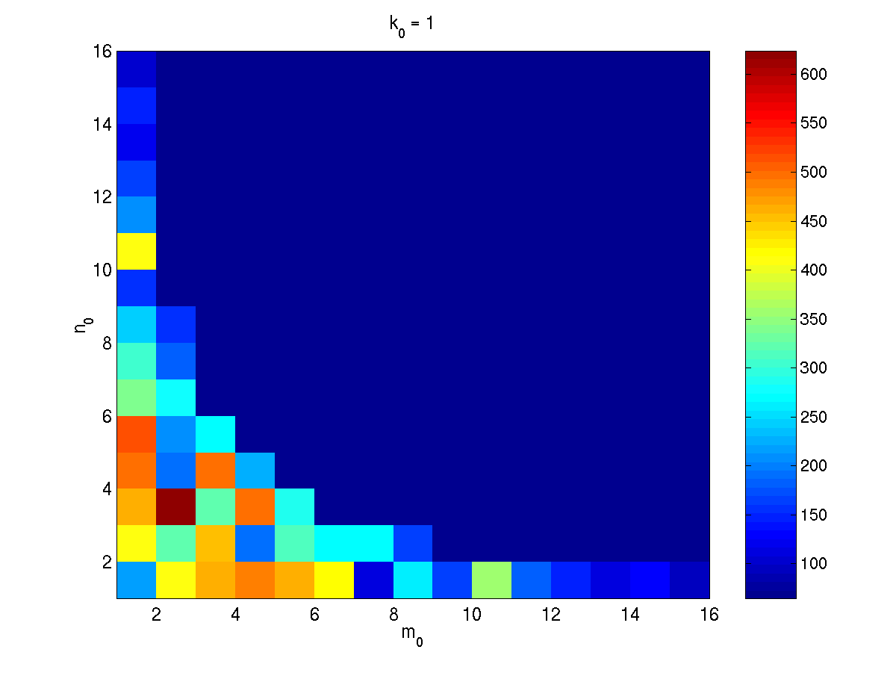
What the Search Space Looks Like
Number of columns in register block
Number of rows in register block
A 2-D slice of a 3-D register-tile search space. The dark blue region was pruned.
(Platform: Sun Ultra-IIi, 333 MHz, 667 Mflop/s peak, Sun cc v5.0 compiler)

Slide 25
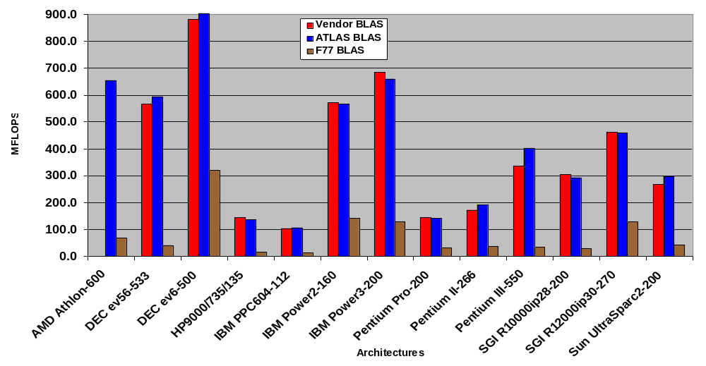
ATLAS (DGEMM n = 500)
Source: Jack Dongarra
ATLAS is faster than all other portable BLAS implementations and it is comparable with machine-specific libraries provided by the vendor.

Slide 26
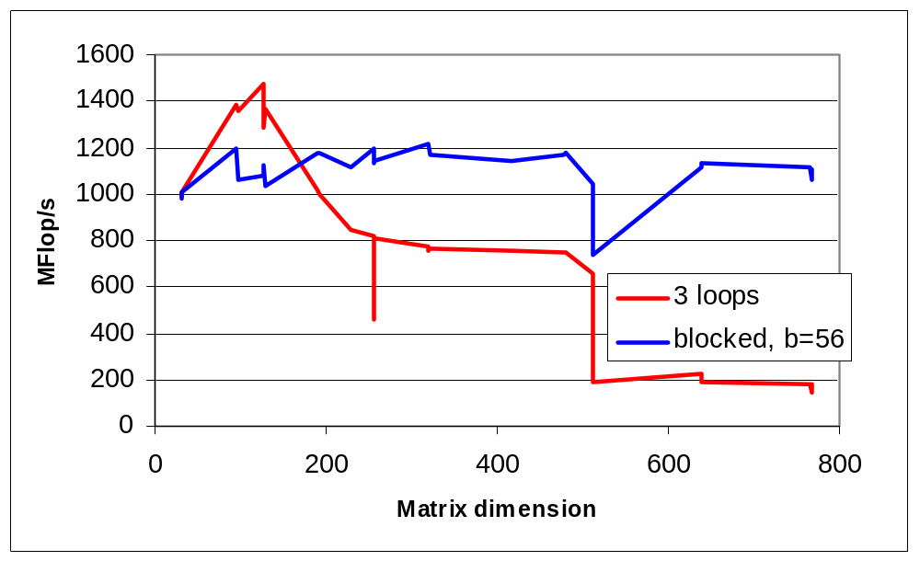
Tiling Alone Might Not Be Enough
Naïve and a “naïvely tiled” code on Itanium 2
  Searched all block sizes to find best, b=56
  Starting point for hw1

Slide 27
Optimizing in Practice
Tiling for registers
  loop unrolling, use of named “register” variables
Tiling for multiple levels of cache and TLB
Exploiting fine-grained parallelism in processor
  superscalar; pipelining
Complicated compiler interactions
Hard to do by hand (but you’ll try)
Automatic optimization an active research area
  BeBOP: bebop.cs.berkeley.edu/
  PHiPAC: www.icsi.berkeley.edu/~bilmes/phipac
  in particular tr-98-035.ps.gz
  ATLAS: www.netlib.org/atlas

Slide 28
Removing False Dependencies
Using local variables, reorder operations to remove false dependencies
a[i] = b[i] + c;
a[i+1] = b[i+1] * d;
false read-after-write hazard
between a[i] and b[i+1]
float f1 = b[i];
float f2 = b[i+1];
a[i] = f1 + c;
a[i+1] = f2 * d;
With some compilers, you can declare a and b unaliased.
Done via “restrict pointers,” compiler flag, or pragma)

Slide 29
Exploit Multiple Registers
Reduce demands on memory bandwidth by pre-loading into local variables
while( … ) {
*res++ = filter[0]*signal[0]
+ filter[1]*signal[1]
+ filter[2]*signal[2];
signal++;
}
float f0 = filter[0];
float f1 = filter[1];
float f2 = filter[2];
while( … ) {
*res++ = f0*signal[0]
+ f1*signal[1]
+ f2*signal[2];
signal++;
}
also: register float f0 = …;
Example is a convolution

Slide 30
Minimize Pointer Updates
Replace pointer updates for strided memory addressing with constant array offsets
f0 = *r8; r8 += 4;
f1 = *r8; r8 += 4;
f2 = *r8; r8 += 4;
f0 = r8[0];
f1 = r8[4];
f2 = r8[8];
r8 += 12;
Pointer vs. array expression costs may differ.
Some compilers do a better job at analyzing one than the other

Slide 31
Loop Unrolling
Expose instruction-level parallelism
float f0 = filter[0], f1 = filter[1], f2 = filter[2];
float s0 = signal[0], s1 = signal[1], s2 = signal[2];
*res++ = f0*s0 + f1*s1 + f2*s2;
do {
signal += 3;
s0 = signal[0];
res[0] = f0*s1 + f1*s2 + f2*s0;
s1 = signal[1];
res[1] = f0*s2 + f1*s0 + f2*s1;
s2 = signal[2];
res[2] = f0*s0 + f1*s1 + f2*s2;
res += 3;
} while( … );

Slide 32
Expose Independent Operations
Hide instruction latency
  Use local variables to expose independent operations that can execute in parallel or in a pipelined fashion
  Balance the instruction mix (what functional units are available?)
f1 = f5 * f9;
f2 = f6 + f10;
f3 = f7 * f11;
f4 = f8 + f12;

Slide 33
Copy optimization
Copy input operands or blocks
  Reduce cache conflicts
  Constant array offsets for fixed size blocks
  Expose page-level locality
Original matrix
(numbers are addresses)
Reorganized into
2x2 blocks
0
4
8
12
0
2
8
10
1
5
9
13
1
3
9
11
2
6
10
14
4
6
12
13
3
7
11
15
5
7
14
15
Notes:
This is one of the optimizations that Atlas performance that PhiPAC does not.

Slide 34
Recursive Data Layouts
Copy optimization often works because it improves spatial locality
A related (recent) idea is to use a recursive structure for the matrix
There are several possible recursive decompositions depending on the order of the sub-blocks
This figure shows Z-Morton Ordering
See papers on “cache oblivious algorithms” and “recursive layouts”
Advantages:
the recursive layout works well for any cache size
Disadvantages:
The index calculations to find A[i,j] are expensive
Implementations switch to column-major for small sizes

Slide 35
Strassen’s Matrix Multiply
The traditional algorithm (with or without tiling) has O(n^3) flops
Strassen discovered an algorithm with asymptotically lower flops
  O(n^2.81)
Consider a 2x2 matrix multiply, normally takes 8 multiplies, 7 adds
  Strassen does it with 7 multiplies and 18 adds
Let M = m11 m12 = a11 a12 b11 b12
m21 m22 = a21 a22 b21 b22
Let p1 = (a12 - a22) * (b21 + b22) p5 = a11 * (b12 - b22)
p2 = (a11 + a22) * (b11 + b22) p6 = a22 * (b21 - b11)
p3 = (a11 - a21) * (b11 + b12) p7 = (a21 + a22) * b11
p4 = (a11 + a12) * b22
Then m11 = p1 + p2 - p4 + p6
m12 = p4 + p5
m21 = p6 + p7
m22 = p2 - p3 + p5 - p7
Extends to nxn by divide&conquer

Slide 36
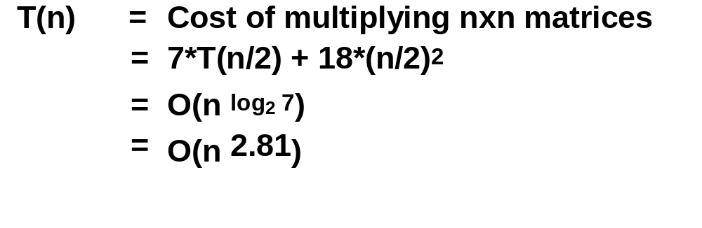
Strassen (continued)
Asymptotically faster
  Several times faster for large n in practice
  Cross-over depends on machine
  Available in several libraries
Caveats
  Needs more memory than standard algorithm
  Can be less accurate because of roundoff error
  Current world’s record is O(n ^{2.376..} )
Why does Hong/Kung theorem not apply?
Notes:
World record due to Winograd and Copperfield
Very complicated algorithm
Needs unrealistically enormous matrices

Slide 37
Locality in Other Algorithms
The performance of any algorithm is limited by q
In matrix multiply, we increase q by changing computation order
  increased temporal locality
For other algorithms and data structures, even hand-transformations are still an open problem
  sparse matrices (reordering, blocking)
  trees (B-Trees are for the disk level of the hierarchy)
  linked lists (some work done here)

Slide 38
Summary
Performance programming on uniprocessors requires
  understanding of memory system
  understanding of fine-grained parallelism in processor
Simple performance models can aid in understanding
  Two ratios are key to efficiency (relative to peak)
  computational intensity of the algorithm:
    q = f/m = # floating point opns / # slow memory opns
  machine balance in the memory system:
    t_{m}/t_{f} = time for slow memory operation / time for floating point operation
Blocking (tiling) is a basic approach
  Techniques apply generally, but the details (e.g., block size) are architecture dependent
  Similar techniques are possible on other data structures and algorithms
Now it’s your turn: Homework 1
  Work in teams of 2 or 3 (assigned this time)

Slide 39
Reading for Today
Sourcebook Chapter 3, (note that chapters 2 and 3 cover the material of lecture 2 and lecture 3, but not in the same order).
"Performance Optimization of Numerically Intensive Codes", by Stefan Goedecker and Adolfy Hoisie, SIAM 2001.
Web pages for reference:
  BeBOP Homepage
  ATLAS Homepage
  BLAS (Basic Linear Algebra Subroutines), Reference for (unoptimized) implementations of the BLAS, with documentation.
  LAPACK (Linear Algebra PACKage), a standard linear algebra library optimized to use the BLAS effectively on uniprocessors and shared memory machines (software, documentation and reports)
  ScaLAPACK (Scalable LAPACK), a parallel version of LAPACK for distributed memory machines (software, documentation and reports)
Tuning Strassen's Matrix Multiplication for Memory Efficiency Mithuna S. Thottethodi, Siddhartha Chatterjee, and Alvin R. Lebeck in Proceedings of Supercomputing '98, November 1998 postscript
Recursive Array Layouts and Fast Parallel Matrix Multiplication” by Chatterjee et al. IEEE TPDS November 2002.

Slide 40
Questions You Should Be Able to Answer
What is the key to understand algorithm efficiency in our simple memory model?
What is the key to understand machine efficiency in our simple memory model?
What is tiling?
Why does block matrix multiply reduce the number of memory references?
What are the BLAS?
What is LAPACK? ScaLAPACK?
Why does loop unrolling improve uniprocessor performance?

Slide 41
Reading Assignment
Next week: Current high performance architectures
  Cray X1
    http://www.sc-conference.org/sc2003/paperpdfs/pap183.pdf
  Blue Gene L
    http://sc-2002.org/paperpdfs/pap.pap207.pdf
  Clusters
    http://www.mirror.ac.uk/sites/www.beowulf.org/papers/ICPP95/
Optional
  Chapter 1,2 of the “Sourcebook of Parallel Computing”
  Alternative to Beowulf paper:
    http://now.cs.berkeley.edu/Case/case.html

Slide 42
Review from Last Lecture

Slide 43
Membench: What to Expect
average cost per access
memory
time
size > L1
cache hit time
total size < L1
s = stride
Consider the average cost per load
  Plot one line for each array size, time vs. stride
  Small stride is best: if cache line holds 4 words, at most ¼ miss
  If array is smaller than a given cache, all those accesses will hit (after the first run, which is negligible for large enough runs)
  Picture assumes only one level of cache
  Values have gotten more difficult to measure on modern procs

Slide 44
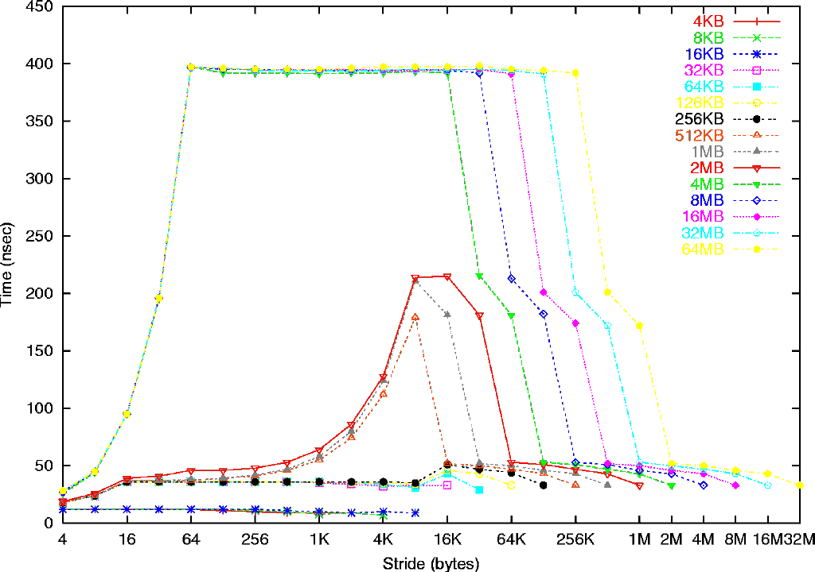
Memory Hierarchy on a Sun Ultra-2i
Sun Ultra-2i, 333 MHz
Array size
Mem: 396 ns
(132 cycles)
L2: 2 MB,
12 cycles (36 ns)
L1:
16 KB
2 cycles (6ns)
L1: 16 B line
L2: 64 byte line
8 K pages
See www.cs.berkeley.edu/~yelick/arvindk/t3d-isca95.ps for details

Slide 45
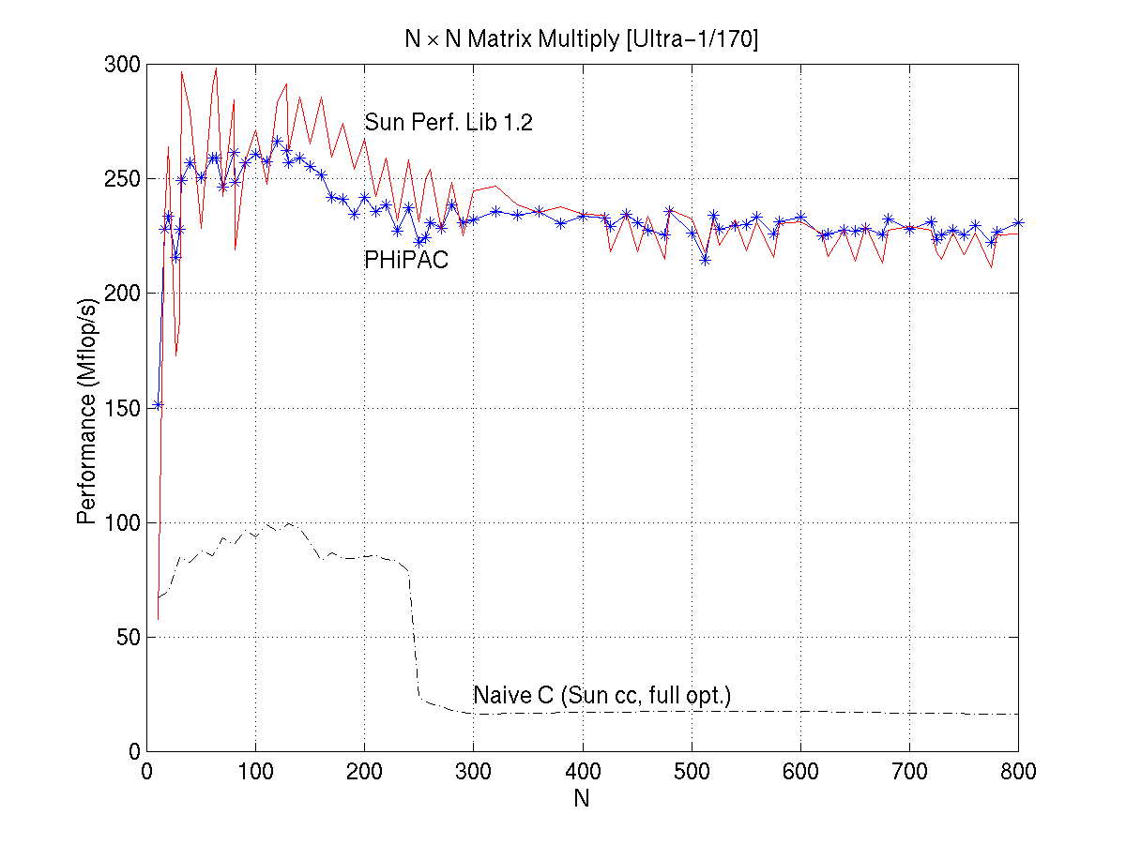
PHiPAC: Portable High Performance ANSI C
Speed of n-by-n matrix multiply on Sun Ultra-1/170, peak = 330 MFlops

