Slide 1
Scraping the New York Times Crossword Puzzle
How the crossword stays current
Rachel Kogan
May 9, 2017
Notes:
My project is about crossword puzzles.
I scraped all the New York Times crossword puzzle clues and answers from the last five years, and I’ve done the crossword manually almost every day for the past eight years, so I’ve actually clued in way more puzzles over my lifetime than I was able to scrape this past week.
I think there’s a myth about crosswords, which is that being good at crosswords is about knowing a lot of trivia, and that’s just completely false. Sometimes a constructor will put an obscure word in there just to get all the clues to fit, but if you put too much trivia in your crossword puzzle, Will Shortz will not print it because that is explicitly not their goal.

Slide 2
What makes a good crossword?
A good NYT crossword consists of two important elements:
Clever puns
Zeitgeist-y clue-answer pairs
We will analyze two types of crossword answers:
Frequently used answers
Unique/debut answers
Notes:
“zeitgeist” is a german word which means “spirit of the times”. If you examine the html code of these crosswords, the title field of every crossword puzzle is just the date. And the idea is that every crossword puzzle is supposed to be about that day, it is supposed to capture the spirit of that particular moment.
I don’t know how to analyze how clever the puns are, so my project was just about the second thing, it was about trying to visualize and understand how the NYT crossword puzzle stays current.
And in order to do that, I attacked it on two different fronts:
The first is frequently used answers, and how the clues to these answers change throughout time
The second is unique or debut answers, so answers that have recently been used for the very first time
In order to analyze frequent words, let’s briefly summarize which words are actually showing up a lot in the crossword puzzle.

Slide 3
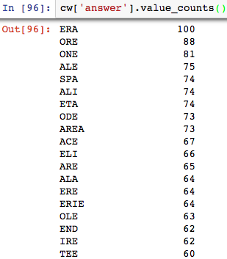
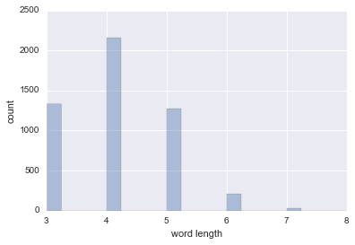
The 5000 most common answers
Notes:
On the left I took a look at the most common crossword answers and you can see that it’s a lot of 3-letter words and a lot of the same letters getting used.
What happens is that when you make a crossword, you often end up in a corner, and only three-letter words fit there, and you kinda have to keep re-using the same letters.
On the right is the 5000 most common answers in the last five years by word length. We can see that almost all of them are three- to five-letters long.
Now in a vaccuum, this isn’t that meaningful, so we can overlay this right chart with the 5000 most common words in the English language.

Slide 4
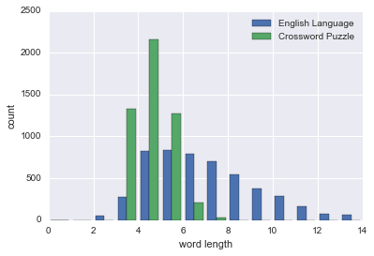
Distribution of word length
The most common words in the crossword puzzle are a lot shorter than the most common words in the English language.
Notes:
the blue bars are the english language, the green bars are the crossword.
In English prose, people are using much longer words – you can see the blue bars extend much further right than the green bars.
You can see how this could present a problem, because there aren’t 1400 common three-letter words in the English language, so we get a lot of three-letter pre-fixes, acronyms, and proper nouns. UMA thurman, her first name comes up all the time.
You can actually learn a lot about the crossword puzzle by tracing some of these three-letter answers throughout time and seeing how the clues change:
So we are going to follow certain answers in the crossword and catalog how the clues have changed over time.
I chose these three-letter words very intentionally to be illustrative.
http://www.wordfrequency.info/intro.asp
The 5,000 word list is based upon the only large, genre-balanced, up-to-date corpus of American English – the 450 million word Corpus of Contemporary American English (COCA).

Slide 5
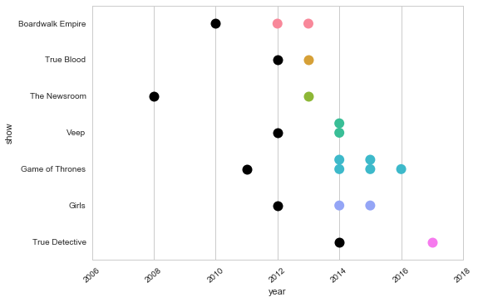
Clues for ‘HBO’ By Year
Notes:
HBO has been an answer in the crossword puzzle fourteen times in the past 5 years, and every time it’s always clued with a specific TV show. For example:
-”Game of Thrones” network
-”The Newsroom” channel
In this graph, the colorful dots represent the show being used as an HBO clue, and the black dots represent the year that show premiered.
Now if you follow which TV show was used throughout time, you can see that:
- The editors are trying to switch it up, in any year they use a few different shows
- The editors are trying to stay current, so as new shows come out they add them to the clue roster – most recently, True Detective
- There’s at least a year lag between a show premiering and the show appearing in the crossword for the first time. And that’s because they are waiting for a show to get big – they aren’t trying to use obscure shows, it’s not about trivia.

Slide 6
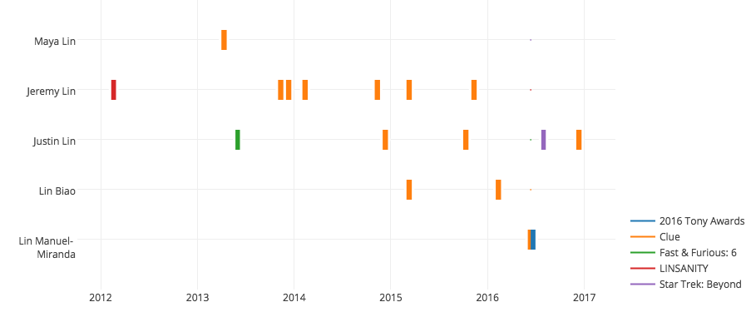
Clues for ‘LIN’ By Year
Notes:
The next one is clues for the three-letter name LIN. Now LIN has appeared thirteen times in the past 5 years, and it’s always clued as a person first or last name, for example:
Justin who directed four of the Fast and the Furious movies
Jeremy of the NBA
Now in this graph, the orange dots represent clues and the colorful dots represent relevant current events.
Now Jeremy Lin is a basketball player who played for the Knicks in 2012 and sparked a huge craze called LINSANITY. And you can see that Jeremy Lin was the go-to LIN clue for a while after that. But then he went and played for Houston, and the crossword constructors started rotating with Justin Lin the director, Lin Biao, a figure in Communist China. And maybe I’m cherry-picking here, but Lin Manuel-Miranda being the LIN clue three days before his show wins 10 Tonys, and Justin Lin showing up a few months after Star Trek premiers, I don’t think these are coincidences, I think they are intentional; the crossword puzzle is just really aligned with what is going on in current events.
You can see that LIN hasn’t appeared yet in 2017, but Jeremy Lin is back in NY, playing for the Brooklyn Nets, and I predict that Jeremy Lin will make a crossword comeback. Mark my words. You heard it here first.
So next I want to look at debut answers. Debut means an answer that appears in the crossword for the first time.

Slide 7
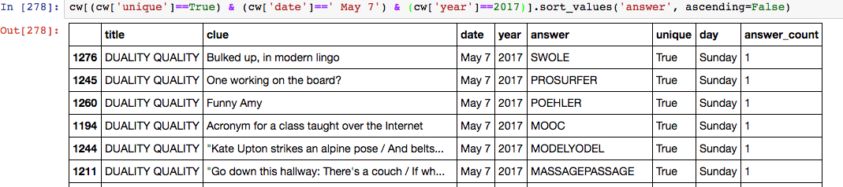
Debut answers from this past Sunday
New answers come in two types:
Long puns or jokes that will probably never appear again
MODELYODEL, MASSAGEPASSAGE
New words added to the crossword corpus that may reappear
SWOLE, MOOC, POEHLER
Notes:
Here are some of the debut answers from this past Sunday. You can see the unique column is “true” for all these words.
New debut answers usually come in one of two types:
Some are just long jokes that will probably never reappear like model yodel, massage passage – those answers related to theme on Sunday
The second type is more relevant to our analysis, it’s new words added to the crossword corpus that may reappear. Some examples from Sunday are millennial slang words, like “SWOLE” or tech jargon words like “MOOC”, or celebrities like Amy Poehler (I’m surprised this is her first xword appearance because she has been famous for a while but I guess her last name is a little long.)

Slide 8
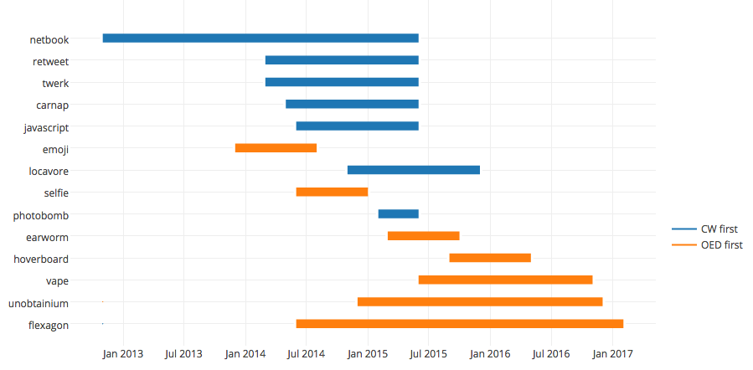
Time between NYT CW and OED debuts
But the relationship breaks down for projects with goals greater than $30,000 or $40,000
Notes:
I was curious whether words were being added faster to the Oxford English dictionary corpus or the NYT crossword puzzles corpus, so I scraped all the new additions to the OED over the past four years and it turns out to be kind of a dead heat with few discernible patterns.
Do you find anything surprising here?
I was pretty surprised that emoji was adapted before selfie. I was taking selfies way before I was using emojis.

Slide 9
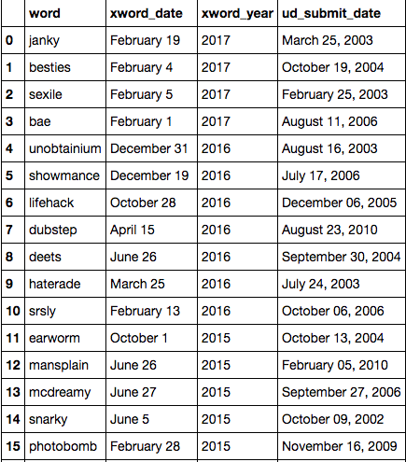
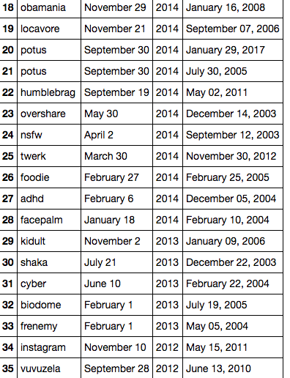
Debut words that also appear in Urban Dictionary
Notes:
I also scraped urban dictionary to see if words on there end up in the new york times crossword, and they do! And actually a lot more often, there’s a lot more overlap than with the OED.
Now words show up in the urban dictionary way earlier than they show up in the crossword, which is not too surprising. But something that is interesting is that there almost now words from UD submitted after 2010, and I think this suggests that UD had a golden age but that now it’s sort of on the decline.

Slide 10
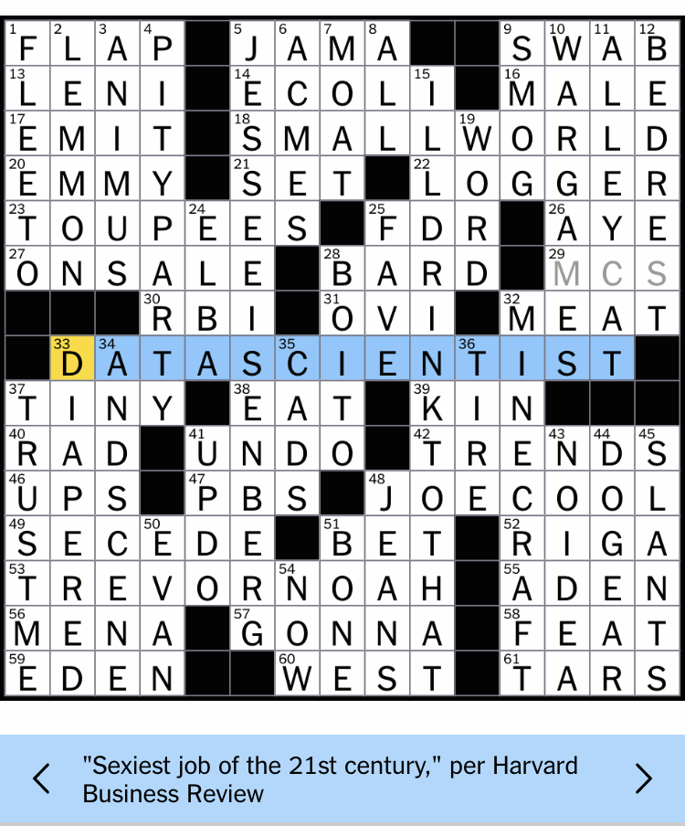
Notes:
Here’s a debut answer from this past February: data scientist! I just wanted to show this.
The NYT Crossword became a regular feature in 1950. And I used to go back in the archive and try to do puzzles from back before I was born, and I found them impossible.
And I used to think, wow, I guess people were a lot smarter back then, the puzzles are so much harder. I now after this project I don’t think that’s the case. I think that the NYT Crossword is one big inside joke, and you just had to be there, and if you weren’t there for it you just don’t get it. And that’s my presentation. Thanks for listening.

Slide 11
Ideas for Further Exploration
Natural Language Processing
Get better at grouping clues and answers that are similar but not identical
How to distinguish between compound words and multi-word clues
Catalogue new portmanteaus and compound words
Build a crossword solver

