Slide 1
Cluster Analysis: Twitter Data
Mohammad Haseeb Durrani

Slide 2
Outline
Motivation
Getting the Data
Clustering/Topic Modeling
Keyword Search Tweets
Open Streaming Tweets
Focused Tweets
Future Directions

Slide 3
Motivation
Unlabeled Data
Unsupervised Learning
Unsupervised Learning

Slide 4
Clustering/Topic Modeling
Latent Dirichlet Allocation
K-means Clustering
Non-negative Matrix Factorization

Slide 5
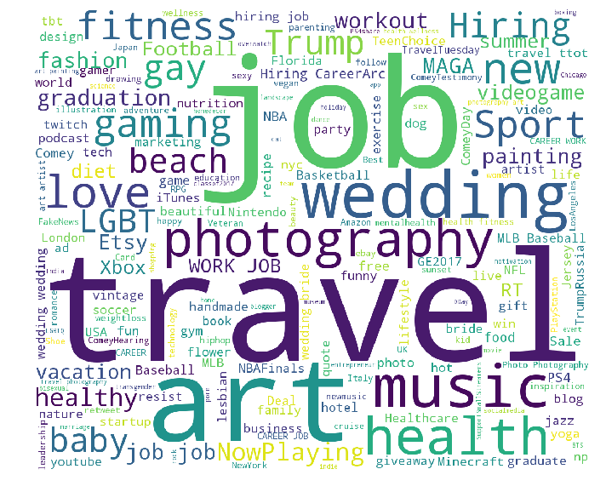
Tweets by keyword search
Health & Fitness
Travel
Sports
News/Politics
Art
Music
Videogames
Dating/Relationships
Wedding/Marriage
Not so good clustering

Slide 6
Latent Dirichlet Allocation

Slide 7
K-means Clustering
Good clustering
Not so good clustering

Slide 8
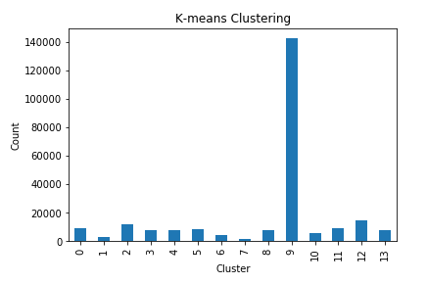
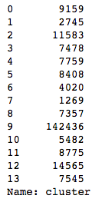
K-means Clustering

Slide 9
Non-negative Matrix Factorization
Good grouping
\
Not so good grouping

Slide 10
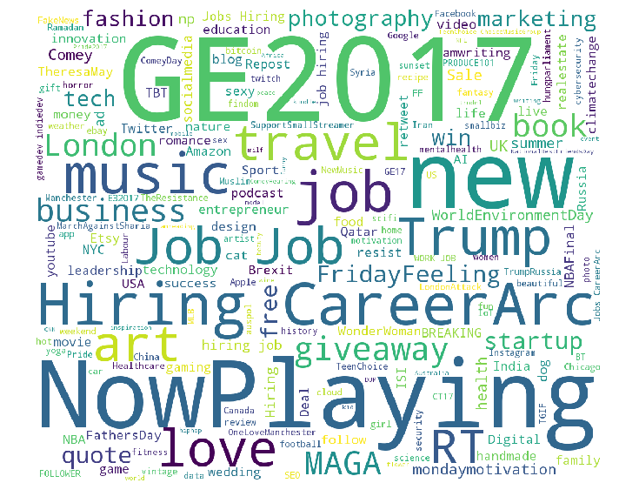
Open Streaming Tweets

Slide 11
Latent Dirichlet Allocation

Slide 12
K-means Clustering
Good clustering
Not so good clustering

Slide 13
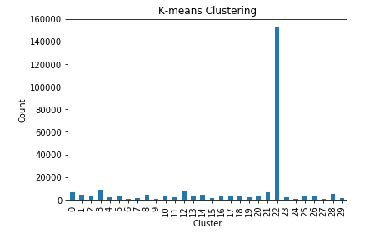
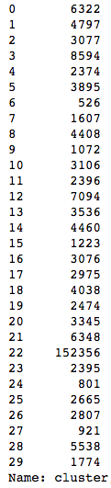
K-means Clustering

Slide 14
Non-negative Matrix Factorization
Good grouping
Not so good grouping

Slide 15
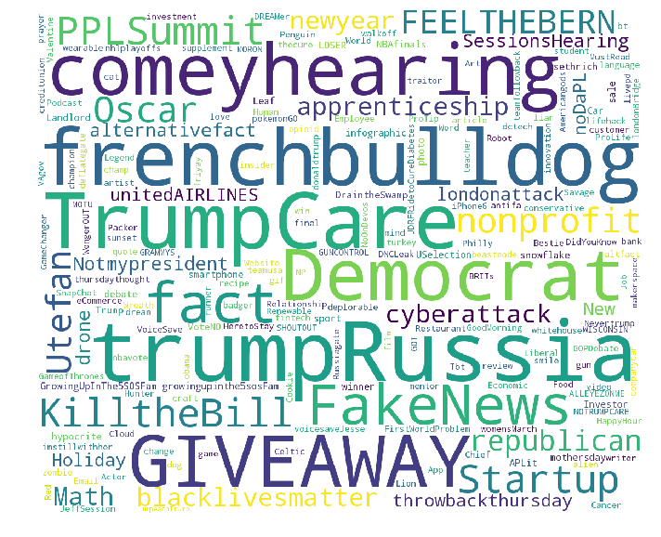
Tweets by followers
Barclays
Fitbit
Tinder
Democrats
Republicans
The Economist
200k followers
100 tweets from 2000
Not so good clustering

Slide 16
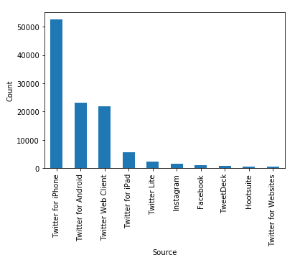
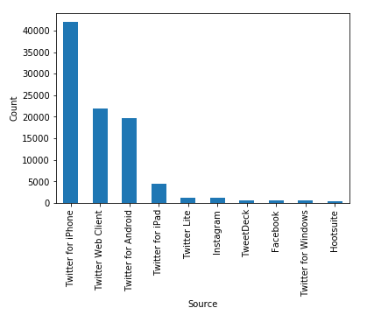
Competitors
Democrats
Republicans

Slide 17
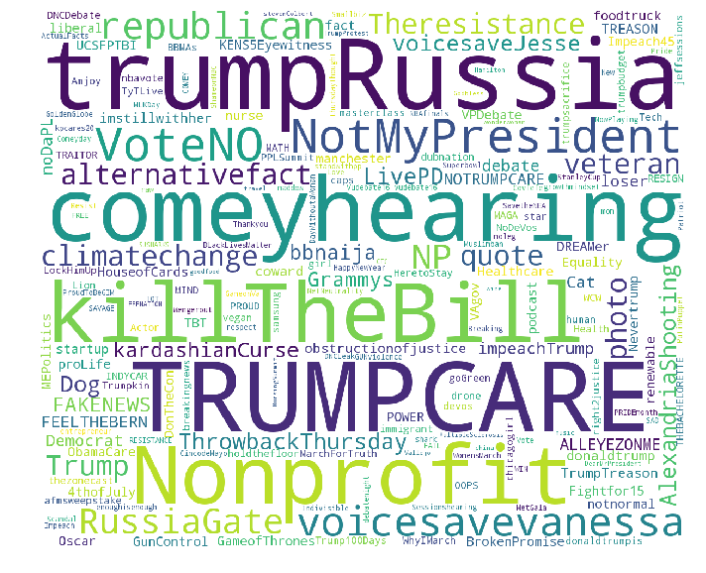
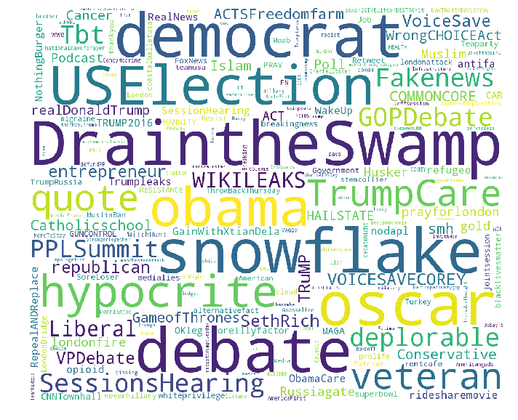
Competitors
Democrats
Republicans

Slide 18
Competitors
Democrats
Republicans

Slide 19
Future directions
Topic Modeling
Classification
Supervised Learning
Text Cleaning
Extend to other forms of social media
Text analysis
Image analysis
Video analysis
Facebook/Instagram/Snapchat

Slide 20
Thank You Any Questions?

