Slide 1
Cryptocurrency Safari
Ran Dong
May 2017

Slide 2
Why do I choose the topic
Decentralization
Blockchain
Paper currency: Inflation
I personally invested in Bitcoin

Slide 3
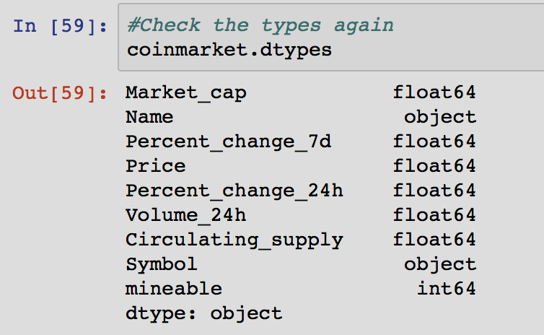
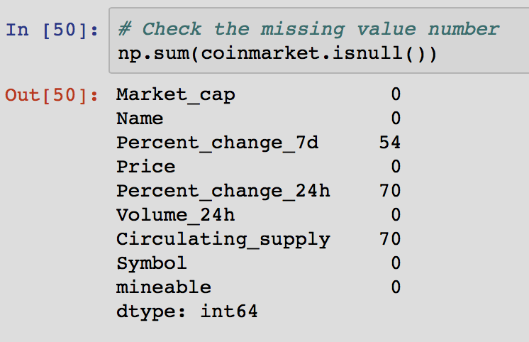
My dataset
Web scraping: coinmarketcap.com
822 Observations & 9 Variables
6 float variables & 1 categorical variable

Slide 4
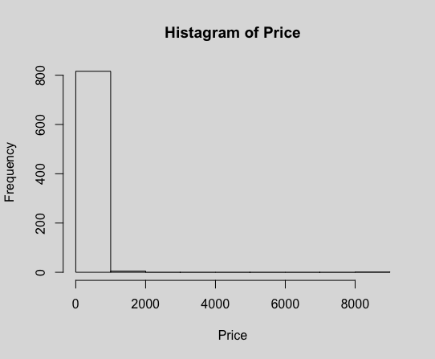
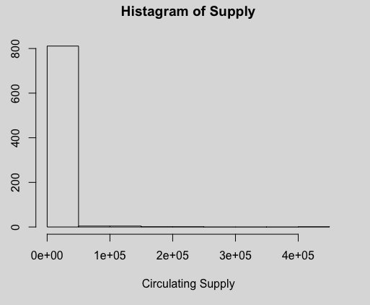
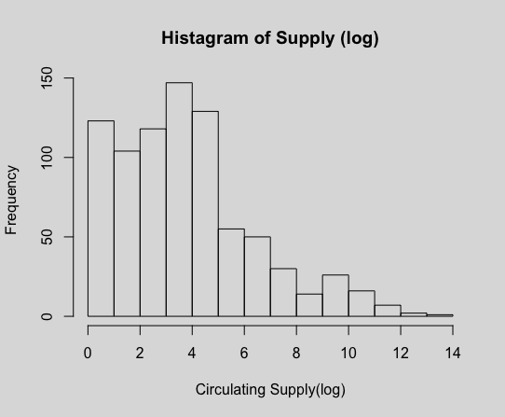
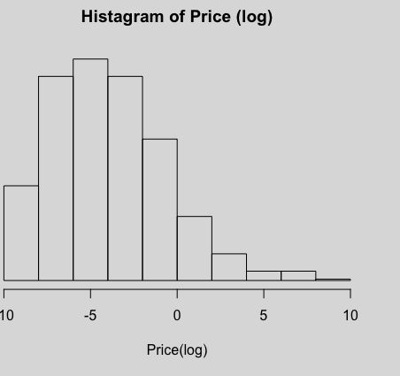
Data Manipulation
Fill missing values - K nearest neighbor (5NN)
Log transformation

Slide 5
Background and Terms
Cryptocurrency
ICO
Mineable & Non Mineable & Significantly mined
Circulating supply
Market Capital
Notes:
A cryptocurrency is a digital or virtual currency that uses cryptography for security.
ICOs are similar to IPOs and crowdfunding. Initial Coin Offering.

Slide 6
Supply and Price
Does the supply and price trend follow the economic logic?
We check the model by the categorical variable (mineable)

Slide 7
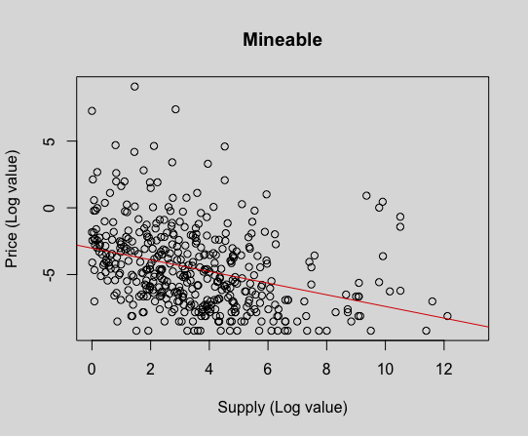
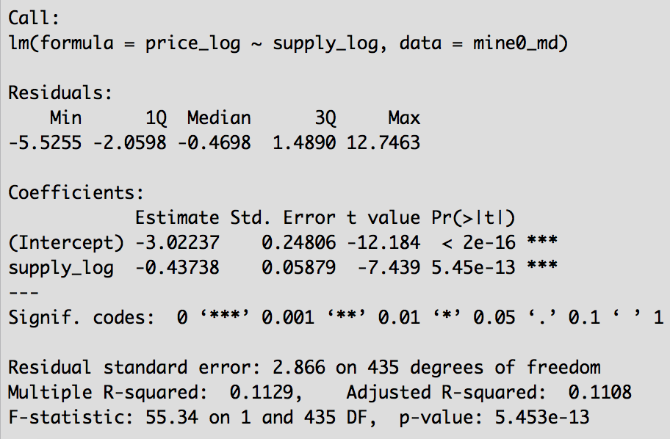
Mineable
Model: y=-0.44x-3.02
p value is less than 0.05, which means the model is significant, but it only explains 11% of the variability.

Slide 8
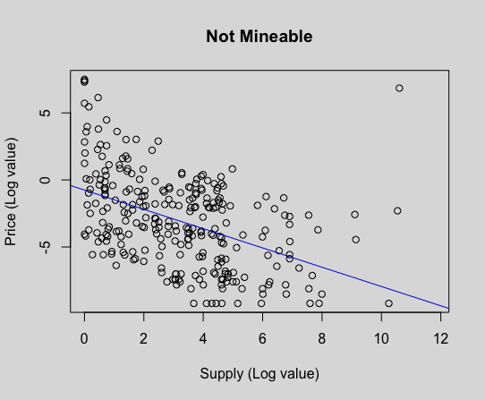
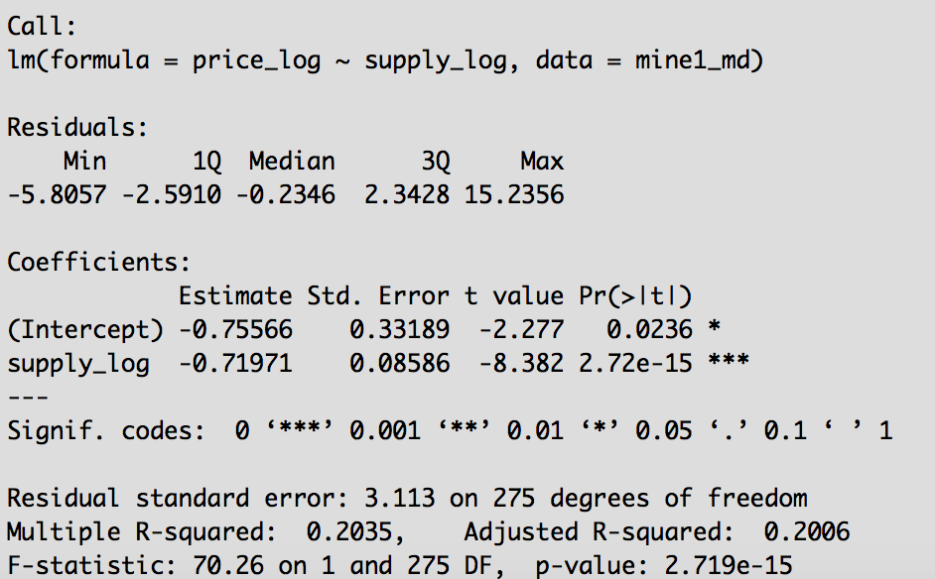
Not Mineable
Model: y=-0.72x-0.76
p value is less than 0.05, which means the model is significant, but it only explains 20% of the variability.

Slide 9
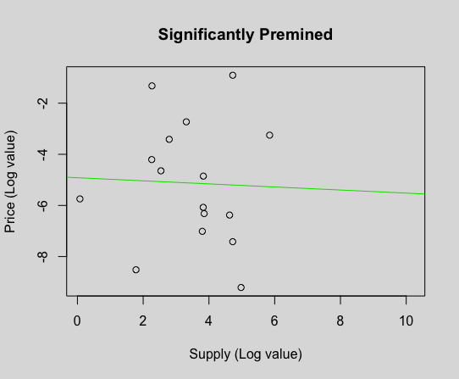
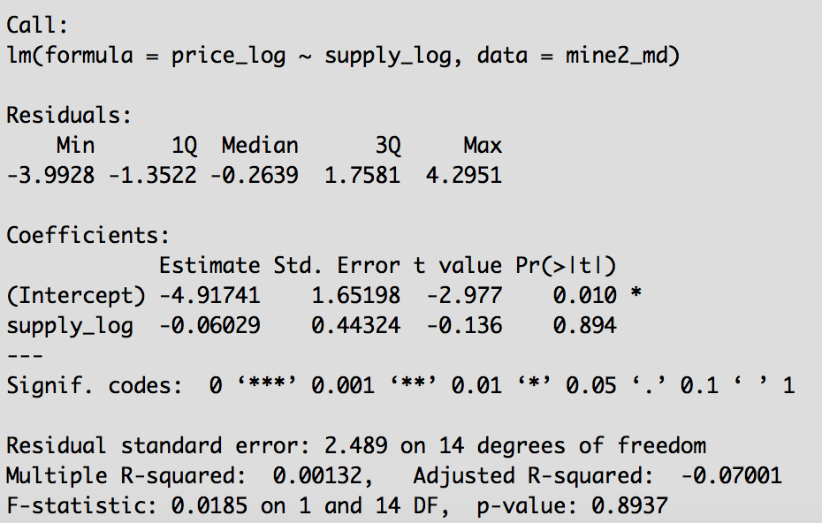
Significantly Premined
Model: y=-0.06x-4.92
p value is bigger than 0.05. The model is not significant.

Slide 10

Supply and Price
Does the supply and price trend follow the economic logic?
We check the model by the categorical variable (mineable)
Conclusion: The supply and price are negatively correlated in mineable and not mineable cryptocurrencies. However, the models just explain a small amount of the dataset. We can conclude that there are a lot of other factors may affect the market, such as the Bitcoin ETF event.

Slide 11
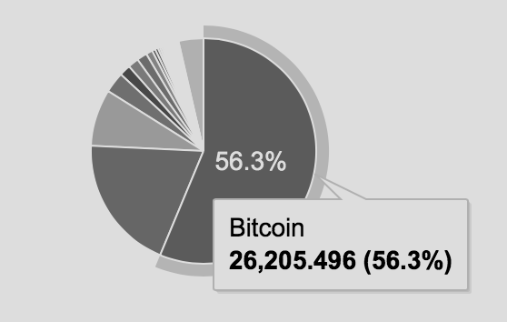
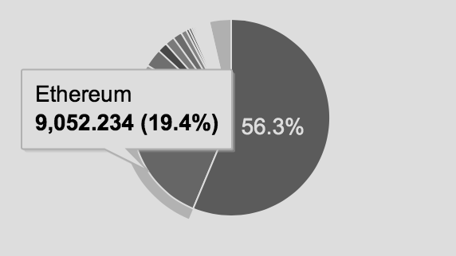
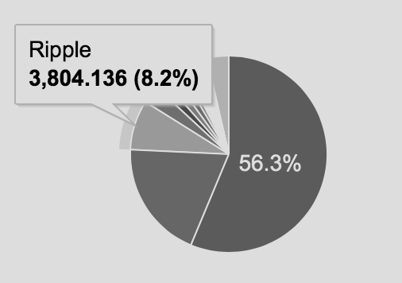
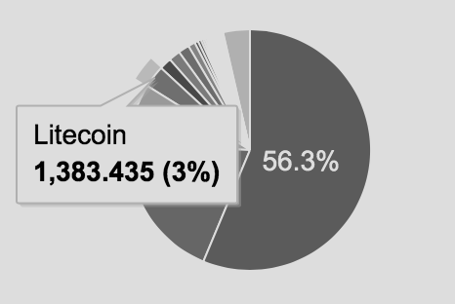
Top Market Capital Coins
Unit: Million

Slide 12
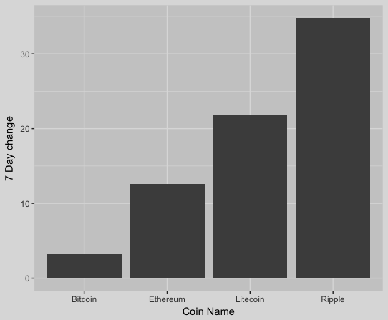
How volatile are the biggest coins

Slide 13
Should we invest?

Slide 14
Dataset is not enough for making decision.

Slide 15
When the dataset can’t provide us enough information, data analysis may not the only way to solve problems.
Don’t forget the importance of background knowledge and industry insights.

Slide 16
Further Research
Word analysis: Reddit and Twitter.
Compare the coins with the major currencies and track the exchange rate.

