Slide 1
Cluster Analysis: Twitter Data
Mohammad Haseeb Durrani

Slide 2
Outline
Motivation
Getting the Data
Workflow
Clustering/Topic Modeling
Keyword Search Tweets
Open Streaming Tweets
Focused Tweets
Future Directions

Slide 3
Motivation
Why Twitter?
Unlabeled Data
Unsupervised Learning

Slide 4
Workflow
Get tweets
Clustering/Topic Modeling
Automated Tweet Labeling System
Chunk Labeling/Classification
Supervised Learning
Train and Test on new tweets

Slide 5
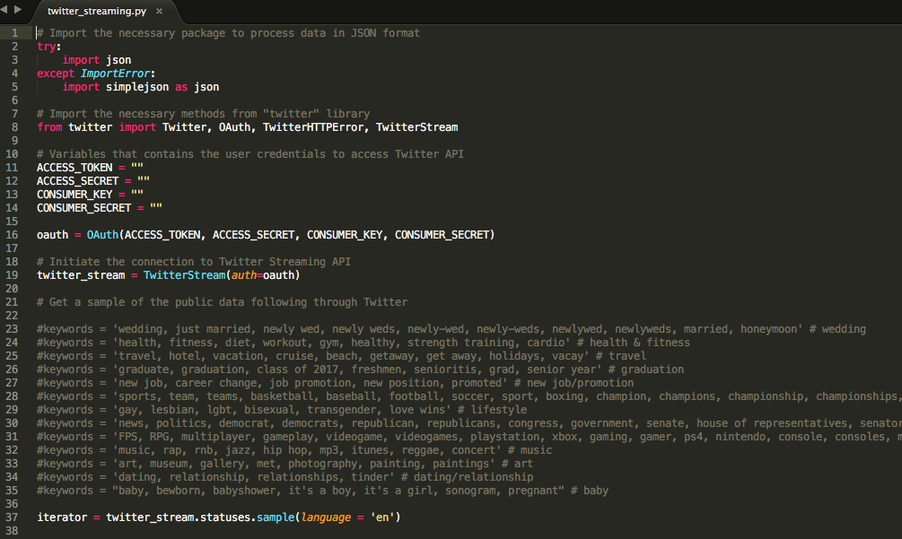
Getting/Cleaning the Data
Twitter Streaming API
Tweepy
Cleaning tweets
RT
@
Links
Stopwords

Slide 6
Clustering/Topic Modeling
Latent Dirichlet Allocation
Probabilities
K-means Clustering
Non-negative Matrix Factorization
Linear Algebra

Slide 7
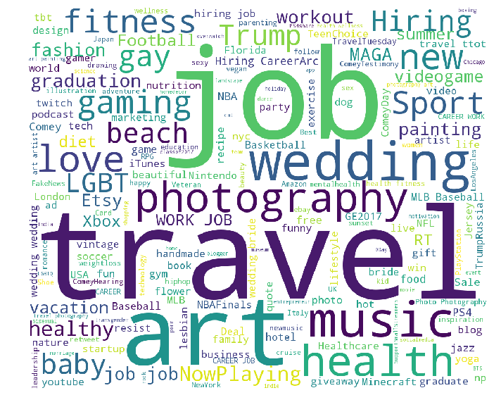
Tweets by keyword search
Health & Fitness
Travel
Sports
News/Politics
Art
Music
Videogames
Lifestyle
Dating/Relationships
Wedding/Marriage
Not so good clustering

Slide 8
Latent Dirichlet Allocation

Slide 9
K-means Clustering
Good clustering
Not so good clustering

Slide 10
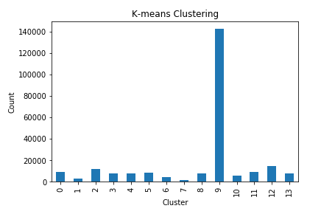
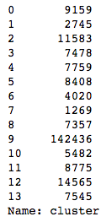
K-means Clustering

Slide 11
Non-negative Matrix Factorization
Good grouping
\
Not so good grouping

Slide 12
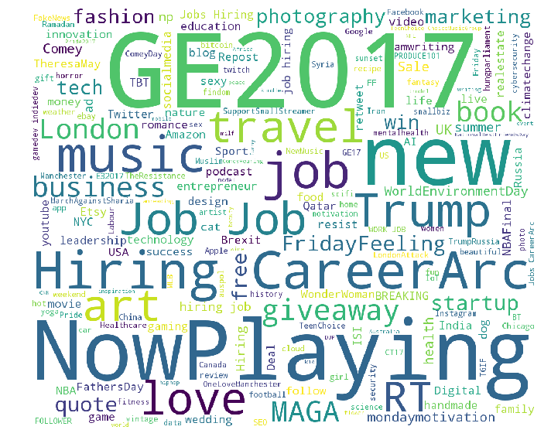
Open Streaming Tweets

Slide 13
Latent Dirichlet Allocation

Slide 14
K-means Clustering
Good clustering
Not so good clustering

Slide 15
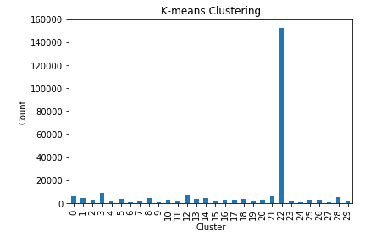
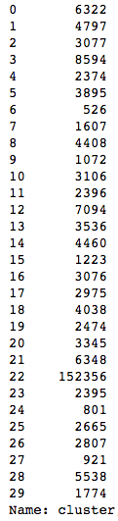
K-means Clustering

Slide 16
Non-negative Matrix Factorization
Good grouping
Not so good grouping

Slide 17
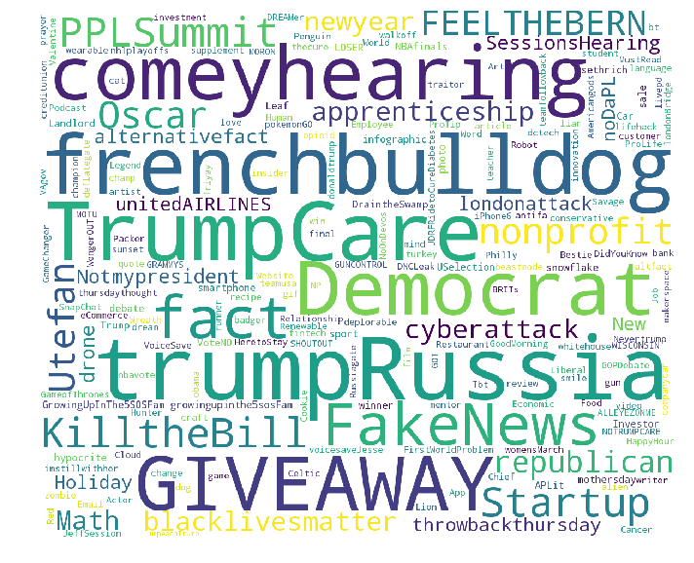
Tweets by followers
Barclays
Fitbit
Tinder
Democrats
Republicans
The Economist
200k followers
100 tweets from 2000
Not so good clustering

Slide 18
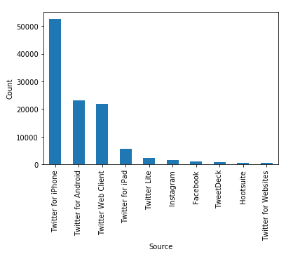
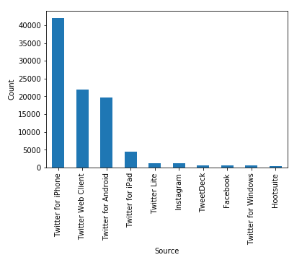
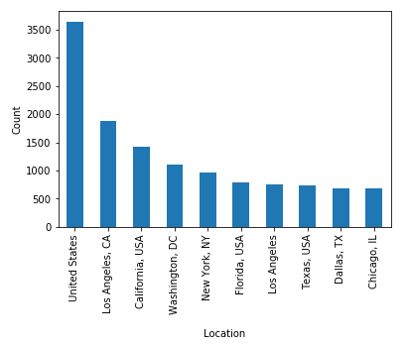
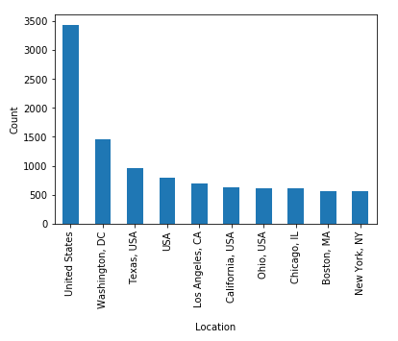
Competitors
Democrats
Republicans

Slide 19
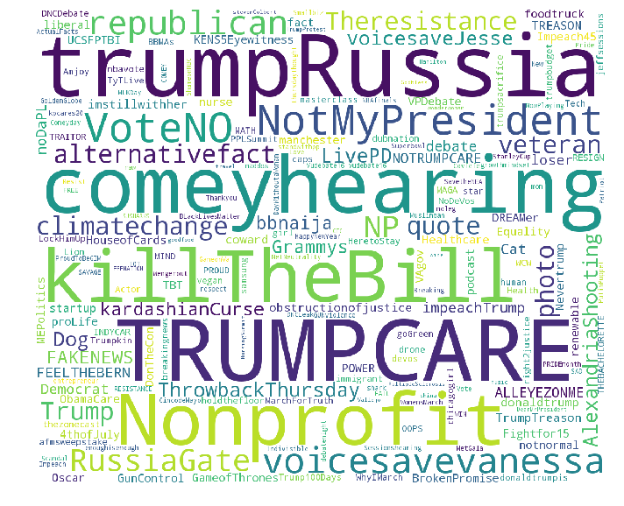
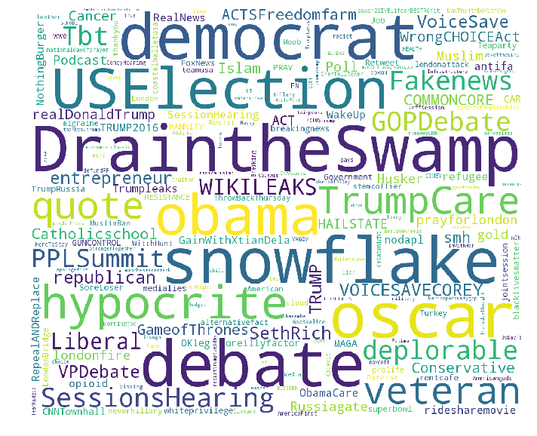
Competitors
Democrats
Republicans

Slide 20
Competitors
Democrats
Republicans

Slide 21
Future directions
Topic Modeling
Classification
Supervised Learning
Text Cleaning
Extend to other forms of social media
Text analysis
Image analysis
Video analysis
Facebook/Instagram/Snapchat

Slide 22
Thank You Any Questions?

