Slide 1
NFL Betting Lines:
Sharp or not?
Jack Enyeart

Slide 2
Goals of Project:
Investigate betting lines of NFL Games from 2006-2016 seasons.
Compare betting lines with actual game results.
Evaluate if the betting lines are reliable predictors of actual game results.
If not, try to understand why. (Affected by betting trends?)

Slide 3
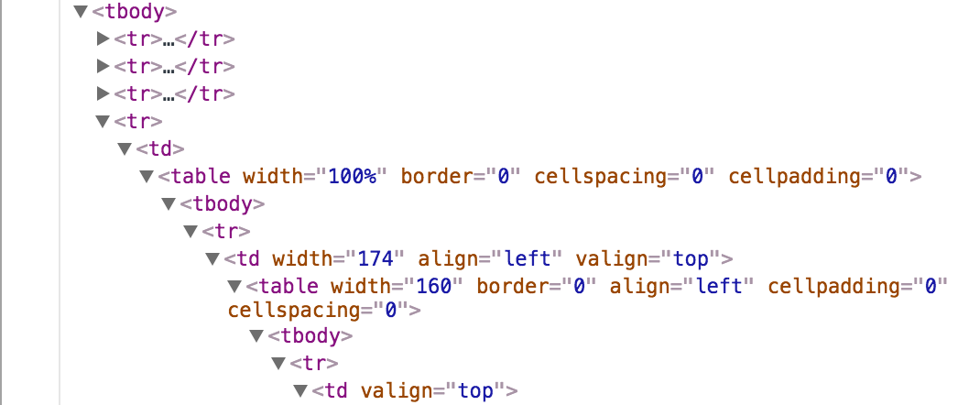
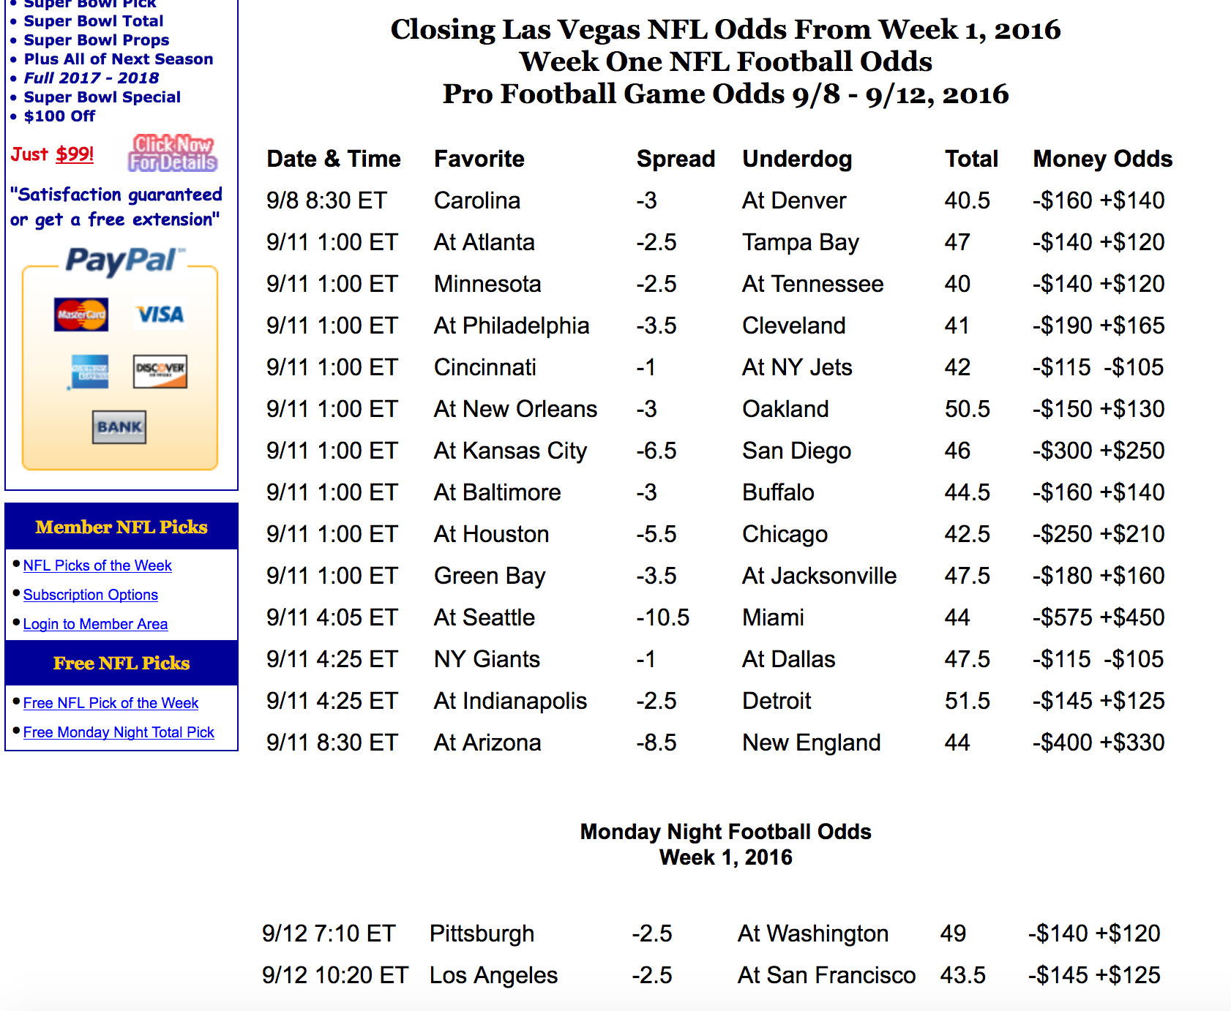
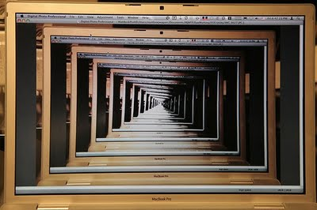
The Data:
NFL Betting Lines Data:
Scrapy on: http://www.footballlocks.com/
Results?
?

Slide 4
The Data (cont’d):
NFL Game Results:
www.aussportsbetting.com/
Combined Data:
Processed in Python
Approximately 2500 observations (games) from 2006-2016 NFL Regular seasons.

Slide 5
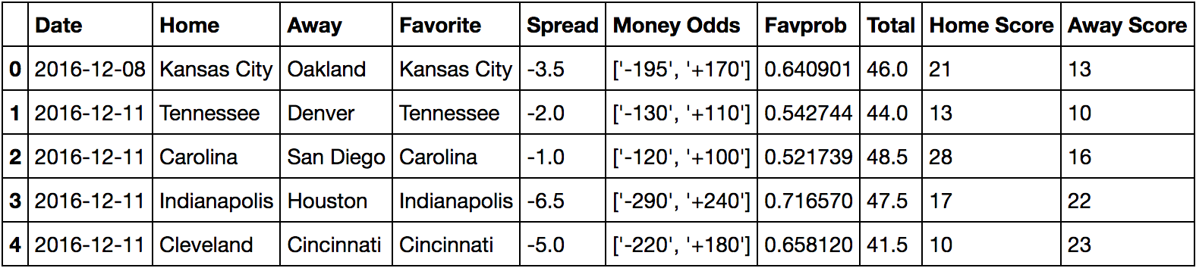
Procedure:
Sample observations:

Slide 6
Procedure (continued):
Sample observations:
Focus on these variables
Motivation: Article from fivethirtyeight.com: “Approximately 65% of total bets are placed on the favorite.”

Slide 7
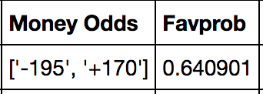
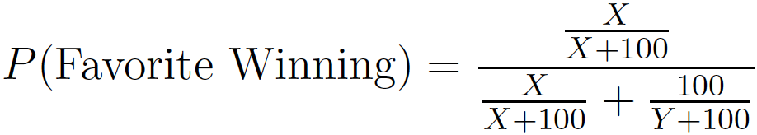
Investigating favorites:
Money Odds indicate payouts for bets on favorite/underdog, respectively.
$195 bet on the favorite yields: $195 + $100 = $295 total ($100 profit), when favorite wins.
$100 bet on the underdog yields: $100 + $170 = $270 total ($170 profit), when underdog wins.
From given money odds [-X,+Y], we can calculate the implied probability of X (and Y) winning:

Slide 8
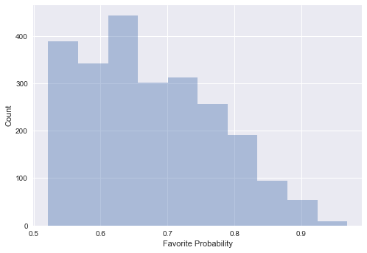
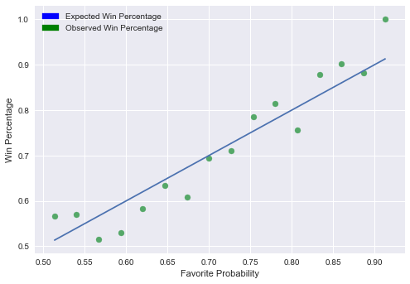
Investigating Favorites (Cont’d):
Distribution of favorite probabilities?:
Performance of favorites?

Slide 9
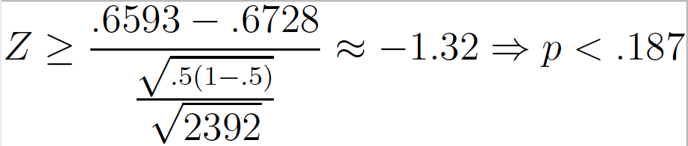
Investigating favorites(cont’d):
Question: Overall, are favorites winning more/less than they’re expected to?
Each game X_{i} = Bern(p_{i})
Expected # of Favorite Wins = Σ p_{i}
N = 2392
Expected Win Percentage:
67.28%
Observed Win Percentage:
65.93%

Slide 10
Investigating Favorites (cot’d)
Favorites not underperforming at a statistically significant value (with respect to win percentage), but how about versus the “spread”? (Most popular bet)
Focus on these variables

Slide 11
What is a spread?:
Game: Team A vs. Team B
Hypothetical Spread: A (-3)
Gambler has 2 options: A(-3) or B(+3)
If A wins by more than 3 points, A(-3) is the winning bet. (A covers)
If A wins by less than 3 points (or loses), B(+3) is the winning bet. (B covers)
Winning bets yield ~90% of initial bet. (10% disparity called “vig”)
Losing bets lose 100% of initial bet.
How do linesetters pick the spread?

Slide 12
How are spreads picked?
Theory 1 (Conventional Wisdom/Financial Market Model):
Linesetters pick a spread that ensures equal amount of bets placed on either team.
Example: $100 bet on team A, $100 bet on team B.
Profit = $100 - .9($100) = $10 = (.05)*($200), in either outcome.
This method requires knowledge of bettors’ tendencies rather than game itself.
Resembles “Buyers/Sellers” structure of financial markets.

Slide 13
How are spreads picked(continued)?
Theory 2 (Probabilistic Modeling):
Linesetters pick spread such that the A (or B) covers with probability 0.5
Let X,Y be the amount of money bet on A,B, respectively.
Expected Profit = P(A Covers)(Y - (.9)(X)) + P(B Covers)(X - (.9)Y)
= (0.5)(Y - (.9)(X)) + (0.5)(X - (.9)Y))
= (0.5)(.1Y+.1X)
= (.05)(X+Y) > 0
Linesetters may win or lose on any given game, but Expected Profit > 0.
“Sharp” line-setting--requires ability to predict the outcome of the game well.

Slide 14
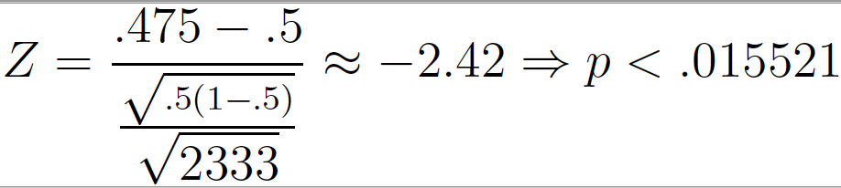
Favorite against the spread:
Do favorites perform poorly against the spread? (Statistically significant?)
Expected Favorite Cover Percentage:
50%
Observed Favorite Cover Percentage:
47.5%
We reject the null hypothesis that μ = 0.5 (i.e. we reject that the probability of favorite covering the spread is 0.5)

Slide 15
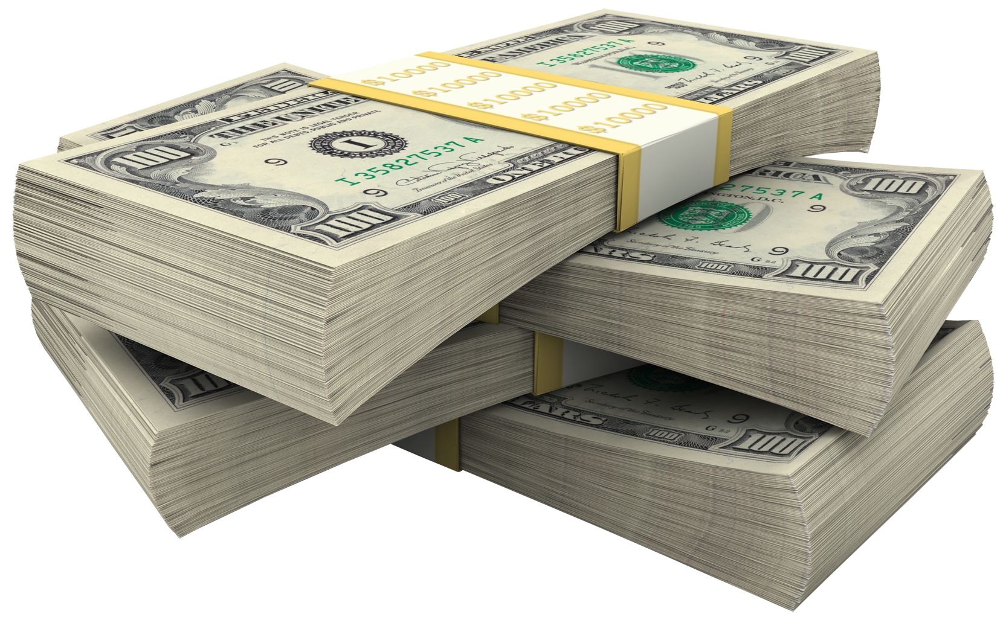
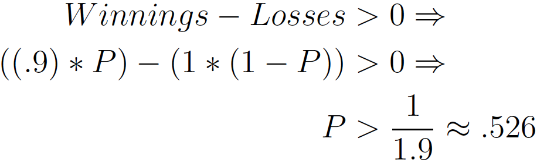
Betting against the favorite a viable strategy?
What percentage of bets do I have to win to make a profit? (Assume vig = 10%)?
Let P = Win percentage
If exclusively bet against favorite for past 11 seasons, P = .525...a very small loser.

Slide 16
Why are favorites bad against the spread?:
Linesetters appear to be setting lines such that P(Favorite covers) < 0.5
Similar findings in article from “The Economic Journal”(2004).
Is this intentional? Does it increase profits?
Hypothetical to see why lines are set this way:
Team A vs. Team B--A is the favorite, set line such that P(A Covers) = 0.5
$130 dollars bet on A, $70 dollars bet on B.
Currently:
Expected Profit = 0.05(130+70) = $10
Adjust the spread such that P(A Covers) = 0.475, assume no effect on betting tendencies:
Expected Profit = 0.475(70-.9(130))+0.525(130-.9(70))
= $12.85 ~ 28.5% increase in profit

Slide 17
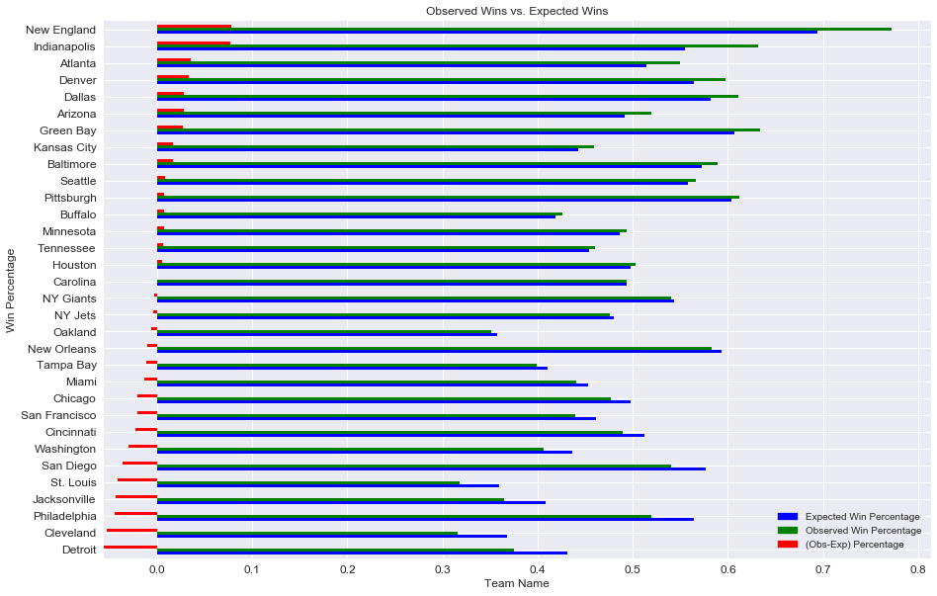
Future plans: Trends based on team/geography?

Slide 18
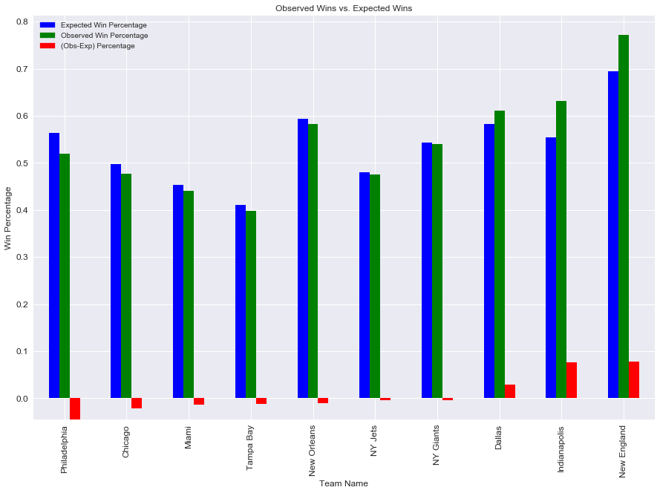
Teams located in regions with increased gambling:

