Slide 1

Five-slides report
Abdomen Vision
Team log
Captain：Zhunan Cao
Group Member：Fuqinke Xie, Yucheng Meng
Guide belt

Slide 2
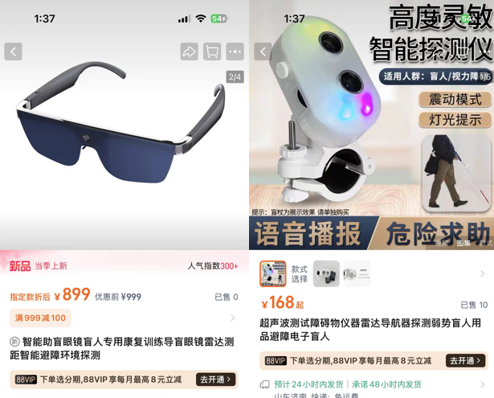
Background & Motivation
Background: Visually impaired people need a better guide production.
Question: What kind of guide equipment can better serve the visually impaired groups?
Motivation: We need to propose a new type of guide program that not only has a better guide effect, but also needs to have a lower price.

Slide 3
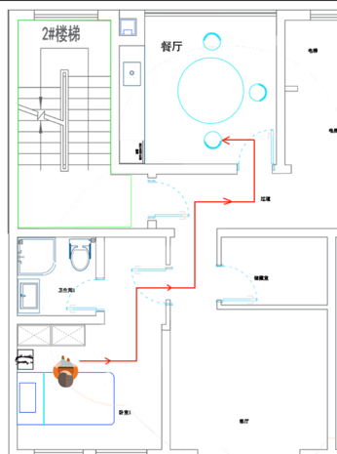
CONSTRAINTS & GOALS
Constraints: Cost, equipment weight, man-machine relationship, mode of operation, external interference.
Goals:
Used to avoid collisions in non-extremely crowded indoor scenes and reduce collisions in non-crowded outdoor scenes.

Slide 4
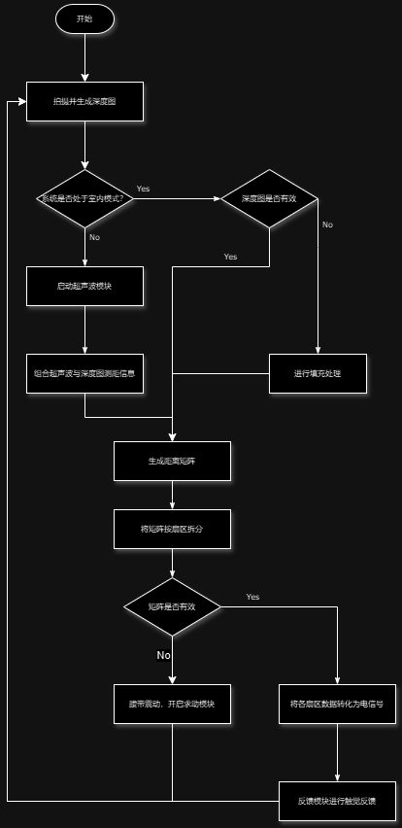
Overview of technical project plan
Step 1:Visual recognition and ranging
Step 2:Data processing and abstraction
Step 3:Haptic feedback and alarm

Slide 5
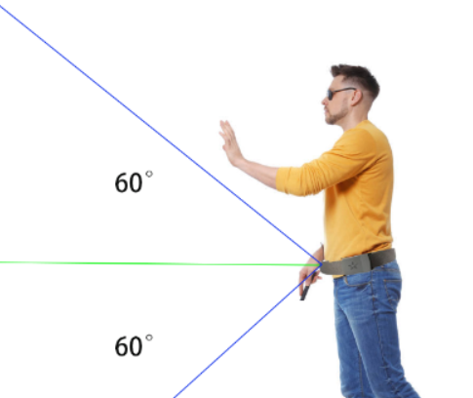
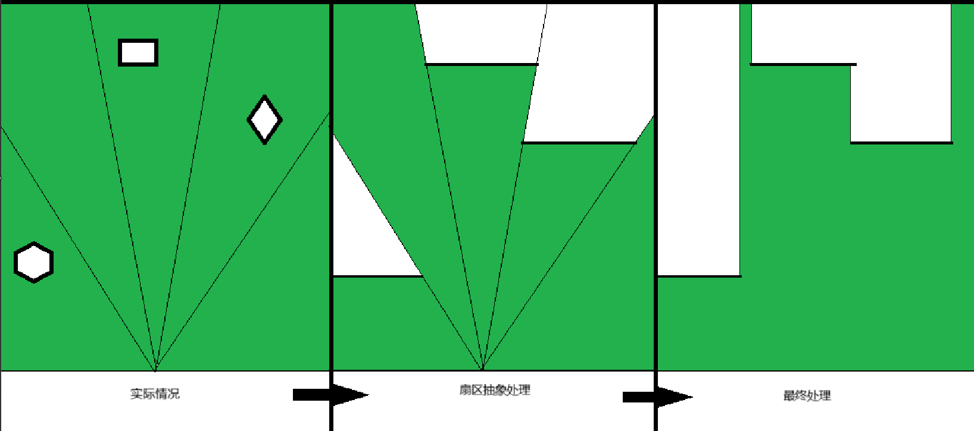
Validation
Step 1:Design
Step 2:Simulation
Step 3:Validation

Slide 6
References
张月圆. 惯性信息辅助的单目视觉SLAM技术研究[D]. 江苏:南京航空航天大学,2020.
吕睿. 基于双目视觉的智能清扫车道路目标检测[D]. 吉林:吉林大学,2024.
孙嘉泽. 智能轮椅室内定位建图及自主导航研究[D]. 辽宁:沈阳理工大学,2023.
陈志强. 室内服务机器人自主定位算法研究[D]. 山东:青岛科技大学,2023.
任晓壮,王艺璇,马新瑞,等. 智能导盲鞋[J]. 电子世界,2018(11):162,164.
韩雪峰. 导盲机器人[D]. 黑龙江:哈尔滨工程大学,2009. DOI:10.7666/d.y1488945.
未来穿戴健康科技股份有限公司. 按摩腰带:CN202222333787.6[P]. 2023-06-30.
黄锦敬,何进英,刘娘湖,等. 智能穿戴超声波测距可定位导盲腰带研究与设计[J]. 工业控制计算机,2022,35(2):100-101,123. DOI:10.3969/j.issn.1001-182X.2022.02.041.
深圳市镭神智能系统有限公司. 一种导盲腰带:CN201610877142.5[P]. 2017-02-22.
东北大学秦皇岛分校. 便携式导盲腰带:CN201520493030.0[P]. 2015-11-18.
https://scholar.google.com/
https://sc.panda321.com/

