Slide 1

Race Condition Bugs in Android Drivers
Yang Dai

Slide 2
About me
Security researcher of Vulpecker Team @360
Android Vulnerabilities research
Focus on kernel & driver
Digging & Exploit
huahuaisadog@gmail.com

Slide 3
Agenda
Overview
Race condition bugs
Finding race condition bugs
Exploiting race condition bugs

Slide 4
Overview
Others 126
Race conditon 40

Slide 5
Overview
Camera Driver
Video Driver
Power Driver
Audio Driver
Gpu Driver
…

Slide 6
Agenda
Overview
Race condition bugs
Finding race condition bugs
Exploiting race condition bugs

Slide 7
Race condition bugs
multiple threads access the same memory at the same time

Slide 8
Race condition bugs
Race condition in single variable
Race condition in list

Slide 9
Race condition in single variable
No lock protection on global variable

Slide 10
CVE-2017-11045
static int msm_fd_s_ctrl(struct file *file, void *fh, struct v4l2_control *a)
{
...
case V4L2_CID_FD_WORK_MEMORY_FD:
if (ctx->work_buf.handle)
msm_fd_hw_unmap_buffer(&ctx->work_buf);
if (a->value >= 0) {
ret = msm_fd_hw_map_buffer(&ctx->mem_pool,
a->value, &ctx->work_buf);
if (ret < 0)
return ret;
}
...
}
free(ctx->work.buf.handle)
ctx->work.buf.handle = NULL

Slide 11
CVE-2017-11045
Thread A
if (ctx->work_buf.handle)
msm_fd_hw_unmap_buffer
Thread B
if (ctx->work_buf.handle)
return
work_buf.handle == NULL

Slide 12
CVE-2017-11045
Thread A
if (ctx->work_buf.handle)
msm_fd_hw_unmap_buffer
Thread B
if (ctx->work_buf.handle)
msm_fd_hw_unmap_buffer
double free

Slide 13
CVE-2017-10661
static void timerfd_setup_cancel(struct timerfd_ctx *ctx, int flags)
{ …
if (!ctx->might_cancel) {
ctx->might_cancel = true;
spin_lock(&cancel_lock);
list_add_rcu(&ctx->clist, &cancel_list);
spin_unlock(&cancel_lock);
}
…
}

Slide 14
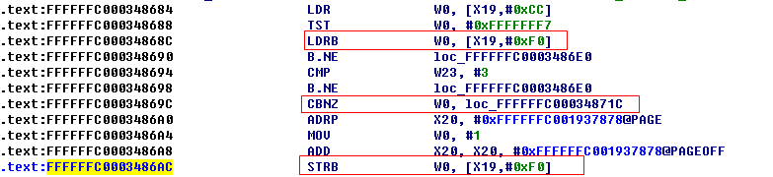
CVE-2017-10661
get value of might_cancel
If(!might_cancel)
might_cancel = true

Slide 15
CVE-2017-10661
Add the same
node twice
Thread A
if (!ctx->might_cancel)
ctx->might_cancel = true
list_add_rcu(&ctx->clist, &cancel_list);
Thread B
if (!ctx->might_cancel)
ctx->might_cancel = true
list_add_rcu(&ctx->clist, &cancel_list);

Slide 16
Race condition in list
no lock protection on list operation
simple but rare
no lock protection on list node
complex but common

Slide 17
Race condition in list
simple :
LIST_POISION
?
A
B
C
B->next = LIST_POISION;
A->next = A->next->next
0ops!
B->next = B->next->next;
B->next = LIST_POSISON->next
B = A->next;
A->next = A->next->next;
B->next = LIST_POISION;
C = B->next;
B->next = B->next->next;
C->next = LIST_POISION;

Slide 18
race condition in list
Race condition in list
To have lock protection on every list operation:
list_find
node
Lock
Unlock
list_del
node
Lock
Unlock
list_add
node
Lock
Unlock

Slide 19
Race condition in list
Is it safe now?

Slide 20
Race condition in list
complex :
get node A
Delete node A
list_find
node
list_del
node
Lock
Unlock
Lock
Unlock
get node A
Delete node A twice
list_find
node
list_del
node
Lock
Unlock
Lock
Unlock

Slide 21
Race condition in list
No lock protection on Node A !

Slide 22
Race condition in list
common :
SVE-2017-9574
SVE-2017-9492
SVE-2017-9572(could root Samsung s8)
….

Slide 23

SVE-2017-9574
Lock for list operation :
list_find
struct hdcp_session_node *hdcp_session_list_find(…)
{…
mutex_lock(&ss_list->ss_mutex);
ss_head = &ss_list->hdcp_session_head;
for (pos = ss_head->next; pos != ss_head && pos != NULL; pos = pos->next) {
if (pos->ss_data->id == id) {
mutex_unlock(&ss_list->ss_mutex);
return pos;
}
}
mutex_unlock(&ss_list->ss_mutex);
return NULL;
}

Slide 24
SVE-2017-9574
void hdcp_session_list_del(…)
{
if (!del_ent || !ss_list)
return;
mutex_lock(&ss_list->ss_mutex);
del_ent->prev->next = del_ent->next;
del_ent->next->prev = del_ent->prev;
mutex_unlock(&ss_list->ss_mutex);
}
Lock for list operation :
list_del

Slide 25




SVE-2017-9574
No lock protection for ss_node
enum hdcp_result hdcp_session_close(…)
{
…
ss_node = hdcp_session_list_find(ss_handle, &g_hdcp_session_list);
…
hdcp_session_list_del(ss_node, &g_hdcp_session_list);
hdcp_session_data_destroy(&(ss_node->ss_data));
}
Two threads hold the same “ss_node” at here
Thread 1 gets a node and goes here
cause a double delete and double free
delete the node and free the data

Slide 26

SVE-2017-9492
Almost the same vulnerability
int del_kek(int engine_id, int kek_type)
{
kek_pack_t *pack;
kek_item_t *item;
…
item = find_kek_item(pack, kek_type);
if(item == NULL) return -ENOENT;
spin_lock(&pack->kek_list_lock);
del_kek_item(item);
spin_unlock(&pack->kek_list_lock);
return 0;
}

Slide 27
SVE-2017-9572
accessed by opening
/dev/mobicore-user
int client_gp_release_shared_mem(struct tee_client *client,
const struct gp_shared_memory *memref)
{
struct cwsm *cwsm = cwsm_find(client, memref);
if (!cwsm)
return -ENOENT;
/* Release reference taken by cwsm_find */
cwsm_put(cwsm);
cwsm_put(cwsm);
return 0;
}
delete cwsm

Slide 28

SVE-2017-9572

Slide 29
Agenda
Overview
Race condition bugs
Finding race condition bugs
Exploiting race condition bugs

Slide 30
Fuzzing tool’s map
human analysis
Panic log collector
Auto start
Fuzzing threads
result
info analysis
data
path store/drop
panic and reboot

Slide 31
Multiple threads fuzzing
open/close threads
read/write threads
ioctl command threads

Slide 32
Kernel patch assistant
Add log to help find better path
Add “sleep” code to increase race success

Slide 33
About 20 CVEs & SVEs on race condition
CVE-2017-11045(msm camera)
CVE-2018-3564(msm DSP service)
CVE-2017-6262(tegra GPU)
CVE-2017-13271(msm mnh)
SVE-2017-9572(samsung mobicore)
…

Slide 34
Agenda
Overview
Race condition bugs
Finding race condition bugs
Exploiting race condition bugs

Slide 35
Exploiting race condition bugs
Win the race
Do the exploit

Slide 36
Exploiting race condition bugs
CVE-2016-5195 (DirtyCow)
CVE-2017-7533
CVE-2017-10661

Slide 37
CVE-2016-5195 (DirtyCow)
Win the race → get a page without write permission
Do the exploit → write the page

Slide 38
CVE-2017-7533
Win the race → Cause heap overflow
Do the exploit → Exploit heap spray bug

Slide 39
Exploiting CVE-2017-10661
Add the same
node twice
Thread A
if (!ctx->might_cancel)
ctx->might_cancel = true
list_add_rcu(&ctx->clist, &cancel_list);
Thread B
if (!ctx->might_cancel)
ctx->might_cancel = true
list_add_rcu(&ctx->clist, &cancel_list);

Slide 40
Exploiting CVE-2017-10661
Win the race → Add the same node twice
Do the exploit → ?

Slide 41
Exploiting CVE-2017-10661
cancel_list
victim ctx
ctx
next
next
next
prev
prev
prev
add victim ctx

Slide 42
Exploiting CVE-2017-10661
new->next = next
new->prev = prev
prev->next = new
next->prev = new
cancel_list
victim ctx
ctx
prev
new/next
next
next
next
prev
prev
prev
add victim ctx again!

Slide 43
Exploiting CVE-2017-10661
victim->next->prev = victim->prev;
victim->prev->next = victim->next;
victim->prev = LIST_POISON2;
cancel_list
victim ctx
ctx
next
next
next
prev
prev
prev
LIST_POISON2
delete victim ctx

Slide 44
Exploiting CVE-2017-10661
We have deleted victim ctx.
-------- Victim ctx is still in the list .
------------------ Access victim ctx by using the list.
---------------------------- Use After Free !

Slide 45
Exploiting CVE-2017-10661
Win the race → Add the same node twice
Do the exploit → Exploit Use-After-Free bug

Slide 46
Exploiting CVE-2017-10661
pipe spray , turn use-after-free to arbitrary write
write memory descriptor to achieve kernel patch
patch kernel to get root
my post : https://www.anquanke.com/post/id/129468#h2-2

Slide 47
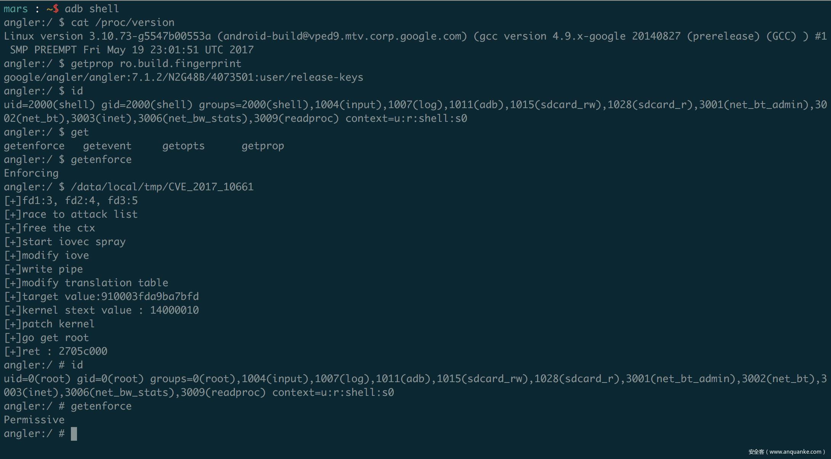

Slide 48
Conclusion
Race condition bugs are numerous in Android drivers
Race condition bugs can be easily ignored
Race condition bugs can be very dangerous

Slide 49
SVE-2017-10012,SVE-2017-10013,SVE-2017-10011,SVE-2017-10010,SVE-2017-9796,SVE-2017-9797,SVE-2017-9765,SVE-2017-9732,SVE-2017-9574,SVE-2017-9573,SVE-2017-9576,SVE-2017-9575,SVE-2017-9572,SVE-2017-9492,SVE-2017-9493,SVE-2017-9414,SVE-2017-9415,CVE-2017-0869,CVE-2017-6262, CVE-2017-6263, CVE-2017-6280,CVE-2017-11045,CVE-2016-10282,CVE-2017-0517, CVE-2017-0532,CVE-2017-0615, CVE-2017-0618, CVE-2017-0625, CVE-2017-0795, CVE-2017-0799, CVE-2017-0804,CVE-2017-0803, CVE-2016-8768
Q&A

