Slide 1

Online Anonymous Multi-User Message Board
大氣四
109601003
林群賀
GitHub Repo: https://github.com/1chooo/multi-message-board

Slide 2
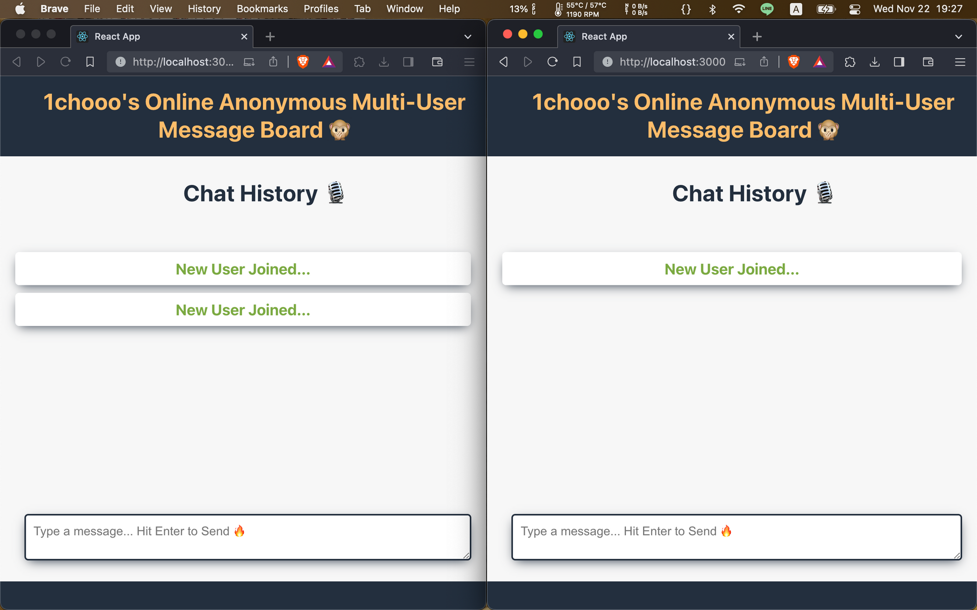

Slide 3
Go Backend / ReactJS Frontend
TCP Socket
Real-Time, Multithreading
Friendly to CS Students
RWD
Non Blocking
Git Version Control, Dockerfile
Features

Slide 4
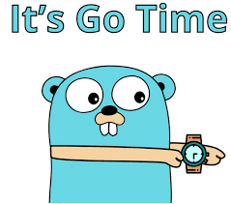

Why Go, ReactJS
Multithreading, Frontend and Backend Separately

Slide 5

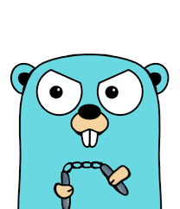
How it works?
api
ws://localhost:8080/ws
Frontend
localhost:3000
Backend
localhost:8080

Slide 6



How it works?
Websocket
TCP
User
Servers
Hello

Slide 7
How it works?
Websocket
TCP
User
Servers
Hello

Slide 8
How it works?
Websocket
TCP
User
Servers
Hello

Slide 9
How it works?
Websocket
TCP
Hello
User
Servers

Slide 10
How it works?
Websocket
TCP
User
Hello
Websocket
TCP
Servers
User

Slide 11
How it works?
Hello
Websocket
TCP
User
Websocket
TCP
Servers
User

Slide 12
How it works?
Websocket
TCP
Hello
User
Websocket
TCP
Servers
User
Hello

Slide 13
How it works?
Websocket
TCP
Hello
User
Websocket
TCP
Servers
Hello
User

Slide 14
Record User Information
Represent the number of online users
Deploy into AWS
Future

Slide 15
Thanks for your enjoying!
Represent by 林群賀
Notes:
QA 5分鐘

Slide 16
Create A Real Time Chat App With Golang, Angular, And Websockets
Building a Chat Application in Go with ReactJS
Reference

